Slide 1
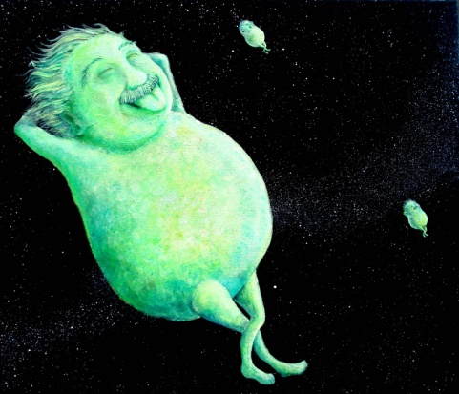
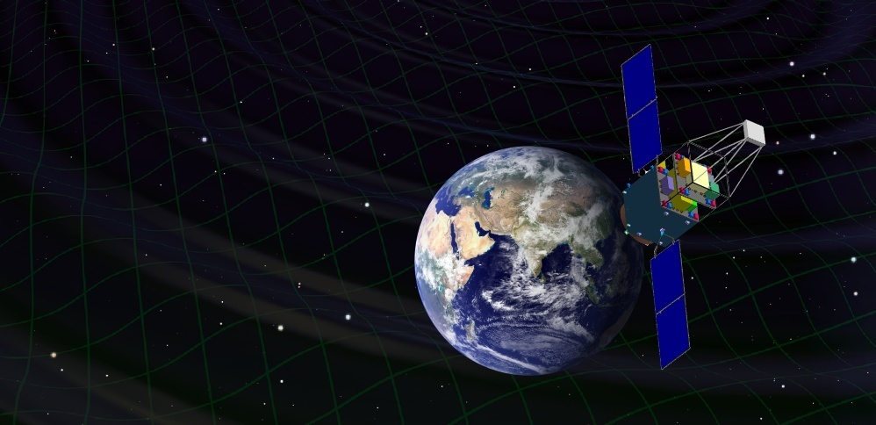
DECIGO the Japanese Space Gravitational Wave Antenna
Masaki Ando
(Department of Physics, Kyoto University)
Original
Picture : Sora
Seiji Kawamura, Takashi Nakamura, Kimio Tsubono, Takahiro Tanaka, Ikkoh Funaki, Naoki Seto, Kenji Numata, Shuichi Sato, Nobuyuki Kanda, Takeshi Takashima, Kunihito Ioka, Kazuhiro Agatsuma, Tomotada Akutsu, Tomomi Akutsu, Koh-suke Aoyanagi, Koji Arai, Yuta Arase, Akito Araya, Hideki Asada, Yoichi Aso, Takeshi Chiba, Toshikazu Ebisuzaki, Motohiro Enoki, Yoshiharu Eriguchi, Masa-Katsu Fujimoto, Ryuichi Fujita, Mitsuhiro Fukushima, Toshifumi Futamase, Katsuhiko Ganzu, Tomohiro Harada, Tatsuaki Hashimoto, Kazuhiro Hayama, Wataru Hikida, Yoshiaki Himemoto, Hisashi Hirabayashi, Takashi Hiramatsu, Feng-Lei Hong, Hideyuki Horisawa, Mizuhiko Hosokawa, Kiyotomo Ichiki, Takeshi Ikegami, Kaiki T. Inoue, Koji Ishidoshiro, Hideki Ishihara, Takehiko Ishikawa, Hideharu Ishizaki, Hiroyuki Ito, Yousuke Itoh, Shogo Kamagasako, Nobuki Kawashima, Fumiko Kawazoe, Hiroyuki Kirihara, Naoko Kishimoto, Kenta Kiuchi, Shiho Kobayashi, Kazunori Kohri, Hiroyuki Koizumi, Yasufumi Kojima, Keiko Kokeyama, Wataru Kokuyama, Kei Kotake, Yoshihide Kozai, Hideaki Kudoh, Hiroo Kunimori, Hitoshi Kuninaka, Kazuaki Kuroda, Kei-ichi Maeda, Hideo Matsuhara, Yasushi Mino, Osamu Miyakawa, Shinji Miyoki, Mutsuko Y. Morimoto, Tomoko Morioka , Toshiyuki Morisawa, Shigenori Moriwaki, Shinji Mukohyama, Mitsuru Musha, Shigeo Nagano, Isao Naito, Noriyasu Nakagawa, Kouji Nakamura, Hiroyuki Nakano, Kenichi Nakao, Shinichi Nakasuka, Yoshinori Nakayama, Erina Nishida, Kazutaka Nishiyama, Atsushi Nishizawa, Yoshito Niwa, Masatake Ohashi, Naoko Ohishi, Masashi Ohkawa, Akira Okutomi, Kouji Onozato, Kenichi Oohara, Norichika Sago, Motoyuki Saijo, Masaaki Sakagami, Shin-ichiro Sakai, Shihori Sakata, Misao Sasaki, Takashi Sato, Masaru Shibata, Hisaaki Shinkai, Kentaro Somiya, Hajime Sotani, Naoshi Sugiyama, Yudai Suwa, Hideyuki Tagoshi, Kakeru Takahashi, Keitaro Takahashi, Tadayuki Takahashi, Hirotaka Takahashi, Ryuichi Takahashi, Ryutaro Takahashi, Takamori Akiteru, Tadashi Takano, Keisuke Taniguchi, Atsushi Taruya, Hiroyuki Tashiro, Mitsuru Tokuda, Masao Tokunari, Morio Toyoshima, Shinji Tsujikawa, Yoshiki Tsunesada, Ken-ichi Ueda, Masayoshi Utashima, Hiroshi Yamakawa, Kazuhiro Yamamoto, Toshitaka Yamazaki, Jun'ichi Yokoyama, Chul-Moon Yoo, Shijun Yoshida, Taizoh Yoshino

Slide 2
DECIGO
DECIGO
(Deci-hertz interferometer
Gravitational wave Observatory)
Space GW antenna (~2024)
Obs. band around 0.1 Hz
Arm cavity
Baseline length: 1000 km
3 S/C formation flight
3 FP interferometers
Drag-free control
1000km
Arm cavity
Laser
Mirror
Photo-
detector
Drag-free S/C

Slide 3

    1. DECIGO
    GW observation and Science
    Pre-conceptual Design
    2. DECIGO Pathfinder
    Overview and Design
    Status
    3. Summary

Slide 4
    1. DECIGO
    GW observation and Science
    Pre-conceptual Design
    2. DECIGO Pathfinder
    Overview and Design
    Status
    3. Summary

Slide 5
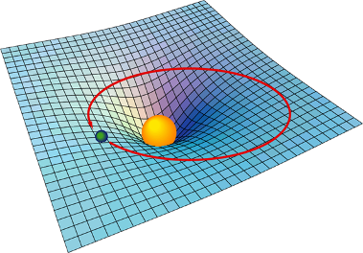

Gravitational Waves
General Relativity
Interpret gravity as
nature of space-time
Einstein equation
From presentation
by Laura Cadonati
"Mass tells space-time how to curve,
and space-time tells mass how to move.“
John Archibald Wheeler
Curvature of
Space-time
Mass
(Energy-Momentum)
Motion of Mass
→ Ripples in gravitational field
→ Propagate as waves
Gravitational Waves

Slide 6
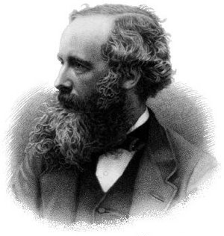
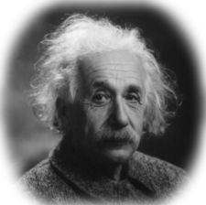
EM and GW waves
Electromagnetic wave
Gravitational wave
J.C. Maxwell
A. Einstein
Waves in electromagnetic field
Waves in space-time (gravitational field)
Solution of the Maxwell equations
Solution of the Einstein equation
1864 : Predicted by Maxwell
1888 : Confirmed by
the Hertz’s experiment
1918: Predicted by Einstein
1989: Confirmed by
a Binary pulsar observation
Radiated by acceleration
of charged particles
Utilized in telecommunications
and observations
Radiated by acceleration
of masses
High transmittance through matter
(Small interactions with matter)
‘Gravitational-wave astronomy’
Independent Information
Direct probe of dynamic motion of matters
Early universe before recombination

Slide 7
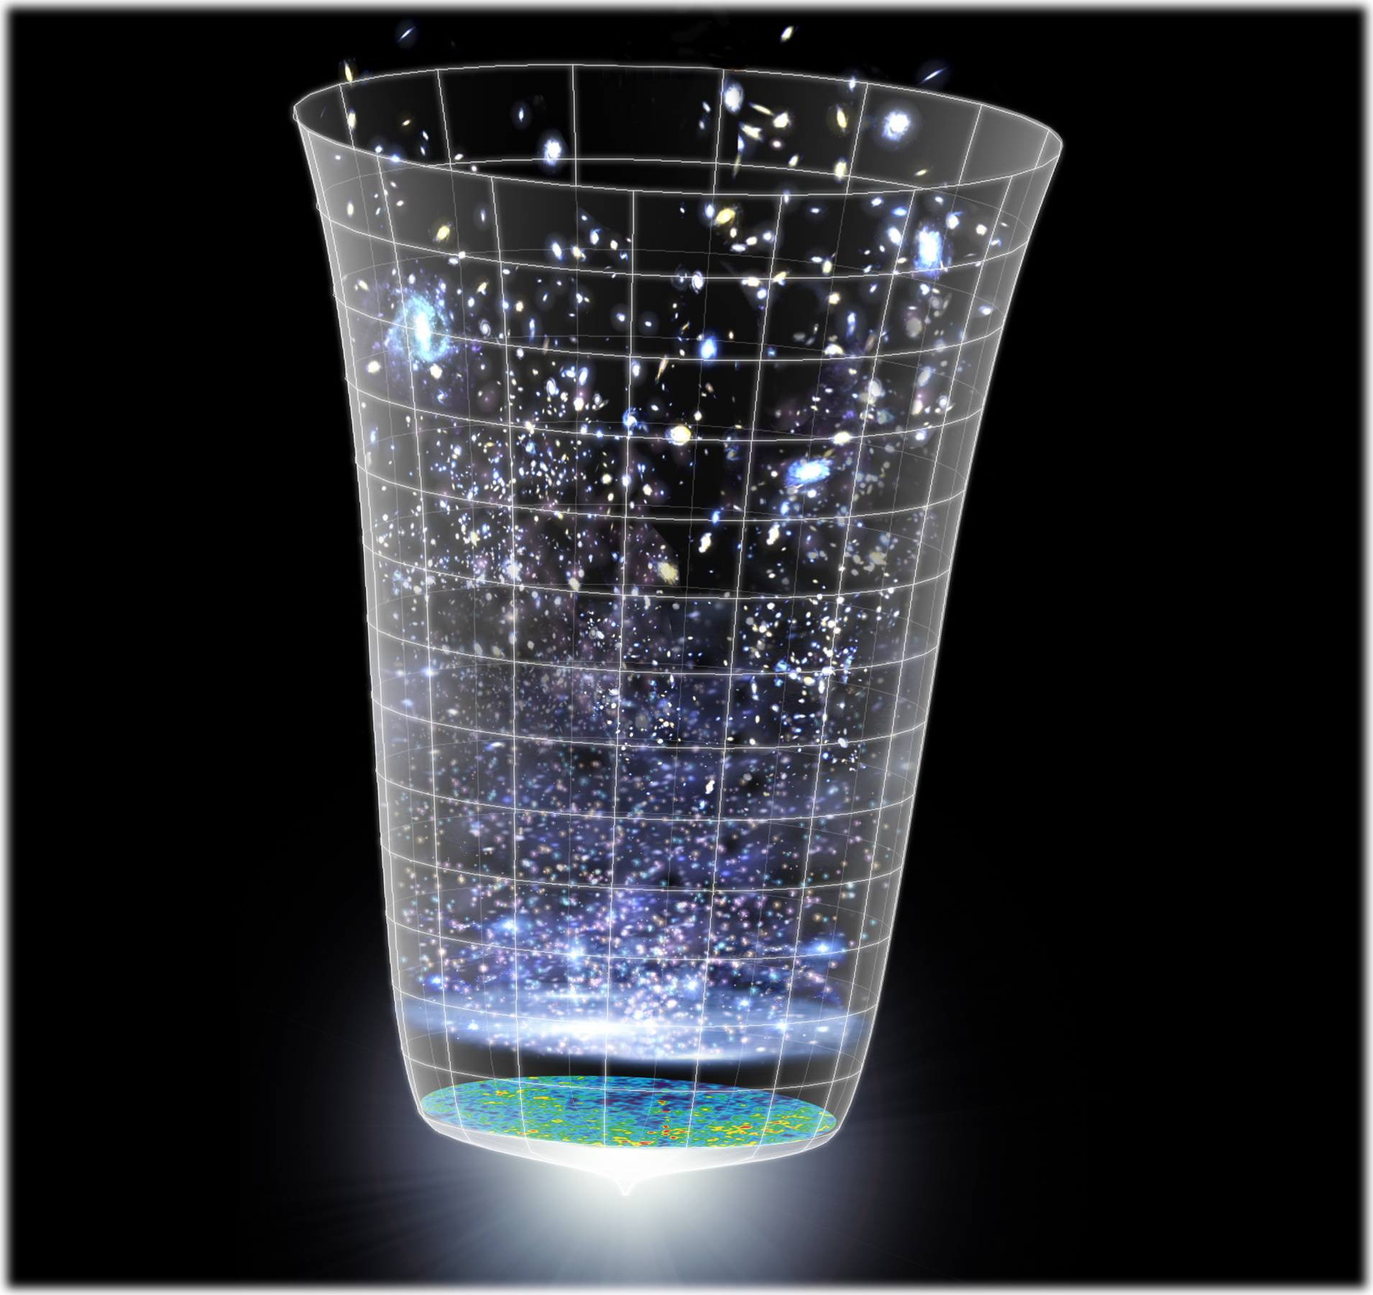
Astronomical Probes
重力波による天文学
General Relativity
Cosmic-Ray
observation
Relativity in Strong
Gravitational-Field
Nuclear Physics
High-Density Matter
Neutrino
High-energy CR
GW
observation
Astronomy
Stars
Galaxies
Gamma-ray burst
Supernovae
High-freq.
GWs
EM wave
observation
Black Holes
Massive BHs
Compact Inspiral
Planets
Supernovae
Low-freq. GWs
Astronomical
Phenomena
Pulsar
Gamma
X-ray
Visible ray
Infrared
Microwave
Cosmic
Background
Cosmology
Background
GWs
Inflation
Dark matter
Dark energy
Background:
NASA/WMAP Science Team

Slide 8

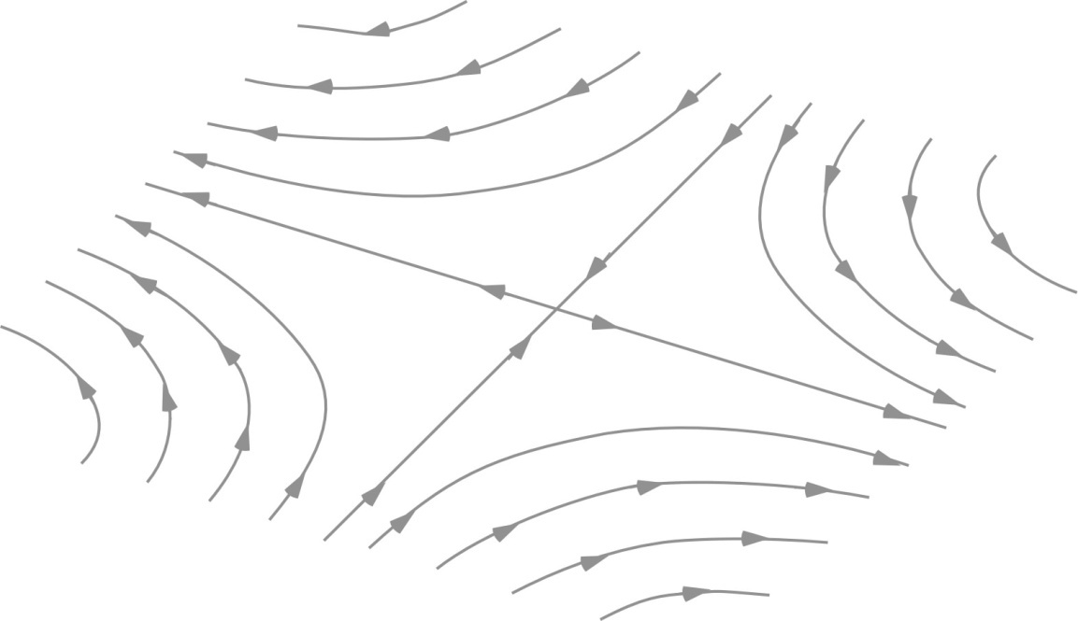
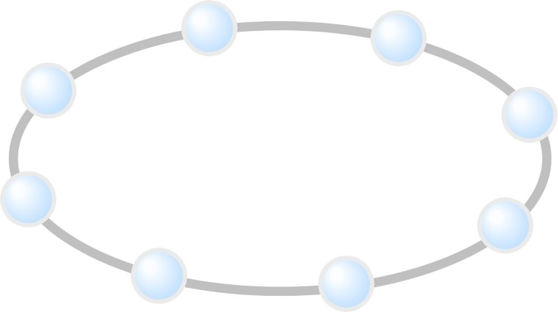

Effect of Gravitational waves
Gravitational Waves
  Change in proper distance
  Tidal force for finite-sized matter
GW
z
GW amplitude h :
Strain (dimensionless)
y
Typical amp. h =10⁻²¹
→ distance change by 10⁻²¹m
for 1-m separation
x
Precise length measurement
with long baseline
→ Formation flight mission

Slide 9
DECIGO Interferometer
Interferometer Unit:
Differential FP interferometer
Baseline length: 1000 km
3 S/C formation flight
3 FP interferometers
Drag-free control
Arm cavity
1000km
Arm cavity
Laser
Mirror
Photo-
detector
Drag-free S/C

Slide 10
Targets and Science
IMBH binary inspiral
NS binary inspiral
Stochastic background
Galaxy formation (Massive BH)
Cosmology
(Inflation, Dark energy)
10⁻¹⁶
10⁻¹⁸
IMBH inspiral (z~1)
10⁻²⁰
GW amplitude [Hz^{-1/2}]
Background GW
(Ωgw ~ 2 x 10⁻¹⁶)
Merger
DECIGO
(1 unit)
10⁻²²
3month
10⁻²⁴
Merger
DECIGO
(Correlation)
10⁻²⁶
NS inspiral (z~1)
10⁻⁴
10⁻²
10⁰
10²
10⁴
Frequency [Hz]

Slide 11
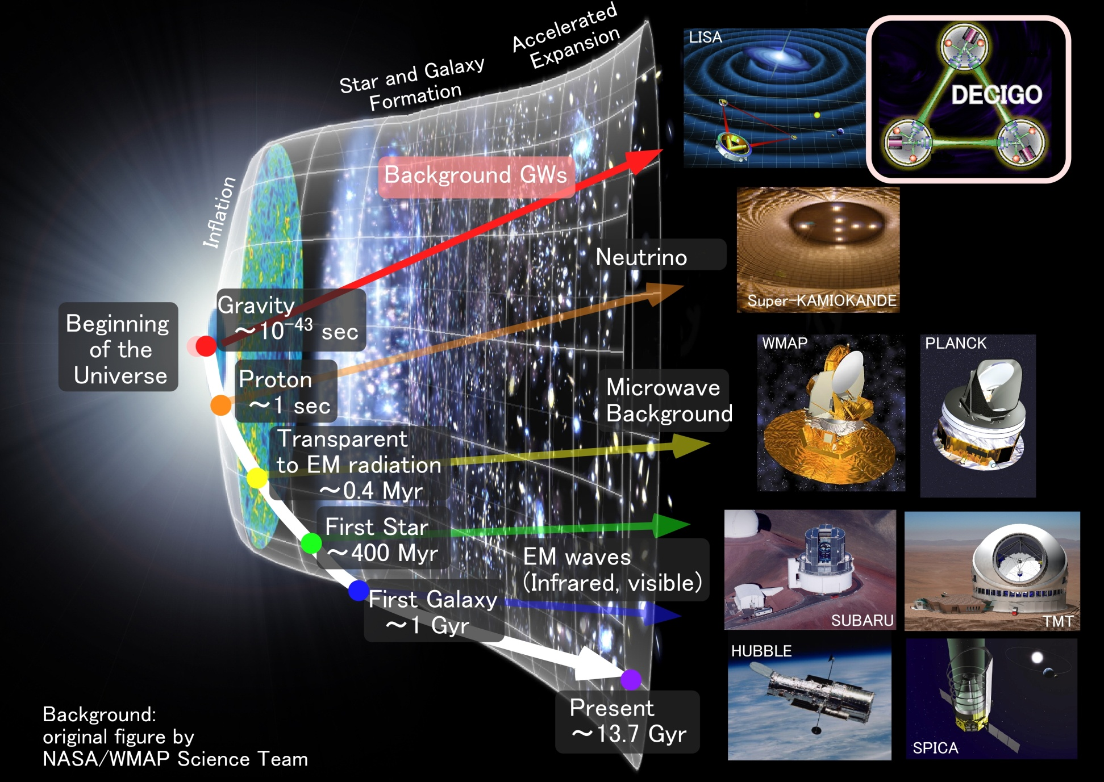
Stochastic Background GWs
Stochastic
Background GWs

Slide 12
    1. DECIGO
    GW observation and Science
    Pre-conceptual Design
    2. DECIGO Pathfinder
    Overview and Design
    Status
    3. Summary

Slide 13
Pre-Conceptual Design
Interferometer Unit:
Differential FP interferometer
Arm length: 1000 km
Finesse: 10
Mirror diameter: 1 m
Mirror mass: 100 kg
Laser power: 10 W
Laser wavelength：532 nm
Arm cavity
Arm cavity
S/C: drag free
3 interferometers
Laser
Mirror
Photo-
detector
Drag-free S/C

Slide 14
Cavity and S/C control
Cavity length change
PDH error signal → Mirror position (and Laser frequency)
Relative motion between mirror and S/C
Local sensor → S/C thruster
Displacement Signal between S/C and Mirror
Local Sensor
S/C 1
S/C 2
Mirror
Thruster
Thruster
Actuator
Fig: S. Kawamura
Displacement signal between the two Mirrors

Slide 15
Requirements
Sensor Noise
Shot noise 3 x 10⁻¹⁸ m/Hz^{1/2} (0.1 Hz)
x 10 of LCGT in phase noise
Other noises should be well below the shot noise
Laser freq. noise: 1 Hz/Hz^{1/2} (1Hz)
Stab. Gain 10⁵, CMRR 10⁵
Acceleration Noise
Force noise 4x10⁻¹⁷ N/Hz^{1/2} (0.1 Hz)
x 1/50 of LISA
External force sources
Fluctuation of magnetic field, electric field, gravitational field, temperature, pressure, etc.

Slide 16
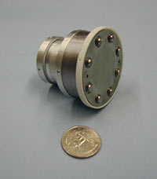
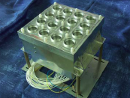
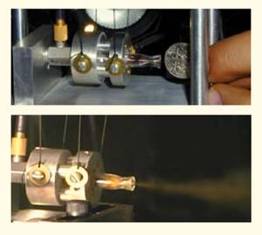
Thruster
Requirements for thrusters
Compensate external forces
Low thrust noise
Quick response
Long lifetime
Max. thrust 100 μN (variable thrust)
Thrust noise δF_{thruster} < 10⁻⁷ N/Hz^{1/2}
Response > 10 Hz
Total impulse > 10⁴ Ns
Thruster candidates
Ion Thruster
FEEP Thruster
Cold Gas Jet
Type
JPL Miniature Xenon
Ion Thruster
ESA FEEP Thruster Array
Thrust
control
Voltage, Pressure
Bias Voltage
Gas pressure
Response
<500ms ?
<10ms
<100ms0
Noise
sources
Current, Heat,
Discharge
0.1μN/Hz^{1/2}
500μN/Hz^{1/2}
Current, Heat, Discharge
Gas flow, Vulve

Slide 17
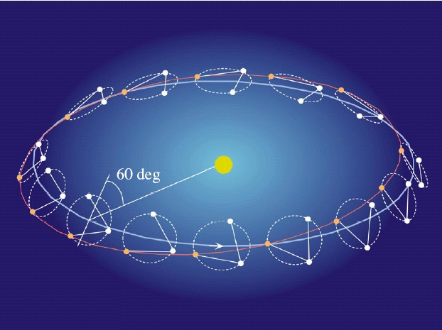
Orbit and Constellation
Candidate of orbit:
Record-disk orbit around the Sun
Relative acc. 4x10⁻¹² m/s²
Separated
unit
(Mirror force ~10⁻⁹ N )
Halo orbit around L2 (or L1)
Relative acc. 4x10⁻⁷ m/s²
(Mirror force ~10⁻⁴ N )
Constellation
Separated
unit
overlapped
units
4 interferometer units
2 overlapped units → Cross correlation
2 separated units → Angular resolution

Slide 18
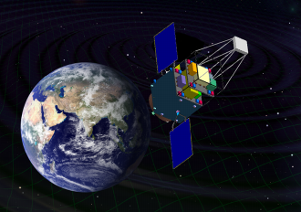
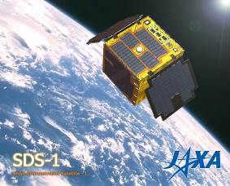
Roadmap
Figure: S.Kawamura
 | 2007 | 08 | 09 | 10 | 11 | 12 | 13 | 14 |  | 15 | 16 | 17 | 18 | 19 | 20 | 21 | 22 | 23 | 24 | 25 | 26
Mission
Objective | Space test of key tech. GW observation |  |  |  |  |  |  |  | Detect GW with min. spec FP between S/C |  |  |  |  |  |  | GW astronomy
Design | Single small satellite Short FP interferometer |  |  |  |  |  |  |  | 3 S/C 1 interferometer unit |  |  |  |  |  |  | 3 S/C x 3-4 units
R&D
Fabrication
R&D
Fabrication
R&D
Fabrication
DECIGO
Pathfinder
(DPF)
Pre-DECIGO
DECIGO
SDS-1/SWIM

Slide 19
    1. DECIGO
    GW observation and Science
    Pre-conceptual Design
    2. DECIGO Pathfinder
    Overview and Design
    Status
    3. Summary

Slide 20
DECIGO-PF
DECIGO Pathfinder (DPF)
First milestone mission for DECIGO
Shrink arm cavity
DECIGO 1000km → DPF 30cm
Single satellite
(Payload ~1m³ , 350kg)
Low-earth orbit
(Altitude 500km, sun synchronous)
30cm FP cavity with 2 test masses
Stabilized laser source
Drag-free control
Local Sensor
Actuator
Thruster

Slide 21
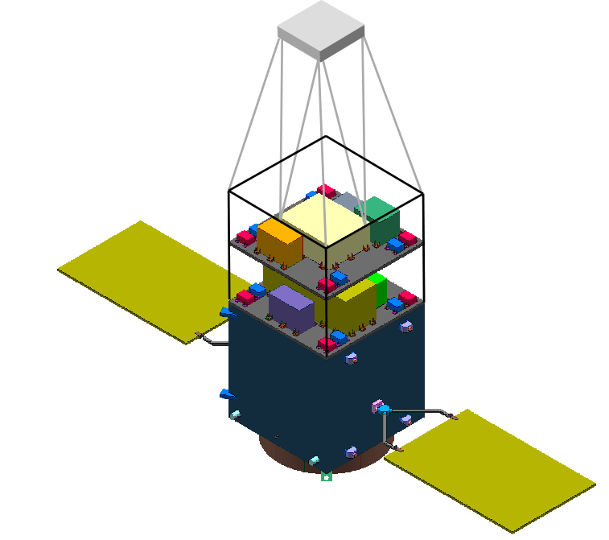
DPF satellite
Mast
structure
DPF Payload
Size : 950mm cube
Weight : 150kg
Power : 130W
Data Rate: 800kbps
Mission thruster x12
Mission
Thruster head
Stabilized.
Laser source
On-board
Computer
Power Supply
SpW Comm.
Satellite Bus
(‘Standard bus’ system)
Size :
950x950x1100mm
Weight : 200kg
SAP : 960W
Battery: 50AH
Downlink : 2Mpbs
DR: 1GByte
3N Thrusters x 4
Interferometer
module
Satellite
Bus system
Bus thruster
Solar Paddle

Slide 22
    1. DECIGO
    GW observation and Science
    Pre-conceptual Design
    2. DECIGO Pathfinder
    Overview and Design
    Status
    3. Summary

Slide 23
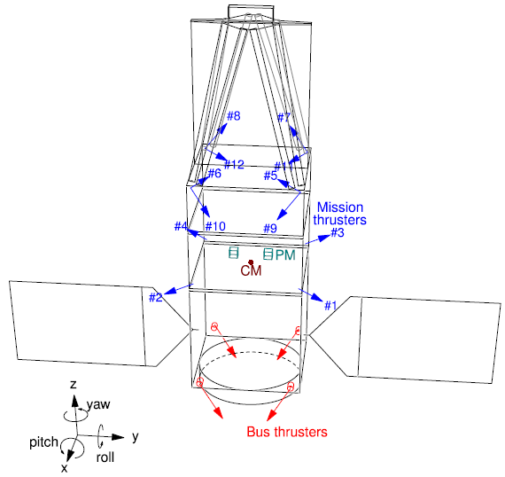
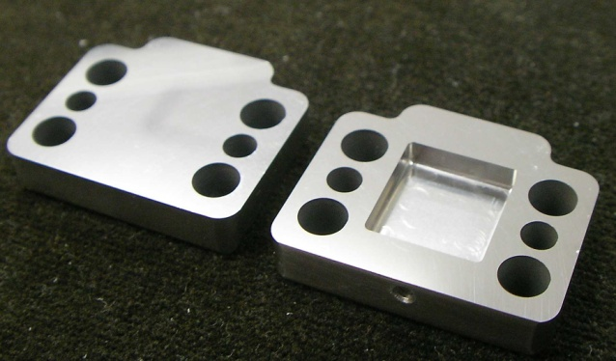
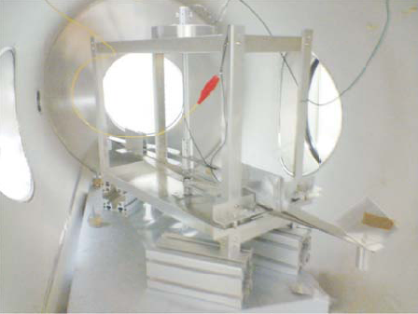
R&D for DPF (2)
By
S.Moriwaki
Attitude control and Drag-free
Satellite structure (mass distribution)
Passive attitude stabilization
by gravity gradient
Mission thruster position
Control topology
Thruster
System design
with existing tech.
Noise meas. system
(thruster stand)
Development of Slit FEEP
By I.Funaki

Slide 24





SWIM launch and operation
Tiny GW detector module
Launched in Jan. 23, 2009
Photo：
JAXA
In-orbit operation
TAM: Torsion Antenna Module with free-falling test mass
(Size : 80mm cube, Weight : ~500g)
Test mass
~47g Aluminum, Surface polished
Small magnets for position control
Coil
Photo sensor
Reflective-type optical
displacement sensor
Separation to mass ~1mm
Sensitivity ~ 10⁻⁹ m/Hz^{1/2}
6 PSs to monitor mass motion

Slide 25

Successful control
SWIM
In-orbit operation
z control on
Test mass controlled
Error signal → zero
Damped oscillation
(in pitch DoF)
yaw control on
Free oscillation
in x and y DoF
Signal injection
→ OL trans. Fn.
Operation: May 12, 2009
Downlink: ~ a week
By
W.Kokuyama

Slide 26

DPF mission status
DPF : One of the candidate of
JAXA’s small satellite series
At least 3 satellite in 5 years with
Standard Bus + M-V follow-on rocket
SPRINT-A /EXCEED
1st mission (2012): SPRINT-A/EXCEED
2nd mission (~2013) in selection
DPF is one of candidates
Next-generation
Solid rocket booster (M-V FO)
Fig. by JAXA

Slide 27
Collaboration and support
・Supports from LISA
Technical advises from LISA/LPF experiences
Support Letter for DECIGO/DPF
LISA-DECIGO workshop (2008.11)
・Collab. with Stanford univ. group
Drag-free control of DECIGO/DPF
UV LED Charge Management System for DPF
・Collab. with JAXA navigation-control section
→ formation flight of DECIGO, DPF drag-free control
・Research Center for the Early Universe (RESCEU), Univ. of Tokyo
Support DECIGO as ones of main projects (2009.4-)
・Collab. with UNISEC (University Space Engineering Consortium)
Call for active young engineers

Slide 28
    1. DECIGO
    GW observation and Science
    Pre-conceptual Design
    2. DECIGO Pathfinder
    Overview and Design
    Status
    3. Summary

Slide 29
Summary
DECIGO :
Formation flight with 3 S/C
1000 km separation
Precise meas. by laser interferometer
Fruitful Sciences
Very beginning of the Universe
Dark energy, Galaxy formation
DECIGO Pathfinder
Important milestone for DECIGO
Strong candidate of JAXA’s satellite series
SWIM – under operation in orbit
first precursor to space!

Slide 30
    End

Slide 31
DECIGO
DECIGO
(Deci-hertz interferometer Gravitational wave Observatory)
Space GW antenna (~2024)
Obs. band around 0.1 Hz
‘Bridge’ the obs.gap between
LISA and Terrestrial detectors
Terrestrial Detectors
(Ad. LIGO, LCGT, etc)
LISA
DECIGO

Slide 32

GW target of DPF
Blackholes events
in our galaxy
IMBH inspiral and merger
h ~ 10⁻¹⁵ , f ~ 4 Hz
Distance 10kpc, m = 10³ M_{sun}
Obs. Duration (~1000sec)
KAGAYA
BH QNM
h ~ 10⁻¹⁵ , f ~ 0.3 Hz
Distance 1Mpc, m = 10⁵ M_{sun}
Observable range reaches
the Galactic center (SNR~5 )
Hard to access by others
→ Original observation
(By N.Kanda)

Slide 33
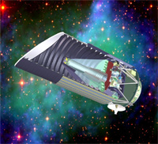
Standard Sources
Fig. from
SNAP
web page
Supernova (EM wave) Neutron-star binary (GW)
‘Standard Candle’ ‘Standard Siren’
Absolute power
or amplitude
Extrapolated from
nearby events
General Relativity
＜
Event rate
2000/yr （SNAP）
＜
10⁴⁻⁵/yr （DECIGO）
Error in distance
~10%
～
10% at z=1
～
Identification
of host galaxy
Require multiple detectors
or statistics
Easy?
＞
Others
Uncertainty by
dust absorption
Negligible interaction
with matters
＜
R.Takahashi (2006)

Slide 34
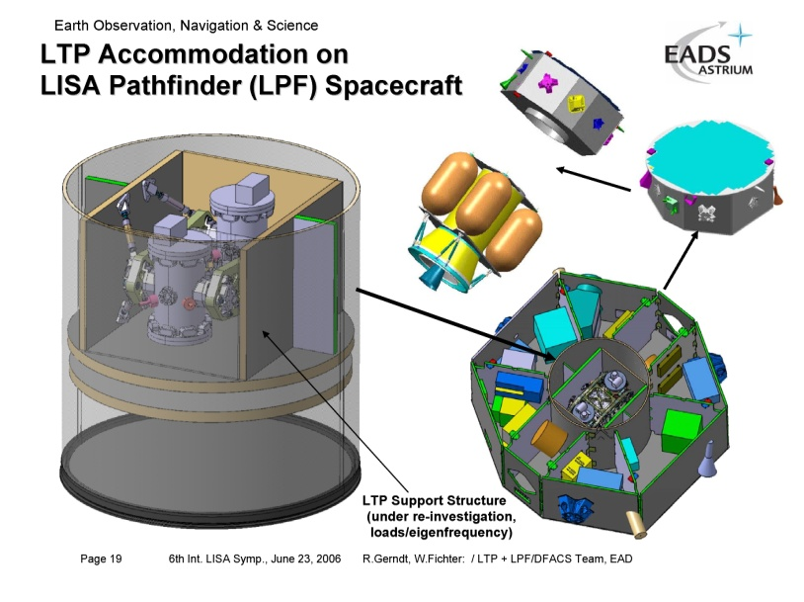
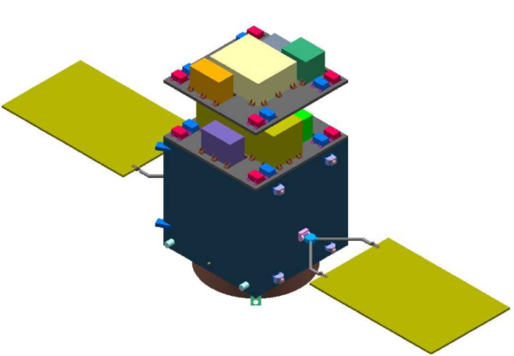
Comparison with LPF
LPF (LISA Pathfinder)
DPF (DECIGO Pathfinder)
Purpose
Launch
Weight
Orbit
Test Mass
Laser source
Interferometer
Sensitivity
Demonstration for LISA
2010
Dedicated launcher (Vega)
1,900 kg
Halo orbit around L1
Drag-free attitude control
Au-Pt alloy x2
Nd:YAG (1064nm)
Mach-Zehnder
3x10⁻¹⁴ m/s²/Hz^{1/2} (1mHz)
Demonstration for DECIGO
GW observation
~2013
Dedicated launcher (M-V follow-on)
350 kg
SSO altitude 500km
Drag-free attitude control
TBD x2
Yb:YAG (1030nm)
Fabry-Perot
1x10⁻¹⁵ m/s²/Hz^{1/2} (0.1Hz)
Thruster
Control Unit
Stabilized Laser
Central
Processing Unit
Mission
Thrusters
Housing
Control Unit
Interferometer
Module
Interfererometer
Control Unit
Bus Thrusters
Solar Paddle

Slide 35

LCGT and DECIGO
LCGT (~2014)
Terrestrial Detector
→ High frequency events
DECIGO (~2024)
Space observatory
→ Low frequency sources
Target: GW detection
Target: GW astronomy

Slide 36
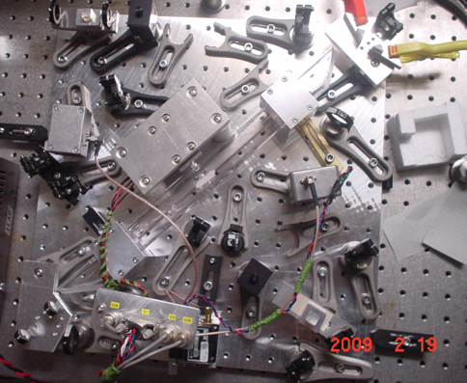
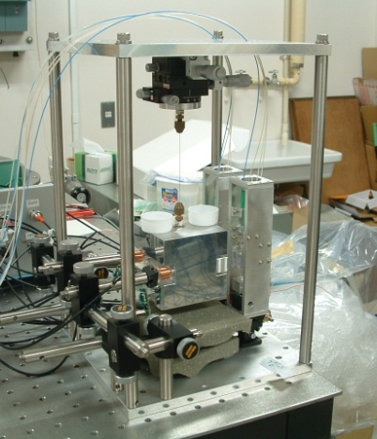

R&D for DPF (1)
By M.Musha
Stabilized Laser
BBM development
Yb:YAG (NPRO) source
Saturated absorption by I₂
→ Stability test, Packaging
IFO and housing
BBM-EM development
→ Test of concepts
+ Earth gravity sensors
By S.Sato
S.Sato’s talk
(P. Session #2, Today)
Y.Wakabayashi’s poster
By A.Araya

Slide 37


SWIM launch
Test of signal processing
and control system
Photo：
JAXA
SWIM (Space-wire Demonstration module)
on SDS-1 satellite
Launched in Jan. 23, 2009
SpaceCube2: Space-qualified Computer
SWIMμν : User Module
CPU: HR5000
(64bit, 33MHz)
System Memory:
2MB Flash Memory
4MB Burst SRAM
4MB Asynch. SRAM
Data Recorder:
1GB SDRAM
1GB Flash Memory
SpW: 3ch
Processor test board
GW+Acc. sensor
FPGA board
DAC 16bit x 8 ch
ADC 16bit x 4 ch
→ 32 ch by MPX
Torsion Antenna x2
~47g test mass
Data Rate : 380kbps
Size: 124 x 224 x 174
Weight: 3.5 kg
Power: ~7W
Size: 71 x 221 x 171
Weight: 1.9 kg
Power: 7W
Photo by JAXA
Photo by JAXA

Slide 38
Organization
PI: Kawamura (NAOJ)
Deputy: Ando (Kyoto)
Executive Committee
Kawamura (NAOJ), Ando (Kyoto), Seto (Kyoto), Nakamura (Kyoto), Tsubono (Tokyo), Tanaka (Kyoto), Funaki (ISAS), Numata (Maryland), Sato (Hosei), Kanda (Osaka city), Takashima (ISAS), Ioka (KEK)
Pre-DECIGO
Sato (Hosei)
Detector
Numata (Maryland)
Ando (Kyoto)
Science, Data
Tanaka (Kyoto)
Seto (Kyoto)
Kanda (Osaka city)
Satellite
Funaki (ISAS)
DECIGO pathfinder
Leader: Ando (Kyoto)
Deputy: Takashima (ISAS)
Design phase
Mission phase
Detector
Ando (Kyoto)
Laser
Ueda (ILS)
Musya (ILS)
Housing
Sato (Hosei)
Drag free
Moriwaki (Tokyo)
Sakai (ISAS)
Thruster
Funaki (ISAS)
Bus
Takashima (ISAS)
Data
Kanda (Osaka city)

Slide 39

DPF mission payload
Mission weight : ~150kg
Mission space : ~90 x 90 x 90 cm
Drag-free control
Local sensor signal
→ Feedback to thrusters
Fabry-Perot interferometer
Finesse : 100
Length : 30cm
Test mass : 1kg
Signal extraction by PDH
Laser source
Yb:YAG laser (1030nm)
Power : 25mW
Freq. stab. by Iodine abs. line

Slide 40
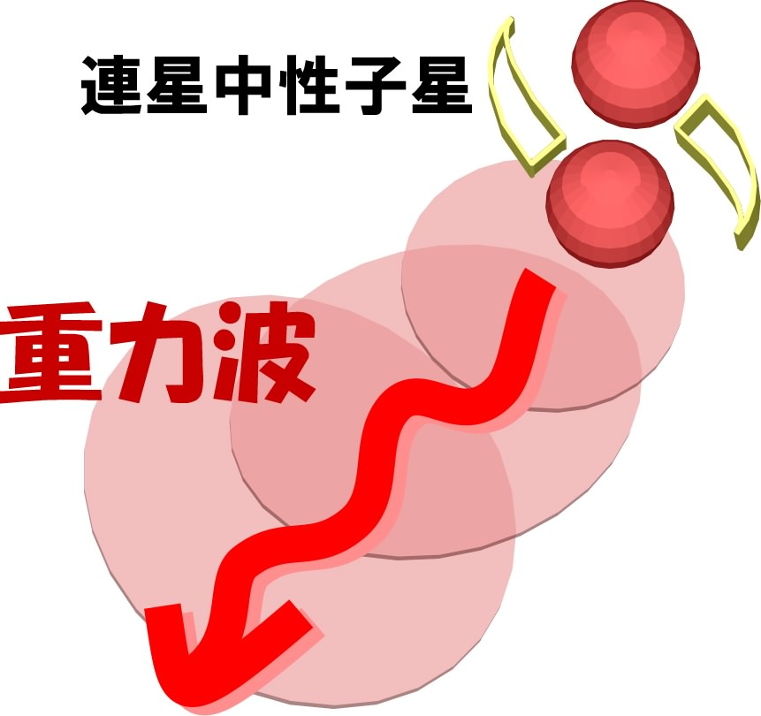
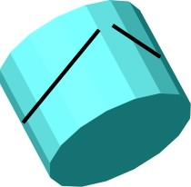
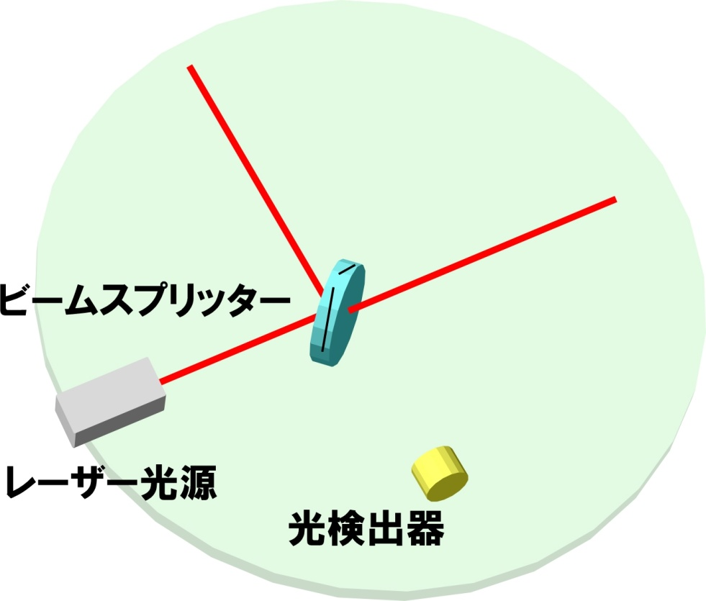
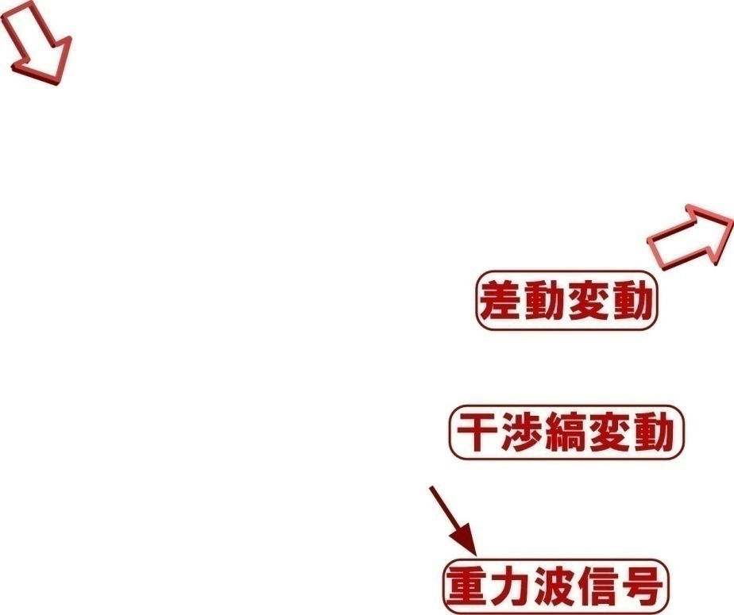
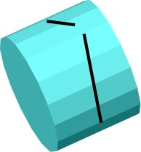
レーザー干渉計型重力波検出器
基本： マイケルソン干渉計
レーザー光源からの光を
直交する2方向に分岐
それぞれ、鏡で打ち返し干渉させる
干渉光を光検出器で観測する
重力波が入射
  腕の長さの差動変動を
  干渉光量の変動として検出

Slide 41
Introduction (3)
Expected science by GW observation
(ex.) Inspiral of binary neutron stars
Stationary orbital motion
of 2 neutron stars
→ Stationary GWs
(Continuous wave)
Loose orbital energy by GW rad.
→ Higher freq. and larger GWs
(Chirp wave)
Collision and merger
→ Short GW radiation
(Burst wave)
BH quasi-normal mode oscillation
→ Decay of oscillation
(Ringdown wave)
BH and NS physics
Test of GR

Slide 42
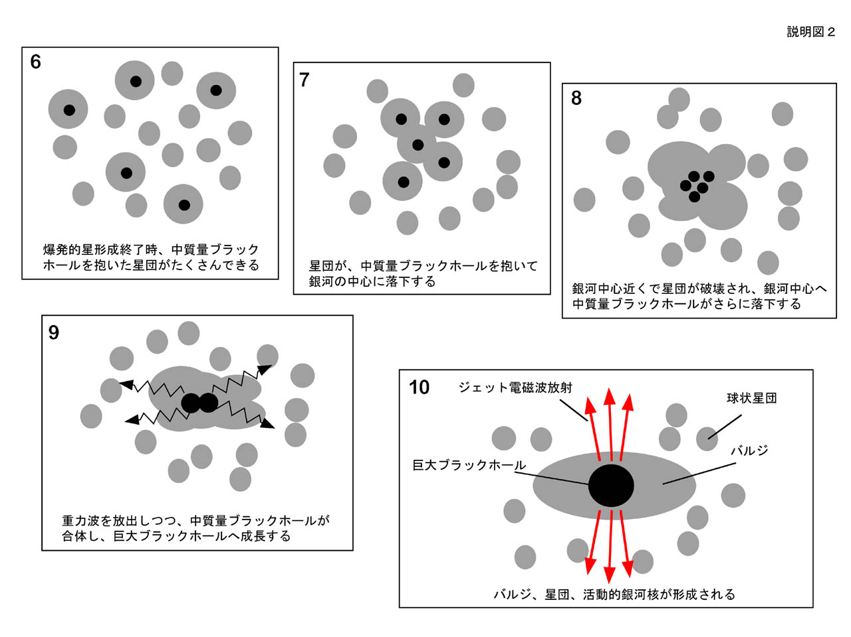
Introduction (4)
Expected science by GW observation (contd.)
Expansion ＋Acceleration?
DECIGO
Merger of intermediate-mass BHs
→ Formation of super-massive BHs
Galaxy formation
Distant neutron-star binaries
→ Direct measurement of
acceleration of expansion
of the universe
Information on dark energy
GWs from early universe
→ Insight on inflation
Unexpected GW sources
→ Paradigm change on the universe?
GW
NS-NS (z～1)
Output
Template
(No Acceleration)
Strain
Real Signal ?
Phase Delay
～1sec (10 years)
Time
Seto, Kawamura, Nakamura,
PRL 87, 221103 (2001)
戎崎俊一(理化学研究所) 先生のwebページより引用 http://atlas.riken.go.jp/~ebisu/smbh.html

Slide 43
DPF Sensitivity
Laser source : 1030nm, 25mW
IFO length : 30cm
Finesse : 100, Mirror mass : 1kg
Q-factor : 10⁵, Substrate: TBD
Temperature : 293K
Satellite mass : 350kg, Area: 2m²
Altitude: 500km
Thruster noise: 0.1μN/Hz^{1/2}
(Preliminary parameters)

Slide 44
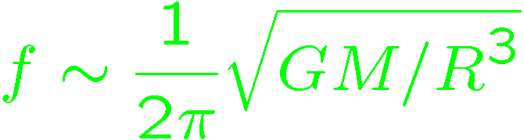
DPF sensitivity
DPF sensitivity h ~ 2x10⁻¹⁵ Hz^{1/2}
(x10 of quantum noises)
Massive BH
inspirals
DPF limit
LISA
Galaxy
binaries
NS binary
inspiral
Core-collapse
Supernovae
Foreground GWs
Pulsar
(1yr)
ScoX-1
(1yr)
DECIGO
Background GWs
from early universe
(Ω_{gw}=10⁻¹⁴)
LCGT
Gravity-gradient noise
(Terrestrial detectors)

Slide 45
Interferometer Design
Transponder type vs Direct-reflection type
Compare : Sensitivity curves and Expected Sciences
Decisive factor: Binary confusion noise
WD-WD
confusion noise

Slide 46
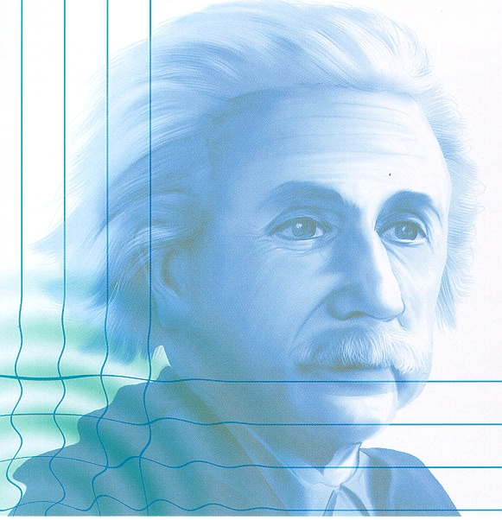
    1. Gravitational Waves
    and observation
      Gravitational-wave astronomy

Slide 47
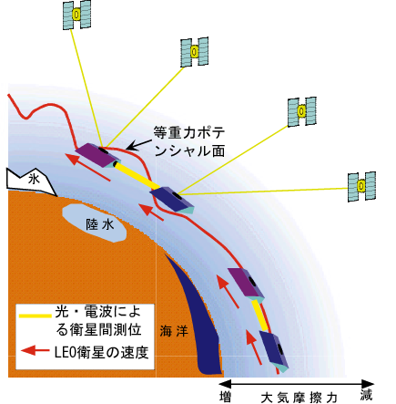
Gravity of the Earth
Measure gravity field of the Earth for Satellite Orbits
GPS satellite
Determine global gravity field
→ Density distribution
Monitor of change in time
Ground water motion
Strains in crusts by
earthquakes and volcanoes
Observation Gap
between GRACE and GRACE-FO
(2012-16)
→ DPF contribution
in international network
東京大字地震研・新谷氏、
京都大学・福田氏の資料/情報提供

Slide 48
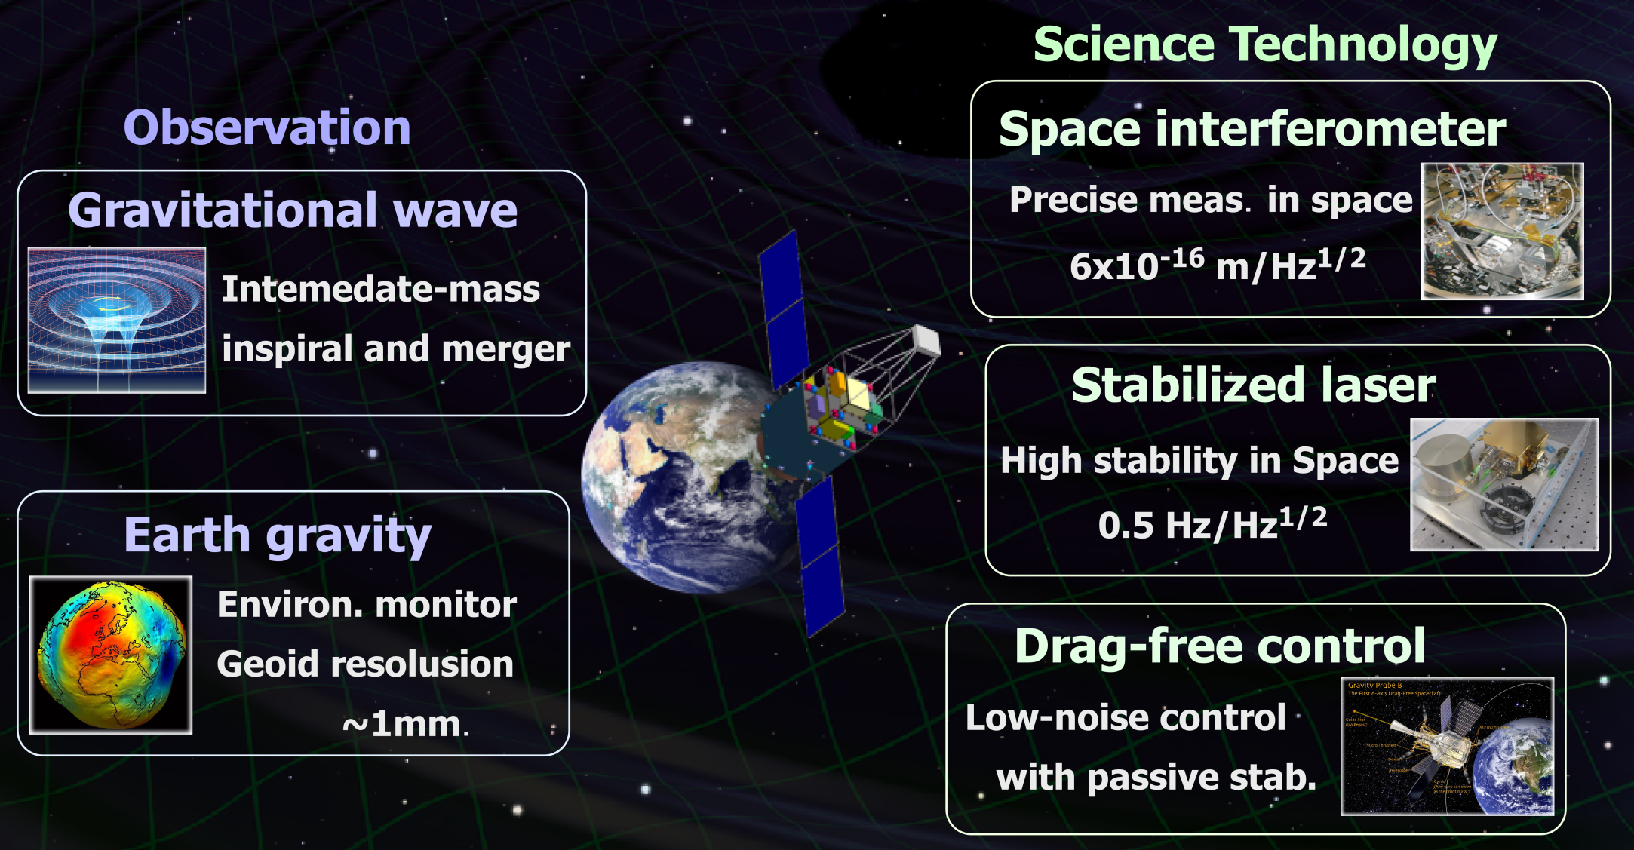
Objectives of DPF

Slide 49




DPF and DECIGO
DPF requirements
DECIGO
requirements
Disp. noise
6x10⁻¹⁶ m/Hz^{1/2}
Precise meas.
by IFO
4x10⁻¹⁸ m/Hz^{1/2}
1000km FP cavity
IFO control in space
Low external force
Large optics
Force noise
10⁻¹⁴ N/Hz^{1/2}
10⁻¹⁷ N/Hz^{1/2}
Ultra stable Laser
Stabilization of source
Stabilization by long arm
Stab. Laser
Freq. Stability
0.5 Hz/Hz^{1/2}
1 Hz/Hz^{1/2}
Formation flight
Stable orbit
Inter S/C Ranging
Drag-free control
Low-noise thruster
Drag-free
control
Satellite disp.
10⁻⁹ m/Hz^{1/2}
Thruster noise
10⁻⁷ N/Hz^{1/2}
Observation
Data procession
Data analysis
Triggered search
GW Obs.
0.1 Hz band
Observation and
Data analysis

Slide 50
Arm length
Cavity arm length : Limited by diffraction loss
Effective reflectivity (TEM₀₀ → TEM₀₀)
Laser wavelength : 532nm
Mirror diameter: 1m
Optimal beam size
1000 km
is almost max.

Slide 51

IMBH inspiral and Merger
DECIGO will observe
Intermediate-mass BH (IMBH)
binary merger with
SNR>6000 for z~1 source
Information on the
formation of
Supermassive BHs
at the center of galaxies
戎崎俊一(理化学研究所) 先生のwebページより引用 http://atlas.riken.go.jp/~ebisu/smbh.html

Slide 52
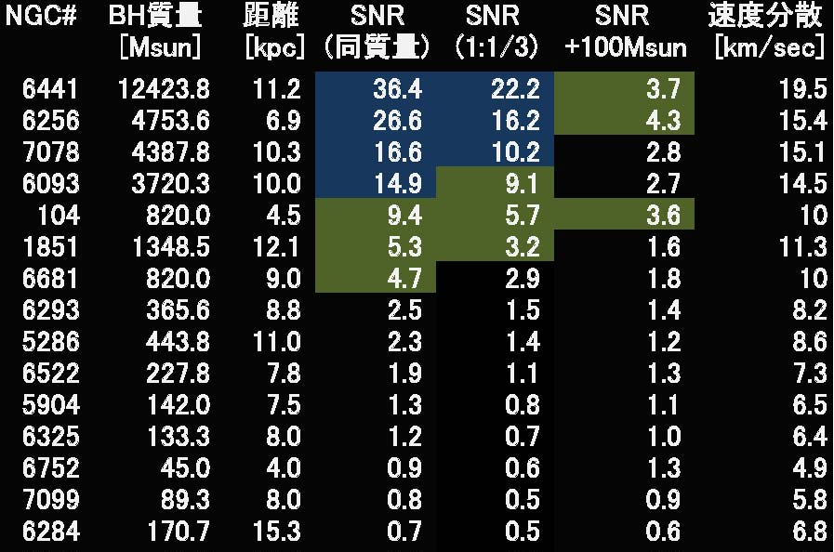
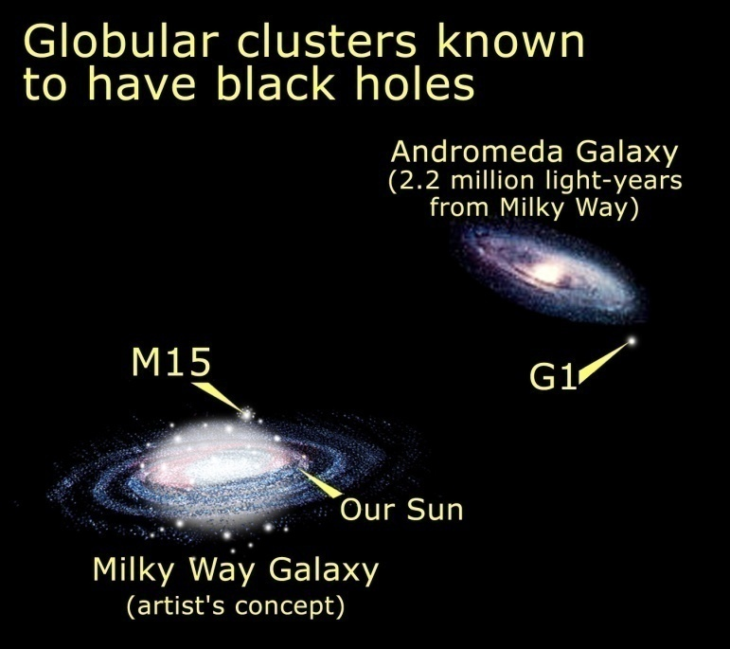
DPF targets
BHs in Globular clusters
BH masses estimated from star motion
Estimate SNR of GW signals
Equal mass, Mass ratio 1:1/3, 100Msun BH capture
Credit: NASA, STScI
(~150 Globular Clusters
in our Galaxy)
(By N.Seto)

Slide 53
Pre-DECIGO
 | Pre-DECIGO | DECIGO
Arm length | 100 km | 1000 km
Mirror diameter | 30 cm | 1 m
Laser wavelength | 0.532 μm | 0.532 μm
Finesse | 30 | 10
Laser power | 1 W | 10 W
Mirror mass | 30 kg | 100 kg
# of interferometers in each cluster | 1 | 3
# of clusters | 1 | 4

Slide 54
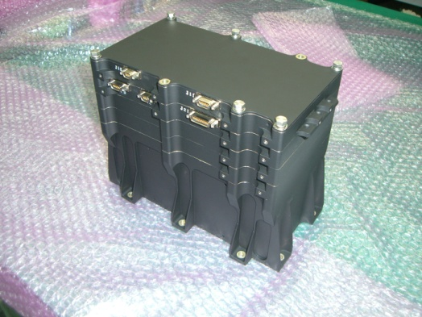
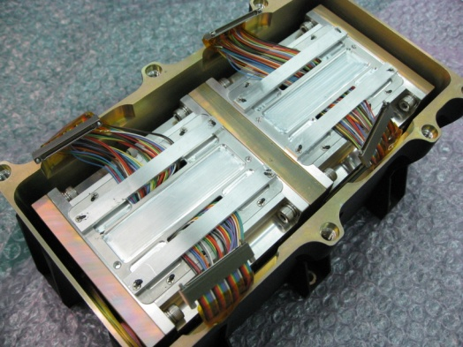
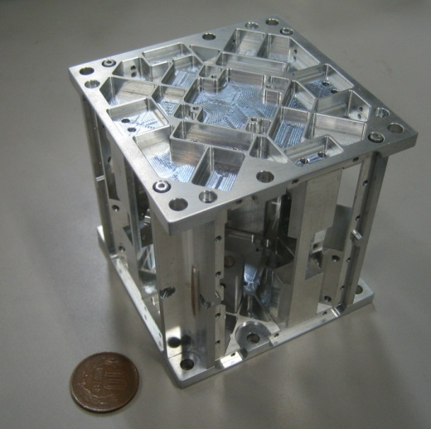
SWIMμν
Tiny GW detector ~47g test masses inside
→ Levitated control in space
TAM: Torsion Antenna Module with free-falling test mass
(Size : 80mm cube, Weight : ~500g)
Test mass
SWIMmn Module
~47g Aluminum, Surface polished
Small magnets for position control
2 TAMs
in the frame
Coil
Used for test-mass
position control
Max current ~100mA
Photo sensor
Reflective-type optical
displacement sensor
Separation to mass ~1mm
Sensitivity ~ 10⁻⁹ m/Hz^{1/2}
6 PSs to monitor mass motion

Slide 55
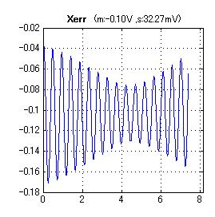
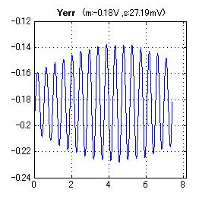
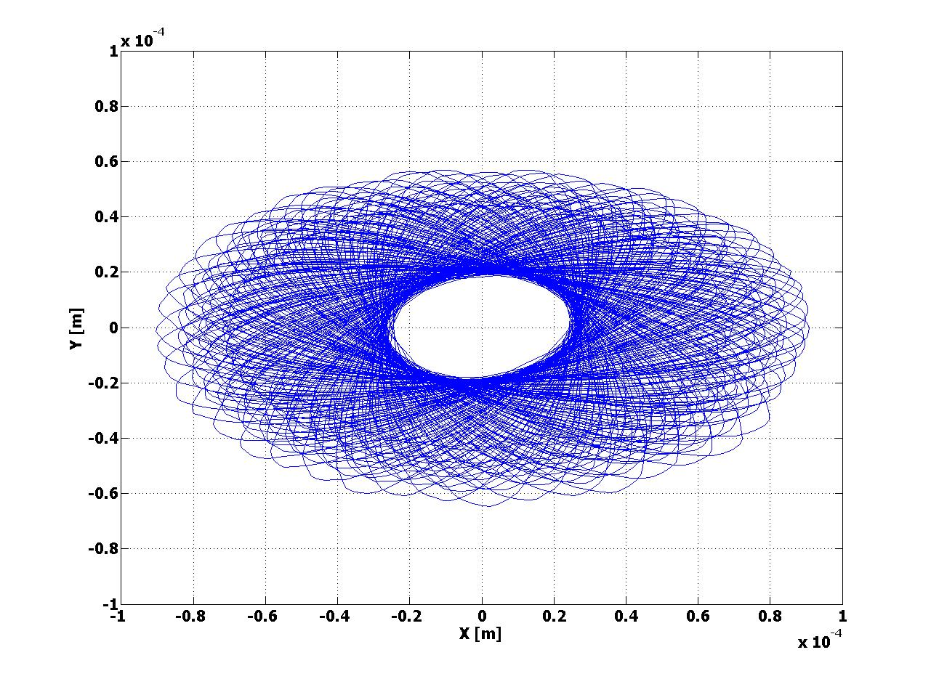
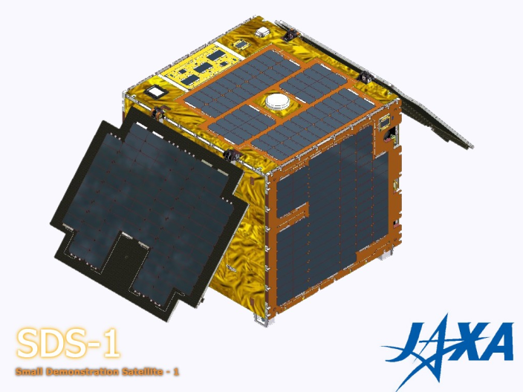
SWIMμν初期運用(5)
XY平面上のマスの動きと衛星スピンの効果
マスが浮上した時、XY平面上で自由振動を行っている様子が観測
X
Y
楕円が回転
Time [sec]
Time [sec]
2Hzの共振＋うなり(~0.05Hz)
スピン安定
X-Yプロット
コリオリ力により
振動軸が回転
→ 「フーコーの振り子」
Z
0.2mm
データからフィッティング：-16.8deg/s
衛星スピンレート：-16.7deg/s
よく一致
センサ固定座標系でみると

Slide 56
SWIMμν初期運用(1)
3回目 例：09/03/14 14時(JST)頃 ノルウェー上空
浮上マスの制御
OFF
Z ON
Yaw ON
そのまま地上では制御できない
(飛行機実験で20秒間の
制御を実証していた)
2月運用時に2回、
3月運用時に2回、
制御を実施
鉛直制御
４回とも宇宙空間での
制御に成功(TAM1)
フォトセンサ(変位センサ)
のオフセット最適化も実施
回転制御
TAM2は動作確認中
(注：データ処理のせいで
過渡応答は一部汚く見える)

Slide 57
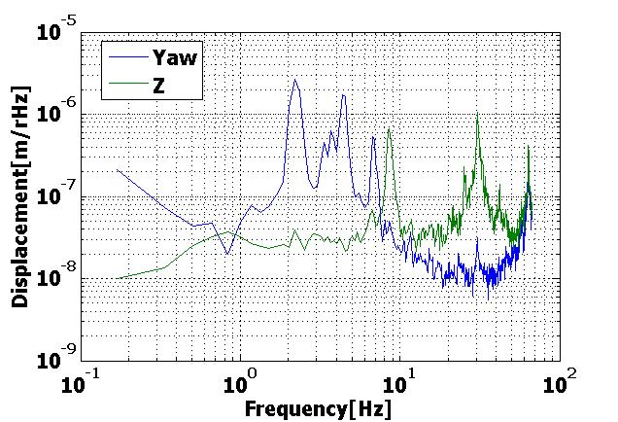
SWIMμν初期運用(2)
制御時残留ノイズスペクトル
Z方向に矩形波信号注入時
XY平面内共振(後述)と倍波
8.4Hz注入信号と3倍波
Pitch
10⁻⁴
10⁻⁵
Rotational Displacement [rad/rHz]
10⁻⁶
10⁻⁷
その他のピーク：解析中
データの取得に成功・解析を実施中

Slide 58
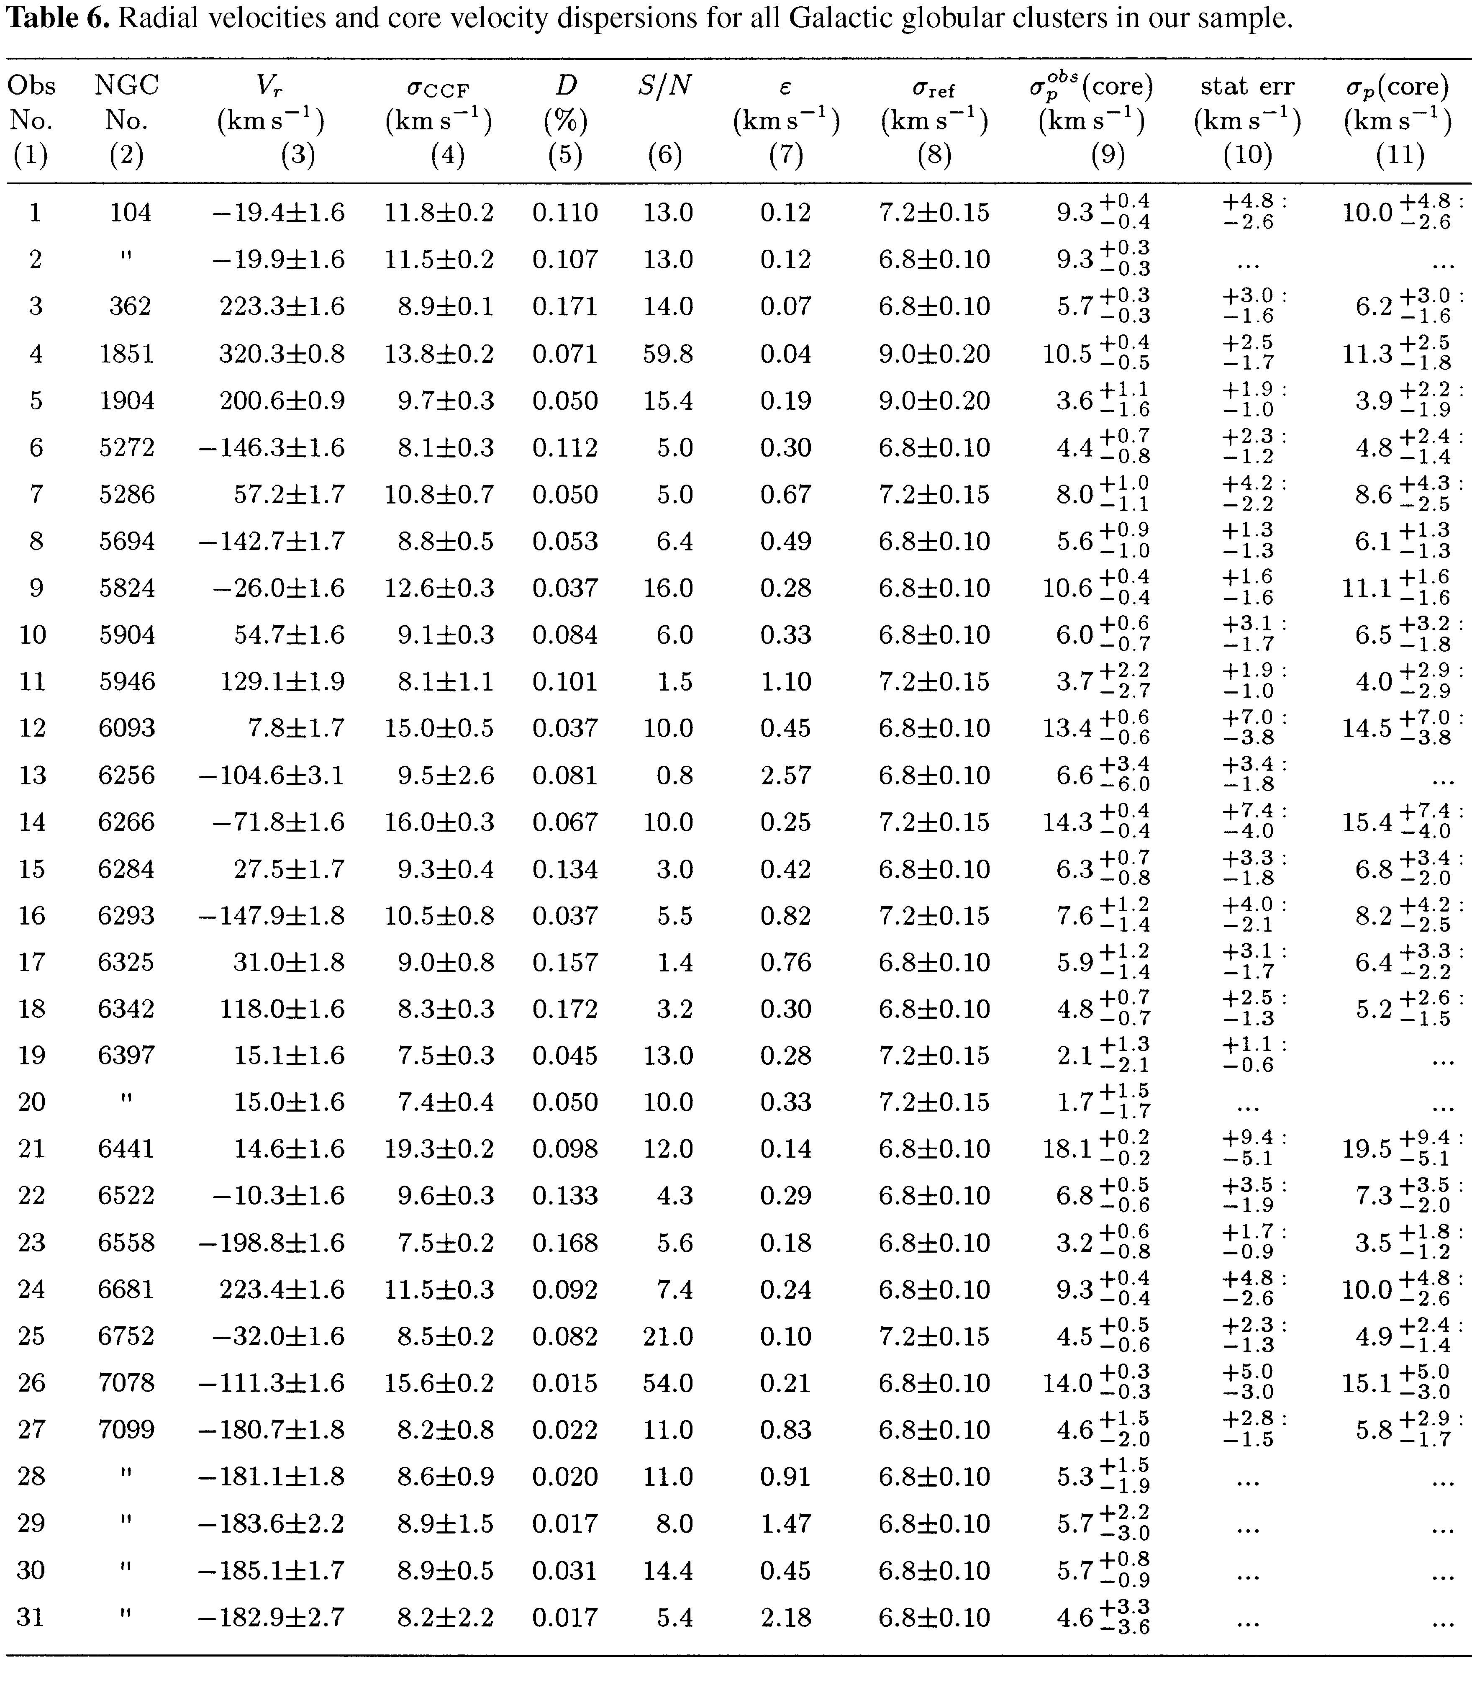
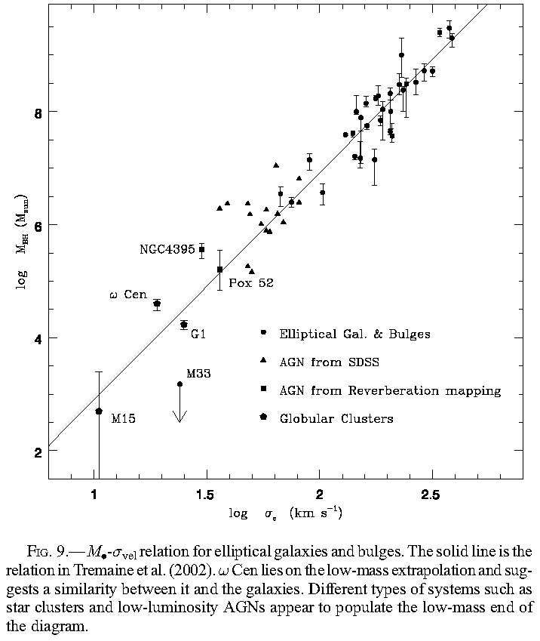
球状星団のブラックホール
中心付近の星の速度分布の観測
中心付近の星の速度分布
と BH質量の関係
Core velocity dispersions for 25 Galactic and 10 old Magellanic globular clusters?
Pierre Dubath et al.,
Astron. Astrophys. 324, 505–522 (1997)
GEMINI AND HUBBLE SPACE TELESCOPE EVIDENCE FOR AN INTERMEDIATE-MASS
BLACK HOLE IN ω CENTAURI
Eva Noyola et al., ApJ 676 (2008) 1008Y1015

Slide 59
地球重力場観測
人工衛星の軌道から地球重力ポテンシャルを検知
軌道検知用ＧＰＳ受信機, および加速度計で構成
地球重力場観測
Globalな重力ポテンシャルの決定
→ 密度分布のモニタ
地球規模の水の監視技術
（海洋・陸水・氷床等）
地球環境モニタ
地震・火山噴火にともなう
地殻変動の検知・予測
GPS衛星
GRACEとGRACE-FOの間の期間
2012-16年を埋める可能性
→ 独自の成果, 国際貢献
東京大字地震研・新谷氏、
京都大学・福田氏の資料/情報提供

Slide 60
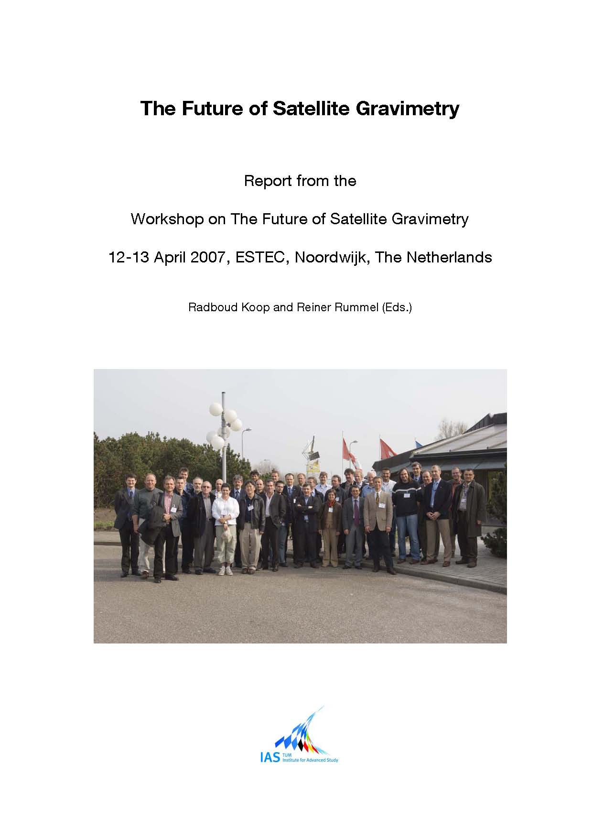
地球重力場観測の観測網
GRACE, GOCEが稼働中
次世代計画 GRACE-FO
GRACEと同等 (マイクロ波測距)
GRACE
L ~ 220km, ΔL ~ 5μm
→ ΔL/L ~ 2 x 10⁻¹¹
DPF
L ~ 0.3m, ΔL ~ 10⁻¹¹ m
→ ΔL/L ~ 3 x 10⁻¹¹
GRACEとGRACE-FOの間
(2012-16年) の空白を埋める可能性
→ 独自の成果, 国際貢献

Slide 61
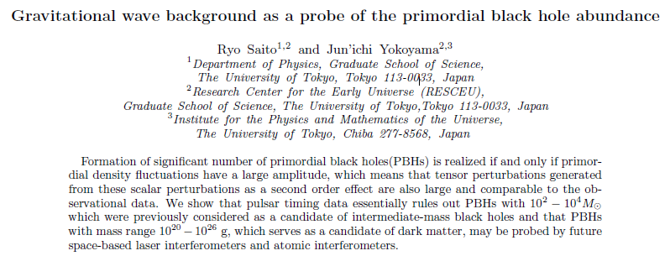
DECIGOによる初期宇宙BH観測

Slide 62
DECIGOによるダークエネルギーの制限
‘Standard Siren’
中性子星連星までの
距離‐赤方偏移関係からモデルに制限
⇒ 宇宙の加速膨張の情報
Expansion ＋Acceleration?
DECIGO
GW
NS-NS (z～1)
Output
Template
(No Acceleration)
で決定
Strain
チャープシグナルから、直接決定
距離:
赤方偏移:
host galaxyを特定
Real Signal ?
Phase Delay
～1sec (10 years)
角度分解能 ～10arcmin （１台）
～10arcsec （３台）
at z=1
Time
Seto, Kawamura, Nakamura,
PRL 87, 221103 (2001)
標準光源としての比較
高橋 龍一氏 (2006)
超新星観測 中性子星連星観測
絶対光度
近傍の観測からの経験則
＜
相対論
イベント数
年間２０００個 （SNAP）
＜
年間 10⁴⁻⁵個 （DECIGO）
距離の決定精度
約１０％
～
約１０％ at z=1
～
＞
１台では厳しい
複数台あれば可能？
母銀河の特定 簡単？
その他
ダスト減光による不定性
＜
物質による吸収・散乱は無視

Slide 63
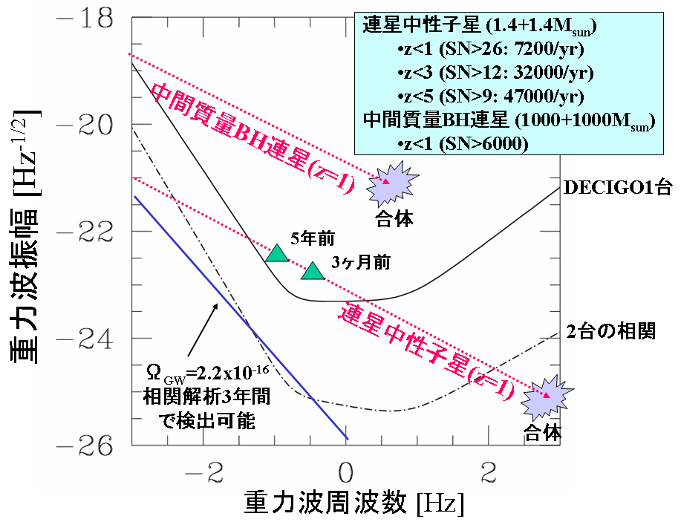
DECIGOの狙う重力波源とサイエンス
S.Kawamura
(2007)
巨大ブラックホール
形成のメカニズム解明
インフレーションの検証
ダークエネルギーの制限

Slide 64
What is DECIGO?
Deci-hertz Interferometer Gravitational Wave Observatory
Japanese space GW antenna to be launched after LISA
Can bridge the gap between LISA and terrestrial detectors
Low confusion noise -> Extremely high sensitivity
10⁻¹⁸
moved above
LISA band
Terrestrial detectors (e.g. LCGT)
LISA
10⁻²⁰
To be moved
into TD band
Strain [Hz^{-1/2}]
DECIGO
10⁻²²
Confusion Noise
10⁻²⁴
10⁻⁴
10⁻²
10⁰
10²
10⁴
Frequency [Hz]

Slide 65
Why FP cavity?
Transponder type
(e.g. LISA)
Shorten
arm length
Implement FP cavity
Radiation pressure noise f⁻²
Radiation pressure noise f⁻²
Shot noise f¹
Shorten
arm length
Shot noise f¹
Strain
Shot noise
Shot noise
Transponder type
(e.g. LISA)
Implement FP cavity
FP cavity type
Better best- sensitivity
Frequency

Slide 66
Drag free and FP cavity: compatible?
S/C II
S/C I
Mirror

Slide 67
FP cavity and drag free : compatible?
Relative position between mirror and S/C
Local sensor
S/C I
S/C II
Mirror
Thruster
Thruster

Slide 68
Drag free and FP cavity: compatible?
Relative position between mirror and S/C
No signal
mixture
Local sensor
S/C I
S/C II
Mirror
Thruster
Thruster
Actuator
Interferometer output (GW signal)

Slide 69
Orbit and constellation (preliminary)
Earth
Correlation for stochastic background
Record disk
Sun
Increase angular resolution

Slide 70
Sensitivity of Pre-DECIGO
S/N~14 for NS-NS@300Mpc, 10-20 events/year

Slide 71
History of DECIGO
1999 the LISA study group convened by Tsubono
2000 Short-arm space antenna suggested by Kawamura
2001 Space GW antenna WG convened as one of the
possible future projects in NAOJ
2001 Named as DECIGO in the PRL paper
2002 1st DECIGO workshop
2003 2nd DECIGO workshop
(FP-type suggested by Ando)
2005 3rd DECIGO workshop
2006 4th DECIGO workshop
(FP-type adopted as a pre-conceptual design)
2007 5th DECIGO workshop
2008 6th DECIGO workshop
1st LISA-DECIGO workshop

Slide 72
Interim organization
PI: Kawamura (NAOJ)
Deputy: Ando (Tokyo)
Executive Committee
Kawamura (NAOJ), Ando (Tokyo), Seto (NAOJ), Nakamura (Kyoto), Tsubono (Tokyo), Tanaka (Kyoto), Funaki (ISAS), Numata (Maryland), Sato (Hosei), Kanda (Osaka city), Takashima (ISAS), Ioka (Kyoto)
Pre-DECIGO
Sato (Hosei)
Detector
Numata (Maryland)
Ando (Tokyo)
Science, Data
Tanaka (Kyoto)
Seto (NAOJ)
Kanda (Osaka city)
Satellite
Funaki (ISAS)
Design phase
DECIGO pathfinder
Leader: Ando (Tokyo)
Deputy: Takashima (ISAS)
Mission phase
Detector
Ando (Tokyo)
Laser
Ueda (ILS)
Musya (ILS)
Housing
Sato (Hosei)
Drag free
Moriwaki (Tokyo)
Sakai (ISAS)
Thruster
Funaki (ISAS)
Bus
Takashima (ISAS)
Data
Kanda (Osaka city)

Slide 73
DECIGO-WG
Kazuhiro Agatsuma, Masaki Ando, Koh-suke Aoyanagi, Koji Arai, Akito Araya, Hideki Asada, Yoichi Aso, Takeshi Chiba, Toshikazu Ebisuzaki, Yumiko Ejiri, Motohiro Enoki, Yoshiharu Eriguchi, Masa-Katsu Fujimoto, Ryuichi Fujita, Mitsuhiro Fukushima, Ikkoh Funaki, Toshifumi Futamase, Katsuhiko Ganzu, Tomohiro Harada, Tatsuaki Hashimoto, Kazuhiro Hayama, Wataru Hikida, Yoshiaki Himemoto, Hisashi Hirabayashi, Takashi Hiramatsu, Feng-Lei Hong, Hideyuki Horisawa, Mizuhiko Hosokawa, Kiyotomo Ichiki, Takeshi Ikegami, Kaiki T. Inoue, Kunihito Ioka, Koji Ishidoshiro, Hideki Ishihara, Takehiko Ishikawa, Hideharu Ishizaki, Hiroyuki Ito, Yousuke Itoh, Nobuyuki Kanda, Seiji Kawamura, Nobuki Kawashima, Fumiko Kawazoe, Naoko Kishimoto, Kenta Kiuchi, Shiho Kobayashi, Kazunori Kohri, Hiroyuki Koizumi, Yasufumi Kojima, Keiko Kokeyama, Wataru Kokuyama, Kei Kotake, Yoshihide Kozai, Hideaki Kudoh, Hiroo Kunimori, Hitoshi Kuninaka, Kazuaki Kuroda, Kei-ichi Maeda, Hideo Matsuhara, Yasushi Mino, Osamu Miyakawa, Shinji Miyoki, Mutsuko Y. Morimoto, Tomoko Morioka , Toshiyuki Morisawa, Shigenori Moriwaki, Shinji Mukohyama, Mitsuru Musha, Shigeo Nagano, Isao Naito, Kouji Nakamura, Takashi Nakamura, Hiroyuki Nakano, Kenichi Nakao, Shinichi Nakasuka, Yoshinori Nakayama, Kazuhiro Nakazawa, Erina Nishida, Kazutaka Nishiyama, Atsushi Nishizawa, Yoshito Niwa, Kenji Numata, Masatake Ohashi, Naoko Ohishi, Masashi Ohkawa, Kouji Onozato, Kenichi Oohara, Norichika Sago, Motoyuki Saijo, Masaaki Sakagami, Shin-ichiro Sakai, Shihori Sakata, Misao Sasaki, Shuichi Sato, Takashi Sato, Naoki Seto, Masaru Shibata, Hisaaki Shinkai, Kentaro Somiya, Hajime Sotani, Naoshi Sugiyama, Yudai Suwa, Rieko Suzuki, Hideyuki Tagoshi, Fuminobu Takahashi, Kakeru Takahashi, Keitaro Takahashi, Ryutaro Takahashi, Ryuichi Takahashi, Tadayuki Takahashi, Hirotaka Takahashi, Takamori Akiteru, Tadashi Takano, Takeshi Takashima, Takahiro Tanaka, Keisuke Taniguchi, Atsushi Taruya, Hiroyuki Tashiro, Mitsuru Tokuda, Yasuo Torii, Morio Toyoshima, Kimio Tsubono, Shinji Tsujikawa, Yoshiki Tsunesada, Akitoshi Ueda, Ken-ichi Ueda, Masayoshi Utashima, Hiroshi Yamakawa, Kazuhiro Yamamoto, Toshitaka Yamazaki, Jun'ichi Yokoyama, Chul-Moon Yoo, Shijun Yoshida, Taizoh Yoshino

Slide 74
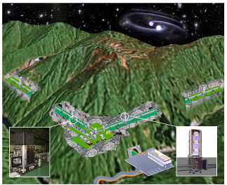


LCGT and DECIGO
Establish GW astronomy Develop GW astronomy
LCGT
DECIGO
Demonstration of technology Demonstration of technology
CLIO
DPF

Slide 75
Budget request to MEXT
“Demonstration of science and technologies for establishment of GW astronomy” (PI: Kawamura)
Consists of 3 researches:
  Ground-based detector (PI: Mio)
  Space antenna (PI: Ando)
  Theory, data analysis (PI: Kanda)
$10M for 5 years
Application to be submitted soon

Slide 76
Summary
DECIGO can bridge the gap between LISA and terrestrial detectors
DECIGO can detect GWs from the inflation as well as can bring us extremely interesting science.
DECIGO uses a differential FP interferometer to enhance sensitivity
We plan to launch DPF and Pre-DECIGO before DECIGO for demonstration of required technologies

Slide 77

Space antenna (4)
DECIGO
(DECI-hertz interferometer Gravitational wave Observatory)
Space GW antenna targeting at ~0.1Hz
(freq. Band between LISA
and ground based detectors)
3 spacecraft
Baseline length 1000km
Fabry-Perot-type interferometer
Targets:
Intermediate mass BH mergers
Distant neutron-star binaries
Background GWs
Launch target ~2024

Slide 78
Space antenna (5)
Comparison of designed sensitivities
GW frequency depends on the timescale of the source
Inspiral of
Massive BH
LISA
Galactic binary
NS inspiral
Core-collapse
super nova
Galactic binary
Foreground noise
Pulsar
(1yr)
ScoX-1
(1yr)
GWs from
Early universe
(Ω_{gw}=10⁻¹⁴)
DECIGO
LCGT
Gravity-gradient
noise for terrestrial detectors

Slide 79
Space antenna (6)
Scientific targets of DECIGO
N.Seto, S.Kawamura
(2007)
Formation mechanism
Of massive black holes
Intermediate-mass BH inspiral
Stochastic
Background GWs
Neutron-star inspiral
Insight on inflation
Constraint on
dark energy

Slide 80
Space antenna (7)
Constraint on dark energy by DECIGO
‘Standard Siren’
Constraint on dark-energy models by
observed relationship between
distance and redshift of
neutron-star binaries
⇒ Information on acceleration
of expansion of the universe
Expansion ＋Acceleration?
DECIGO
GW
NS-NS (z～1)
Output
Template
(No Acceleration)
Strain
Distance:
Estimate from chirp waveform
Real Signal ?
Redshift:
Identify the host galaxy
Phase Delay
～1sec (10 years)
Time
Seto, Kawamura, Nakamura,
PRL 87, 221103 (2001)
Angular resolution ～10arcmin （1 detector）
～10arcsec （3 detectors）
at z=1
Determine cosmological parameters
Absolute and independent measurement

Slide 81
Space antenna (8)
Constraint on dark energy by DECIGO (contd.)
Comparison as standard light
R.Takahashi (2006)
Supernova (EM wave) Neutron-star binary (GW)
‘Standard Candle’ ‘Standard Siren’
Absolute power
or amplitude
Extrapolated from
nearby events
General Relativity
＜
Event rate
2000/yr （SNAP）
＜
10⁴⁻⁵/yr （DECIGO）
Error in distance
~10%
～
10% at z=1
～
Identification
of host galaxy
Require multiple detectors
or statistics
Easy?
＞
Others
Uncertainty by
dust absorption
Negligible interaction
with matters
＜

Slide 82

DECIGO-PF (1)
DECIGO roadmap
LPF
LISA
Ad. LIGO
LCGT

Slide 83

DECIGO-PF (2)
DECIGO Pathfinder (DPF)
DECIGO-PF
One small satellite
(Weight: ~200-300kg, Orbit: around the earth)
30cm Fabry-Perot cavity formed by free masses
Stabilized laser source
Drag-free control system
Test and demonstration for DECIGO
(1) Drag-free control system
(2) Laser source and its stabilization system
(3) Control of Fabry-Perot interferometer
(4) Launch-lock system
Local Sensor
Actuator
Gravitational-wave observation
(5) Observation for low-frequency (0.1-1Hz) GWs
Intermediate-mass BHs at the Galactic center
Thruster

Slide 84

DECIGO-PF (3)
DPF diagram
Drag-free control
Local sensor signal
→ Feedback to thrusters/wheels
Mission weight : ~100kg
Mission space : ~90 x 90 x 90 cm
Laser source
Nd:YAG laser (1064nm)
Power : 25mW
Freq. stab. by reference cavity
Fabry-Perot interferometer
Finesse : 100
Length : 30cm
Test mass : 1kg
Signal extraction by PDH

Slide 85
DECIGO-PF (4)
Comparison with other detectors
Only a little observation data at low-frequency band
Doppler tracking: h ~10⁻¹⁵ (10⁻⁴-10⁻² Hz)
Pulsar timing: h ~10⁻¹⁴ (10⁻⁸ Hz)
Inspiral of
Massive BH
DPF limit
LISA
Galactic binary
NS inspiral
Core-collapse
super nova
Galactic binary
Foreground noise
Pulsar
(1yr)
ScoX-1
(1yr)
GWs from
Early universe
(Ω_{gw}=10⁻¹⁴)
DECIGO
LCGT
Gravity-gradient
noise for terrestrial detectors

Slide 86




DECIGO-PF (5)
DPF targets
Binary inspiral of mid.-scale BHs
h ~ 10⁻¹⁵ , f ~ 4 Hz
Distance 10kpc, m = 10³ M_{sun}
Quasi-normal mode
oscillation of massive BH
h ~ 10⁻¹⁵ , f ~ 0.3 Hz
Distance 1Mpc, m = 10⁵ M_{sun}
Events at Galactic center
will be detectable with SNR~5

Slide 87
DECIGO-PF (6)
DPF status
JAXA is planning to launch 3 small satellite by the year 2013
using next-generation solid rocket booster under development
Reduce time and cost by means of ‘Standard bus system’
Preliminary parameters
Bus weight : ~ 200kg, Bus power : ~ 900W
Downlink ~ 4Mbps, Data storage ~ 1GByte
3-axes angular control
1st mission (2011) has been decided to be
TOPS (Space telescope mission for planet observation)
2nd and 3rd mission will be selected by 2009 March
Candidate missions (high-rank missions being funded)
DPF: GW observation
DIOS: X-ray telescope for dark baryon investigation
ERG: Plasma and particle detector for geo-space investigation
Satellite for Magnet-plasma sail technology demonstration, …

Slide 88

DECIGO-PF (7)
First step to space
Small test-mass module
SWIMμν :
Small GW detector module
To be launched in 2008
2 modules (80mm cubic, 500g each)
Sensitivity : h~10⁻⁷
Included in a SWIM module
Test mass
Photo sensor
Coil-magnet actuator
SWIM
(SpaceWire Interface demonstration Module)
200mm Cubic, 5kg
Test of space-based processor and
communication standard
→ To be used JAXA/ESA/NASA
SDS-I :
Small (~100kg) satellite
for demonstration of space technologies
To be launched in 2008 summer by H-IIA
as piggy-back satellite of GOSAT

Slide 89

宇宙重力波望遠鏡
LISA
(Laser Interferometer Space Antenna)
3台のS/Cで基線長500万kmの干渉計を構成
ターゲット: 1mHz 前後の周波数帯
ESA/NASA共同プロジェクト
打ち上げ: 2018年目標
DECIGO
(Deci-hertz Interferometer
Gravitational Wave Observatory)
3台のS/Cで基線長1000kmの干渉計を構成
ターゲット: 0.1Hz 前後の周波数帯
打ち上げ: 2025年頃
Drag-free satellite
Arm cavity
PD
Laser
Arm cavity
PD
Drag-free satellite
Drag-free satellite

Slide 90


LISA
LISA
(Laser Interferometer Space Antenna)
3機のスペースクラフトで構成された基線長500万kmの干渉計
0.1mHz - 1Hz の周波数帯をターゲット
超巨大ブラックホールの合体 → ブラックホールまでの距離の測定
星の巨大ブラックホールへの落下 → 時空のマッピング情報
銀河系内連星 (確実な波源) → 強い潮汐相互作用, 質量移動への知見
ESA/NASA共同で、2018年以降に打ち上げ予定

Slide 91

LISAの状況
LISAの状況
BEPAC (Beyond Einstein Program Assessment Committee)
Beyond Einsteinミッションの
どれを最初に打ち上げるかを検討
Constellation-X
Laser Interferometer Space Antenna
Joint Dark Energy Mission
Inflation Probe
Black Hole Finder probe
2008年9月にレポートをまとめた
→ JDEM/SNAP を最初に打ち上げる
LISAも当面サポートする
“On purely scientific grounds LISA is the mission that is the most promising and least scientifically risky … Thus, the committee gave LISA its highest scientific ranking.”
“The committee believes it is more responsible technically and financially to propose a LISA new start after the Pathfinder results are taken into account.”
得られるサイエンスは高く評価
LPF(2009年)の結果を受けて
新しいスタートをするのが良い

Slide 92
DPF概要
マスト構造
DECIGOのための前哨衛星
小型科学衛星2号機 (~2013年)
候補としてミッション提案中
ミッション
スラスタヘッド
安定化レーザー光源
小型衛星 1 機
(95cm立方x2, 350kg)
地球周回軌道 高度 500km
中央処理演算器
DECIGOのための宇宙実証
科学技術の確立
干渉計モジュール
衛星バス
宇宙・地球の観測
重力波の観測
衛星バス
3Nスラスタ
地球重力場の観測
太陽電池パドル

Slide 93

DPFが目指す科学的成果

Slide 94

推進体制
DPF-WG 84名
DECIGO 137名

Slide 95




重力波検出実験のこれまで
一般相対性理論
(アインシュタイン, 1916)
望遠鏡による観測
(ガリレオ, 1609)
重力波の予言
(アインシュタイン, 1916)
宇宙放射線の発見
(ヘス, 1912)
銀河中心からの
電波観測
(ジャンスキー, 1931)
共振型アンテナ
(ウェーバー, 1960-)
さそり座X線源の観測
(ジャコーニ, 1962)
重力波観測の報告
(ウェーバー, 1969)
連星パルサーの発見
(ハルス・テイラー, 1974)
干渉計型アンテナ
(1970頃-)
宇宙背景放射の発見
(ペンジアス・ウィルソン, 1964)
重力波存在の証明
(ハルス・テイラー, 1979)
太陽ニュートリノ観測
(デービス, 1964)
低温アンテナ
(Explorer etc, 1990-)
超新星爆発からの
ニュートリノ観測
(小柴, 1987)
極低温アンテナ
(Nautilus etc, 1996-)
大型干渉計の建設
(1995頃-)
国際共同観測
(IGEC, 1997-)
TAMAによる観測開始
(1999-)
LIGOによる観測開始
(2002-)
共同観測
(2003-)

Slide 96



連星パルサーの発見と観測
連星パルサーPSR B1913+16
(1974年 ラッセル・ハルス, ジョゼフ・テイラー)
アレシボ天文台 (プエルトリコ)
公転周期： 7.75時間
質量 : パルサー 1.44 Msolar
伴星 1.39 Msolar
公転周期の変化率：
(-2.4056±0.0051)×10⁻¹²s/s
その後の継続的な観測
重力波の放出
→ 公転エネルギーを失い, 互いに落ち込む
（3×10⁸年後に 合体する）
一般相対性理論による理論値：
(-2.40242±0.00002)×10⁻¹²s/s
理論と観測の差は0.2%程度
重力波の存在の証明
(1993年ノーベル物理学賞： テイラー, ハルス)
J.M. Weisberg, J.H. Taylor, and D.J. Nice,
APJ, 2007, in preparation

Slide 97





電磁波と重力波
電磁波
J.C. Maxwell
重力波
A. Einstein
光速で伝播する電磁場の変動
光速で伝播する時空の歪み
電磁気学から導かれる
(マクスウェル方程式の波動解)
一般相対性理論から導かれる
(アインシュタイン方程式の波動解)
1864年 : マクスウェルが予言
1888年 : ヘルツの実験で発見
1916年: アインシュタインが予言
1989年: 連星パルサーの観測
によって存在を証明
電荷の加速度運動により生成
物質による 吸収, 散乱
波源のスケール > 波長 → 画像情報
双極子放射, 2つの偏波
質量の加速度運動により生成
物質に対して 強い透過力
波源のスケール < 波長 → バルクな情報
四重極放射, 2つの偏波
p
s
From presentation
by Laura Cadonati
plus
cross

Slide 98

重力波による観測
一般相対性理論
宇宙線による
観測
強い重力場における
相対性理論
原子核理論
高密度物体の物理
ニュートリノ
高エネルギー
宇宙線
重力波による
観測
天文学
星形成
恒星進化
銀河
ガンマ線バースト
超新星爆発
高周波数
重力波
電磁波による
観測
さまざまな
天体現象
ブラックホール
巨大ブラックホール
連星合体現象
惑星
超新星爆発
低周波数
重力波
パルサー
ガンマ線
X線
可視光
赤外線
電波
宇宙背景
放射
宇宙論
バックグラウンド
重力波
インフレーション
ダークマター
ダークエネルギー
背景画: NASA/WMAP Science Team

Slide 99







重力波による天文学
重力波の特徴
宇宙を観測する新しい手段
質量の加速度運動により生成
物質に対して 強い透過力
波源のスケール < 波長 → バルクな情報
電磁波と相補的・独立な観測
他では見ることの出来ない現象
‘晴れ上がり’前の初期宇宙
激しい天体現象の内部
CMB
Radio
+
IR
x-ray
GW ?
γ-ray
GRBs

Slide 100

重力波源と期待できる知見
(例) 連星中性子星の合体現象
中性子星の自転・非軸対称性
→ ほぼ定常的(正弦波)な重力波
(連続波)
2つの中性子星がお互いの周りを公転
→ ほぼ定常的(正弦波)な重力波
(連続波)
互いに接近し、公転周期が早くなる
→ 周期が早くなると共に、振幅も増大
(チャープ波)
衝突し合体
→ 短時間の爆発的な重力波放射
(バースト波)
中性子星の物理
ブラックホールの物理
相対性理論の検証
励起されたBH振動の減衰
→ 減衰振動波形
(リングダウン波)

Slide 101
DPFが目指す科学的成果

Slide 102
DPFが目指す科学的成果

Slide 103
DECIGO (4)
制御への要請
干渉計基線長制御
鏡に働く外乱 (重力, 電磁力, レーザー光輻射圧など) を抑圧
干渉計が動作することが必要
→ レーザー光の波長 (532nm) よりも十分良い精度
余計な雑音の影響を避ける
(レーザー光源の強度雑音, 鏡の角度変動とのカップリングなど)
(地上での重力波検出器 :
RMS変動 10⁻¹³ m
変位雑音 10⁻¹⁹ m/Hz^{1/2}
程度が実現されている)
要求値: 3x10⁻¹⁰ m
3 x 10⁻¹⁸ m/Hz^{1/2} (0.1Hz)
鏡と S/C 間の相対変位 (ドラッグフリー制御)
鏡を基準にS/Cに働く外力 (太陽光輻射, 天体重力など) を抑圧
鏡とS/Cがぶつからないことが必要
S/C変動が鏡の変動を引き起こさないことが必要
(重力, 電磁力によるカップリング)
ローカルセンサーの感度： なんとかなる
スラスタの推進力/推進力雑音が重要
要求値: 0.1 mm
3 x 10⁻¹⁰ m/Hz^{1/2} (0.1Hz)
S/C推進系への要請 : 外力より大きな力、 小さな雑音

Slide 104
DECIGO (5)
DECIGO軌道
軌道選定で考慮すべき要素
  ◎ S/C間の相対加速度が小さい (干渉計制御, ドラッグフリー制御からの要請)
  ◎ 太陽電池発電が困難でない (S/C生存からの要請)
  ○ 地球からの距離が遠すぎない (通信の要請)
  ○ 軌道投入が困難でない (推力/重量からの要請)
  △ 地球からの位置関係があまり変化しない (なんとなく)
  △ 制御を失ったときにリカバリーがききやすい (Fail Safeからの要請)
  △ 軌道上に擾乱物がない (干渉計雑音からの要請)
軌道候補
  太陽周回軌道
  LISAと同様の軌道
  地球公転軌道上
  ラグランジュ点
  ハロー軌道
  ラグランジュ点付近への静止
  地球周回軌道
  なんか良い軌道がある可能性？

Slide 105

DECIGO (6)
DECIGO軌道の検討
(例1) LISAと同様の軌道 (高城氏, 森本氏)
惑星重力の効果を含める
(惑星補正なし → 30cm/yrの変動)
基線長: 1000km
地球公転と同様の軌道
(太陽から見て 20度 地球の後ろ)
無制御時の軌道
相対加速度 ~ 4x10⁻¹² m/s²
→ 必要推力 ~ 10⁻⁹ N
(例2) ラグランジュ点まわりのハロー軌道 (歌島氏)
L2点で線形展開した計算
基線長: 1000km
長半径70万kmの周回軌道
無制御時の軌道
相対加速度 ~ 4x10⁻⁷ m/s² (山川氏)

Slide 106
Pre-conceptual Design (7)
S/C thruster force
S/C orbit : TBD
(ex) Similar orbit as that of LISA
Numerical simulation of
multi-bode system
Include gravity of planets
Arm length: 1000km
Earth-like orbit,
20deg. Behind the earth
Length control is indispensable
Acceleration to be controlled:
~4x10⁻¹² m/s²
Black curve: parabolic fitting

Slide 107

DPF Payload
Upper half of the satellite
Drag-free control
Local sensor signal
→ Feedback to mission thrusters
Weight : ~150 kg
Size : ~95 cm cube
Laser source
Yb:YAG laser (1030nm)
Power : 25mW
Freq. stab. by Iodine cell
Fabry-Perot interferometer
Finesse : 100
Length : 30cm
Test mass : 1kg
Signal extraction by PDH

Slide 108
Stabilized laser
Laser source
Yb:YAG laser (1030nm)
Power : 25mW
Freq. stab. by Iodine absorption line
→ 0.5 Hz/Hz^{1/2} (at 0.1Hz)
Comparable stability with that
by a reference cavity at 0.1Hz
Narrow absorption line at 515nm
Advantage of I₂ stabilization
Less affected by environment
Easier ground-base tests
Moderate vibration isolation
No vacuum system
Disadvantages
Less experience

Slide 109

Main interferometer
Test-mass module
Keeps a test inside
Local sensor/actuator
Launch-lock system
Interferometer sensors
for fine measurement
Fabry-Perot interferometer
Finesse : 100
Length : 30cm
Test mass : ~1kg
Signal extraction by PDH

Slide 110

Drag-free and attitude control
Drag-free control for
demonstration of control system
suppression of external disturbances
(solar radiation, air drag, …)
Mast
Requirement:
10⁻⁹ m/Hz^{1/2} (0.1Hz)
for satellite disp.
Passive + Active stabilization
Passive stabilization by gravity-gradient
Mast (~30kg) attached for MOI adj.
Active drag-free with 12 mission thrusters
Satellite Bus
Attitude control at initial phase and fail safe
3N thruster x4, Magnetic torque x3
Solar sensor, Fiber gyroscope

Slide 111
DECIGOのための根幹技術実証
DPFで実証される技術
DECIGOで必要
とされる主要技術
6x10⁻¹⁶ m/Hz^{1/2}
の変位感度
宇宙干渉計
による
精密計測
4x10⁻¹⁸ m/Hz^{1/2}
の変位感度
基線長1000kmのFP干渉計
宇宙における干渉計制御
試験マスに対する外乱抑圧
大型光学系の製作・制御
10⁻¹⁴ N/Hz^{1/2}
の外力雑音
10⁻¹⁷ N/Hz^{1/2}
の外力雑音
安定化レーザー
の宇宙実証
安定化レーザー光源による精密計測
光源の周波数・強度安定化
長基線長を利用した安定化制御
0.5 Hz/Hz^{1/2}
の周波数安定度
フォーメーションフライト
安定な軌道の実現
宇宙機間の距離制御
ドラッグフリー制御
低雑音スラスタ
ドラッグフリー
制御の実現
衛星変動安定度
10⁻⁹ m/Hz^{1/2}
スラスタ雑音
10⁻⁷ N/Hz^{1/2}
観測運用
時系列連続データの処理
データの解析
理論予測・他の観測との比較
重力波観測
0.1 Hz帯の連続
観測とデータ解析

Slide 112
DECIGOのための根幹技術実証
DPFで実証される技術
DECIGOで必要
とされる主要技術
6x10⁻¹⁶ m/Hz^{1/2}
の変位感度
宇宙干渉計
による
精密計測
4x10⁻¹⁸ m/Hz^{1/2}
の変位感度
基線長1000kmのFP干渉計
宇宙における干渉計制御
試験マスに対する外乱抑圧
大型光学系の製作・制御
10⁻¹⁴ N/Hz^{1/2}
の外力雑音
10⁻¹⁷ N/Hz^{1/2}
の外力雑音
安定化レーザー
の宇宙実証
安定化レーザー光源による精密計測
光源の周波数・強度安定化
長基線長を利用した安定化制御
0.5 Hz/Hz^{1/2}
の周波数安定度
フォーメーションフライト
安定な軌道の実現
宇宙機間の距離制御
ドラッグフリー制御
低雑音スラスタ
ドラッグフリー
制御の実現
衛星変動安定度
10⁻⁹ m/Hz^{1/2}
スラスタ雑音
10⁻⁷ N/Hz^{1/2}
観測運用
時系列連続データの処理
データの解析
理論予測・他の観測との比較
重力波観測
0.1 Hz帯の連続
観測とデータ解析

Slide 113
DPFで実証される科学技術
意義・波及効果
DPFで実証される技術
宇宙空間での精密計測技術
→ 基礎物理学実験
無重力環境下での精密計測
6x10⁻¹⁶ m/Hz^{1/2}
の変位感度
宇宙干渉計
による
精密計測
10⁻¹⁴ N/Hz^{1/2}
の外力雑音
宇宙・衛星内環境のより深い理解
宇宙空間での高い安定度の実現
さまざまな応用
地球環境観測 (ADM-Aeolus, GIFTS),
基礎物理実験, マイクロ波標準, 通信
(ACES), 惑星探査 (TPF-C), X線観測
(MAXIM), フォーメーションフライト (LISA,
GRACE-follow-on)
安定化レーザー
の宇宙実証
0.5 Hz/Hz^{1/2}
の周波数安定度
長時間安定な無重力環境
→宇宙環境利用の新しい可能性
基礎物理学実験, 材料工学
ドラッグフリー
制御の実現
衛星変動安定度
10⁻⁹ m/Hz^{1/2}
フォーメーションフライト
のための基礎技術
(TPF-C, LISA, GRACE follow-on)
スラスタ雑音
10⁻⁷ N/Hz^{1/2}
小型低雑音スラスタの宇宙実証

Slide 114
Constraint on dark energy
DECIGO will observe
10⁴⁻⁵ NS binaries at z~1
Precise ‘clock’ at cosmological distance
‘Standard Siren’
Expansion ＋Acceleration?
DECIGO
Relationship between
distance and redshift
GW
NS-NS (z～1)
Output
Template
(No Acceleration)
Distance:
chirp waveform
Redshift:
host galaxy
Strain
→ Information on acceleration
of expansion of the universe
Real Signal ?
Phase Delay
～1sec (10 years)
Time
Seto, Kawamura, Nakamura,
PRL 87, 221103 (2001)
Determine cosmological parameters
Angular resolution
～10arcmin （1 detector）
～10arcsec （3 detectors）
Absolute and independent measurement
at z=1

