Slide 1
Design of the LCGT interferometer observation band
Masaki Ando
(Department of Physics,
Kyoto University)
On behalf of LCGT BW
special working group

Slide 2
Abstract
Explain how
the observation band of
a LCGT interferometer
(and the optical configuration)
has been determined.
Notes:
In this talk, I will explain how the observation band of a LCGT interefereometer,
And the optical configuration has been determined.

Slide 3
Scope
Interferometer observation band should be determined
with investigations from various view point…
Special working group
Science
Detection, Waveform,
Astrophysical information
Observation
Calibration
Target selection
Sensitivity
Stability
Control scheme
Schedule, Cost
Technical
Feasibility
R&D
Project
Strategy
Notes:
This session is for optical configurations and techniques, but this talk is not only for technical issues.
Interferometer observation band should be determined with investigations from various point of view.
We organized a special working group, and investigated from scientific point of view, from technical point of view,
And from a viewpoint of project strategy.

Slide 4
Outline
Introduction
Candidate configurations
Science outcomes
Technical Feasibility
Project Strategy
Conclusion
Notes:
This is the outline of my talk.
At first, in the introduction, I will show the basic configuration and boundary conditions of LCGT interfereometer,
and set 4 candidate configurations in the next part.
After that, I will investigate the deffirence of these configurations from viewpoints of scientific outcomes,
Thechnical feasibilities, and proejct strategy.
At last, I will show the determined configuration and strategy.

Slide 5
Outline
Introduction
Candidate configurations
Science outcomes
Technical Feasibility
Project Strategy
Conclusion
Notes:
I will start my talk from introduction.
Here, I will show the default design of LCGT, and basic concept of RSE.

Slide 6
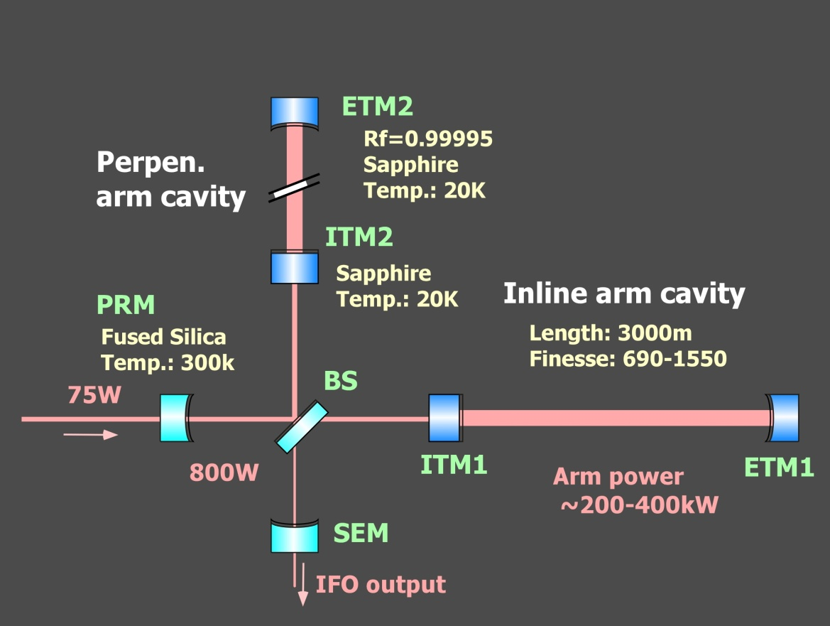
Interferometer setup
LCGT baseline design
Arm length of 3km, Underground site of Kamioka
Cryogenic mirror and suspension
High-power RSE interferometer with cryogenic mirrors
Resonant-Sideband Extraction
Input carrier power : 75W
DC readout
Main IFO mirror
20K, 30kg (Φ250mm, t150mm)
Mech. Loss : 10⁻⁸
Opt. Absorption 20ppm/cm
Suspension
Sapphire fiber 16K
Mech. Loss : 2x10⁻⁸
Notes:
In a default design, LCGT will have an arm length of 3km, will be placed at an underground site of Kamioka,
And cryogenic mirrors and suspensions will be used.
LCGT will be a high-power RSE interferometer, comprised of 3km high finesse arm cavities,
and power recycling and signlal-extraction mirrors.
The main mirrors wil be cooled down to 20K, and suspended by sapphire fibers with a temperature of 16K.

Slide 7
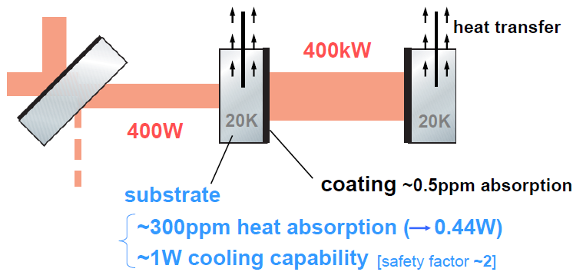
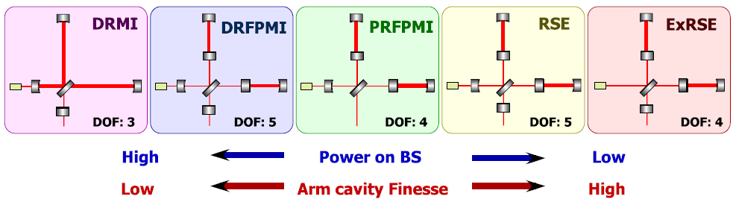
RSE and cryogenics
RSE
High arm-cavity finesse
moderate Power recycling gain
→ Smaller optical loss and
absorption in ITM substrate
Figure: K.Somiya
high power and cryogenics
Notes:
Here, I will mention that RSE is critical technique for LCGT to realize high power and cryogenic interfereometer at the same time.
There are several interfereometer configurations, which can be have high sensitivity.
DRMI, DRFPMI, PRFPMI…
In LCGT the heat caused by the absorption in the ITM substrate should be removed by cryocooler.
The cooing capability is about 1W, and this limits the input laser power or power recycling gain.
So, the finesse of the arm cavity should be high, to realize high power and sensitive interefereometer.

Slide 8
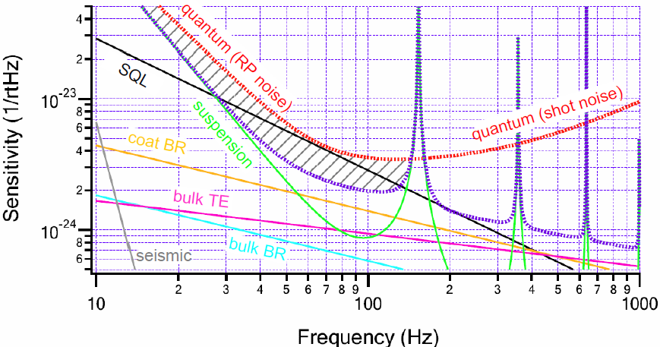
Quantum and Classical noises
Quantum noise is dominant
→ Optimization of RSE configuration
Tuning of obs. band
DC readout
Rooms for
improvement
Figure: K.Somiya
Notes:
This figure shows the sensivtivity curve of LCGT with the given boundary conditions.
The red curve is limitation by optical quantum noise by shot noise and radiation pressure noise.
The purple curve is quadrature sum of other noise sources.
We can see that the sensitivity is mostly imited by the quantum noise,
And there is a plece for improvents in this reagion, by reduction of the quantum noises.

Slide 9
Outline
Introduction
Candidate configurations
Science outcomes
Technical Feasibility
Project Strategy
Conclusion
Notes:
With there conditions, we set candidate intereferometer configurations.

Slide 10
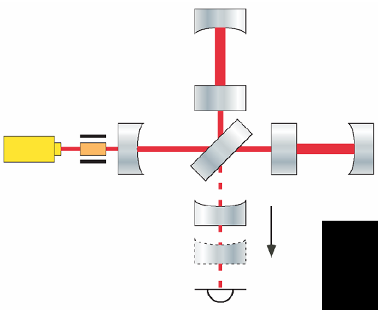
Tuning of observation band
Tune the resonance condition
of Signal-Extraction Cavity
Enhance IFO response,
Reduce quantum noise
at certain frequency band
Optimal reflectivity of
mirrors are different in
Broadband RSE (BRSE) and
Detuned RSE (DRSE)
configurations
SEC
Variable RSE (VRSE)
Change tuning
without replacement of
mirrors or changing in
macroscopic position
Figure: K.Somiya
Notes:
In RSE, it is possible to enhance … and reduce …, by tuning the resonant condition of signal light,
In the signal extraction cavity formed by the ITMs and the signal extraction mirror.
So we set two candidate configurations first.
One is BRSE in which carrier light is resonant with SEC,
And another is DRSE, in which the resonant condition of SEC is slightly offset form BRSE condition.
We also added a variable RSE configuration as a candidate. In VRSE, the tuning condition of SEC can
Be changed without replacement of mirrors or moving the mirror suspension.

Slide 11
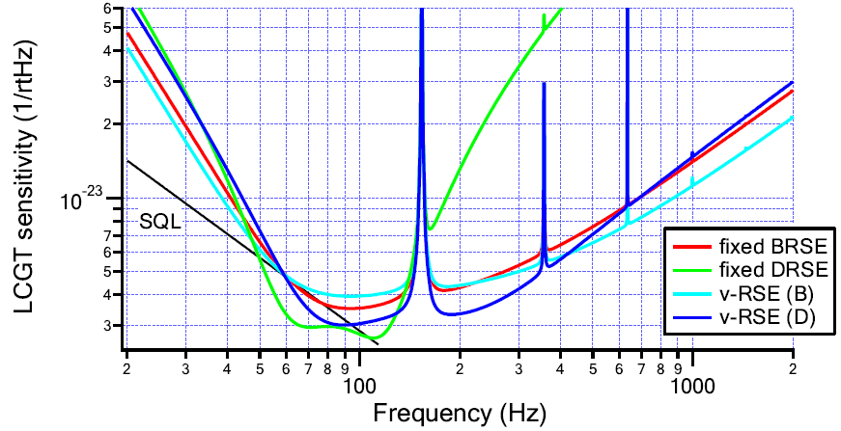
Candidate configurations
4 candidate configurations
Broadband Detuned
Fixed BRSE DRSE
Variable VRSE-B VRSE-D
Optimize parameters for
Neutron-star binary inspirals
(Primary target of LCGT)
Arm cavity finesse, SEC finesse
Detuning phase, DC readout phase
Figure: K.Somiya
Notes:
Here are the sensitivity curves for candidate configurations.
Red curve is for BRSE, which was the default design before this work.
Green curve is for DRSE…
Blue curves are for VRSE: blighter one is for broadband operational point, and
Darker one is for detuned operational point.
The optical parameters were optimized for detection of BNS inspirals.

Slide 12
Outline
Introduction
Candidate configurations
Science outcomes
Technical Feasibility
Project Strategy
Conclusion
Notes:
We investigate these 4 candidate configurations, from viewpoint of science, technical issues, and project strategy.
The first topic is scientific outcomes.

Slide 13
Neutron-star binaries
Primary purpose of LCGT : Detection of GW
→ First target : Neutron-star binary inspirals
Observable range :
estimated from sensitivity curve
Galaxy number density :
R. K. Kopparapu et.al.,
ApJ. 675 1459 (2008)
Event rate :
V. Kalogera et.al.,
ApJ, 601 L179 (2004)
Observable range Detection rate
BRSE 114 Mpc 5.4 yr⁻¹
VRSE-B 112 Mpc 5.2 yr⁻¹
VRSE-D 123 Mpc 6.9 yr⁻¹
DRSE 132 Mpc 8.2 yr⁻¹
(SNR 8, Sky averaged)
Notes:
The primary target of LCGT is to detect GWs, and the most confident source is a BNS inspirals.
So we compare the candidate configurations for this source first.
…
…

Slide 14
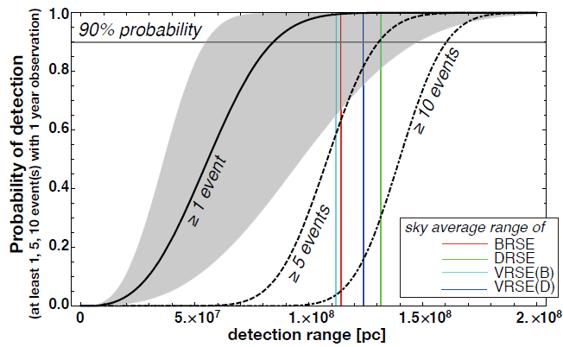
Detection probability
Detection probability
in one-year observation
IR DP
BRSE 114 Mpc
VRSE-B 112 Mpc
VRSE-D 123 Mpc
DRSE 132 Mpc
99.6 %
99.4 %
99.9 %
99.9 %
Success probability
of the LCGT project
Assume
Poisson distribution
Figure: N.Kanda
Notes:
These estimations are interpreted in term of the detection probability.
Since BNS inspirals are the primary target, the probability to detect at least
One event in one-year observation is considered as the success probability of LCGT project.
This figure shows … as a function of detection range.
…

Slide 15
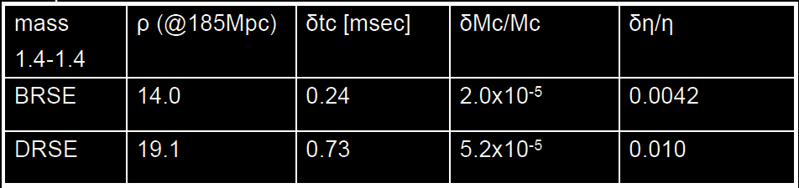
Parameter Estimation
Errors in parameter estimation from observed waveform
SNR
Arrival time
Mass parameters
By H.Tagoshi
DRSE has better observable range,
but poorer astrophysical information
(factor ~2 difference)
Notes:
After detection, we will extract astrophysical imformation from the waveform.
This table shows the …
This is because…

Slide 16
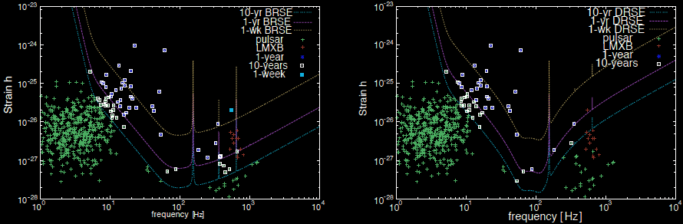
Other Targets
Binary black hole
Obs. range : 570-670 Mpc
Black hole Quasi-Normal mode
Obs. range : 2-3 Gpc
Core-collapse supernova
Galactic events are detectable
Out of band for DRSE ?
Pulsars
25-38 pulsars within band
Better sensitivity than
spin-down upper limit
Less targets for DRSE
BRSE
DRSE
Figure: Y.Miyamoto
Notes:
We have compared the configurations for the other sources.
There are only small differences.
But broadband configuration is a little favorable for core-collapse supernovae, and pulsars.

Slide 17
Outline
Introduction
Candidate configurations
Science outcomes
Technical Feasibility
Project Strategy
Conclusion
Notes:
Next, I will compare the configurations from technical point of view.

Slide 18
Technical feasibility
Mainly discuss the difference in technical difficulties
though there will be many common problems…
・IFO Control (Signal extraction and SNR, Coupling noise by control)
→No critical difference, though each configuration
has advantages and disadvantages
VRSE : realized by additional offset to the error signal
・Requirement for mirror
High arm-cavity finesse (1550) in BRSE, VRSE
→ lower optical loss is required (45ppm)
Backup plan:
Increase of input power, tuning of opt. Config.
No critical difference
Notes:
…

Slide 19
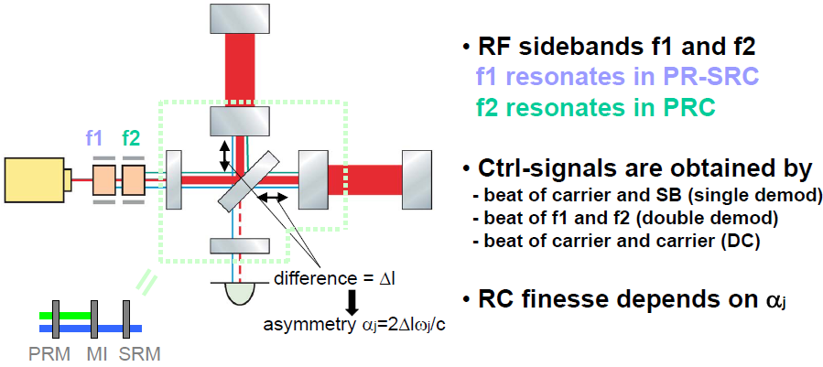
Control scheme
5 length DoF should be controlled in RSE
Figure: K.Somiya
Signals are extracted with RF sidebands at two freq.

Slide 20
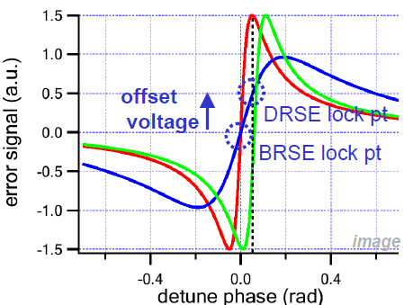
SEM control and VRSE
VRSE is realized by adding
an offset in SEM control signal
DRSE
Tradeoff between
signal strength and
control range
Signal strength
depends on the finesse
of SRC + SEC
VRSE
BRSE
Figure: K.Somiya

Slide 21
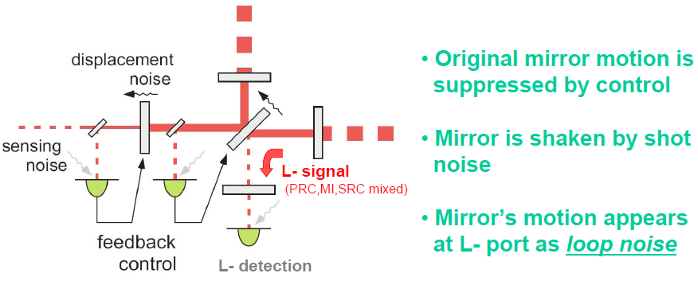
Control loop noise
Figure: K.Somiya

Slide 22
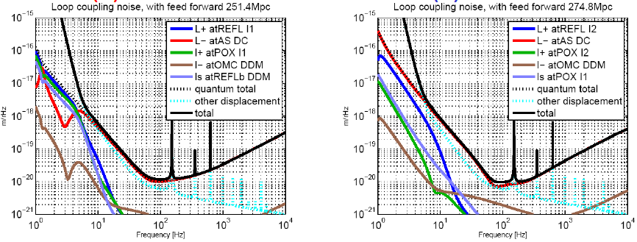
Control loop noise
Control loop noise in VRSE
Normal operation with VRSE-B, control offset for VRSE-D
VRSE-B
VRSE-D
Figure: O. Miyakawa
Contribution of l- and ls loop noise
does not degrade the sensitivity.

Slide 23
Outline
Introduction
Candidate configurations
Science outcomes
Technical Feasibility
Project Strategy
Conclusion

Slide 24
Project Strategy
LCGT should contribute to the first detection
→ Earlier start of observation is desirable
Should consider the total time of
Commissioning term and
Observation time required for the first detection.
・Observation time for the first detection
Two month difference at most
・Commissioning term
Many uncertainties
Difficult to predict in precision of month
In the best guess from current experiences…
→ No critical difference.
・Cost, Risks, Room for future upgrades
→ No critical difference.

Slide 25
Outline
Introduction
Candidate configurations
Science outcomes
Technical Feasibility
Project Strategy
Conclusion

Slide 26
Summary
We compared 4 candidate configurations
Broadband RSE (BRSE), Detuned RSE (DRSE),
Variable RSE (VRSE-B, VRSE-D)
Science
Detection, Waveform,
Astrophysical information
Observation
Calibration
Target selection
Sensitivity
Stability
Control scheme
Schedule, Cost
Technical
Feasibility
R&D
Project
Strategy
Notes:
This session is for optical configurations and techniques, but this talk is not only for technical issues.
Interferometer observation band should be determined with investigations from various point of view.
We organized a special working group, and investigated from scientific point of view, from technical point of view,
And from a viewpoint of project strategy.

Slide 27
Conclusion
1. LCGT should be
Variable RSE configuration (VRSE).
2. In the first stage, it should be
at the detuned operation point (VRSE-D).
In 4 candidate configurations, …
・No critical difference in detection probabilities.
・ No critical difference in technical feasibilities.
・DRSE is tuned for detection of BNS event,
but has less capabilities for the other targets.
・ VRSE-D is slightly better sensitivity for BNS than VRSE-B.
・We have an option to be VRSE-B after first few detections,
for wider scientific outcomes.

Slide 28
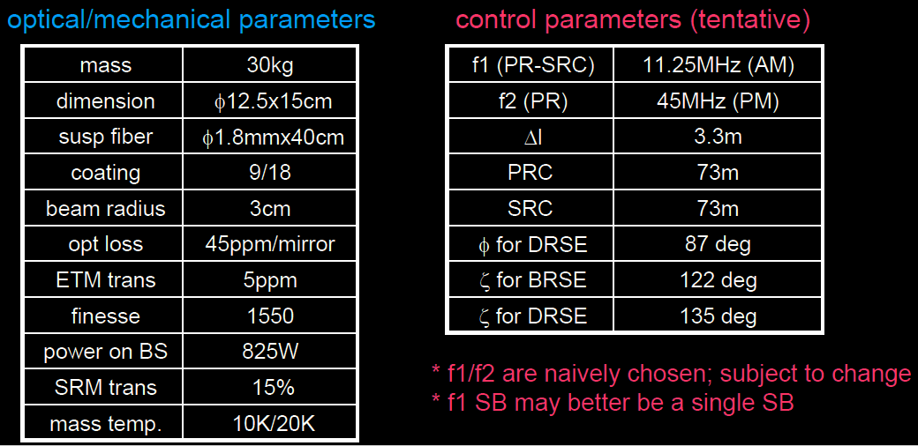
Conclusion
Summary of LCGT interferometer parameters
By K.Somiya

Slide 29
Acknowledgements
Special Working Group members
Coordinator: Seiji Kawamura (NAOJ)
Chair: Masaki Ando (Kyoto University)
Members:
Nobuyuki Kanda (Osaka City University), Yoichi Aso (University of Tokyo), Kentaro Somiya (Caltech), Osamu Miyakawa (ICRR), Hideyuki Tagoshi (Osaka University), Daisuke Tatsumi (NAOJ), Hirotaka Takahashi (Nagaoka University of Technology), Kazuhiro Hayama (AEI), Kazuhiro Agatsuma (NAOJ), Koji Arai (Caltech), Kiwamu Izumi (NAOJ), Yuji Miyamoto (Osaka City University), Shinji Miyoki (ICRR), Shigenori Moriwaki (University of Tokyo), Shigeo Nagano (NICT), Noriaki Ohmae (University of Tokyo), Shuichi Sato (Hosei University), Toshikazu Suzuki (KEK), Ryutaro Takahashi (NAOJ), Takashi Uchiyama (ICRR), Hiroaki Yamamoto (Caltech), Kazuhiro Yamamoto (AEI)
Special thanks to the external evaluation committee :
Stan Whitcomb (Chair), Stefan Ballmer, Hartmut Grote,
Benoit Mours, Peter Shawhan

Slide 30
End

Slide 31
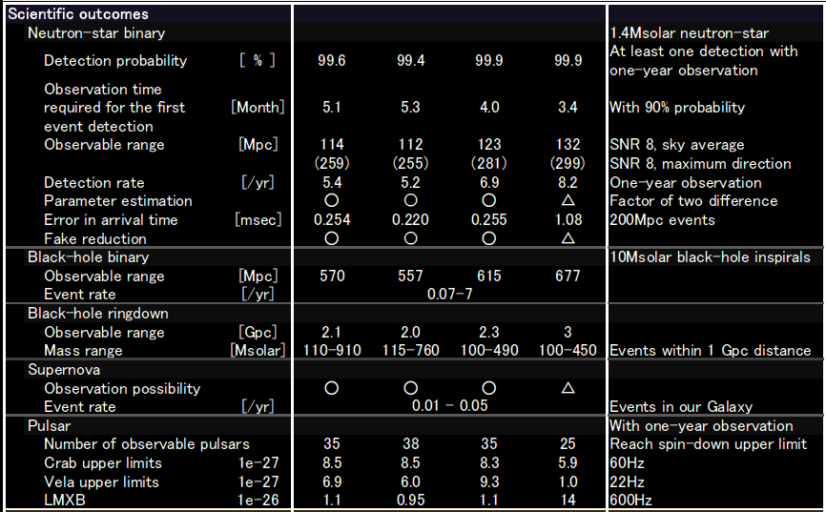
Scientific outcomes
BRSE VRSE-B VRSE-D DRSE

Slide 32
LCGT BW special working group
Scope: To make recommendations on the interferometer
optical configuration design of LCGT,
and its observation band for gravitational waves.
Members: 22 members from LCGT collaborators
Reviewed by an external evaluation committee

