Slide 1

Gravitational-wave observatories:
LCGT and DECIGO
Masaki Ando
(Department of Physics, Kyoto University)
On behalf of
LCGT Collaboration and
DECIGO working group

Slide 2

    1. Introduction
    2. LCGT
    3. DECIGO
    4. Summary

Slide 3
    1. Introduction
    2. LCGT
    3. DECIGO
    4. Summary

Slide 4
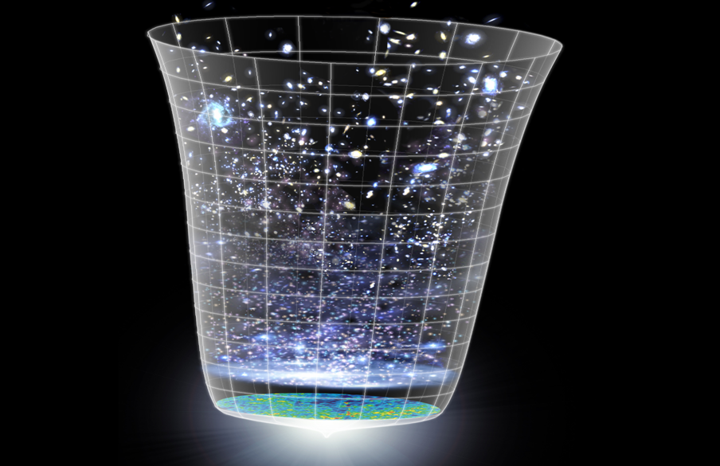
Observation of the Universe
General Relativity
Cosmic-Ray
observation
Relativity in Strong
Gravitational-Field
Nuclear Physics
High-Density Matter
Neutrino
High-energy CR
GW
observation
Astronomy
Stars
Galaxies
Gamma-ray burst
Supernovae
High-freq.
GWs
EM wave
observation
Black Holes
Massive BHs
Compact Inspiral
Planets
Supernovae
Low-freq. GWs
Astronomical
Phenomena
Pulsar
Gamma
X-ray
Visible ray
Infrared
Microwave
Cosmic
Background
Cosmology
Background
GWs
Inflation
Dark matter
Dark energy
Background:
NASA/WMAP Science Team

Slide 5
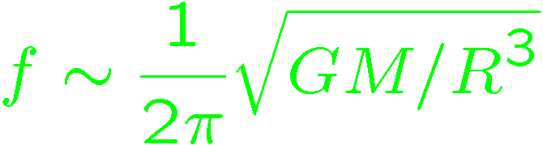
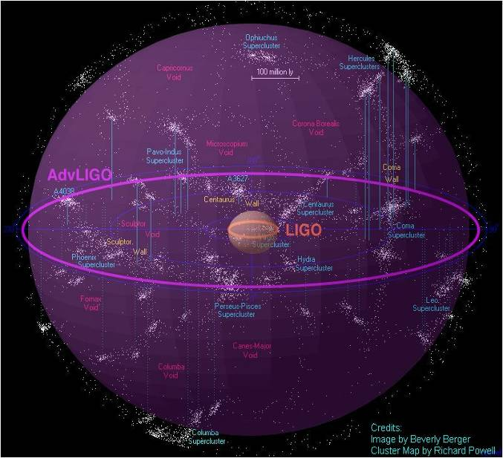
Expanding the Horizon
Current GW detectors : <20Mpc obs. range
However… we can expect only rare events
(10⁻⁵-10⁻³ event/yr)
Next generation detectors
Better sensitivity
to cover more galaxies
Wider observation band
for various sources
Massive BH
inspirals
DPF limit
LISA
Galaxy
binaries
NS binary
inspiral
Core-collapse
Supernovae
Foreground GWs
Pulsar
(1yr)
DECIGO
ScoX-1
(1yr)
Background GWs
from early universe
(W_{gw}=10⁻¹⁴)
LCGT
Gravity-gradient noise
(Terrestrial detectors)

Slide 6
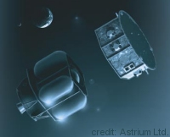
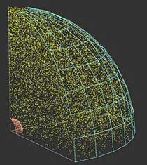
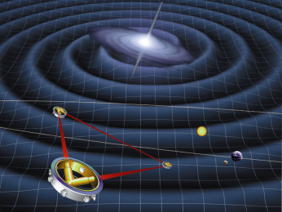
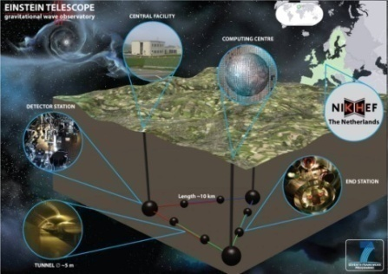
Roadmap of GW detectors
Ground based detectors
Space-borne detectors
Improved sensitivities (10-1kHz)
Low-frequency sources
(0.1mHz – 1Hz)
LIGO
TAMA
CLIO
Virgo/
GEO
Enhanced
LIGO
DECIGO
2010
LPF
DPF
LCGT
Advanced
Virgo
LPF
Advanced
LIGO
2015
ＬＣＧＴ
LISA
Pre-DECIGO
Ａｄ. ＬＩＧＯ
ET
LISA
2020
Guaranteed source
0.1mHz-10mHz
DECIGO
Detection Rate
~10 event/yr
BBO
2025
Cosmological GWs around 0.1Hz

Slide 7
LCGT and DECIGO
LCGT (~2017)
Terrestrial Detector
→ High frequency events
DECIGO (~2027)
Space observatory
→ Low frequency sources
Target: GW detection
Target: GW astronomy

Slide 8
    1. Introduction
    2. LCGT
    Overview and design
    Observable range
    R&D by CLIO
    3. DECIGO
    4. Summary

Slide 9
LCGT
LCGT
(Large-scale Cryogenic Gravitational-wave Telescope)
LCGT
Next-generation GW detector in Japan
Large-scale Detector
Baseline length: 3km
High-power Interferometer
Cryogenic interferometer
Mirror temperature: 20K
Underground site
Kamioka mine,
1000m underground

Slide 10
Recent News
LCGT project was selected by
the ’Facility for the advanced researches’
program of MEXT.
LCGT
Construction cost is partially approved:
9.8 BYen for first 3-year construction.
(Original request: 15.5 BYen for 7 years.)
Baseline design is not changed:
Requesting the additional cost for
full construction of LCGT.
This talk is mainly on the baseline design.

Slide 11
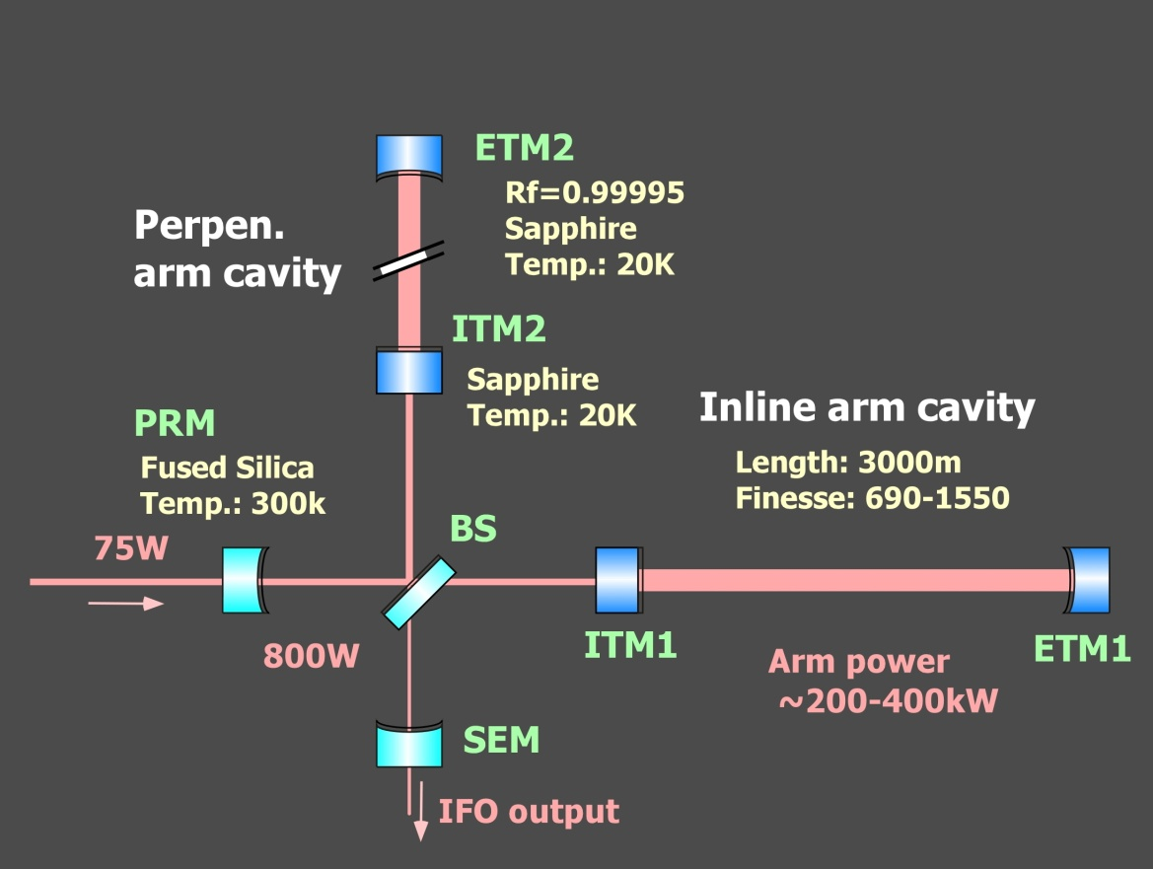
LCGT interferometer
LCGT baseline design
Arm length of 3km, Underground site of Kamioka
Cryogenic mirror and suspension
High-power RSE interferometer with cryogenic mirrors
Resonant-Sideband Extraction
Input carrier power : 75W
DC readout
Main IFO mirror
20K, 30kg (Φ250mm, t150mm)
Mech. Loss : 10⁻⁸
Opt. Absorption 20ppm/cm
Suspension
Sapphire fiber 16K
Mech. Loss : 2x10⁻⁸

Slide 12
Sensitivity Curve
Comparable with Ad.LIGO Ad.VIRGO
→ Global network observation
Seismic
Noise
Optical
Readout noise
Thermal
Noise

Slide 13
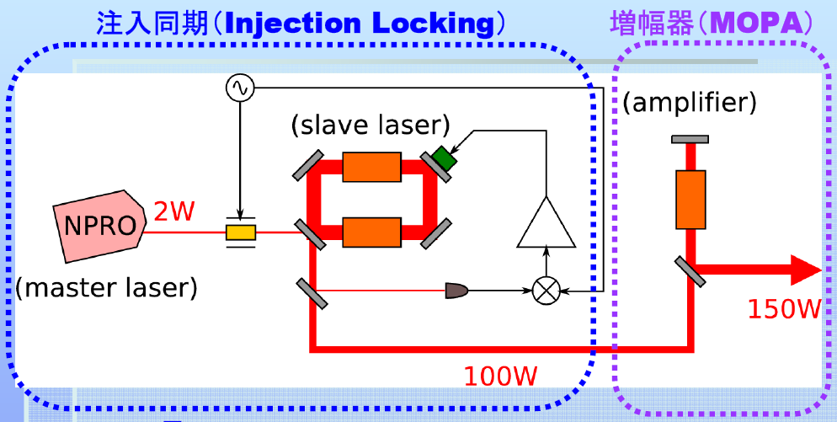

Readout-noise reduction
High-freq. (> 100 Hz) improvement
Shot noise reduction by high power in arm cavities
Optical configuration
High-power laser source
Fabry-Perot Michelson interferometer with RSE
(Resonant-Sideband Extraction)
Nd:YAG laser source with
150W output power
Fabry-Perot cavity
Fabry-Perot cavity
Signal-extraction
mirror
Low-loss mirror
Power-recycling
mirror
Less than 45ppm by reflection

Slide 14
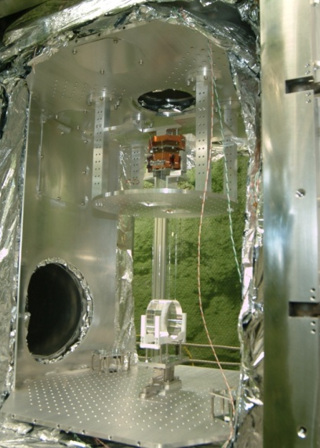
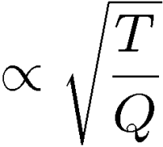
Thermal-noise reduction
Mid.-freq. (around 100 Hz) improvement
Cryogenics
Cryogenic mirror and
suspension of CLIO
100-m interferometer
Mirror ~20K
Suspension ~16K
Sapphire mirror
→ High mechanical Q-value
at low temperature
Low-vibration
Cryo-cooler design
Thermal
noise
Cryogenic is
a straight-forward way
to reduce thermal noise.

Slide 15
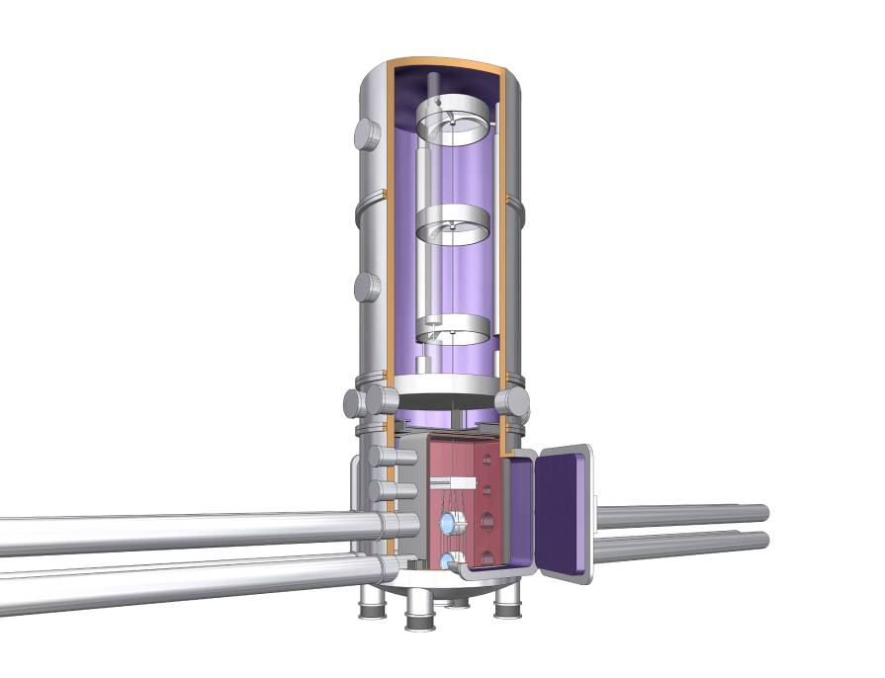
Seismic-noise reduction
Low-freq. (< 100 Hz) improvement
Quiet site
Better Isolation system
Kamioka underground site
(~1000km underground)
Multi-stage and Low-freq.
vibration isolation system
Lower seismic disturbance
by 2-3 orders
Vacuum is common
SAS:
three stages with
inverted pendulum
Outer shield of cryostat
Sapphire fiber
suspending mirror
Heat links extend
to the inner shield
heat anchor.
Main mirror

Slide 16
    1. Introduction
    2. LCGT
    Overview and design
    Observable range
    R&D by CLIO
    3. DECIGO
    4. Summary

Slide 17
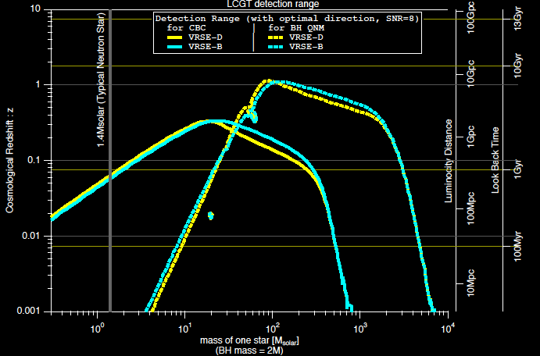
Observable range
Primary purpose of LCGT : Detection of GW
→ First target : Neutron-star binary inspirals
Obs. Range 120Mpc
(SNR=8, Avg. over sky pos. an pol.)
120 Mpc
1.4 M_{sun}
NS-NS
By N.Kanda

Slide 18
Detection rate of LCGT
Neutron-star binary inspirals events
Observable range
sensitivity curve → 120 Mpc
Galaxy number density :
R. K. Kopparapu et.al.,
ApJ. 675 1459 (2008)
Event rate :
V. Kalogera et.al.,
ApJ, 601 L179 (2004)
Detection rate 6.9 events/yr

Slide 19
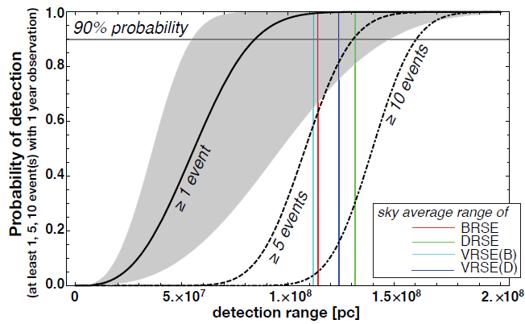
Detection probability
Probability to detect
at least one event
in one-year observation
Success probability
of the LCGT project
99.9%
Assume
Poisson distribution
Figure: N.Kanda

Slide 20
    1. Introduction
    2. LCGT
    Overview and design
    Observable range
    R&D by CLIO
    3. DECIGO
    4. Summary

Slide 21
CLIO
T.Uchiyama
March 29, 2009 JPS Meeting

Slide 22
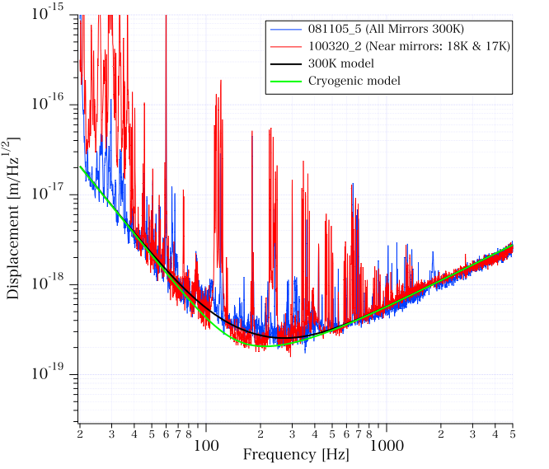
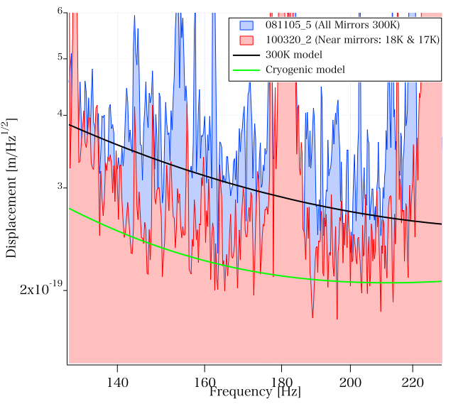
CLIO sensitivity
Sensitivity improvement with cryogenic operation
T.Uchiyama
GWADW2010

Slide 23
    1. Introduction
    2. LCGT
    3. DECIGO
    Overview and design
    DECIGO Pathfinder
    Space demonstration by SWIM
    4. Summary

Slide 24
DECIGO
DECIGO
(Deci-hertz interferometer Gravitational wave Observatory)
Space GW antenna (~2027)
Obs. band around 0.1 Hz
‘Bridge’ the obs.gap between
LISA and Terrestrial detectors
Terrestrial Detectors
(Ad. LIGO, LCGT, etc)
LISA
DECIGO

Slide 25
DECIGO Interferometer
Interferometer Unit:
Differential FP interferometer
Baseline length: 1000 km
3 S/C formation flight
3 FP interferometers
Drag-free control
Arm cavity
1000km
Arm cavity
Laser
Mirror
Photo-
detector
Drag-free S/C

Slide 26
Targets and Science
IMBH binary inspiral
NS binary inspiral
Stochastic background
Galaxy formation (Massive BH)
Cosmology
(Inflation, Dark energy)
10⁻¹⁶
10⁻¹⁸
IMBH inspiral (z~1)
10⁻²⁰
GW amplitude [Hz^{-1/2}]
Background GW
(Ωgw ~ 2 x 10⁻¹⁶)
Merger
DECIGO
(1 unit)
10⁻²²
3month
10⁻²⁴
Merger
DECIGO
(Correlation)
10⁻²⁶
NS inspiral (z~1)
10⁻⁴
10⁻²
10⁰
10²
10⁴
Frequency [Hz]

Slide 27
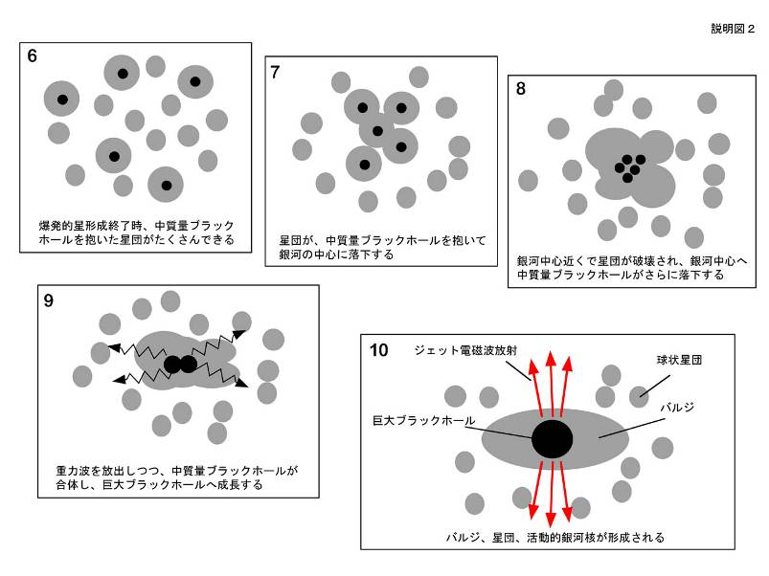
IMBH inspiral and Merger
DECIGO will observe
Intermediate-mass BH (IMBH)
binary merger with
SNR>6000 for z~1 source
Information on the
formation of
Supermassive BHs
at the center of galaxies
戎崎俊一(理化学研究所) 先生のwebページより引用 http://atlas.riken.go.jp/~ebisu/smbh.html

Slide 28
Constraint on dark energy
DECIGO will observe
10⁴⁻⁵ NS binaries at z~1
Precise ‘clock’ at cosmological distance
‘Standard Siren’
Relationship between
distance and redshift
Expansion ＋Acceleration?
DECIGO
Distance:
chirp waveform
GW
Redshift:
host galaxy
NS-NS (z～1)
Output
→ Information on acceleration
of expansion of the universe
Seto, Kawamura, Nakamura,
PRL 87, 221103 (2001)
Determine cosmological parameters
Angular resolution
～10arcmin （1 detector）
～10arcsec （3 detectors）
Absolute and independent measurement
at z=1

Slide 29
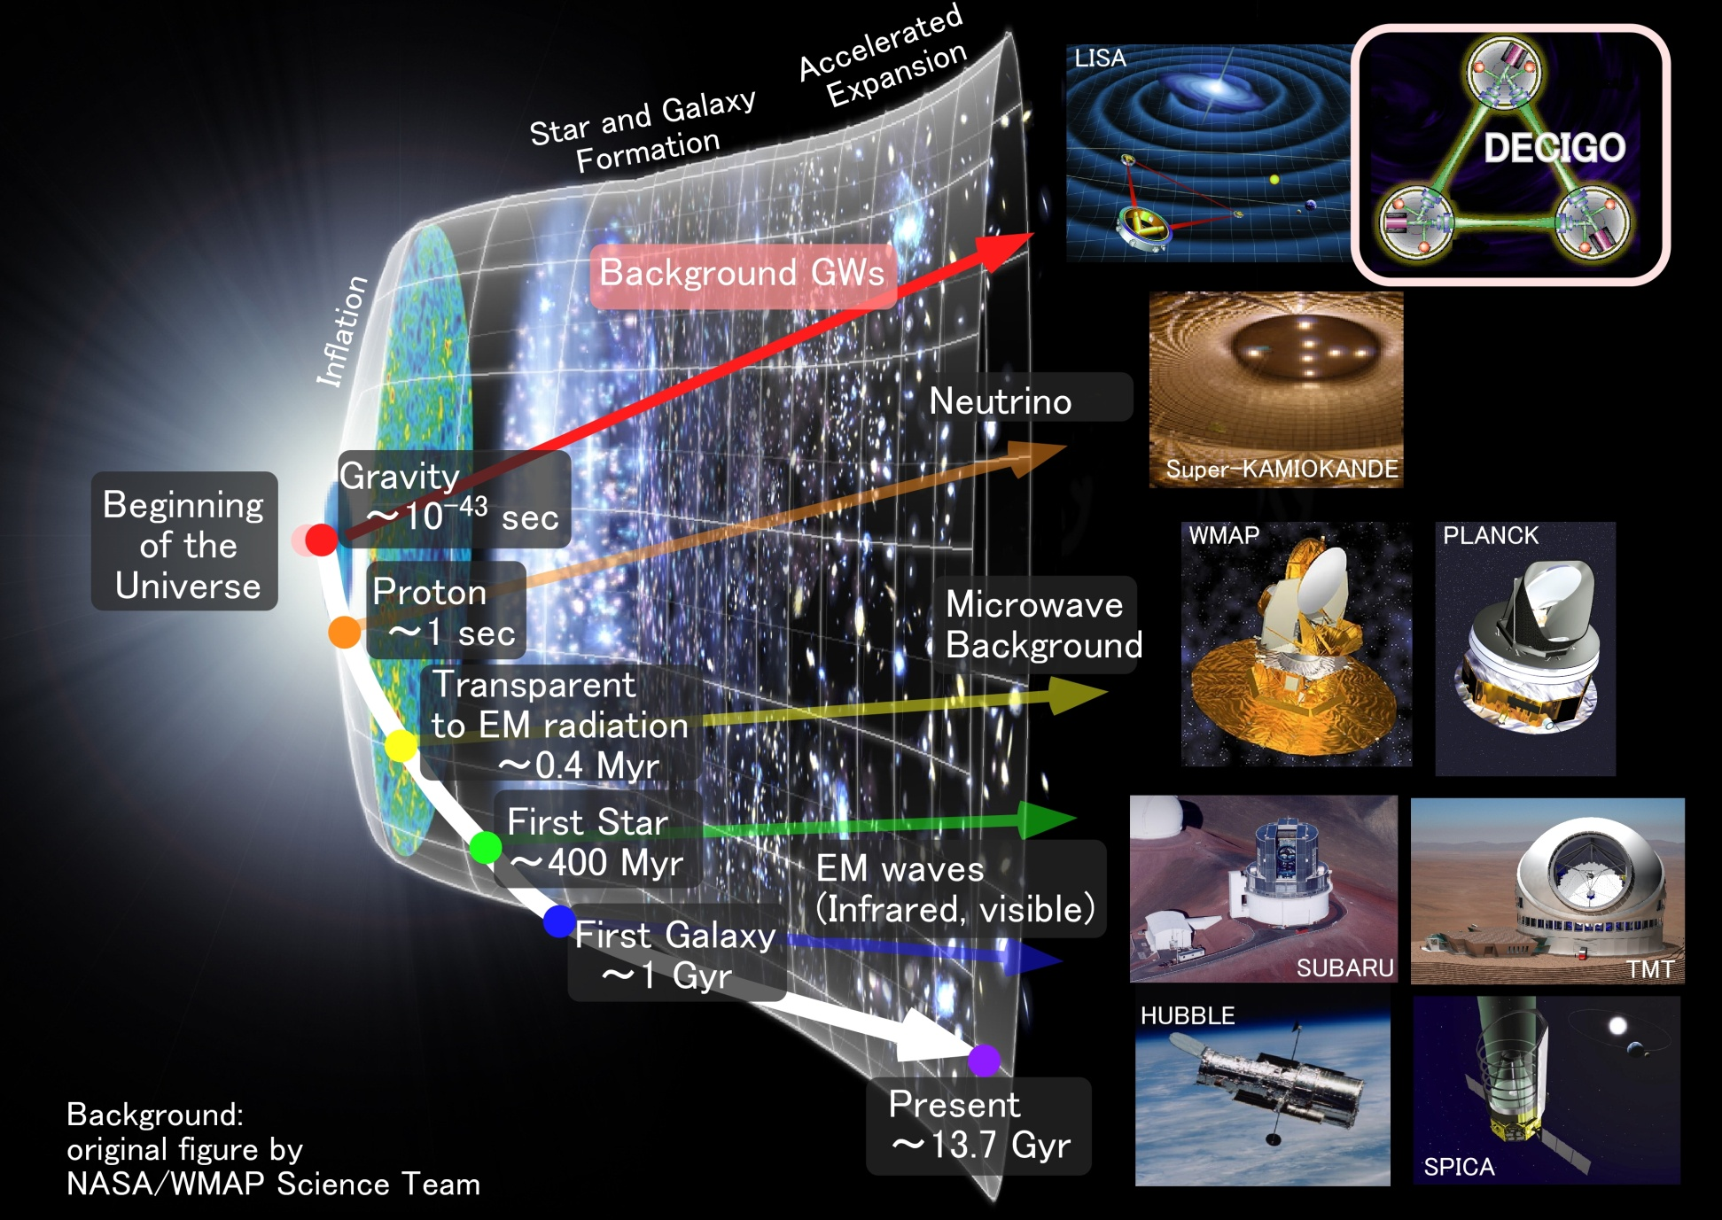
Stochastic Background GWs
Stochastic
Background GWs

Slide 30
Pre-Conceptual Design
Interferometer Unit:
Differential FP interferometer
Arm length: 1000 km
Finesse: 10
Mirror diameter: 1 m
Mirror mass: 100 kg
Laser power: 10 W
Laser wavelength：532 nm
Arm cavity
Arm cavity
S/C: drag free
3 interferometers
Laser
Mirror
Photo-
detector
Drag-free S/C

Slide 31
Interferometer Design
Transponder type vs Direct-reflection type
Compare : Sensitivity curves and Expected Sciences
Decisive factor: Binary confusion noise
WD-WD
confusion noise

Slide 32
Cavity and S/C control
Cavity length change
PDH error signal → Mirror position (and Laser frequency)
Relative motion between mirror and S/C
Local sensor → S/C thruster
Displacement Signal between S/C and Mirror
Local Sensor
S/C 1
S/C 2
Mirror
Thruster
Thruster
Actuator
Fig: S. Kawamura
Displacement signal between the two Mirrors

Slide 33
Requirements
Sensor Noise
Shot noise 3 x 10⁻¹⁸ m/Hz^{1/2} (0.1 Hz)
x 10 of LCGT in phase noise
Other noises should be well below the shot noise
Laser freq. noise: 1 Hz/Hz^{1/2} (1Hz)
Stab. Gain 10⁵, CMRR 10⁵
Acceleration Noise
Force noise 4x10⁻¹⁷ N/Hz^{1/2} (0.1 Hz)
x 1/50 of LISA
External force sources
Fluctuation of magnetic field, electric field, gravitational field, temperature, pressure, etc.

Slide 34
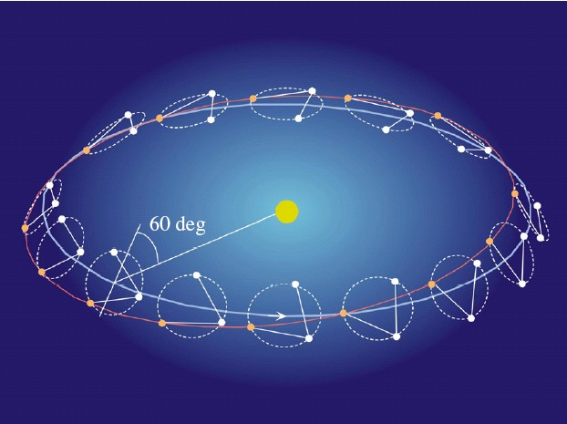
Orbit and Constellation
Candidate of orbit:
Record-disk orbit around the Sun
Relative acc. 4x10⁻¹² m/s²
Separated
unit
(Mirror force ~10⁻⁹ N )
Halo orbit around L2 (or L1)
Relative acc. 4x10⁻⁷ m/s²
(Mirror force ~10⁻⁴ N )
Constellation
Separated
unit
overlapped
units
4 interferometer units
2 overlapped units → Cross correlation
2 separated units → Angular resolution

Slide 35
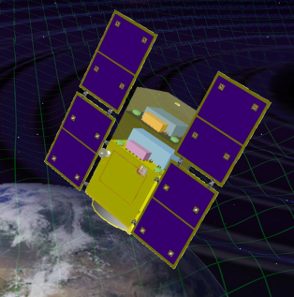
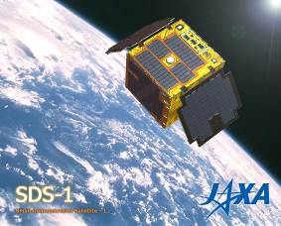
Roadmap
Figure: S.Kawamura
 | 2010 | 11 | 12 | 13 | 14 | 15 | 16 | 17 |  | 18 | 19 | 20 | 21 | 22 | 23 | 24 | 25 | 26 | 27 | 28 | 29
Mission
Objective | Space test of key tech. GW observation |  |  |  |  |  |  |  | Detect GW with min. spec FP between S/C |  |  |  |  |  |  | GW astronomy
Design | Single small satellite Short FP interferometer |  |  |  |  |  |  |  | 3 S/C 1 interferometer unit |  |  |  |  |  |  | 3 S/C x 3-4 units
R&D
Fabrication
R&D
Fabrication
R&D
Fabrication
DECIGO
Pathfinder
(DPF)
Pre-DECIGO
DECIGO
SDS-1/SWIM

Slide 36
    1. Introduction
    2. LCGT
    3. DECIGO
    Overview and design
    DECIGO Pathfinder
    Space demonstration by SWIM
    4. Summary

Slide 37

Roadmap
Figure: S.Kawamura
 | 2010 | 11 | 12 | 13 | 14 | 15 | 16 | 17 |  | 18 | 19 | 20 | 21 | 22 | 23 | 24 | 25 | 26 | 27 | 28 | 29
Mission
Objective | Space test of key tech. GW observation |  |  |  |  |  |  |  | Detect GW with min. spec FP between S/C |  |  |  |  |  |  | GW astronomy
Design | Single small satellite Short FP interferometer |  |  |  |  |  |  |  | 3 S/C 1 interferometer unit |  |  |  |  |  |  | 3 S/C x 3-4 units
R&D
Fabrication
R&D
Fabrication
R&D
Fabrication
DECIGO
Pathfinder
(DPF)
Pre-DECIGO
DECIGO
SDS-1/SWIM

Slide 38
DECIGO-PF
DECIGO Pathfinder (DPF)
DECIGO
First milestone mission for DECIGO
Shrink arm cavity
DECIGO 1000km → DPF 30cm
1000km
Single satellite
(Payload ~1m³ , 350kg)
Low-earth orbit
(Altitude 500km, sun synchronous)
30cm FP cavity with 2 test masses
Stabilized laser source
Drag-free control
Local Sensor
Laser
30cm
Actuator
DPF
Thruster

Slide 39
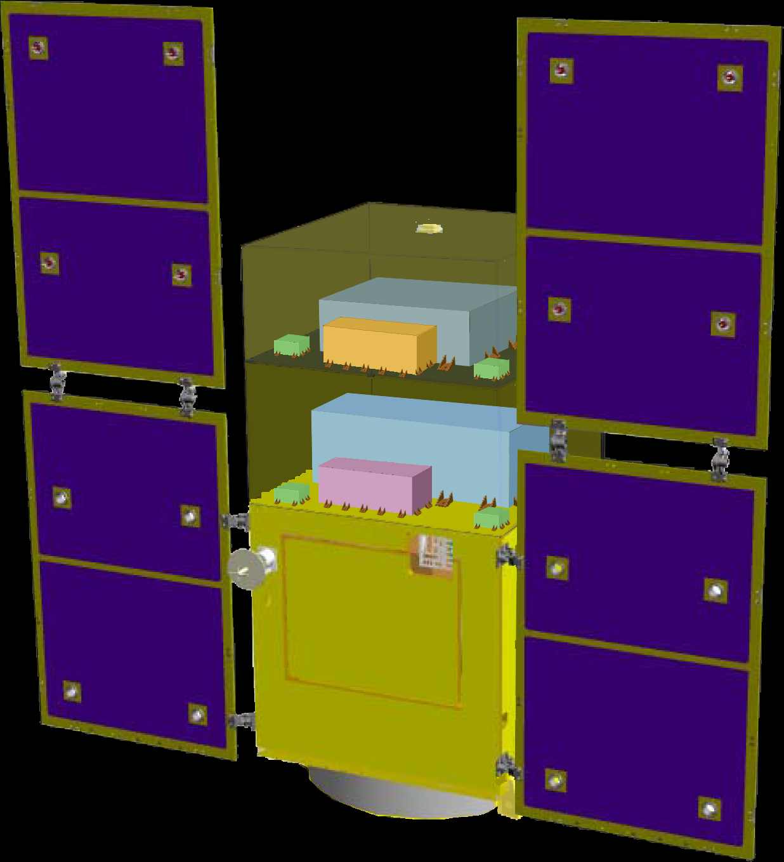
DPF satellite
DPF Payload
Size : 950mm cube
Weight : 150kg
Power : 130W
Data Rate: 800kbps
Mission thruster x12
Mission
Thruster head
Stabilized.
Laser source
On-board
Computer
Power Supply
SpW Comm.
Satellite Bus
(‘Standard bus’ system)
Size :
950x950x1100mm
Weight : 200kg
SAP : 960W
Battery: 50AH
Downlink : 2Mpbs
DR: 1GByte
3N Thrusters x 4
Interferometer
module
Satellite
Bus system
Bus thruster
Solar Paddle

Slide 40

DPF mission payload
Mission weight : ~150kg
Mission space : ~95 x 95 x 90 cm
Drag-free control
Local sensor signal
→ Feedback to thrusters
Thruster
Fabry-Perot interferometer
Finesse : 100
Length : 30cm
Test mass : ~1kg
Signal extraction by PDH
Laser source
Yb:YAG laser (1030nm)
Power : 25mW
Freq. stab. by Iodine abs. line

Slide 41
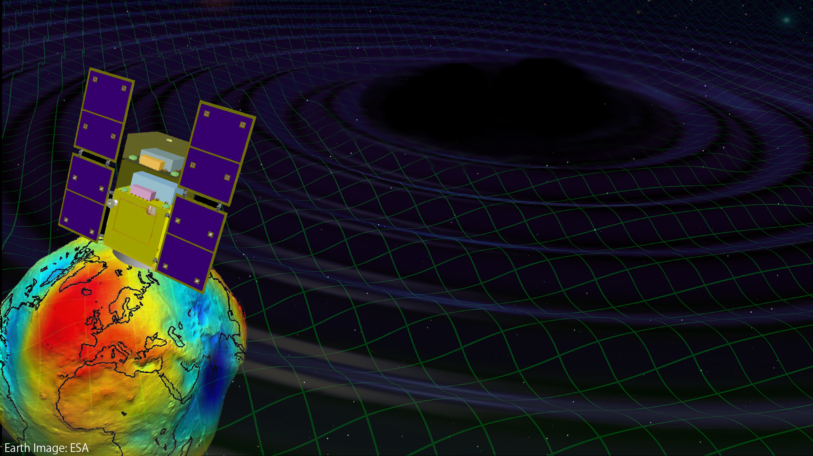
Targets of DPF
Scientific observations
Gravitational Waves form BH mergers
→ BH formation mechanism
Gravity of the Earth
→ Geophysics, Earth environment
Science technology
Space demonstration for DECIGO
→ Most tech. with single satellite
(IFO, Laser, Drag-free)
Precision measurement in orbit
→ IFO measurement
under stable zero-gravity

Slide 42
DPF sensitivity
DPF sensitivity h ~ 2x10⁻¹⁵ Hz^{1/2}
(x10 of quantum noises)
Massive BH
inspirals
DPF limit
LISA
Galaxy
binaries
NS binary
inspiral
Core-collapse
Supernovae
Foreground GWs
Pulsar
(1yr)
ScoX-1
(1yr)
DECIGO
Background GWs
from early universe
(Ω_{gw}=10⁻¹⁴)
LCGT
Gravity-gradient noise
(Terrestrial detectors)

Slide 43
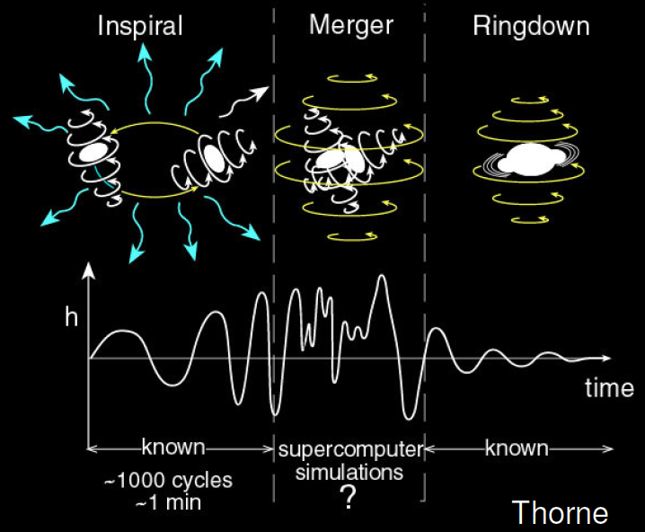

GW target of DPF
Blackholes events
in our galaxy
IMBH inspiral and merger
h ~ 10⁻¹⁵ , f ~ 4 Hz
Distance 10kpc, m = 10³ M_{sun}
Obs. Duration (~1000sec)
BH QNM
h ~ 10⁻¹⁵ , f ~ 0.3 Hz
Distance 1Mpc, m = 10⁵ M_{sun}
Observable range covers
our Galaxy (SNR~5 )
Hard to access by others
→ Original observation
KAGAYA
(By K.Yagi)

Slide 44
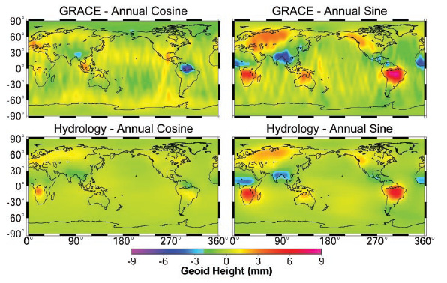
Earth’s Gravity Observation
Measure gravity field of the Earth
from Satellite Orbits, and gravity-gradiometer
comprehensive and homogeneous-quality data
Determine global gravity field
→ Basis of the shape of
the Earth (Geoid)
Monitor of change in time
→ Result of Earth’s dynamics
Ground water motion
Strains in crusts by
earthquakes and volcanoes
Seasonal change of the gravitational potential observed by GRACE

Slide 45
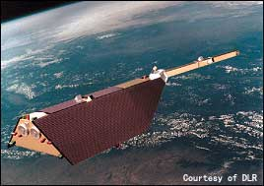

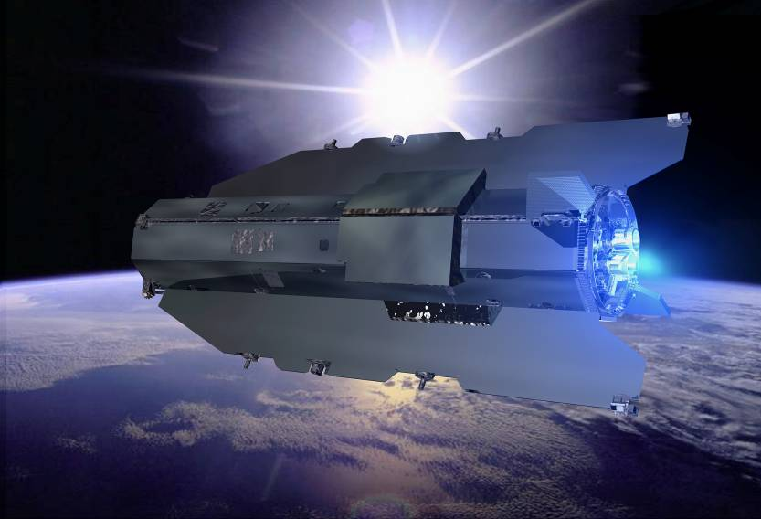
Satellite Gravity missions
3-types of satellite gravity missions
Satellite-to Satellite
tracking High-Low
Satellite-to Satellite
tracking Low-Low
Satellite
Gravity Gradiometry
・Observe satellite orbit
by global positioning
system (GPS,…)
・Cancel drag-effects
by accelerometer
・Distance meas. by
along-track satellites
・Cancel drag-effects
by accelerometer
・Observe potential by
gravity gradiometer
・Drag-free control for
cancellation of drags
CHAMP (GFZ, 2000-)
GRACE (NASA, 2002-)
GOCE (ESA, 2009-)

Slide 46
DPF sensitivity
Comparison of sensitivities
Better in low orders (large scale) ← Sensors
Report for Mission Selection
Gravity Field and Steady-State
Ocean Circulation Mission
ESA SP-1233(1) July 1999.
Worse in high orders (small scale) ← Altitude
400km
100km
80km
Scale
(with margin 10)

Slide 47
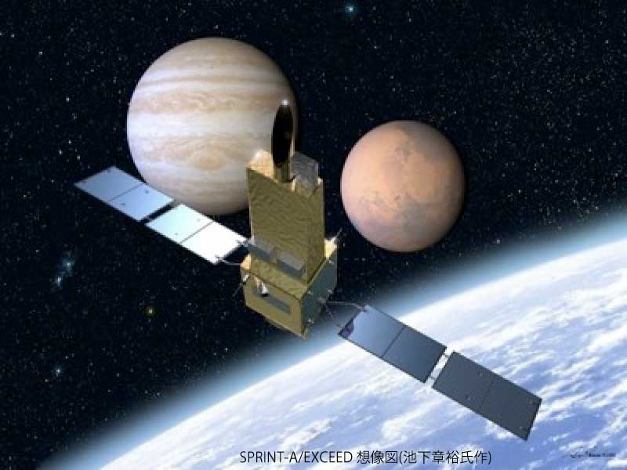

DPF mission status
DPF : One of the candidate of
JAXA’s small satellite series
At least 3 satellite in 5 years with
Standard Bus + M-V follow-on rocket
SPRINT-A /EXCEED
UV telescope mission
1st mission (2012): SPRINT-A/EXCEED
2nd mission (~2013/14) : ERG
3rd mission (~2015/16) : TBD
DPF survived until final two
DPF is one of the strong
candidates of the 3rd mission
Next-generation
Solid rocket booster (M-V FO)
Fig. by JAXA

Slide 48
    1. Introduction
    2. LCGT
    3. DECIGO
    Overview and design
    DECIGO Pathfinder
    Space demonstration by SWIM
    4. Summary

Slide 49
Roadmap
Figure: S.Kawamura
 | 2010 | 11 | 12 | 13 | 14 | 15 | 16 | 17 |  | 18 | 19 | 20 | 21 | 22 | 23 | 24 | 25 | 26 | 27 | 28 | 29
Mission
Objective | Space test of key tech. GW observation |  |  |  |  |  |  |  | Detect GW with min. spec FP between S/C |  |  |  |  |  |  | GW astronomy
Design | Single small satellite Short FP interferometer |  |  |  |  |  |  |  | 3 S/C 1 interferometer unit |  |  |  |  |  |  | 3 S/C x 3-4 units
R&D
Fabrication
R&D
Fabrication
R&D
Fabrication
DECIGO
Pathfinder
(DPF)
Pre-DECIGO
DECIGO
SDS-1/SWIM

Slide 50




SWIM launch and operation
Tiny GW detector module
Launched in Jan. 23, 2009
Photo：
JAXA
In-orbit operation
TAM: Torsion Antenna Module with free-falling test mass
(Size : 80mm cube, Weight : ~500g)
Test mass
~47g Aluminum, Surface polished
Small magnets for position control
Coil
Photo sensor
Reflective-type optical
displacement sensor
Separation to mass ~1mm
Sensitivity ~ 10⁻⁹ m/Hz^{1/2}
6 PSs to monitor mass motion

Slide 51
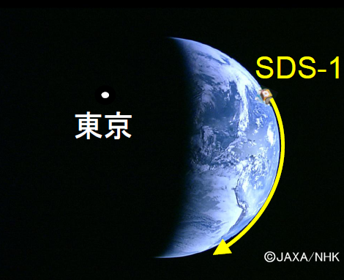
SWIM observation
Observation by SWIM
Jun 17, 2010 ~120 min. operation
July 15, 2010 ~240 min. operation
Tokyo
Kyoto
Ground-based detectors were
operated at the same period.
Data analysis
Orbital period
~100min.
Orbital Period
10mHz LPF

Slide 52
    1. Introduction
    2. LCGT
    3. DECIGO
    4. Summary

Slide 53
Summary (1)
LCGT : Project started
Costs have been partially funded
Form global network
with Ad. LIGO and Ad. VIRGO
R&D and detailed design
CLIO: Improved sensitivity
at cryogenic temperature
Designs and developments underway

Slide 54
Summary (2)
DECIGO : Fruitful Sciences
Very beginning of the Universe
Dark energy
Galaxy formation
DECIGO Pathfinder
Important milestone for DECIGO
Strong candidate of JAXA’s satellite series
SWIM – under operation in orbit
first precursor to space!

Slide 55


    End
Original
Picture : Sora

