Slide 1
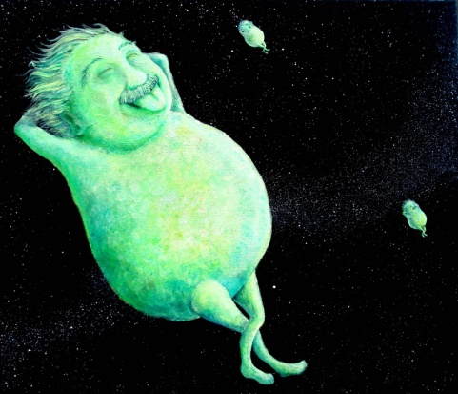
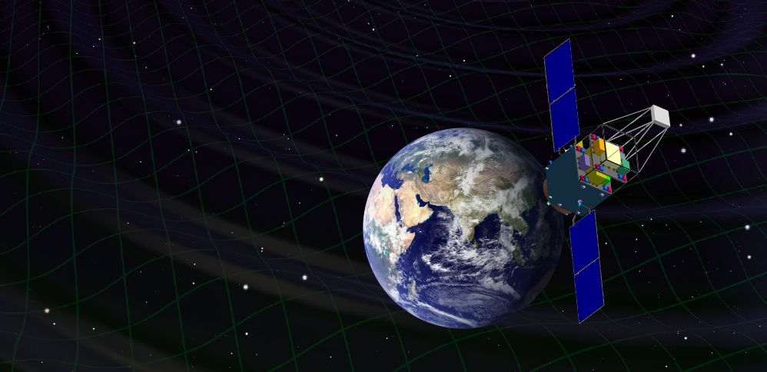
DECIGO and Pathfinder Missions
Masaki Ando
(Department of Physics, Kyoto University)
Original
Picture : Sora
Seiji Kawamura, Takashi Nakamura, Kimio Tsubono, Takahiro Tanaka, Ikkoh Funaki, Naoki Seto, Kenji Numata, Shuichi Sato, Nobuyuki Kanda, Takeshi Takashima, Kunihito Ioka, Kazuhiro Agatsuma, Tomotada Akutsu, Tomomi Akutsu, Koh-suke Aoyanagi, Koji Arai, Yuta Arase, Akito Araya, Hideki Asada, Yoichi Aso, Takeshi Chiba, Toshikazu Ebisuzaki, Motohiro Enoki, Yoshiharu Eriguchi, Masa-Katsu Fujimoto, Ryuichi Fujita, Mitsuhiro Fukushima, Toshifumi Futamase, Katsuhiko Ganzu, Tomohiro Harada, Tatsuaki Hashimoto, Kazuhiro Hayama, Wataru Hikida, Yoshiaki Himemoto, Hisashi Hirabayashi, Takashi Hiramatsu, Feng-Lei Hong, Hideyuki Horisawa, Mizuhiko Hosokawa, Kiyotomo Ichiki, Takeshi Ikegami, Kaiki T. Inoue, Koji Ishidoshiro, Hideki Ishihara, Takehiko Ishikawa, Hideharu Ishizaki, Hiroyuki Ito, Yousuke Itoh, Shogo Kamagasako, Nobuki Kawashima, Fumiko Kawazoe, Hiroyuki Kirihara, Naoko Kishimoto, Kenta Kiuchi, Shiho Kobayashi, Kazunori Kohri, Hiroyuki Koizumi, Yasufumi Kojima, Keiko Kokeyama, Wataru Kokuyama, Kei Kotake, Yoshihide Kozai, Hideaki Kudoh, Hiroo Kunimori, Hitoshi Kuninaka, Kazuaki Kuroda, Kei-ichi Maeda, Hideo Matsuhara, Yasushi Mino, Osamu Miyakawa, Shinji Miyoki, Mutsuko Y. Morimoto, Tomoko Morioka , Toshiyuki Morisawa, Shigenori Moriwaki, Shinji Mukohyama, Mitsuru Musha, Shigeo Nagano, Isao Naito, Noriyasu Nakagawa, Kouji Nakamura, Hiroyuki Nakano, Kenichi Nakao, Shinichi Nakasuka, Yoshinori Nakayama, Erina Nishida, Kazutaka Nishiyama, Atsushi Nishizawa, Yoshito Niwa, Masatake Ohashi, Naoko Ohishi, Masashi Ohkawa, Akira Okutomi, Kouji Onozato, Kenichi Oohara, Norichika Sago, Motoyuki Saijo, Masaaki Sakagami, Shin-ichiro Sakai, Shihori Sakata, Misao Sasaki, Takashi Sato, Masaru Shibata, Hisaaki Shinkai, Kentaro Somiya, Hajime Sotani, Naoshi Sugiyama, Yudai Suwa, Hideyuki Tagoshi, Kakeru Takahashi, Keitaro Takahashi, Tadayuki Takahashi, Hirotaka Takahashi, Ryuichi Takahashi, Ryutaro Takahashi, Takamori Akiteru, Tadashi Takano, Keisuke Taniguchi, Atsushi Taruya, Hiroyuki Tashiro, Mitsuru Tokuda, Masao Tokunari, Morio Toyoshima, Shinji Tsujikawa, Yoshiki Tsunesada, Ken-ichi Ueda, Masayoshi Utashima, Hiroshi Yamakawa, Kazuhiro Yamamoto, Toshitaka Yamazaki, Jun'ichi Yokoyama, Chul-Moon Yoo, Shijun Yoshida, Taizoh Yoshino

Slide 2
DECIGO
DECIGO
(Deci-hertz interferometer
Gravitational wave Observatory)
Space GW antenna (~2024)
Obs. band around 0.1 Hz
Arm cavity
Baseline length: 1000 km
3 S/C formation flight
3 FP interferometers
Drag-free control
1000km
Arm cavity
Laser
Mirror
Photo-
detector
Drag-free S/C

Slide 3

    1. DECIGO
    Overview and Science
    Pre-conceptual Design
    2. DECIGO Pathfinder
    Overview and Science
    Design and Status
    3. Summary

Slide 4
    1. DECIGO
    Overview and Science
    Pre-conceptual Design
    2. DECIGO Pathfinder
    Overview and Science
    Design and Status
    3. Summary

Slide 5
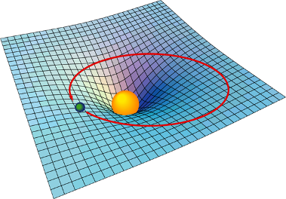

Gravitational Waves
General Relativity
Interpret gravity as
nature of space-time
Einstein equation
From presentation
by Laura Cadonati
"Mass tells space-time how to curve,
and space-time tells mass how to move.“
John Archibald Wheeler
Curvature of
Space-time
Mass
(Energy-Momentum)
Motion of Mass
→ Ripples in gravitational field
→ Propagate as waves
Gravitational Waves

Slide 6
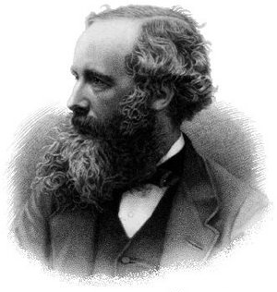
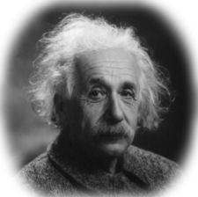
EM and GW waves
Electromagnetic wave
Gravitational wave
J.C. Maxwell
A. Einstein
Waves in electromagnetic field
Waves in space-time (gravitational field)
Solution of the Maxwell equations
Solution of the Einstein equation
1864 : Predicted by Maxwell
1888 : Confirmed by
the Hertz’s experiment
1918: Predicted by Einstein
1989: Confirmed by
a Binary pulsar observation
Radiated by acceleration
of charged particles
Utilized in telecommunications
and observations
Radiated by acceleration
of masses
High transmittance through matter
(Small interactions with matter)
‘Gravitational-wave astronomy’
Independent Information
Direct probe of dynamic motion of matters
Early universe before recombination

Slide 7
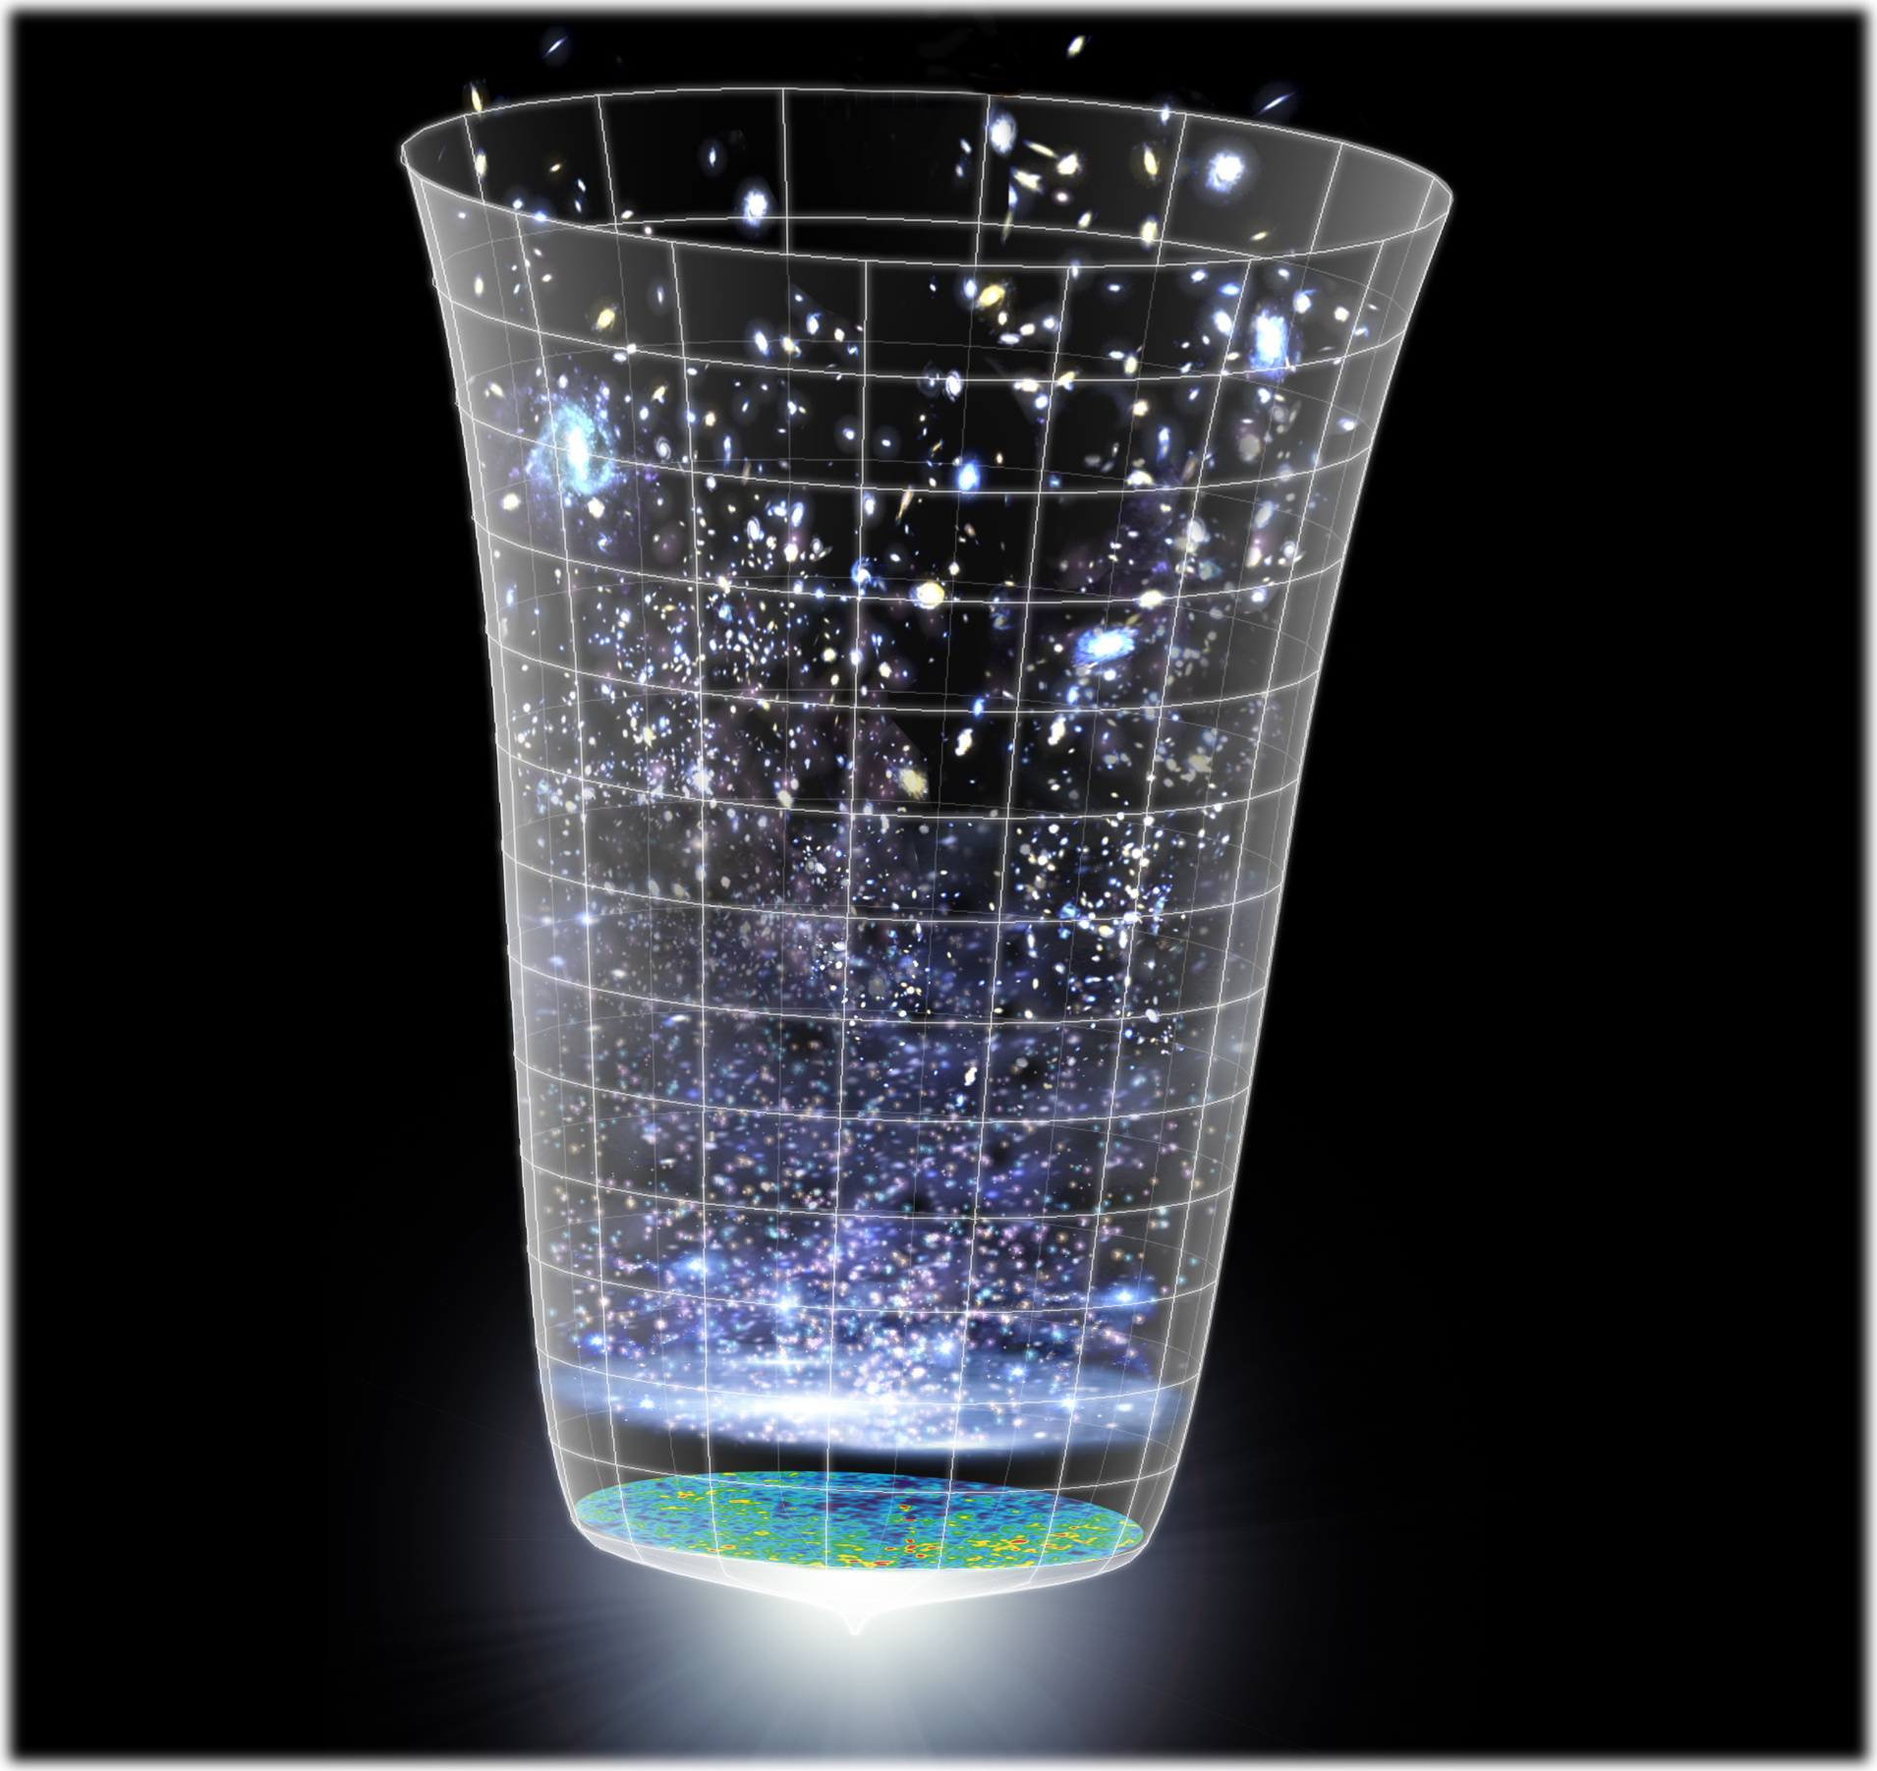
Astronomical Probes
重力波による天文学
General Relativity
Cosmic-Ray
observation
Relativity in Strong
Gravitational-Field
Nuclear Physics
High-Density Matter
Neutrino
High-energy CR
GW
observation
Astronomy
Stars
Galaxies
Gamma-ray burst
Supernovae
High-freq.
GWs
EM wave
observation
Black Holes
Massive BHs
Compact Inspiral
Planets
Supernovae
Low-freq. GWs
Astronomical
Phenomena
Pulsar
Gamma
X-ray
Visible ray
Infrared
Microwave
Cosmic
Background
Cosmology
Background
GWs
Inflation
Dark matter
Dark energy
Background:
NASA/WMAP Science Team

Slide 8

LCGT and DECIGO
LCGT (~2014)
Terrestrial Detector
→ High frequency events
DECIGO (~2024)
Space observatory
→ Low frequency sources
Target: GW detection
Target: GW astronomy

Slide 9
DECIGO
DECIGO
(Deci-hertz interferometer Gravitational wave Observatory)
Space GW antenna (~2024)
Obs. band around 0.1 Hz
‘Bridge’ the obs.gap between
LISA and Terrestrial detectors
Terrestrial Detectors
(Ad. LIGO, LCGT, etc)
LISA
DECIGO

Slide 10

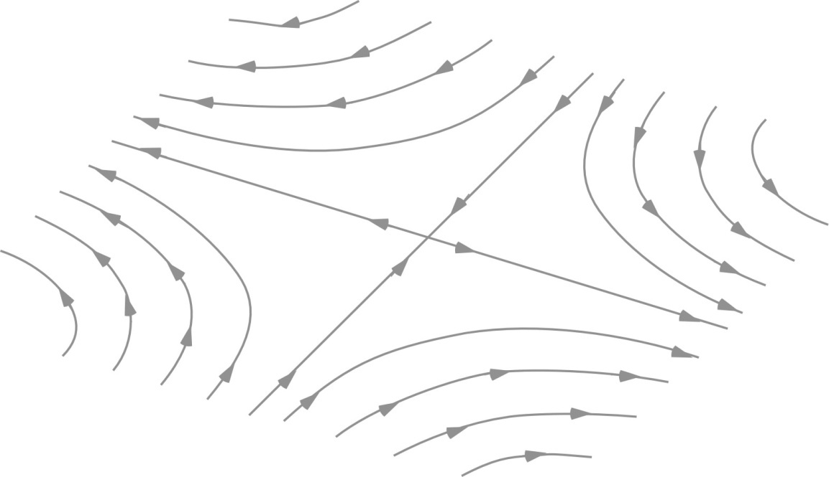
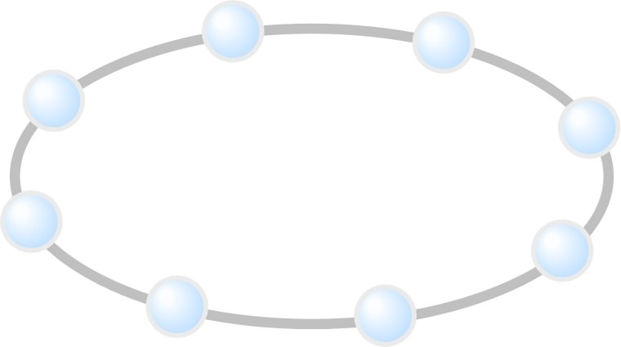

Effect of Gravitational waves
Gravitational Waves
  Change in proper distance
  Tidal force for finite-sized matter
GW
z
GW amplitude h :
Strain (dimensionless)
y
Typical amp. h =10⁻²¹
→ distance change by 10⁻²¹m
for 1-m separation
x
Precise length measurement
with long baseline

Slide 11
DECIGO Interferometer
Interferometer Unit:
Differential FP interferometer
Baseline length: 1000 km
3 S/C formation flight
3 FP interferometers
Drag-free control
Arm cavity
1000km
Arm cavity
Laser
Mirror
Photo-
detector
Drag-free S/C

Slide 12
Targets and Science
IMBH binary inspiral
NS binary inspiral
Stochastic background
Galaxy formation (Massive BH)
Cosmology
(Inflation, Dark energy)
10⁻¹⁶
10⁻¹⁸
IMBH inspiral (z~1)
10⁻²⁰
GW amplitude [Hz^{-1/2}]
Background GW
(Ωgw ~ 2 x 10⁻¹⁶)
Merger
DECIGO
(1 unit)
10⁻²²
3month
10⁻²⁴
Merger
DECIGO
(Correlation)
10⁻²⁶
NS inspiral (z~1)
10⁻⁴
10⁻²
10⁰
10²
10⁴
Frequency [Hz]

Slide 13
Constraint on dark energy
DECIGO will observe
10⁴⁻⁵ NS binaries at z~1
Precise ‘clock’ at cosmological distance
‘Standard Siren’
Expansion ＋Acceleration?
DECIGO
Relationship between
distance and redshift
GW
NS-NS (z～1)
Output
Template
(No Acceleration)
Distance:
chirp waveform
Redshift:
host galaxy
Strain
→ Information on acceleration
of expansion of the universe
Real Signal ?
Phase Delay
～1sec (10 years)
Time
Seto, Kawamura, Nakamura,
PRL 87, 221103 (2001)
Determine cosmological parameters
Angular resolution
～10arcmin （1 detector）
～10arcsec （3 detectors）
Absolute and independent measurement
at z=1

Slide 14
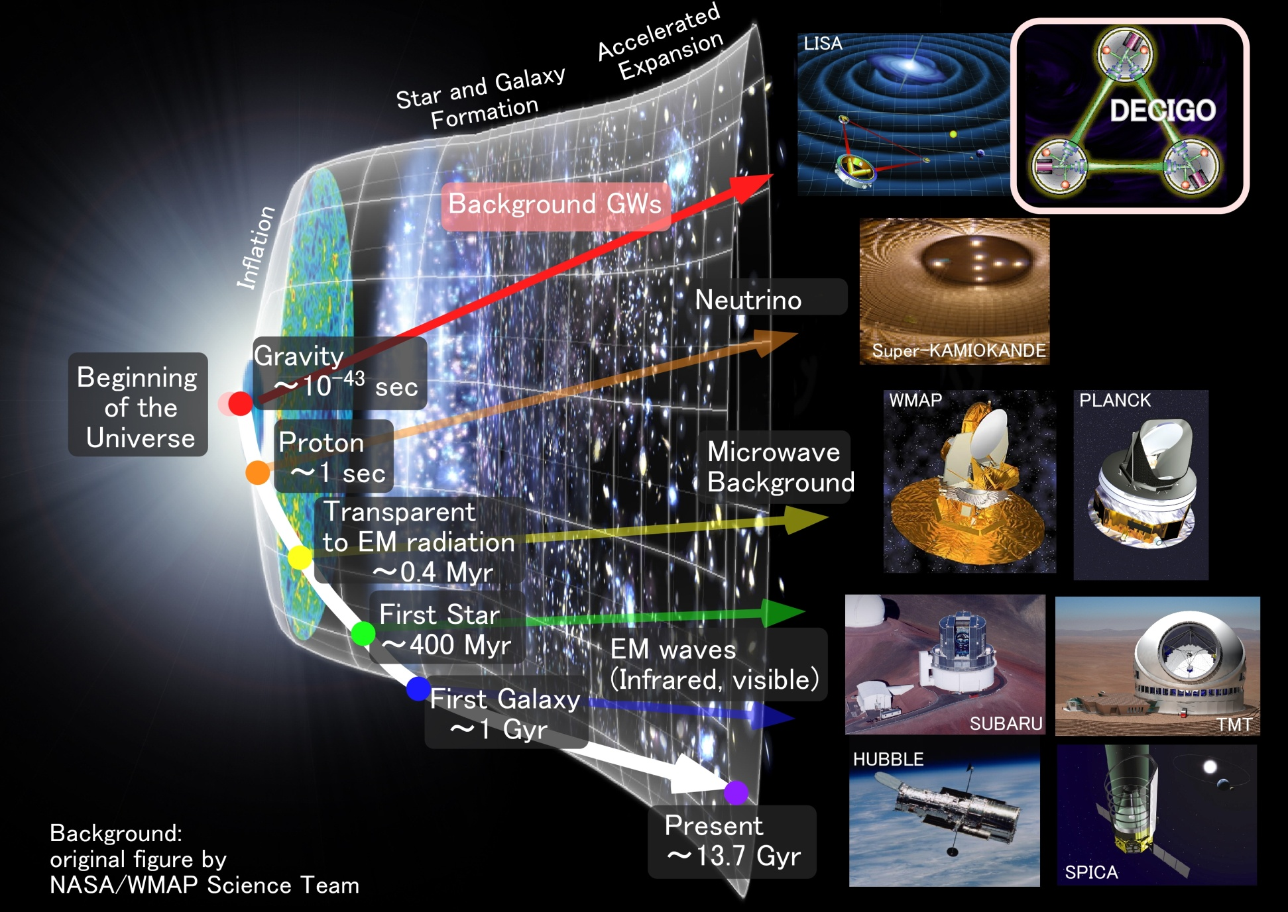
Stochastic Background GWs
Stochastic
Background GWs

Slide 15
    1. DECIGO
    Overview and Science
    Pre-conceptual Design
    2. DECIGO Pathfinder
    Overview and Science
    Design and Status
    3. Summary

Slide 16
Pre-Conceptual Design
Interferometer Unit:
Differential FP interferometer
Arm length: 1000 km
Finesse: 10
Mirror diameter: 1 m
Mirror mass: 100 kg
Laser power: 10 W
Laser wavelength：532 nm
Arm cavity
Arm cavity
S/C: drag free
3 interferometers
Laser
Mirror
Photo-
detector
Drag-free S/C

Slide 17
Interferometer Design
Transponder type vs Direct-reflection type
Compare : Sensitivity curves and Expected Sciences
Decisive factor: Binary confusion noise
WD-WD
confusion noise

Slide 18
Cavity and S/C control
Cavity length change
PDH error signal → Mirror position (and Laser frequency)
Relative motion between mirror and S/C
Local sensor → S/C thruster
Displacement Signal between S/C and Mirror
Local Sensor
S/C 1
S/C 2
Mirror
Thruster
Thruster
Actuator
Fig: S. Kawamura
Displacement signal between the two Mirrors

Slide 19
Requirements
Disp. meas. Noise
Shot noise 3 x 10⁻¹⁸ m/Hz^{1/2} (0.1 Hz)
x 10 of LCGT in phase noise
Other noises should be well below the shot noise
Laser freq. noise: 1 Hz/Hz^{1/2} (1Hz)
Stab. Gain 10⁵, CMRR 10⁵
Acceleration Noise
Force noise 4x10⁻¹⁷ N/Hz^{1/2} (0.1 Hz)
x 1/50 of LISA
External force sources
Fluctuation of magnetic field, electric field, gravitational field, temperature, pressure, etc.

Slide 20
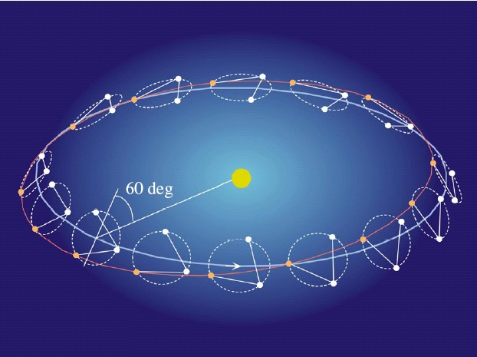
Orbit and Constellation
Candidate of orbit:
Record-disk orbit around the Sun
Relative acc. 4x10⁻¹² m/s²
Separated
unit
(Mirror force ~10⁻⁹ N )
Halo orbit around L2 (or L1)
Relative acc. 4x10⁻⁷ m/s²
(Mirror force ~10⁻⁴ N )
Constellation
Separated
unit
overlapped
units
4 interferometer units
2 overlapped units → Cross correlation
2 separated units → Angular resolution

Slide 21
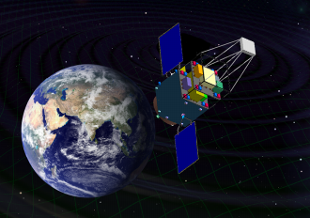
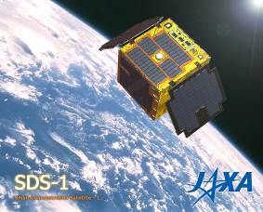
Roadmap
+2
Figure: S.Kawamura
 | 2007 | 08 | 09 | 10 | 11 | 12 | 13 | 14 |  | 15 | 16 | 17 | 18 | 19 | 20 | 21 | 22 | 23 | 24 | 25 | 26
Mission
Objective | Space test of key tech. GW observation |  |  |  |  |  |  |  | Detect GW with min. spec FP between S/C |  |  |  |  |  |  | GW astronomy
Design | Single small satellite Short FP interferometer |  |  |  |  |  |  |  | 3 S/C 1 interferometer unit |  |  |  |  |  |  | 3 S/C x 3-4 units
R&D
Fabrication
R&D
Fabrication
R&D
Fabrication
DECIGO
Pathfinder
(DPF)
Pre-DECIGO
DECIGO
SDS-1/SWIM

Slide 22
Organization
PI: Kawamura (NAOJ)
Deputy: Ando (Kyoto)
Executive Committee
Kawamura (NAOJ), Ando (Kyoto), Seto (Kyoto), Nakamura (Kyoto), Tsubono (Tokyo), Tanaka (Kyoto), Funaki (ISAS), Numata (Maryland), Sato (Hosei), Kanda (Osaka city), Takashima (ISAS), Ioka (KEK)
Pre-DECIGO
Sato (Hosei)
Detector
Numata (Maryland)
Ando (Kyoto)
Science, Data
Tanaka (Kyoto)
Seto (Kyoto)
Kanda (Osaka city)
Satellite
Funaki (ISAS)
DECIGO pathfinder
Leader: Ando (Kyoto)
Deputy: Takashima (ISAS)
Design phase
Mission phase
Detector
Ando (Kyoto)
Laser
Ueda (ILS)
Musya (ILS)
Housing
Sato (Hosei)
Drag free
Moriwaki (Tokyo)
Sakai (ISAS)
Thruster
Funaki (ISAS)
Bus
Takashima (ISAS)
Data
Kanda (Osaka city)

Slide 23
Collaboration and support
・Supports from LISA
Technical advises from LISA/LPF experiences
Support Letter for DECIGO/DPF
LISA-DECIGO workshop (2008.11)
・Collab. with Stanford univ. group
Drag-free control of DECIGO/DPF
UV LED Charge Management System for DPF
・Collab. with JAXA navigation-control section
→ formation flight of DECIGO, DPF drag-free control
・Research Center for the Early Universe (RESCEU), Univ. of Tokyo
Support DECIGO as one of main projects (2009.4-)

Slide 24
    1. DECIGO
    Overview and Science
    Pre-conceptual Design
    2. DECIGO Pathfinder
    Overview and Science
    Design and Status
    3. Summary

Slide 25
Roadmap
Figure: S.Kawamura
 | 2007 | 08 | 09 | 10 | 11 | 12 | 13 | 14 |  | 15 | 16 | 17 | 18 | 19 | 20 | 21 | 22 | 23 | 24 | 25 | 26
Mission
Objective | Space test of key tech. GW observation |  |  |  |  |  |  |  | Detect GW with min. spec FP between S/C |  |  |  |  |  |  | GW astronomy
Design | Single small satellite Short FP interferometer |  |  |  |  |  |  |  | 3 S/C 1 interferometer unit |  |  |  |  |  |  | 3 S/C x 3-4 units
R&D
Fabrication
R&D
Fabrication
R&D
Fabrication
DECIGO
Pathfinder
(DPF)
Pre-DECIGO
DECIGO
SDS-1/SWIM

Slide 26
DECIGO-PF
DECIGO Pathfinder (DPF)
First milestone mission for DECIGO
Shrink arm cavity
DECIGO 1000km → DPF 30cm
Single satellite
(Payload ~1m³ , 350kg)
Low-earth orbit
(Altitude 500km, sun synchronous)
30cm FP cavity with 2 test masses
Stabilized laser source
Drag-free control
Local Sensor
Actuator
Thruster

Slide 27
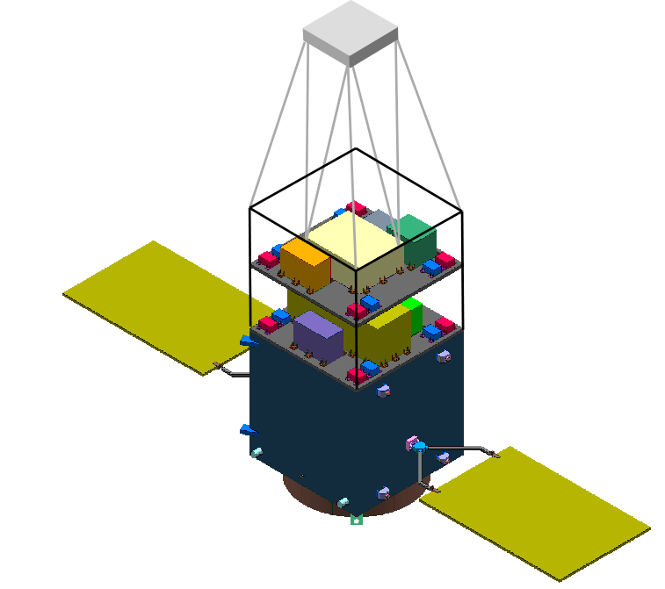
DPF satellite
Mast
structure
DPF Payload
Size : 950mm cube
Weight : 150kg
Power : 130W
Data Rate: 800kbps
Mission thruster x12
Mission
Thruster head
Stabilized.
Laser source
On-board
Computer
Power Supply
SpW Comm.
Satellite Bus
(‘Standard bus’ system)
Size :
950x950x1100mm
Weight : 200kg
SAP : 960W
Battery: 50AH
Downlink : 2Mpbs
DR: 1GByte
3N Thrusters x 4
Interferometer
module
Satellite
Bus system
Bus thruster
Solar Paddle

Slide 28

DPF mission payload
Mission weight : ~150kg
Mission space : ~90 x 90 x 90 cm
Drag-free control
Local sensor signal
→ Feedback to thrusters
Fabry-Perot interferometer
Finesse : 100
Length : 30cm
Test mass : 1kg
Signal extraction by PDH
Laser source
Yb:YAG laser (1030nm)
Power : 25mW
Freq. stab. by Iodine abs. line

Slide 29
DPF Sensitivity
Laser source : 1030nm, 25mW
IFO length : 30cm
Finesse : 100, Mirror mass : 1kg
Q-factor : 10⁵, Substrate: TBD
Temperature : 293K
Satellite mass : 350kg, Area: 2m²
Altitude: 500km
Thruster noise: 0.1μN/Hz^{1/2}
(Preliminary parameters)

Slide 30
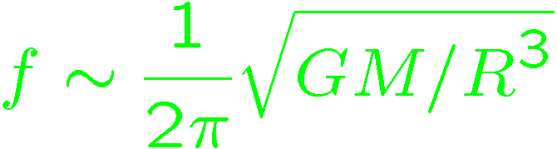
DPF sensitivity
DPF sensitivity h ~ 2x10⁻¹⁵ Hz^{1/2}
(x10 of quantum noises)
Massive BH
inspirals
DPF limit
LISA
Galaxy
binaries
NS binary
inspiral
Core-collapse
Supernovae
Foreground GWs
Pulsar
(1yr)
ScoX-1
(1yr)
DECIGO
Background GWs
from early universe
(Ω_{gw}=10⁻¹⁴)
LCGT
Gravity-gradient noise
(Terrestrial detectors)

Slide 31

GW target of DPF
Blackholes events
in our galaxy
IMBH inspiral and merger
h ~ 10⁻¹⁵ , f ~ 4 Hz
Distance 10kpc, m = 10³ M_{sun}
Obs. Duration (~1000sec)
KAGAYA
BH QNM
h ~ 10⁻¹⁵ , f ~ 0.3 Hz
Distance 1Mpc, m = 10⁵ M_{sun}
Observable range reaches
the Galactic center (SNR~5 )
Hard to access by others
→ Original observation
(By N.Kanda)

Slide 32
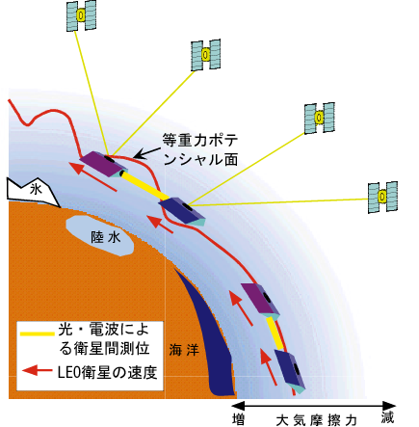
Gravity of the Earth
Measure gravity field of the Earth for Satellite Orbits
GPS satellite
Determine global gravity field
→ Density distribution
Monitor of change in time
Ground water motion
Strains in crusts by
earthquakes and volcanoes
Observation Gap
between GRACE and GRACE-FO
(2012-16)
→ DPF contribution
in international network
東京大字地震研・新谷氏、
京都大学・福田氏の資料/情報提供

Slide 33
    1. DECIGO
    Overview and Science
    Pre-conceptual Design
    2. DECIGO Pathfinder
    Overview and Science
    Design and Status
    3. Summary

Slide 34
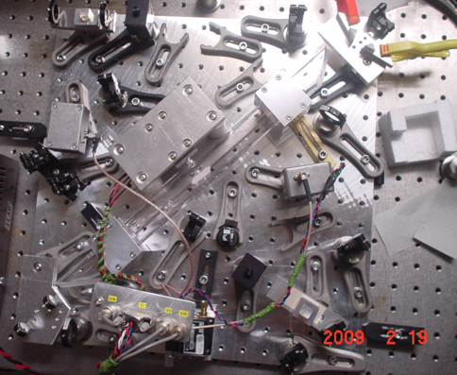
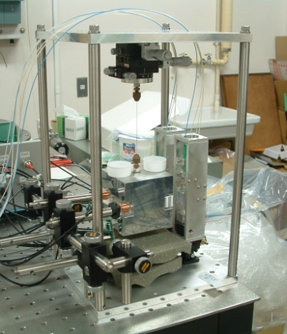

R&D for DPF (1)
By M.Musha
Stabilized Laser
BBM development
Yb:YAG (NPRO) source
Saturated absorption by I₂
→ Stability test, Packaging
IFO and housing
BBM-EM development
→ Test of concepts
+ Earth gravity sensors
By S.Sato
By A.Araya

Slide 35
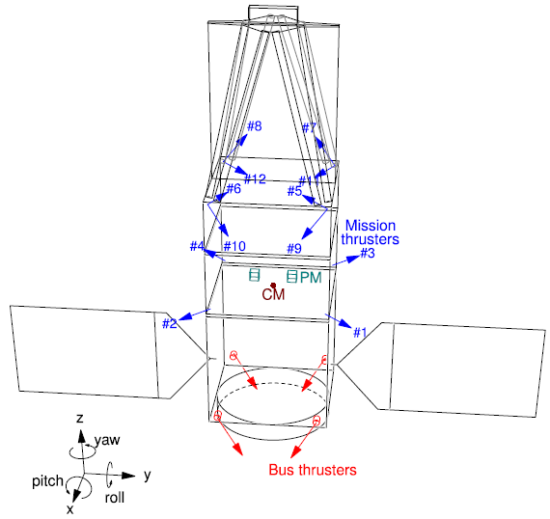
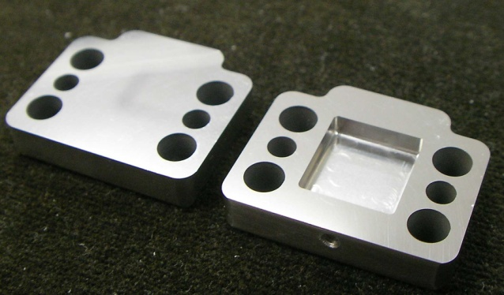
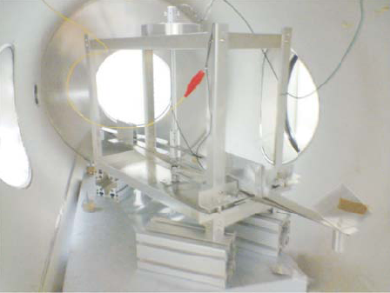
R&D for DPF (2)
By
S.Moriwaki
Attitude control and Drag-free
Satellite structure (mass distribution)
Passive attitude stabilization
by gravity gradient
Mission thruster position
Control topology
Thruster
System design
with existing tech.
Noise meas. system
(thruster stand)
Development of Slit FEEP
By I.Funaki

Slide 36





SWIM launch and operation
Tiny GW detector module
Launched in Jan. 23, 2009
Photo：
JAXA
In-orbit operation
TAM: Torsion Antenna Module with free-falling test mass
(Size : 80mm cube, Weight : ~500g)
Test mass
~47g Aluminum, Surface polished
Small magnets for position control
Coil
Photo sensor
Reflective-type optical
displacement sensor
Separation to mass ~1mm
Sensitivity ~ 10⁻⁹ m/Hz^{1/2}
6 PSs to monitor mass motion

Slide 37

Successful control
SWIM
In-orbit operation
z control on
Test mass controlled
Error signal → zero
Damped oscillation
(in pitch DoF)
yaw control on
Free oscillation
in x and y DoF
Signal injection
→ OL trans. Fn.
Operation: May 12, 2009
Downlink: ~ a week
By
W.Kokuyama

Slide 38

DPF mission status
DPF : One of the candidate of
JAXA’s small satellite series
At least 3 satellite in 5 years with
Standard Bus + M-V follow-on rocket
SPRINT-A /EXCEED
1st mission (2012): SPRINT-A/EXCEED
2nd mission (~2013/14) : ERG
3rd mission (~2015/16) : TBD
DPF is one of the
candidates of 3rd mission
Next-generation
Solid rocket booster (M-V FO)
Fig. by JAXA

Slide 39
    1. DECIGO
    Overview and Science
    Pre-conceptual Design
    2. DECIGO Pathfinder
    Overview and Science
    Design and Status
    3. Summary

Slide 40
Summary
DECIGO : Fruitful Sciences
Very beginning of the Universe
Dark energy
Galaxy formation
DECIGO Pathfinder
Important milestone for DECIGO
Strong candidate of JAXA’s satellite series
SWIM – under operation in orbit
first precursor to space!

Slide 41
    End

