Slide 1
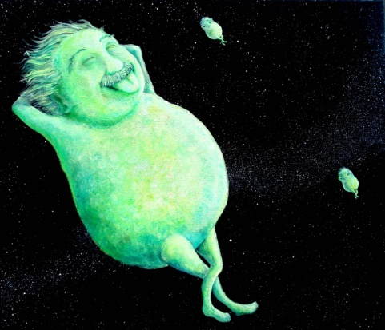
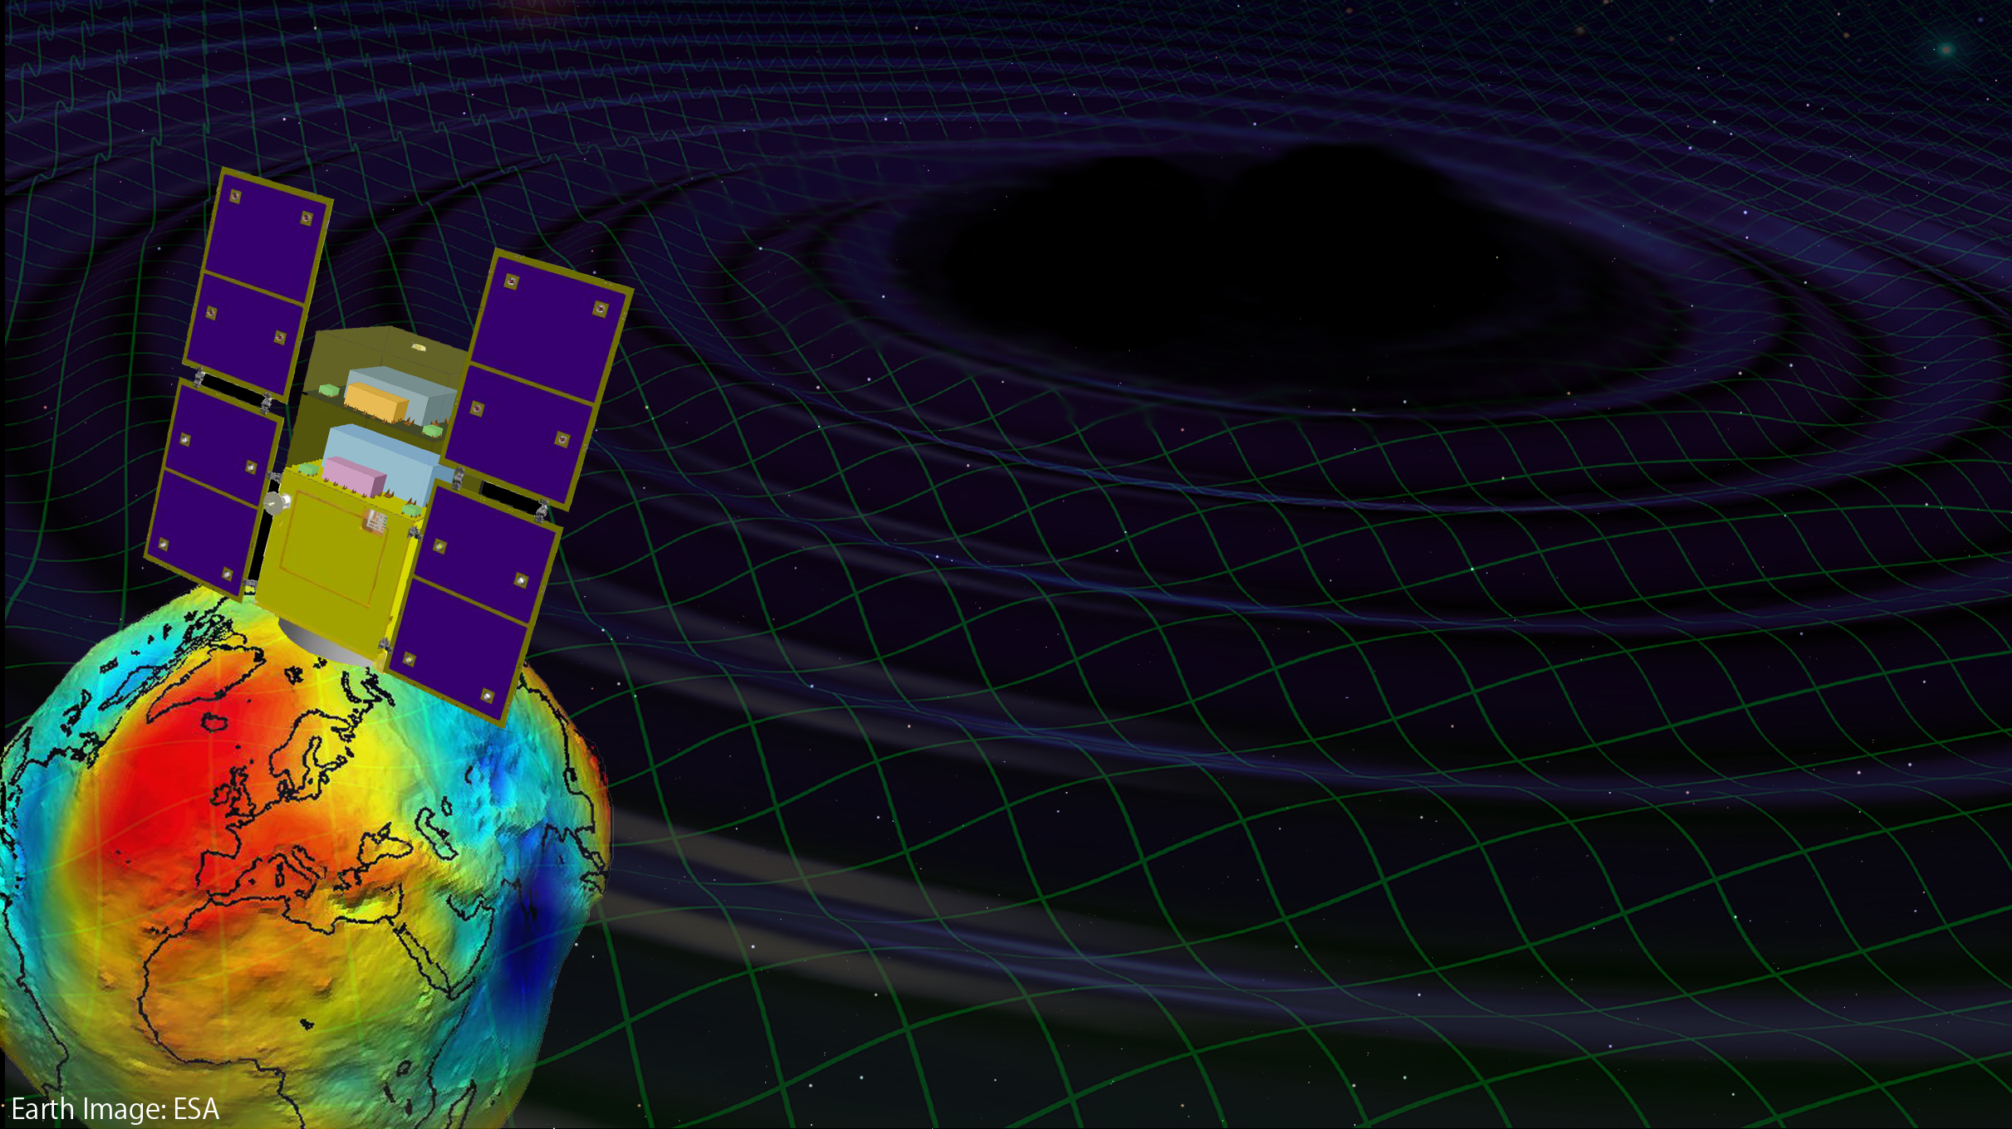
Space Gravitational-Wave Antenna DECIGO
Original
Picture : Sora
Masaki Ando
(Department of Physics, Kyoto University)
Wataru Kokuyama
(Department of Physics, University of Tokyo)
On behalf of
DECIGO working group

Slide 2

    1. DECIGO
    Overview and Science
    Pre-conceptual Design
    2. DECIGO Pathfinder
    Overview and Science
    Design and Status
    Space Demonstration
    3. Summary
← Wataru
Kokuyama

Slide 3
    1. DECIGO
    Overview and Science
    Pre-conceptual Design
    2. DECIGO Pathfinder
    Overview and Science
    Design and Status
    Space Demonstration
    3. Summary

Slide 4
DECIGO
DECIGO
(Deci-hertz interferometer Gravitational wave Observatory)
Space GW antenna (~2027)
Obs. band around 0.1 Hz
‘Bridge’ the obs.gap between
LISA and Terrestrial detectors
Terrestrial Detectors
(Ad. LIGO, LCGT, etc)
LISA
DECIGO

Slide 5
DECIGO Interferometer
Interferometer Unit:
Differential FP interferometer
Baseline length: 1000 km
3 S/C formation flight
3 FP interferometers
Drag-free control
Arm cavity
1000km
Arm cavity
Laser
Mirror
Photo-
detector
Drag-free S/C

Slide 6
Targets and Science
IMBH binary inspiral
NS binary inspiral
Stochastic background
Galaxy formation (Massive BH)
Cosmology
(Inflation, Dark energy)
10⁻¹⁶
10⁻¹⁸
IMBH inspiral (z~1)
10⁻²⁰
GW amplitude [Hz^{-1/2}]
Background GW
(Ωgw ~ 2 x 10⁻¹⁶)
Merger
DECIGO
(1 unit)
10⁻²²
3month
10⁻²⁴
Merger
DECIGO
(Correlation)
10⁻²⁶
NS inspiral (z~1)
10⁻⁴
10⁻²
10⁰
10²
10⁴
Frequency [Hz]

Slide 7
Constraint on dark energy
DECIGO will observe
10⁴⁻⁵ NS binaries at z~1
Precise ‘clock’ at cosmological distance
‘Standard Siren’
Expansion ＋Acceleration?
DECIGO
Relationship between
distance and redshift
GW
NS-NS (z～1)
Output
Template
(No Acceleration)
Distance:
chirp waveform
Redshift:
host galaxy
Strain
→ Information on acceleration
of expansion of the universe
Real Signal ?
Phase Delay
～1sec (10 years)
Time
Seto, Kawamura, Nakamura,
PRL 87, 221103 (2001)
Determine cosmological parameters
Angular resolution
～10arcmin （1 detector）
～10arcsec （3 detectors）
Absolute and independent measurement
at z=1

Slide 8
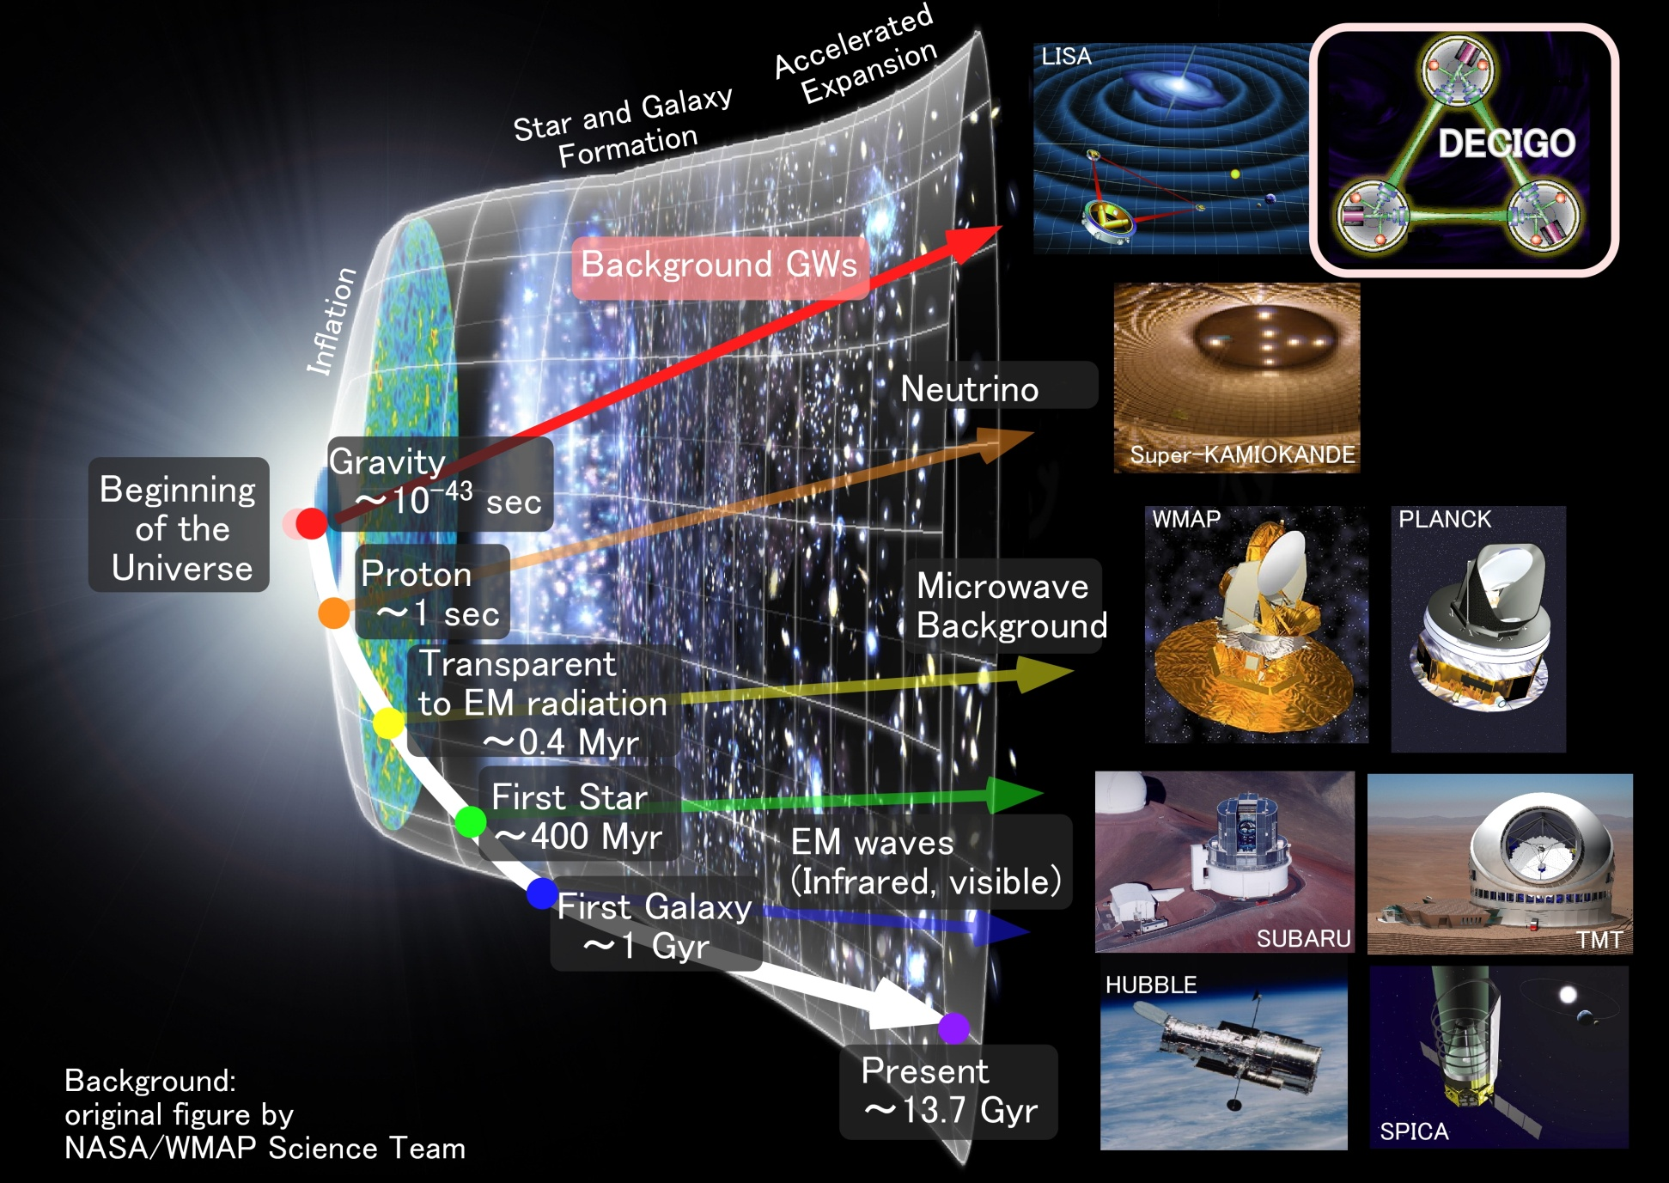
Stochastic Background GWs
Stochastic
Background GWs

Slide 9
    1. DECIGO
    Overview and Science
    Pre-conceptual Design
    2. DECIGO Pathfinder
    Overview and Science
    Design and Status
    Space Demonstration
    3. Summary

Slide 10
Pre-Conceptual Design
Interferometer Unit:
Differential FP interferometer
Arm length: 1000 km
Finesse: 10
Mirror diameter: 1 m
Mirror mass: 100 kg
Laser power: 10 W
Laser wavelength：532 nm
Arm cavity
Arm cavity
S/C: drag free
3 interferometers
Laser
Mirror
Photo-
detector
Drag-free S/C

Slide 11
Interferometer Design
Transponder type vs Direct-reflection type
Compare : Sensitivity curves and Expected Sciences
Decisive factor: Binary confusion noise
WD-WD
confusion noise

Slide 12
Cavity and S/C control
Cavity length change
PDH error signal → Mirror position (and Laser frequency)
Relative motion between mirror and S/C
Local sensor → S/C thruster
Displacement Signal between S/C and Mirror
Local Sensor
S/C 1
S/C 2
Mirror
Thruster
Thruster
Actuator
Fig: S. Kawamura
Displacement signal between the two Mirrors

Slide 13
Requirements
Sensor Noise
Shot noise 3 x 10⁻¹⁸ m/Hz^{1/2} (0.1 Hz)
x 10 of LCGT in phase noise
Other noises should be well below the shot noise
Laser freq. noise: 1 Hz/Hz^{1/2} (1Hz)
Stab. Gain 10⁵, CMRR 10⁵
Acceleration Noise
Force noise 4x10⁻¹⁷ N/Hz^{1/2} (0.1 Hz)
x 1/50 of LISA
External force sources
Fluctuation of magnetic field, electric field, gravitational field, temperature, pressure, etc.

Slide 14
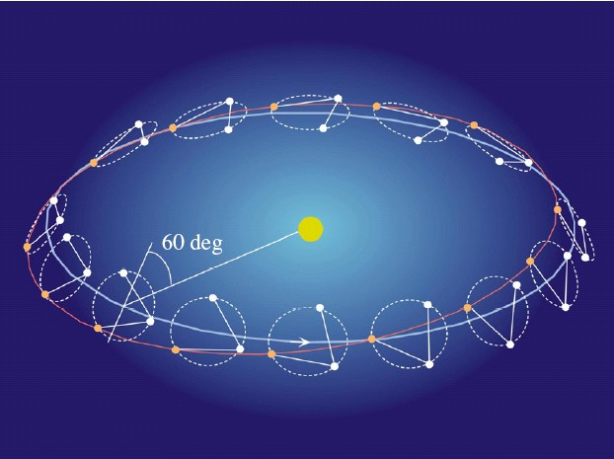
Orbit and Constellation
Candidate of orbit:
Record-disk orbit around the Sun
Relative acc. 4x10⁻¹² m/s²
Separated
unit
(Mirror force ~10⁻⁹ N )
Halo orbit around L2 (or L1)
Relative acc. 4x10⁻⁷ m/s²
(Mirror force ~10⁻⁴ N )
Constellation
Separated
unit
overlapped
units
4 interferometer units
2 overlapped units → Cross correlation
2 separated units → Angular resolution

Slide 15
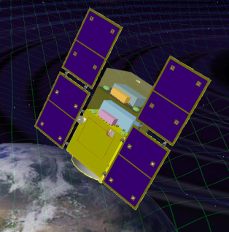
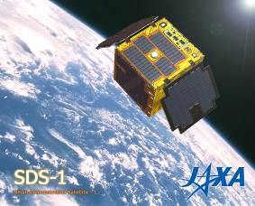
Roadmap
Figure: S.Kawamura
 | 2010 | 11 | 12 | 13 | 14 | 15 | 16 | 17 |  | 18 | 19 | 20 | 21 | 22 | 23 | 24 | 25 | 26 | 27 | 28 | 29
Mission
Objective | Space test of key tech. GW observation |  |  |  |  |  |  |  | Detect GW with min. spec FP between S/C |  |  |  |  |  |  | GW astronomy
Design | Single small satellite Short FP interferometer |  |  |  |  |  |  |  | 3 S/C 1 interferometer unit |  |  |  |  |  |  | 3 S/C x 3-4 units
R&D
Fabrication
R&D
Fabrication
R&D
Fabrication
DECIGO
Pathfinder
(DPF)
Pre-DECIGO
DECIGO
SDS-1/SWIM

Slide 16
Organization
PI: Kawamura (NAOJ)
Deputy: Ando (Kyoto)
Executive Committee
Kawamura (NAOJ), Ando (Kyoto), Seto (Kyoto), Nakamura (Kyoto), Tsubono (Tokyo), Tanaka (Kyoto), Funaki (ISAS), Numata (Maryland), Sato (Hosei), Kanda (Osaka city), Takashima (ISAS), Ioka (KEK), Yokoyama (Tokyo)
Pre-DECIGO
Sato (Hosei)
Detector
Akutsu (NAOJ)
Numata (Maryland)
Science, Data
Tanaka (Kyoto)
Seto (Kyoto)
Kanda (Osaka city)
Satellite
Funaki (ISAS)
DECIGO pathfinder
Leader: Ando (Kyoto)
Design phase
Mission phase
Detector
Sato (Hosei)
Ueda (NAOJ)
Aso (Tokyo)
Laser
Musha (ILS)
Ueda (ILS)
Drag free
Moriwaki (Tokyo)
Sakai (ISAS)
Thruster
Funaki (ISAS)
Bus
Takashima (ISAS)
Data
Kanda (Osaka city)

Slide 17
Collaboration and support
・Supports from LISA
Technical advices from LISA/LPF experiences
Support Letter for DECIGO/DPF, Joint workshop (2008.11)
・Collab. with Stanford univ. group
Drag-free control of DECIGO/DPF
UV LED Charge Management System for DPF
・Collab. with NASA/GSFC
Fiber Laser , started discussion
・Collab. with JAXA navigation-control section
→ formation flight of DECIGO, DPF drag-free control
・Research Center for the Early Universe (RESCEU), Univ. of Tokyo
Support DECIGO as ones of main projects (2009.4-)
・Advanced technology center ( ATC) of NAOJ
Will make it a main nucleus of DPF

Slide 18
    1. DECIGO
    Overview and Science
    Pre-conceptual Design
    2. DECIGO Pathfinder
    Overview and Science
    Design and Status
    Space Demonstration
    3. Summary

Slide 19

Roadmap
Figure: S.Kawamura
 | 2010 | 11 | 12 | 13 | 14 | 15 | 16 | 17 |  | 18 | 19 | 20 | 21 | 22 | 23 | 24 | 25 | 26 | 27 | 28 | 29
Mission
Objective | Space test of key tech. GW observation |  |  |  |  |  |  |  | Detect GW with min. spec FP between S/C |  |  |  |  |  |  | GW astronomy
Design | Single small satellite Short FP interferometer |  |  |  |  |  |  |  | 3 S/C 1 interferometer unit |  |  |  |  |  |  | 3 S/C x 3-4 units
R&D
Fabrication
R&D
Fabrication
R&D
Fabrication
DECIGO
Pathfinder
(DPF)
Pre-DECIGO
DECIGO
SDS-1/SWIM

Slide 20
DECIGO-PF
DECIGO Pathfinder (DPF)
DECIGO
First milestone mission for DECIGO
Shrink arm cavity
DECIGO 1000km → DPF 30cm
1000km
Single satellite
(Payload ~1m³ , 350kg)
Low-earth orbit
(Altitude 500km, sun synchronous)
30cm FP cavity with 2 test masses
Stabilized laser source
Drag-free control
Local Sensor
Laser
30cm
Actuator
DPF
Thruster

Slide 21
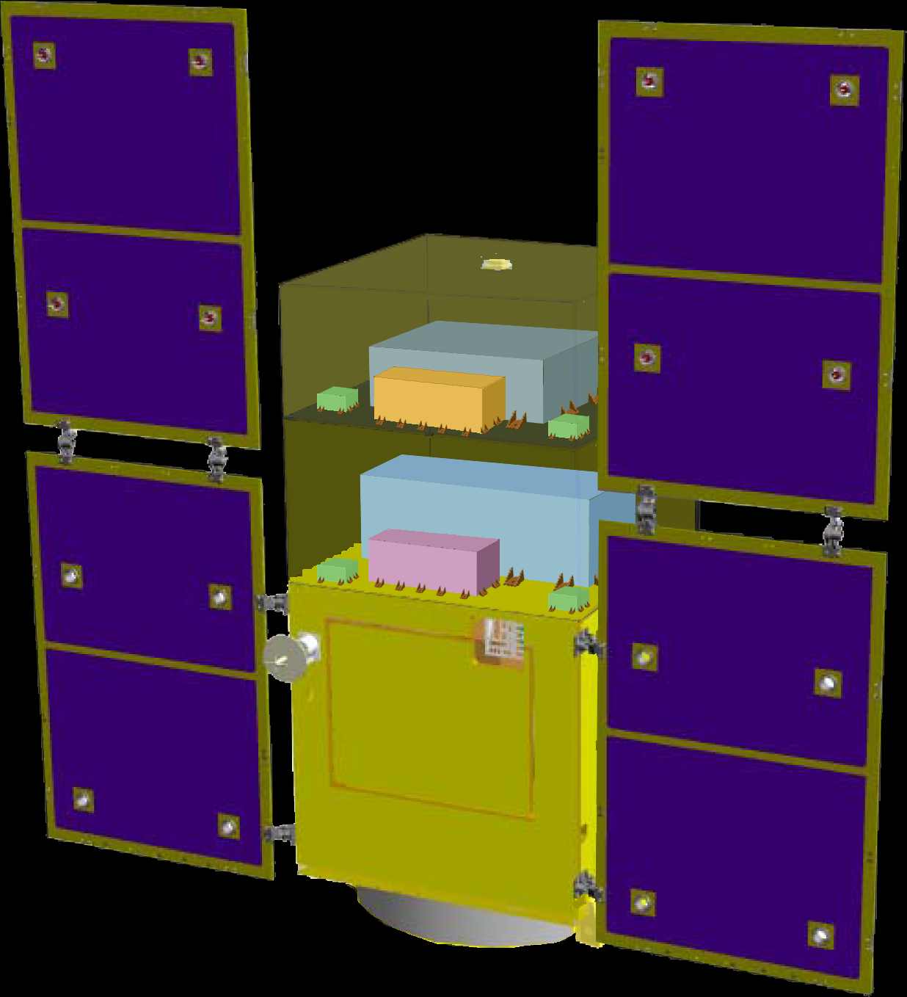
DPF satellite
DPF Payload
Size : 950mm cube
Weight : 150kg
Power : 130W
Data Rate: 800kbps
Mission thruster x12
Mission
Thruster head
Stabilized.
Laser source
On-board
Computer
Power Supply
SpW Comm.
Satellite Bus
(‘Standard bus’ system)
Size :
950x950x1100mm
Weight : 200kg
SAP : 960W
Battery: 50AH
Downlink : 2Mpbs
DR: 1GByte
3N Thrusters x 4
Interferometer
module
Satellite
Bus system
Bus thruster
Solar Paddle

Slide 22

DPF mission payload
Mission weight : ~150kg
Mission space : ~95 x 95 x 90 cm
Drag-free control
Local sensor signal
→ Feedback to thrusters
Thruster
Fabry-Perot interferometer
Finesse : 100
Length : 30cm
Test mass : ~1kg
Signal extraction by PDH
Laser source
Yb:YAG laser (1030nm)
Power : 25mW
Freq. stab. by Iodine abs. line

Slide 23
DPF Sensitivity
Laser source : 1030nm, 25mW
IFO length : 30cm
Finesse : 100, Mirror mass : 1kg
Q-factor : 10⁵, Substrate: TBD
Temperature : 293K
Satellite mass : 350kg, Area: 2m²
Altitude: 500km
Thruster noise: 0.1μN/Hz^{1/2}
(Preliminary parameters)

Slide 24
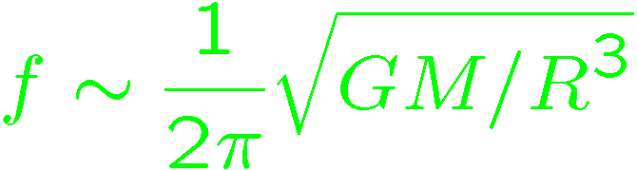
DPF sensitivity
DPF sensitivity h ~ 2x10⁻¹⁵ Hz^{1/2}
(x10 of quantum noises)
Massive BH
inspirals
DPF limit
LISA
Galaxy
binaries
NS binary
inspiral
Core-collapse
Supernovae
Foreground GWs
Pulsar
(1yr)
ScoX-1
(1yr)
DECIGO
Background GWs
from early universe
(Ω_{gw}=10⁻¹⁴)
LCGT
Gravity-gradient noise
(Terrestrial detectors)

Slide 25
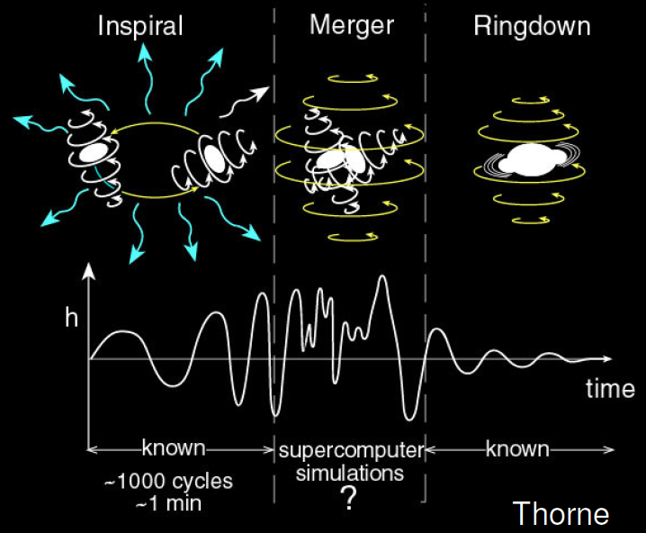

GW target of DPF
Blackholes events
in our galaxy
IMBH inspiral and merger
h ~ 10⁻¹⁵ , f ~ 4 Hz
Distance 10kpc, m = 10³ M_{sun}
Obs. Duration (~1000sec)
BH QNM
h ~ 10⁻¹⁵ , f ~ 0.3 Hz
Distance 1Mpc, m = 10⁵ M_{sun}
Observable range covers
our Galaxy (SNR~5 )
Hard to access by others
→ Original observation
KAGAYA
(By K.Yagi)

Slide 26
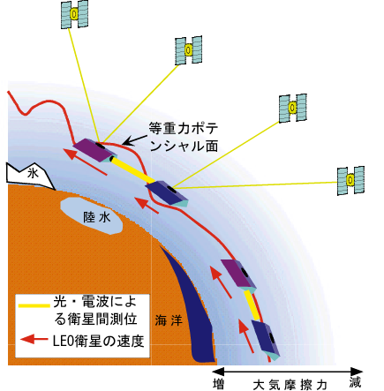
Gravity of the Earth
Measure gravity field of the Earth
from Satellite Orbits, and gravity-gradiometer
GPS satellite
Determine global gravity field
→ Density distribution
Monitor of change in time
Ground water motion
Strains in crusts by
earthquakes and volcanoes
Observation Gap
between GRACE and GRACE-FO
(2012-16)
→ DPF contribution
in international network
By Araya and Fukuda

Slide 27
    1. DECIGO
    Overview and Science
    Pre-conceptual Design
    2. DECIGO Pathfinder
    Overview and Science
    Design and Status
    Space Demonstration
    3. Summary

Slide 28

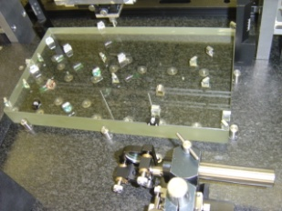
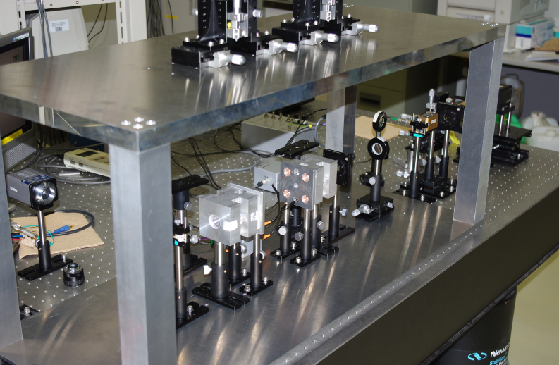
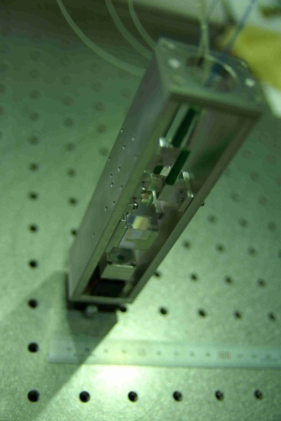
Interferometer Module
Interferometer Module : Test mass + IFO
Interferometer
Module
Test-mass module
→ Gravity reference
・BBM of Module,
Sensor, Actuator,
Clump/Release
・μ-Grav. Exp.
Hosei, NAOJ,
Ochanomizu, Stanford
Interferometer
→ GW, Gravity observation
・30cm IFO BBM ・Packaging
Digital control ・Monolithic Opt.
Laser sensor
→ Small MI
・BBM test
・Sensitivity meas.
NAOJ, U-Tokyo
ERI, U-Tokyo

Slide 29
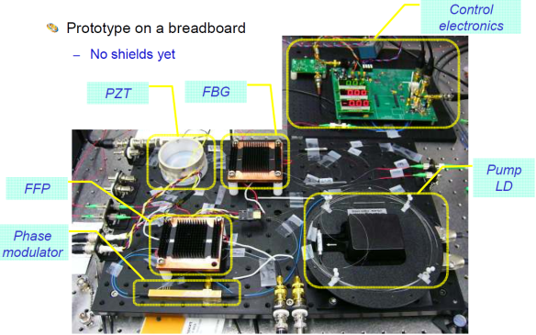
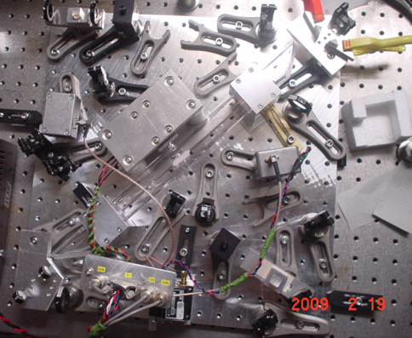
Stabilized Laser Module
Stabilized Laser : Laser source + Stabilization system
Yb:YAG (NPRO or Fiber laser)
→ Laser source
・BBM
development
UEC, NASA/GSFC
I₂ absorption line
→ Frequency
reference
Stabilized
Laser Module
・BBM development
・Stability meas.
UEC, NICT

Slide 30
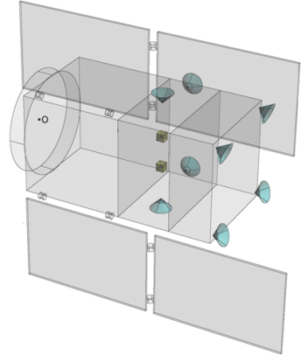
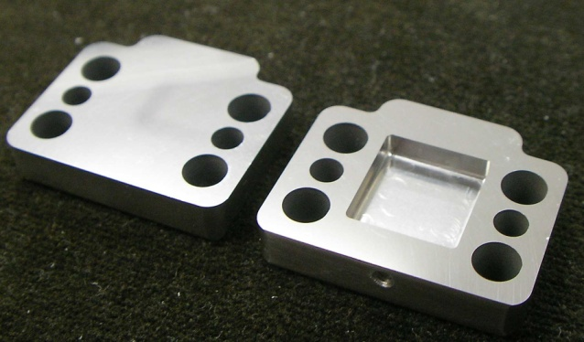
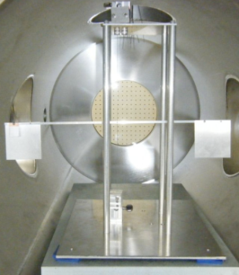
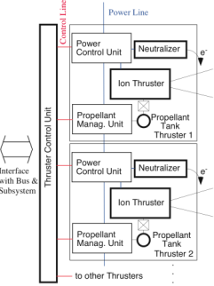
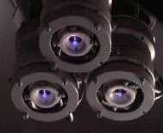
Attitude and Drag-free control
Attitude and Drag-free control : Structure, Thrusters, Control
Structure, thermal stability
・Passive
attitude stability
・Drag-free control
Low-noise
Thruster
Mass balance
U-Tokyo, JAXA
Low-noise Thruster
→ Actuators for satellite control
・BBM and system design
JAXA, NDAJ, Tokai-U

Slide 31


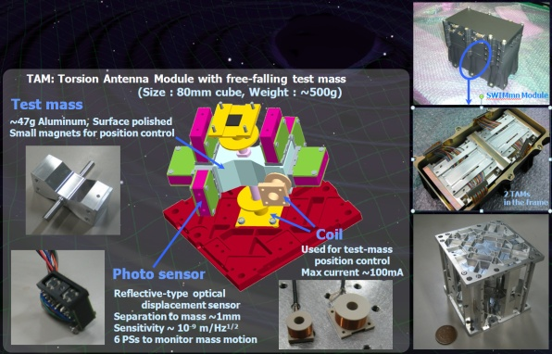

Signal processing and Control
Signal Processing and Control : SpaceWire-based system
SpC2 + SpW system
→ Signal processing and install. ctrl
Signal processor
SpC2
SWIMmn
Photo
by JAXA
Test-mass
control
Space demonstration
bySDS-1/SWIM
SDS-1
(Jan. 2009)
JAXA, U-Tokyo, Kyoto
SWIMmn demonstration
→ Test mass control in orbit
Satellite Bus
JAXA, U-Tokyo, Kyoto

Slide 32
    1. DECIGO
    Overview and Science
    Pre-conceptual Design
    2. DECIGO Pathfinder
    Overview and Science
    Design and Status
    Space Demonstration
    3. Summary

Slide 33
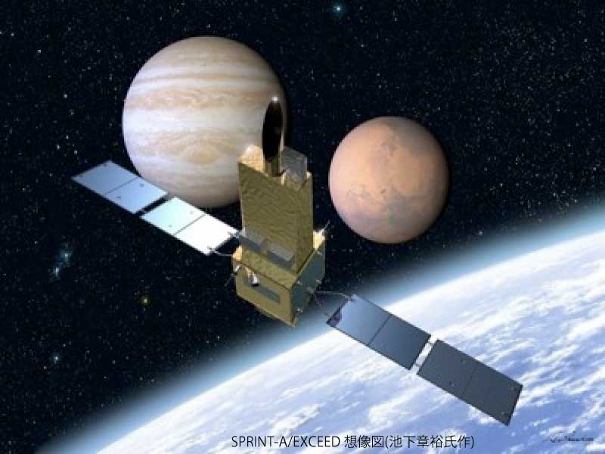

DPF mission status
DPF : One of the candidate of
JAXA’s small satellite series
At least 3 satellite in 5 years with
Standard Bus + M-V follow-on rocket
SPRINT-A /EXCEED
UV telescope mission
1st mission (2012): SPRINT-A/EXCEED
2nd mission (~2013/14) : ERG
3rd mission (~2015/16) : TBD
DPF survived until final two
DPF is one of the strongest
candidates of the 3rd mission
Next-generation
Solid rocket booster (M-V FO)
Fig. by JAXA

Slide 34
    1. DECIGO
    Overview and Science
    Pre-conceptual Design
    2. DECIGO Pathfinder
    Overview and Science
    Design and Status
    Space Demonstration
    3. Summary

Slide 35
Summary
DECIGO : Fruitful Sciences
Very beginning of the Universe
Dark energy
Galaxy formation
DECIGO Pathfinder
Important milestone for DECIGO
Strong candidate of JAXA’s satellite series
SWIM – under operation in orbit
first precursor to space!

Slide 36

    End
Original
Picture : Sora

