Slide 1
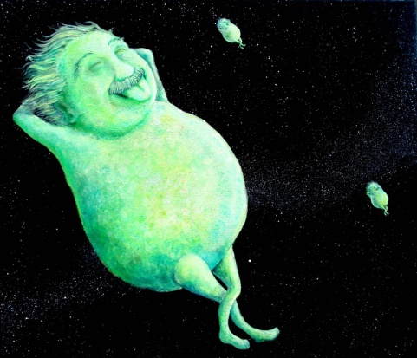
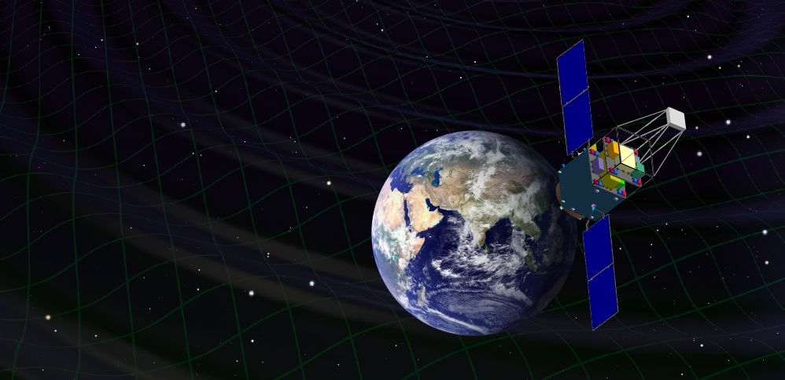
DECIGO and Pathfinder Missions
Masaki Ando
(Department of Physics, Kyoto University)
Original
Picture : Sora
Seiji Kawamura, Takashi Nakamura, Kimio Tsubono, Takahiro Tanaka, Ikkoh Funaki, Naoki Seto, Kenji Numata, Shuichi Sato, Nobuyuki Kanda, Takeshi Takashima, Kunihito Ioka, Kazuhiro Agatsuma, Tomotada Akutsu, Tomomi Akutsu, Koh-suke Aoyanagi, Koji Arai, Yuta Arase, Akito Araya, Hideki Asada, Yoichi Aso, Takeshi Chiba, Toshikazu Ebisuzaki, Motohiro Enoki, Yoshiharu Eriguchi, Masa-Katsu Fujimoto, Ryuichi Fujita, Mitsuhiro Fukushima, Toshifumi Futamase, Katsuhiko Ganzu, Tomohiro Harada, Tatsuaki Hashimoto, Kazuhiro Hayama, Wataru Hikida, Yoshiaki Himemoto, Hisashi Hirabayashi, Takashi Hiramatsu, Feng-Lei Hong, Hideyuki Horisawa, Mizuhiko Hosokawa, Kiyotomo Ichiki, Takeshi Ikegami, Kaiki T. Inoue, Koji Ishidoshiro, Hideki Ishihara, Takehiko Ishikawa, Hideharu Ishizaki, Hiroyuki Ito, Yousuke Itoh, Shogo Kamagasako, Nobuki Kawashima, Fumiko Kawazoe, Hiroyuki Kirihara, Naoko Kishimoto, Kenta Kiuchi, Shiho Kobayashi, Kazunori Kohri, Hiroyuki Koizumi, Yasufumi Kojima, Keiko Kokeyama, Wataru Kokuyama, Kei Kotake, Yoshihide Kozai, Hideaki Kudoh, Hiroo Kunimori, Hitoshi Kuninaka, Kazuaki Kuroda, Kei-ichi Maeda, Hideo Matsuhara, Yasushi Mino, Osamu Miyakawa, Shinji Miyoki, Mutsuko Y. Morimoto, Tomoko Morioka , Toshiyuki Morisawa, Shigenori Moriwaki, Shinji Mukohyama, Mitsuru Musha, Shigeo Nagano, Isao Naito, Noriyasu Nakagawa, Kouji Nakamura, Hiroyuki Nakano, Kenichi Nakao, Shinichi Nakasuka, Yoshinori Nakayama, Erina Nishida, Kazutaka Nishiyama, Atsushi Nishizawa, Yoshito Niwa, Masatake Ohashi, Naoko Ohishi, Masashi Ohkawa, Akira Okutomi, Kouji Onozato, Kenichi Oohara, Norichika Sago, Motoyuki Saijo, Masaaki Sakagami, Shin-ichiro Sakai, Shihori Sakata, Misao Sasaki, Takashi Sato, Masaru Shibata, Hisaaki Shinkai, Kentaro Somiya, Hajime Sotani, Naoshi Sugiyama, Yudai Suwa, Hideyuki Tagoshi, Kakeru Takahashi, Keitaro Takahashi, Tadayuki Takahashi, Hirotaka Takahashi, Ryuichi Takahashi, Ryutaro Takahashi, Takamori Akiteru, Tadashi Takano, Keisuke Taniguchi, Atsushi Taruya, Hiroyuki Tashiro, Mitsuru Tokuda, Masao Tokunari, Morio Toyoshima, Shinji Tsujikawa, Yoshiki Tsunesada, Ken-ichi Ueda, Masayoshi Utashima, Hiroshi Yamakawa, Kazuhiro Yamamoto, Toshitaka Yamazaki, Jun'ichi Yokoyama, Chul-Moon Yoo, Shijun Yoshida, Taizoh Yoshino

Slide 2

    1. DECIGO
    Overview and Science
    Pre-conceptual Design
    2. DECIGO Pathfinder
    Overview and Science
    Design and Status
    3. Summary

Slide 3
    1. DECIGO
    Overview and Science
    Pre-conceptual Design
    2. DECIGO Pathfinder
    Overview and Science
    Design and Status
    3. Summary

Slide 4
DECIGO
DECIGO
(Deci-hertz interferometer Gravitational wave Observatory)
Space GW antenna (~2024)
Obs. band around 0.1 Hz
‘Bridge’ the obs.gap between
LISA and Terrestrial detectors
Terrestrial Detectors
(Ad. LIGO, LCGT, etc)
LISA
DECIGO

Slide 5
DECIGO Interferometer
Interferometer Unit:
Differential FP interferometer
Baseline length: 1000 km
3 S/C formation flight
3 FP interferometers
Drag-free control
Arm cavity
1000km
Arm cavity
Laser
Mirror
Photo-
detector
Drag-free S/C

Slide 6
Targets and Science
IMBH binary inspiral
NS binary inspiral
Stochastic background
Galaxy formation (Massive BH)
Cosmology
(Inflation, Dark energy)
10⁻¹⁶
10⁻¹⁸
IMBH inspiral (z~1)
10⁻²⁰
GW amplitude [Hz^{-1/2}]
Background GW
(Ωgw ~ 2 x 10⁻¹⁶)
Merger
DECIGO
(1 unit)
10⁻²²
3month
10⁻²⁴
Merger
DECIGO
(Correlation)
10⁻²⁶
NS inspiral (z~1)
10⁻⁴
10⁻²
10⁰
10²
10⁴
Frequency [Hz]

Slide 7
Constraint on dark energy
DECIGO will observe
10⁴⁻⁵ NS binaries at z~1
Precise ‘clock’ at cosmological distance
‘Standard Siren’
Expansion ＋Acceleration?
DECIGO
Relationship between
distance and redshift
GW
NS-NS (z～1)
Output
Template
(No Acceleration)
Distance:
chirp waveform
Redshift:
host galaxy
Strain
→ Information on acceleration
of expansion of the universe
Real Signal ?
Phase Delay
～1sec (10 years)
Time
Seto, Kawamura, Nakamura,
PRL 87, 221103 (2001)
Determine cosmological parameters
Angular resolution
～10arcmin （1 detector）
～10arcsec （3 detectors）
Absolute and independent measurement
at z=1

Slide 8
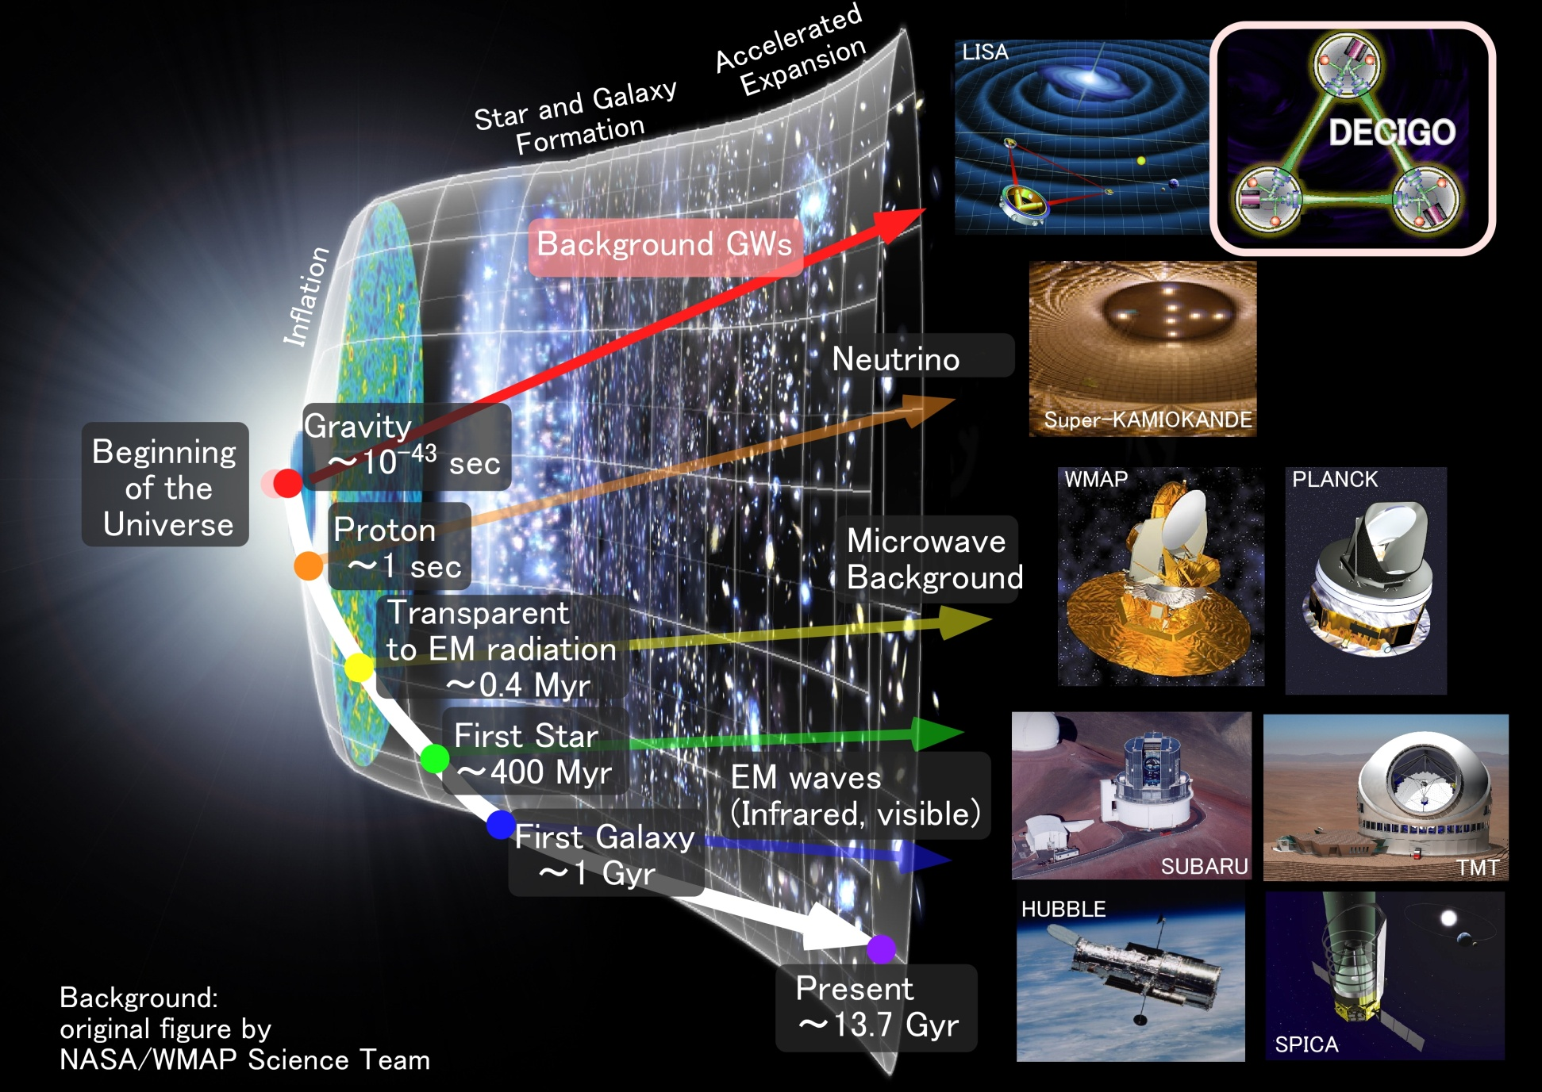
Stochastic Background GWs
Stochastic
Background GWs

Slide 9
    1. DECIGO
    Overview and Science
    Pre-conceptual Design
    2. DECIGO Pathfinder
    Overview and Science
    Design and Status
    3. Summary

Slide 10
Pre-Conceptual Design
Interferometer Unit:
Differential FP interferometer
Arm length: 1000 km
Finesse: 10
Mirror diameter: 1 m
Mirror mass: 100 kg
Laser power: 10 W
Laser wavelength：532 nm
Arm cavity
Arm cavity
S/C: drag free
3 interferometers
Laser
Mirror
Photo-
detector
Drag-free S/C

Slide 11
Interferometer Design
Transponder type vs Direct-reflection type
Compare : Sensitivity curves and Expected Sciences
Decisive factor: Binary confusion noise
WD-WD
confusion noise

Slide 12
Cavity and S/C control
Cavity length change
PDH error signal → Mirror position (and Laser frequency)
Relative motion between mirror and S/C
Local sensor → S/C thruster
Displacement Signal between S/C and Mirror
Local Sensor
S/C 1
S/C 2
Mirror
Thruster
Thruster
Actuator
Fig: S. Kawamura
Displacement signal between the two Mirrors

Slide 13
Requirements
Sensor Noise
Shot noise 3 x 10⁻¹⁸ m/Hz^{1/2} (0.1 Hz)
x 10 of LCGT in phase noise
Other noises should be well below the shot noise
Laser freq. noise: 1 Hz/Hz^{1/2} (1Hz)
Stab. Gain 10⁵, CMRR 10⁵
Acceleration Noise
Force noise 4x10⁻¹⁷ N/Hz^{1/2} (0.1 Hz)
x 1/50 of LISA
External force sources
Fluctuation of magnetic field, electric field, gravitational field, temperature, pressure, etc.

Slide 14
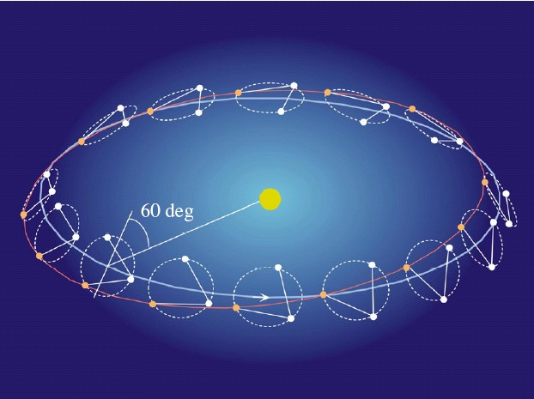
Orbit and Constellation
Candidate of orbit:
Record-disk orbit around the Sun
Relative acc. 4x10⁻¹² m/s²
Separated
unit
(Mirror force ~10⁻⁹ N )
Halo orbit around L2 (or L1)
Relative acc. 4x10⁻⁷ m/s²
(Mirror force ~10⁻⁴ N )
Constellation
Separated
unit
overlapped
units
4 interferometer units
2 overlapped units → Cross correlation
2 separated units → Angular resolution

Slide 15
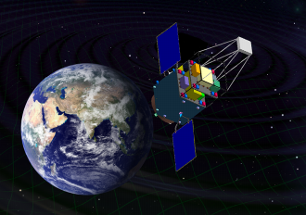
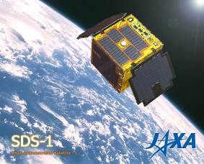
Roadmap
Figure: S.Kawamura
 | 2007 | 08 | 09 | 10 | 11 | 12 | 13 | 14 |  | 15 | 16 | 17 | 18 | 19 | 20 | 21 | 22 | 23 | 24 | 25 | 26
Mission
Objective | Space test of key tech. GW observation |  |  |  |  |  |  |  | Detect GW with min. spec FP between S/C |  |  |  |  |  |  | GW astronomy
Design | Single small satellite Short FP interferometer |  |  |  |  |  |  |  | 3 S/C 1 interferometer unit |  |  |  |  |  |  | 3 S/C x 3-4 units
R&D
Fabrication
R&D
Fabrication
R&D
Fabrication
DECIGO
Pathfinder
(DPF)
Pre-DECIGO
DECIGO
SDS-1/SWIM

Slide 16
Organization
PI: Kawamura (NAOJ)
Deputy: Ando (Kyoto)
Executive Committee
Kawamura (NAOJ), Ando (Kyoto), Seto (Kyoto), Nakamura (Kyoto), Tsubono (Tokyo), Tanaka (Kyoto), Funaki (ISAS), Numata (Maryland), Sato (Hosei), Kanda (Osaka city), Takashima (ISAS), Ioka (KEK)
Pre-DECIGO
Sato (Hosei)
Detector
Numata (Maryland)
Ando (Kyoto)
Science, Data
Tanaka (Kyoto)
Seto (Kyoto)
Kanda (Osaka city)
Satellite
Funaki (ISAS)
DECIGO pathfinder
Leader: Ando (Kyoto)
Deputy: Takashima (ISAS)
Design phase
Mission phase
Detector
Ando (Kyoto)
Laser
Ueda (ILS)
Musya (ILS)
Housing
Sato (Hosei)
Drag free
Moriwaki (Tokyo)
Sakai (ISAS)
Thruster
Funaki (ISAS)
Bus
Takashima (ISAS)
Data
Kanda (Osaka city)

Slide 17
Collaboration and support
・Supports from LISA
Technical advises from LISA/LPF experiences
Support Letter for DECIGO/DPF
LISA-DECIGO workshop (2008.11)
・Collab. with Stanford univ. group
Drag-free control of DECIGO/DPF
UV LED Charge Management System for DPF
・Collab. with JAXA navigation-control section
→ formation flight of DECIGO, DPF drag-free control
・Research Center for the Early Universe (RESCEU), Univ. of Tokyo
Support DECIGO as ones of main projects (2009.4-)
・Collab. with UNISEC (University Space Engineering Consortium)
Call for active young engineers

Slide 18
    1. DECIGO
    Overview and Science
    Pre-conceptual Design
    2. DECIGO Pathfinder
    Overview and Science
    Design and Status
    3. Summary

Slide 19
Roadmap
Figure: S.Kawamura
 | 2007 | 08 | 09 | 10 | 11 | 12 | 13 | 14 |  | 15 | 16 | 17 | 18 | 19 | 20 | 21 | 22 | 23 | 24 | 25 | 26
Mission
Objective | Space test of key tech. GW observation |  |  |  |  |  |  |  | Detect GW with min. spec FP between S/C |  |  |  |  |  |  | GW astronomy
Design | Single small satellite Short FP interferometer |  |  |  |  |  |  |  | 3 S/C 1 interferometer unit |  |  |  |  |  |  | 3 S/C x 3-4 units
R&D
Fabrication
R&D
Fabrication
R&D
Fabrication
DECIGO
Pathfinder
(DPF)
Pre-DECIGO
DECIGO
SDS-1/SWIM

Slide 20
DECIGO-PF
DECIGO Pathfinder (DPF)
First milestone mission for DECIGO
Shrink arm cavity
DECIGO 1000km → DPF 30cm
Single satellite
(Payload ~1m³ , 350kg)
Low-earth orbit
(Altitude 500km, sun synchronous)
30cm FP cavity with 2 test masses
Stabilized laser source
Drag-free control
Local Sensor
Actuator
Thruster

Slide 21
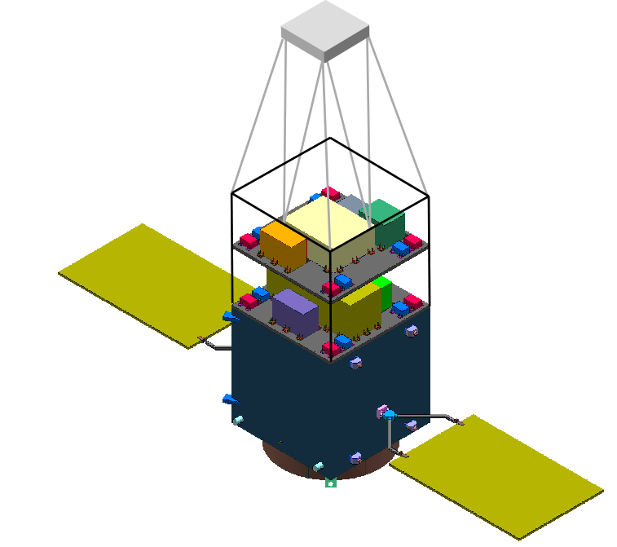
DPF satellite
Mast
structure
DPF Payload
Size : 950mm cube
Weight : 150kg
Power : 130W
Data Rate: 800kbps
Mission thruster x12
Mission
Thruster head
Stabilized.
Laser source
On-board
Computer
Power Supply
SpW Comm.
Satellite Bus
(‘Standard bus’ system)
Size :
950x950x1100mm
Weight : 200kg
SAP : 960W
Battery: 50AH
Downlink : 2Mpbs
DR: 1GByte
3N Thrusters x 4
Interferometer
module
Satellite
Bus system
Bus thruster
Solar Paddle

Slide 22

DPF mission payload
Mission weight : ~150kg
Mission space : ~90 x 90 x 90 cm
Drag-free control
Local sensor signal
→ Feedback to thrusters
Fabry-Perot interferometer
Finesse : 100
Length : 30cm
Test mass : 1kg
Signal extraction by PDH
Laser source
Yb:YAG laser (1030nm)
Power : 25mW
Freq. stab. by Iodine abs. line

Slide 23
DPF Sensitivity
Laser source : 1030nm, 25mW
IFO length : 30cm
Finesse : 100, Mirror mass : 1kg
Q-factor : 10⁵, Substrate: TBD
Temperature : 293K
Satellite mass : 350kg, Area: 2m²
Altitude: 500km
Thruster noise: 0.1μN/Hz^{1/2}
(Preliminary parameters)

Slide 24
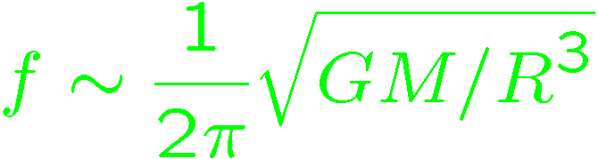
DPF sensitivity
DPF sensitivity h ~ 2x10⁻¹⁵ Hz^{1/2}
(x10 of quantum noises)
Massive BH
inspirals
DPF limit
LISA
Galaxy
binaries
NS binary
inspiral
Core-collapse
Supernovae
Foreground GWs
Pulsar
(1yr)
ScoX-1
(1yr)
DECIGO
Background GWs
from early universe
(Ω_{gw}=10⁻¹⁴)
LCGT
Gravity-gradient noise
(Terrestrial detectors)

Slide 25

GW target of DPF
Blackholes events
in our galaxy
IMBH inspiral and merger
h ~ 10⁻¹⁵ , f ~ 4 Hz
Distance 10kpc, m = 10³ M_{sun}
Obs. Duration (~1000sec)
KAGAYA
BH QNM
h ~ 10⁻¹⁵ , f ~ 0.3 Hz
Distance 1Mpc, m = 10⁵ M_{sun}
Observable range reaches
the Galactic center (SNR~5 )
Hard to access by others
→ Original observation
(By N.Kanda)

Slide 26
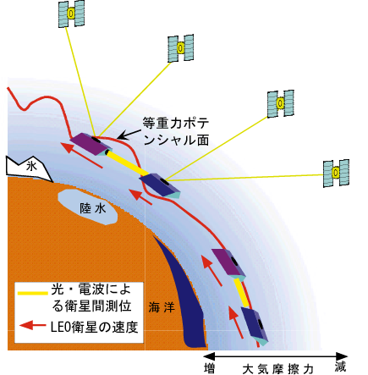
Gravity of the Earth
Measure gravity field of the Earth for Satellite Orbits
GPS satellite
Determine global gravity field
→ Density distribution
Monitor of change in time
Ground water motion
Strains in crusts by
earthquakes and volcanoes
Observation Gap
between GRACE and GRACE-FO
(2012-16)
→ DPF contribution
in international network
東京大字地震研・新谷氏、
京都大学・福田氏の資料/情報提供

Slide 27
    1. DECIGO
    Overview and Science
    Pre-conceptual Design
    2. DECIGO Pathfinder
    Overview and Science
    Design and Status
    3. Summary

Slide 28
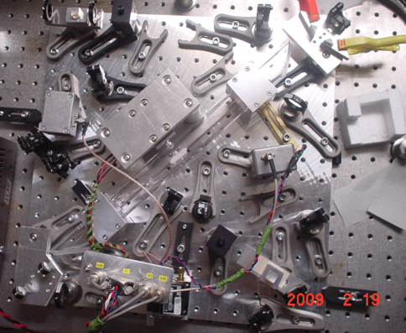
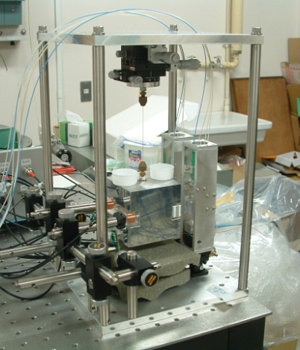

R&D for DPF (1)
By M.Musha
Stabilized Laser
BBM development
Yb:YAG (NPRO) source
Saturated absorption by I₂
→ Stability test, Packaging
IFO and housing
BBM-EM development
→ Test of concepts
+ Earth gravity sensors
By S.Sato
S.Sato’s talk
(P. Session #2, Today)
Y.Wakabayashi’s poster
By A.Araya

Slide 29
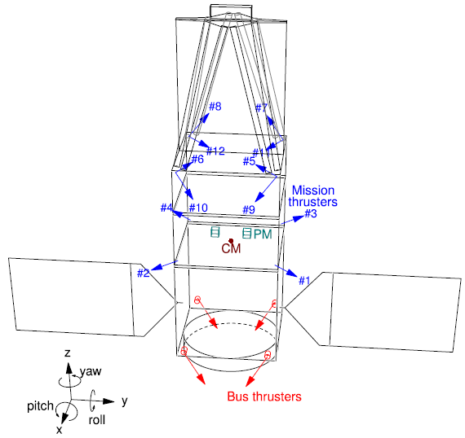
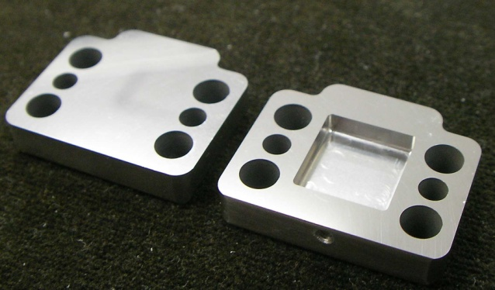
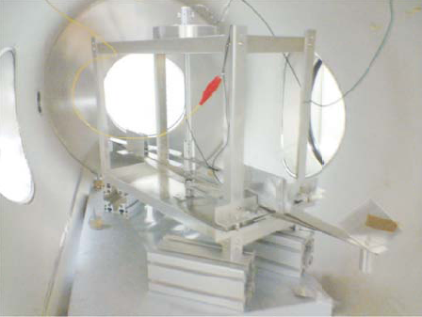
R&D for DPF (2)
By
S.Moriwaki
Attitude control and Drag-free
Satellite structure (mass distribution)
Passive attitude stabilization
by gravity gradient
Mission thruster position
Control topology
Thruster
System design
with existing tech.
Noise meas. system
(thruster stand)
Development of Slit FEEP
By I.Funaki

Slide 30





SWIM launch and operation
Tiny GW detector module
Launched in Jan. 23, 2009
Photo：
JAXA
In-orbit operation
TAM: Torsion Antenna Module with free-falling test mass
(Size : 80mm cube, Weight : ~500g)
Test mass
~47g Aluminum, Surface polished
Small magnets for position control
W.Kokuyama’s talk
(P. Session #2,
Today)
Coil
Photo sensor
Reflective-type optical
displacement sensor
Separation to mass ~1mm
Sensitivity ~ 10⁻⁹ m/Hz^{1/2}
6 PSs to monitor mass motion

Slide 31

DPF mission status
DPF : One of the candidate of
JAXA’s small satellite series
At least 3 satellite in 5 years with
Standard Bus + M-V follow-on rocket
SPRINT-A /EXCEED
1st mission (2012): SPRINT-A/EXCEED
2nd mission (~2013) in selection
Candidates: 2 missions (ERG, DPF)
Next-generation
Solid rocket booster (M-V FO)
Fig. by JAXA
Decision in this month

Slide 32
    1. DECIGO
    Overview and Science
    Pre-conceptual Design
    2. DECIGO Pathfinder
    Overview and Science
    Design and Status
    3. Summary

Slide 33
Summary
DECIGO : Fruitful Sciences
Very beginning of the Universe
Dark energy
Galaxy formation
DECIGO Pathfinder
Important milestone for DECIGO
Strong candidate of JAXA’s satellite series
SWIM – under operation in orbit
first precursor to space!

Slide 34
    End

Slide 35

LCGT and DECIGO
LCGT (~2014)
Terrestrial Detector
→ High frequency events
DECIGO (~2024)
Space observatory
→ Low frequency sources
Target: GW detection
Target: GW astronomy

Slide 36
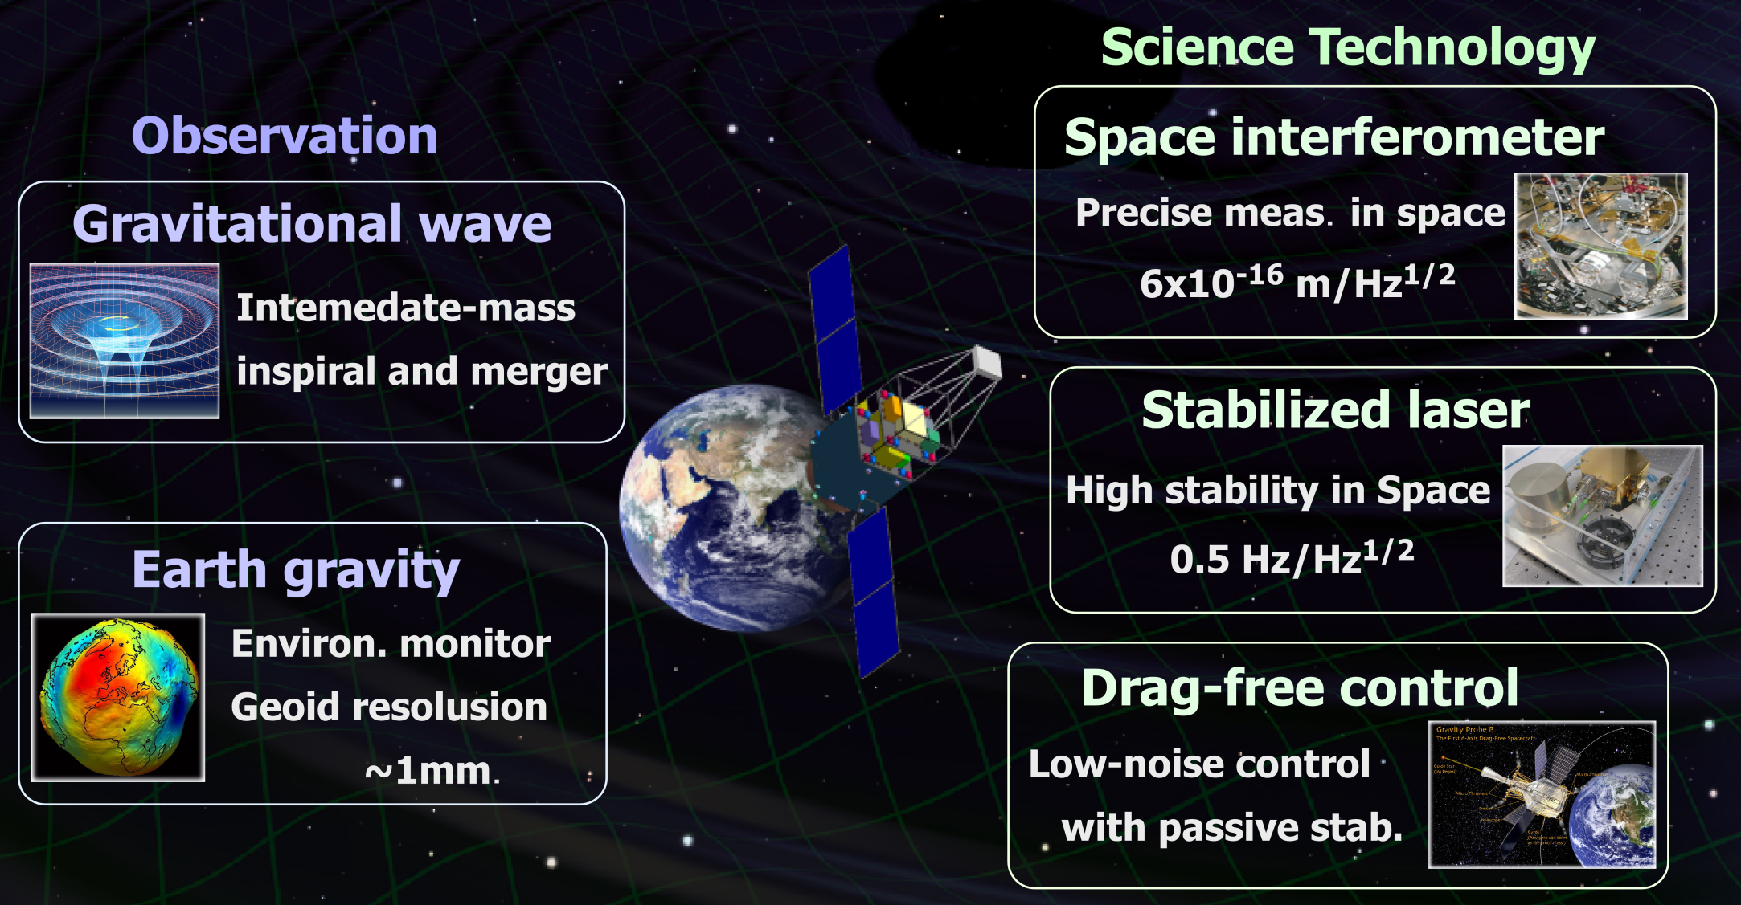
Objectives of DPF

Slide 37




DPF and DECIGO
DPF requirements
DECIGO
requirements
Disp. noise
6x10⁻¹⁶ m/Hz^{1/2}
Precise meas.
by IFO
4x10⁻¹⁸ m/Hz^{1/2}
1000km FP cavity
IFO control in space
Low external force
Large optics
Force noise
10⁻¹⁴ N/Hz^{1/2}
10⁻¹⁷ N/Hz^{1/2}
Ultra stable Laser
Stabilization of source
Stabilization by long arm
Stab. Laser
Freq. Stability
0.5 Hz/Hz^{1/2}
1 Hz/Hz^{1/2}
Formation flight
Stable orbit
Inter S/C Ranging
Drag-free control
Low-noise thruster
Drag-free
control
Satellite disp.
10⁻⁹ m/Hz^{1/2}
Thruster noise
10⁻⁷ N/Hz^{1/2}
Observation
Data procession
Data analysis
Triggered search
GW Obs.
0.1 Hz band
Observation and
Data analysis

Slide 38
Arm length
Cavity arm length : Limited by diffraction loss
Effective reflectivity (TEM₀₀ → TEM₀₀)
Laser wavelength : 532nm
Mirror diameter: 1m
Optimal beam size
1000 km
is almost max.

Slide 39
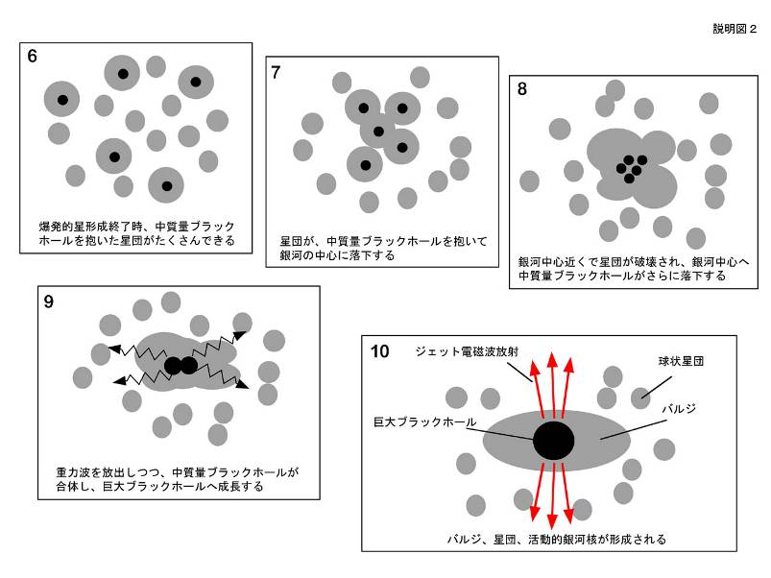
IMBH inspiral and Merger
DECIGO will observe
Intermediate-mass BH (IMBH)
binary merger with
SNR>6000 for z~1 source
Information on the
formation of
Supermassive BHs
at the center of galaxies
戎崎俊一(理化学研究所) 先生のwebページより引用 http://atlas.riken.go.jp/~ebisu/smbh.html

Slide 40
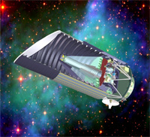
Standard Sources
Fig. from
SNAP
web page
Supernova (EM wave) Neutron-star binary (GW)
‘Standard Candle’ ‘Standard Siren’
Absolute power
or amplitude
Extrapolated from
nearby events
General Relativity
＜
Event rate
2000/yr （SNAP）
＜
10⁴⁻⁵/yr （DECIGO）
Error in distance
~10%
～
10% at z=1
～
Identification
of host galaxy
Require multiple detectors
or statistics
Easy?
＞
Others
Uncertainty by
dust absorption
Negligible interaction
with matters
＜
R.Takahashi (2006)

Slide 41
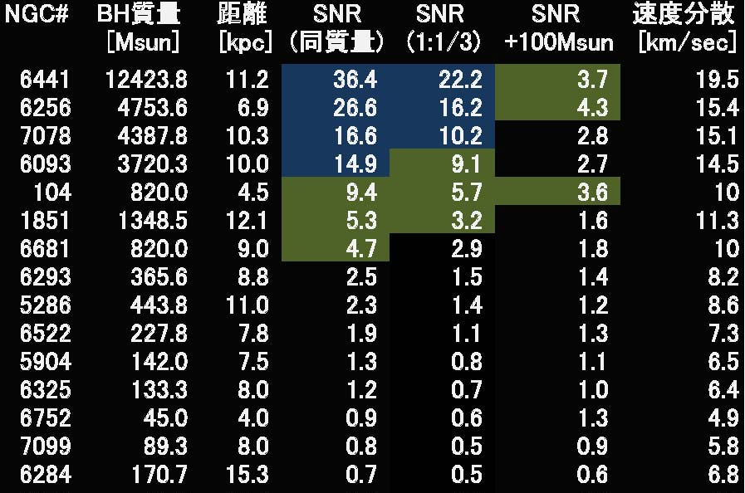
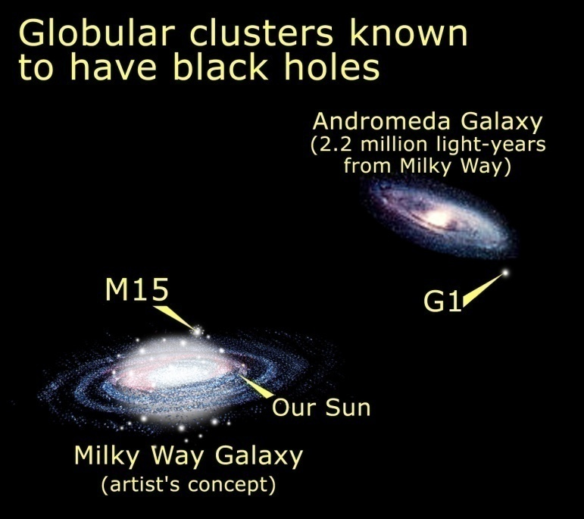
DPF targets
BHs in Globular clusters
BH masses estimated from star motion
Estimate SNR of GW signals
Equal mass, Mass ratio 1:1/3, 100Msun BH capture
Credit: NASA, STScI
(~150 Globular Clusters
in our Galaxy)
(By N.Seto)

Slide 42
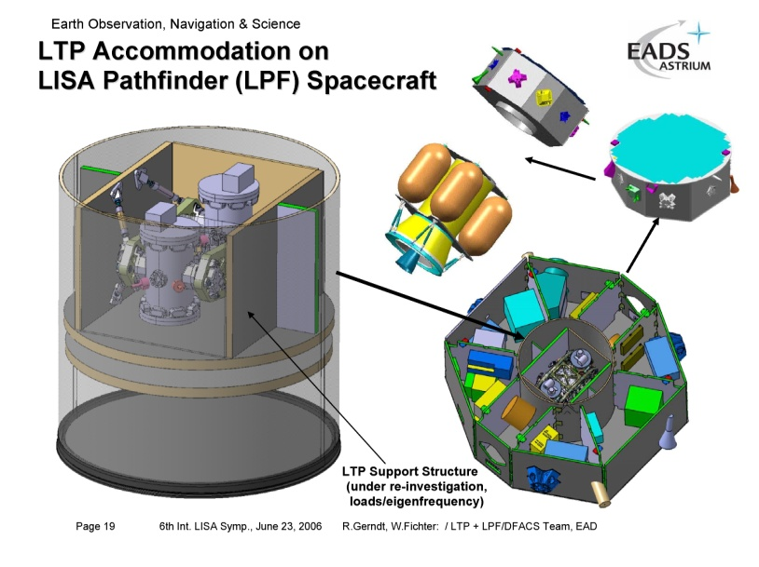
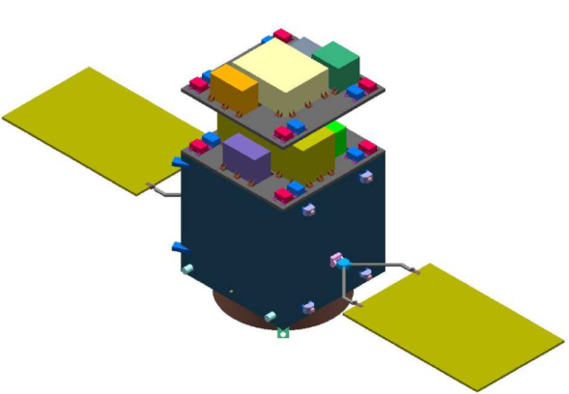
Comparison with LPF
LPF (LISA Pathfinder)
DPF (DECIGO Pathfinder)
Purpose
Launch
Weight
Orbit
Test Mass
Laser source
Interferometer
Sensitivity
Demonstration for LISA
2010
Dedicated launcher (Vega)
1,900 kg
Halo orbit around L1
Drag-free attitude control
Au-Pt alloy x2
Nd:YAG (1064nm)
Mach-Zehnder
3x10⁻¹⁴ m/s²/Hz^{1/2} (1mHz)
Demonstration for DECIGO
GW observation
~2013
Dedicated launcher (M-V follow-on)
350 kg
SSO altitude 500km
Drag-free attitude control
TBD x2
Yb:YAG (1030nm)
Fabry-Perot
1x10⁻¹⁵ m/s²/Hz^{1/2} (0.1Hz)
Thruster
Control Unit
Stabilized Laser
Central
Processing Unit
Mission
Thrusters
Housing
Control Unit
Interferometer
Module
Interfererometer
Control Unit
Bus Thrusters
Solar Paddle

Slide 43
Pre-DECIGO
 | Pre-DECIGO | DECIGO
Arm length | 100 km | 1000 km
Mirror diameter | 30 cm | 1 m
Laser wavelength | 0.532 μm | 0.532 μm
Finesse | 30 | 10
Laser power | 1 W | 10 W
Mirror mass | 30 kg | 100 kg
# of interferometers in each cluster | 1 | 3
# of clusters | 1 | 4

Slide 44


SWIM launch
Test of signal processing
and control system
Photo：
JAXA
SWIM (Space-wire Demonstration module)
on SDS-1 satellite
Launched in Jan. 23, 2009
SpaceCube2: Space-qualified Computer
SWIMμν : User Module
CPU: HR5000
(64bit, 33MHz)
System Memory:
2MB Flash Memory
4MB Burst SRAM
4MB Asynch. SRAM
Data Recorder:
1GB SDRAM
1GB Flash Memory
SpW: 3ch
Processor test board
GW+Acc. sensor
FPGA board
DAC 16bit x 8 ch
ADC 16bit x 4 ch
→ 32 ch by MPX
Torsion Antenna x2
~47g test mass
Data Rate : 380kbps
Size: 124 x 224 x 174
Weight: 3.5 kg
Power: ~7W
Size: 71 x 221 x 171
Weight: 1.9 kg
Power: 7W
Photo by JAXA
Photo by JAXA

Slide 45
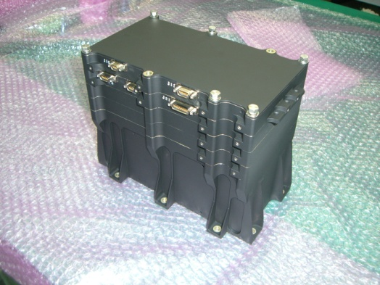
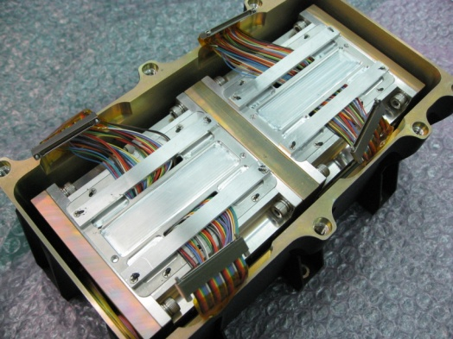
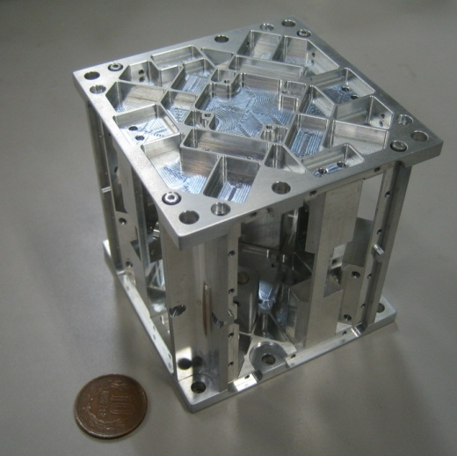
SWIMμν
Tiny GW detector ~47g test masses inside
→ Levitated control in space
TAM: Torsion Antenna Module with free-falling test mass
(Size : 80mm cube, Weight : ~500g)
Test mass
SWIMmn Module
~47g Aluminum, Surface polished
Small magnets for position control
2 TAMs
in the frame
Coil
Used for test-mass
position control
Max current ~100mA
Photo sensor
Reflective-type optical
displacement sensor
Separation to mass ~1mm
Sensitivity ~ 10⁻⁹ m/Hz^{1/2}
6 PSs to monitor mass motion

Slide 46

Successful control
SWIM
In-orbit operation
z control on
Test mass controlled
Error signal → zero
Damped oscillation
(in pitch DoF)
yaw control on
Free oscillation
in x and y DoF
Signal injection
→ OL trans. Fn.
Operation: May 12, 2009
Downlink: ~ a week
By
W.Kokuyama

