Slide 1
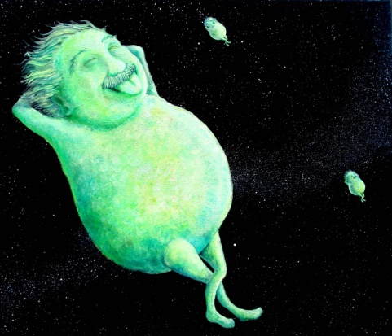
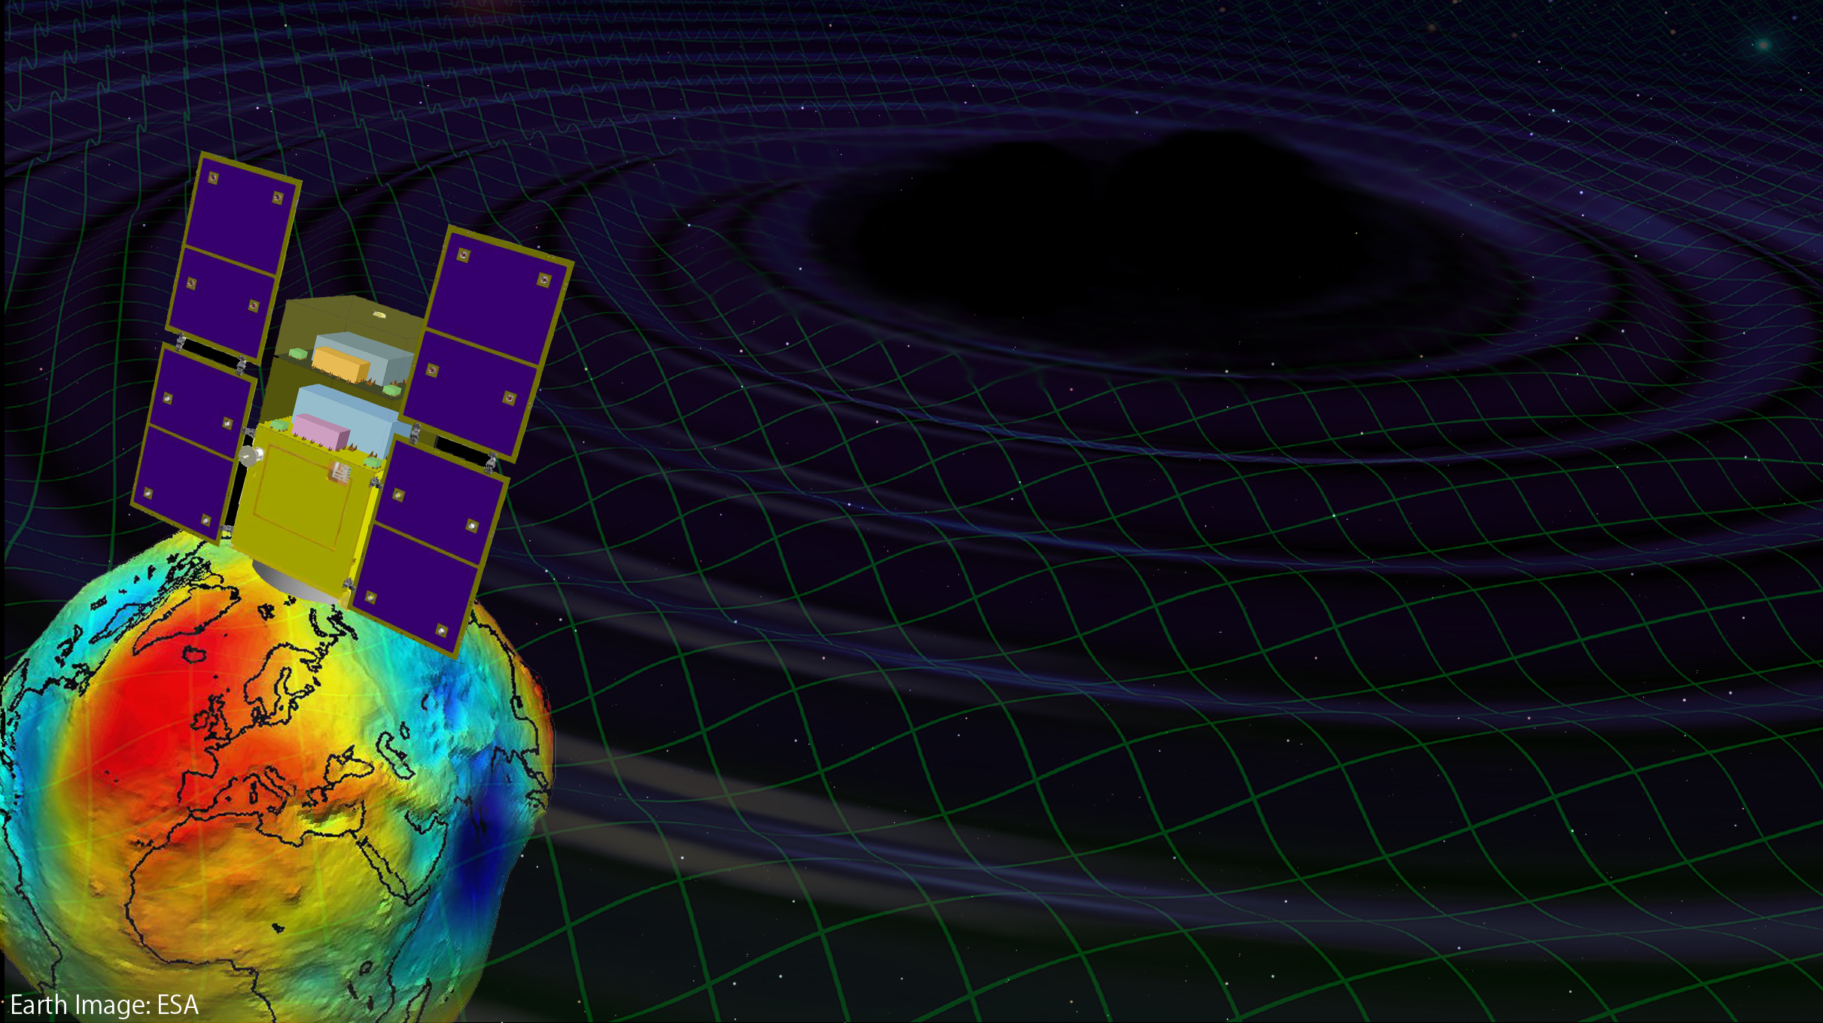
DECIGO and DECIGO Pathfinder
Masaki Ando
(Dept. of Physics, Univ. of Tokyo /
National Astronomical Observatory Japan)

Slide 2
DECIGO Members
Koh-suke Aoyanagi, Kazuhiro Agatsuma, Tomotada Akutsu, Hideki Asada, Yoichi Aso, Koji Arai, Akito Araya, Masaki Ando, Kunihito Ioka, Takeshi Ikegami, Takehiko Ishikawa, Hideharu Ishizaki, Hideki Ishihara, Kiwamu Izumi, Kiyotomo Ichiki, Hiroyuki Ito, Yousuke Itoh, Kaiki T. Inoue, Akitoshi Ueda, Ken-ichi Ueda, Takafumi Ushiba, Masayoshi Utashima, Satoshi Eguchi, Yumiko Ejiri, Motohiro Enoki, Toshikazu Ebisuzaki, Yoshiharu Eriguchi, Naoko Ohishi, Masashi Ohkawa, Masatake Ohashi, Kenichi Oohara, Yoshiyuki Obuchi, Kenshi Okada, Norio Okada, Koki Okutomi, Nobuki Kawashima, Fumiko Kawazoe, Isao Kawano, Seiji Kawamura, Nobuyuki Kanda, Kenta Kiuchi, Naoko Kishimoto, Hitoshi Kuninaka, Hiroo Kunimori, Kazuaki Kuroda, Sachiko Kuroyanagi, Hiroyuki Koizumi, Feng-Lei Hong, Kazunori Kohri, WataruKokuyama, Keiko Kokeyama, Yoshihide Kozai, Yasufumi Kojima, Kei Kotake, Shiho Kobayashi, Rina Gondo, Motoyuki Saijo, Ryo Saito, Shin-ichiro Sakai, Masaaki Sakagami, Shihori Sakata, Norichika Sago, Misao Sasaki, Shuichi Sato, Takashi Sato, Masaru Shibata, Kazunori Shibata, Ayaka Shoda, Hisaaki Shinkai, Aru Suemasa, Naoshi Sugiyama, Rieko Suzuki, Yudai Suwa, Naoki Seto, Kentaro Somiya, Hajime Sotani, Takeshi Takashima, Tadashi Takano, Kakeru Takahashi, Keitaro Takahashi, Tadayuki Takahashi, Hirotaka Takahashi, Fuminobu Takahashi, Ryuichi Takahashi, Ryutaro Takahashi, Takamori Akiteru, Hideyuki Tagoshi, Hiroyuki Tashiro, Takahiro Tanaka, Nobuyuki Tanaka, Keisuke Taniguchi, Atsushi Taruya, Takeshi Chiba, Dan Chen, Shinji Tsujikawa, Yoshiki Tsunesada, Kimio Tsubono, Morio Toyoshima, Yasuo Torii, Kenichi Nakao, Kazuhiro Nakazawa, Shinichi Nakasuka, Hiroyuki Nakano, Shigeo Nagano, Kouji Nakamura, Takashi Nakamura, Yoshinori Nakayama, Atsushi Nishizawa, Erina Nishida, Kazutaka Nishiyama, Yoshito Niwa, Kenji Numata, Taiga Noumi, Tatsuaki Hashimoto, Kazuhiro Hayama, Tomohiro Harada, Wataru Hikida, Yoshiaki Himemoto, Hisashi Hirabayashi, Takashi Hiramatsu, Mitsuhiro Fukushima, Ryuichi Fujita, Masa-Katsu Fujimoto, Toshifumi Futamase, Ikkoh Funaki, Mizuhiko Hosokawa, Hideyuki Horisawa, Kei-ichi Maeda, Hideo Matsuhara, Nobuyuki Matsumoto, Yuta Michimura, Osamu Miyakawa, Umpei Miyamoto, Shinji Miyoki, Shinji Mukohyama, Mitsuru Musha, Toshiyuki Morisawa, Mutsuko Y. Morimoto, Shigenori Moriwaki, Kent Yagi, Hiroshi Yamakawa, Toshitaka Yamazaki, Kazuhiro Yamamoto, Jun'ichi Yokoyama, Shijun Yoshida, Taizoh Yoshino, Chul-Moon Yoo, Yaka Wakabayashi
(On February 28th, 2014)

Slide 3

    ・ DECIGO
    ・ DECIGO Pathfinder
Notes:
This talk contains two parts.
The first part is for DECIGO. I will present overview, science , and conceptual design of DECIGO.
The second part is for DECIGO pathfinder, which is the first milestone mission for DECIGO.
In this part, I will present overview, science, and current status of DECIGO pathfinder.

Slide 4
DECIGO

Slide 5
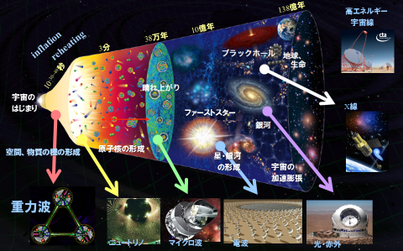
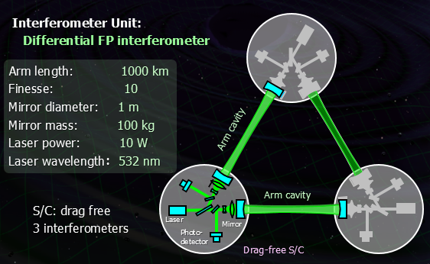
Space GW Antenna DECIGO
DECIGO
(DECI-hertz interferometer Gravitational wave Observatory)
Purpose: To Obtain Cosmological Knowledge.
Direct observation of the origin of space-time
and matter in Big-bang Universe.
背景画: 福井康雄監修 「宇宙史を物理学で読み解く
-素粒子から物質・生命まで」（名古屋大学出版会）より

Slide 6
DECIGO
DECIGO
(Deci-hertz interferometer Gravitational wave Observatory)
Space GW antenna (~2030)
Obs. band around 0.1 Hz
‘Bridge’ the obs.gap between
LISA and Terrestrial detectors
Terrestrial Detectors
(Ad. LIGO, KAGRA, etc)
LISA
DECIGO
Notes:
The first topic is sciences of DECIGO.
DECIGO stands for Deci-hertz....., firstly proposed in 2001.
This is a space GW antenna with observation band around 0.1Hz.
Since this frequency band is between the terrestrial detectors and LISA,
DECIGO will bridge the observation gap between them.

Slide 7
Targets and Science
IMBH binary inspiral
NS binary inspiral
Stochastic background
Galaxy formation (Massive BH)
Cosmology (Inflation, Dark energy)
Fundamental physics
10⁻¹⁶
10⁻¹⁸
IMBH inspiral (z~1)
10⁻²⁰
GW amplitude [Hz^{-1/2}]
Background GW
(Ωgw ~ 2 x 10⁻¹⁵)
Merger
DECIGO
(1 unit)
10⁻²²
3month
10⁻²⁴
Merger
DECIGO
(Correlation)
10⁻²⁶
NS inspiral (z~1)
10⁻⁴
10⁻²
10⁰
10²
10⁴
Frequency [Hz]
Notes:
With this configuration, DECIGO will have this sensitivity curve.
The horizontal axis is frequency, and the vertical axis is sensitivity to GWs in unit of per-root-hertz.
DECIGO has three main targets.
The first one is inspiral of intermediate-mass BHs.
This line represents the amplitude of signal from 1000 solar mass blackhole
binaries at the distance of redshift of one. The binary will merge at the center of the DECIGO band.
This observation may bring us information on the formation of supermassive BHs at the center of galaxies.
The second target is inspiral of neutron star binaries. This yellow line shows
the GW signal amplitude for NS binary at distance of redshift one. The signal is
in the DECIGO band about several years before the merger. The signal moves to higher
frequency in time, and the merger signal will radiated in the band of ground-based
detectors. So DECIGO will work as a predictor for ground based detectors.
The third target is stochastic background GWs from the early universe.
For this target, we need multiple detectors, in order to distinguish the signal
from detectors noise, This green curve represents the noise level by one-year
cross-correlation observation with two interferometer units.
This level reaches to gravitational-wave energy density ratio of 2 times 10^-16.

Slide 8
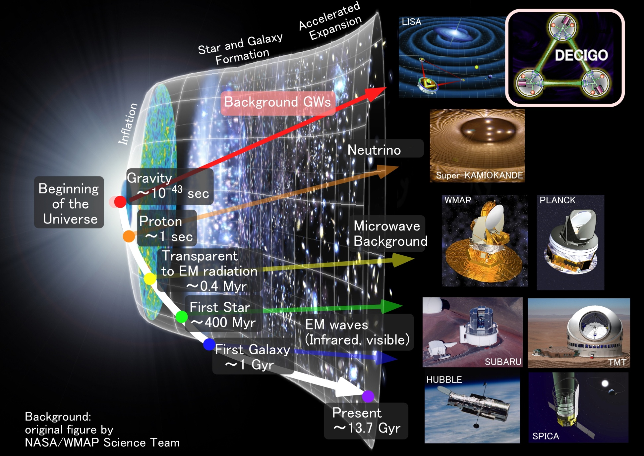
Characterization of inflation
Stochastic
Background GWs
35
Direct probe to
the history of the Universe
Notes:
As for the stochastic background gravitational waves, DECIGO has a potential to see
directory the very beginning of the universe. The picture of the earliest universe we have
is obtained from cosmic microwave background. This is a picture of 0.4 million years after the
beginning of the universe. There are several proposals to observe the first stars and first galaxies
using infrared and optical telescopes. These targets were formed about hundred millions to billion
years after the beginning of the universe. Using gravitational waves, DECIGO would watch the
very beginning, less than one seconds from the beginning of the universe.

Slide 9
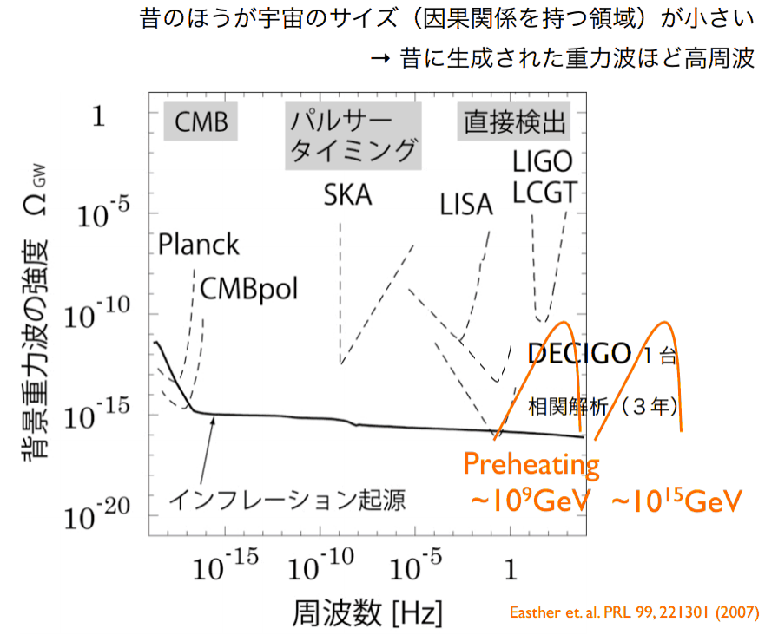
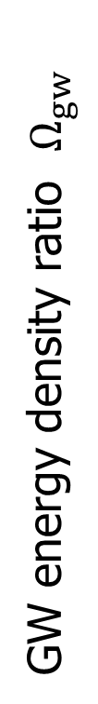
Primordial GW
Earlier universe → Smaller horizon scale → High GW freq.
Original Figure by
S. Kuroyanagi (2011)
KAGRA
GW energy density ratio $Ω_{gw}$
DECIGO
GW from Inflation
Frequency [Hz]

Slide 10
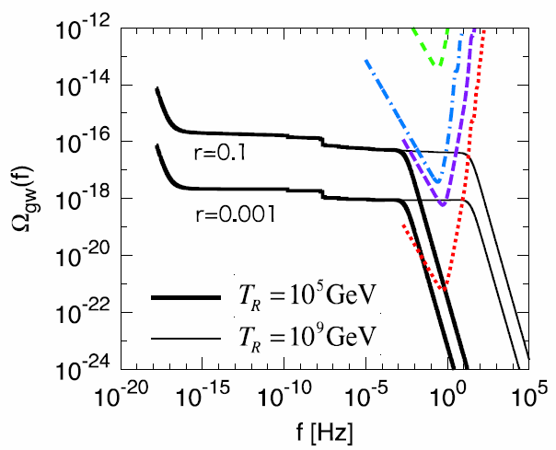

GW from Inflation
Energy density $∝$ Tensor-Scalar Ratio ($r$).
Power spectrum : Evolution history of the Universe.
DECIGO Correlation
・Spectrum Power.
→ Energy scale
of inflation
・Cut-off freq.
→Energy scale
of Reheating
Nakayama+,
Journal of Cosmology
and Astroparticle Physics
06 (2008) 020.

Slide 11
Pre-Conceptual Design
Interferometer Unit:
Differential FP interferometer
Arm length: 1000 km
Finesse: 10
Mirror diameter: 1 m
Mirror mass: 100 kg
Laser power: 10 W
Laser wavelength： 532 nm
Arm cavity
Arm cavity
S/C: drag free
3 interferometers
Laser
Mirror
Photo-
detector
Drag-free S/C
Notes:
Next, I will talk on the pre-conceptual design of DECIGO.
One interferometer unit is formed by three spacecraft.
Each spacecraft has test-mass mirrors inside it.
A mirror has a diameter of 1m and weight of 100kg.
These mirrors forms Fabry-Perot interferometers with a finesse of 10 and a baseline length of 1000km.
As light sources, we will use green lasers with output power of 10W.
So as to suppress the effect of external disturbances on test mass mirrors,
such as solar radiations, each spacecraft is drag-free-controlled.
I mean, the position of spacecraft is controlled to follow the test mass position.

Slide 12
Interferometer Design
Transponder type vs Direct-reflection type
Compare : Sensitivity curves and Expected Sciences
Decisive factor: Binary confusion noise
WD-WD
confusion noise
Notes:
One of the key features of DECIGO is to use Fabry-Perot cavities for the baseline
length change measurement. Since DECIGO has between the observation band of LISA and
ground-based detectors, we have two choices in the selection of interferometer configuration.
One choice is to adopt optical transponder-type interferometer and shorten the
baseline from LISA. The estimated noise level is shown by this orange curve.
Another choice is to adopt Fabry-Perot interferometer as ground based detectors,
and expand the baseline. The noise level with this configuration is shown
by this red curve. Optical-transponder type has advantage in low frequencies,
because it can have longer baselines, and the acceleration noises on the
test mass can be relatively suppressed. The Fabry-Perot type has an advantage in
high-frequency band and best floor sensitivity. This is because the laser power
is effectively accumulated in the cavities, and the shot noise level can be suppressed.

Slide 13
Arm length
Cavity arm length : Limited by diffraction loss
Effective reflectivity (TEM₀₀ → TEM₀₀)
Laser wavelength : 532nm
Mirror diameter: 1m
Optimal beam size
1000 km
is almost max.

Slide 14
Cavity and S/C control
Cavity length change
PDH error signal → Mirror position (+Laser freq.)
Relative motion between mirror and S/C
Local sensor → S/C thruster
Displacement Signal between S/C and Mirror
Local Sensor
S/C 1
S/C 2
Mirror
Thruster
Thruster
Actuator
Fig: S. Kawamura
Displacement signal between the two Mirrors
Notes:
Here, I will talk a little more on the compatibility of Fabry-Perot cavity length
control and drag-free control of the space craft position.
This figure shows one arm cavity of DECIGO.
The distance between the mirrors is measured by Fabry-Perot cavity. The signal
is fed back to the mirror position to keep the cavity length, using mirror actuators.
On the other hand, relative displacement between a mirror and S/C are measured by
local sensors around the mirrors, These signals are fed back to the thrusters attached
to the S/C. In short, this mirror follows the motion of this mirror, and each S/C
follows the mirror inside it. So, cavity control and drag-free controls are compatible.

Slide 15
Requirements
Displacement Noise
Shot noise 3 x 10⁻¹⁸ m/Hz^{1/2} (0.1 Hz)
x 10 of KAGRA in phase noise
Other noises should be well below the shot noise
Laser freq. noise: 1 Hz/Hz^{1/2} (1Hz)
Stab. Gain 10⁵, CMRR 10⁵
Acceleration Noise
Force noise 4x10⁻¹⁷ N/Hz^{1/2} (0.1 Hz)
x 1/50 of LISA
External force sources
Fluctuation of magnetic field, electric field,
gravitational field, temperature, pressure, etc.
Notes:
This viewgraph shows important requirements to reach the target sensitivity of DECIGO.
For displacement noise, 3x10^-18 m/sqrt of Hz is requires at the frequency band of 0.1Hz.
This level is about 10 times easer than that of ground based detectors.
For laser frequency noise, 1 Hz/sqrt Hz is requires for laser source,
and 10^5 gain is required for stabilization by arm cavities assuming 10^5 CMRR.
As for the acceleration noise, 4x10^-17 N/Hz^1/2 is required. This is 50 times
stringent requirement than LISA. This will be one of the most challenging requirement
in DECIGO. To realize this, we have to deeply investigate various kinds of noise sources.

Slide 16
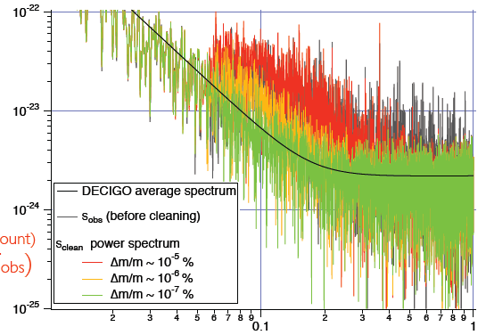
Foreground Cleaning
DECIGO obs. band: free from WD binary foreground
→ Open for cosmological observation
DECIGO will watch
~ 10⁵ NS binaries
Fig: N. Kanda
Foreground for GWB
In principle, possible
to remove them.
Require waveform
Accuracy Δm/m < ~10⁻⁷ %

Slide 17
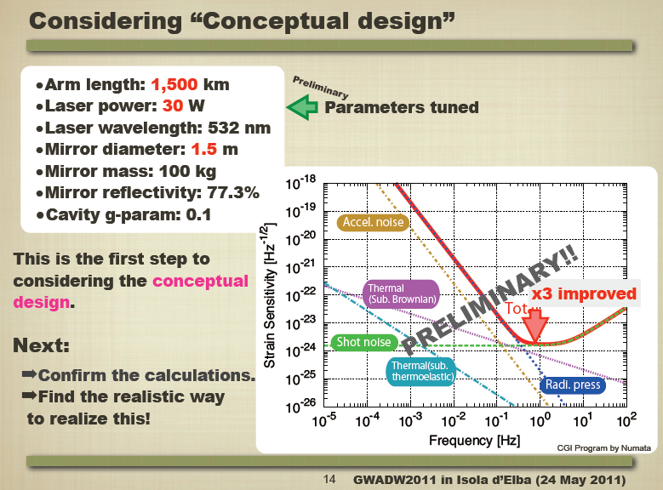
Design Update
By T.Akutsu

Slide 18
DECIGO Pathfinder

Slide 19
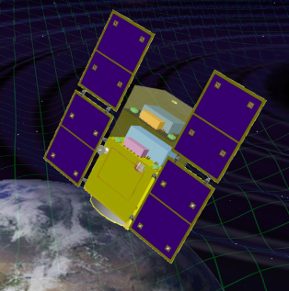

Roadmap for DECIGO
Figure: S.Kawamura
 | 2014 | 15 | 16 | 17 | 18 | 19 | 20 | 21 |  | 22 | 23 | 24 | 25 | 26 | 27 | 28 | 29 | 30 | 31 | 32 | 33
Mission
Purpose | Interferometer in Space (Obs. Of GW and Earth Gravity) |  |  |  |  |  |  |  | Long-baseline Precise Formation Flight (GW Observation) |  |  |  |  |  |  | GW Astronomy and Cosmology
Design | One Small Satellite Short FP cavity + Drag-free |  |  |  |  |  |  |  | FF with 3 S/C 1 IFO unit |  |  |  |  |  |  | FF with 3 S/C 3-4 IFO units
R&D
Fabrication
R&D
Fabrication
R&D
Fabrication
DECIGO
Pathfinder
(DPF)
Pre-DECIGO
DECIGO
SDS-1/SWIM

Slide 20
Technical Steps for DECIGO
・Key technologies for DECIGO
(1) Precise measurement by laser interferometer.
Operation of Fabry-Perot interferometer
in Space environment and Drag-free control.
(2) Long-baseline formation flight.
Realization of precise formation flight
with more than km scale
Demonstration by DPF
Demonstration by Pre-DECIGO

Slide 21
Technical Steps for DECIGO
DPF target
Pre-DECIGO target
DECIGO Requirement
First demonstration of
FP cavity (30cm) in space. Disp. noise
~10⁻¹⁶m/Hz^{1/2}, Acc. Noise 10⁻¹⁵ N/Hz^{1/2}.
FP operation with
long-base line (100km).
Disp. noise 10⁻¹⁷m/Hz^{1/2}
Acc. noise 10⁻¹⁶ N/Hz^{1/2}.
Disp. 3x10⁻¹⁸ m/Hz^{1/2}.
Acc. 10⁻¹⁷ N/Hz^{1/2}.
Space FP
Baseline length
1000km.
Freq. stability of 0.5Hz/Hz^{1/2}
in space environment.
Output pow. : 100mW.
Stab. Laser
source
Freq. stability of
0.5Hz/Hz^{1/2}.
Output pow. : 1W.
Freq. Stab. of
0.5Hz/Hz^{1/2}.
Output pow. : 10W.
All DoF DF control
1x10⁻⁹ m/Hz^{1/2}.
All DoF DF control
1x10⁻⁹ m/Hz^{1/2}.
Drag-free
Control
and FF
Realize all DoF drag-
free control with
1x10⁻⁹ m/Hz^{1/2}.
Long-baseline Formation
Flight 100km.
Long-baseline FF
1000km.

Slide 22
DECIGO-PF
DECIGO Pathfinder (DPF)
DECIGO
First milestone mission for DECIGO
Shrink arm cavity
DECIGO 1000km → DPF 30cm
1000km
Purpose
- FP interferometer in space
- Stabilized laser source
- Drag-free control
- Continuous data-processing
Local Sensor
Laser
30cm
Actuator
DPF
Thruster
Notes:
Here, I will go on to the second part of my talk, on the DECIGO pathfinder.
DPF is the first milestone mission for DECIGO. The original purpose is to test the
key technologies for DECIGO. For this purpose, DPF is designed to be a prototype
of DECIGO. In DPF, one 1000km arm of DECIGO is shrunk down to 30cm, and placed
inside one small satellite orbiting around the earth.
A 30cm Fabry-Perot cavity is formed by two test mass mirrors. And the length change
is measured by means of stabilized laser. The relative displacement between the test
mass and the satellite is measured by a local sensor, and the signals are fed back to the
satellite thrusters to realize drag-free control.

Slide 23
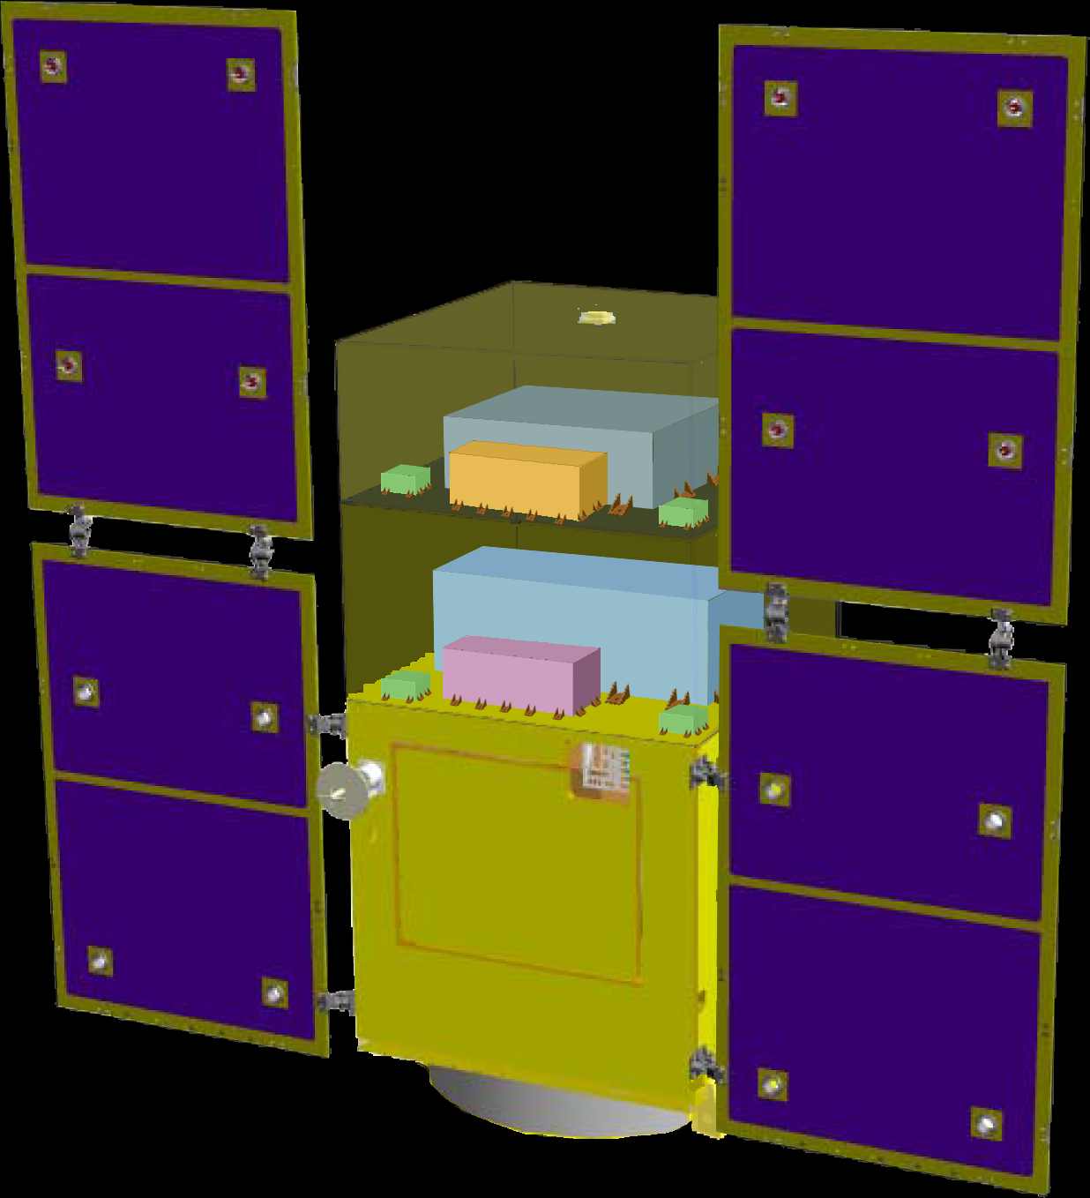
DPF satellite
DPF Payload
Size : 950mm cube
Weight : 200kg
Power : 130W
Data Rate: 800kbps
Mission thruster x10
Mission
Thruster head
Stabilized.
Laser source
On-board
Computer
Power Supply
SpW Comm.
Satellite Bus
(‘Standard bus’ system)
Size :
950x950x1100mm
Weight : 250kg
SAP : 960W
Battery: 50AH
Downlink : 2Mpbs
DR: 1GByte
3N Thrusters x 4
Interferometer
module
Satellite
Bus system
Bus thruster
Solar Paddle
Notes:
DPF satellite will look like this figure. The satellite is comprised of two parts.
The bottom part contains the bus system with solar puddles, batteries, data processing system,
temperature control system, and telecommunication system with ground station.
The upper part is a mission payload. The interferometer module is placed in the first floor,
and stabilized laser system is placed in the second floor. 10 small low-noise thrusters
are attached at the corners of the payload.

Slide 24

DPF mission payload
Mission weight : ~200kg
Mission space : ~95 x 95 x 90 cm
Drag-free control
Local sensor signal
→ Feedback to thrusters
Thruster
Fabry-Perot interferometer
Finesse : 100
Length : 30cm
Test mass : ~a few kg
Signal extraction by PDH
Laser source
Yb:YAG laser (1030nm)
Power : 25mW
Freq. stab. by Iodine abs. line
Notes:
This figure show the design of mission payload part.
As a laser source, we will use a Yb:YAG laser stabilized using iodine absorption line.
The stabilized beam is introduced to the 30cm main interferometer,
formed by two test mass mirrors.
The length change signal is extracted by a Pound-Drever-Hall scheme. The signal is fed back
to the mirror using electro-static-type actuators. The relative displacement between the
test mass and the satellite is monitored by electro-static-type local sensors and fed back to
the mission thrusters to realize dreg-free-control.

Slide 25
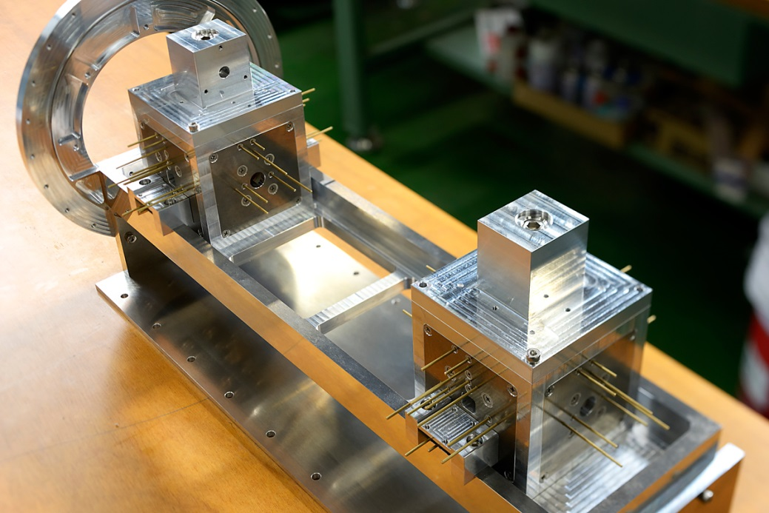
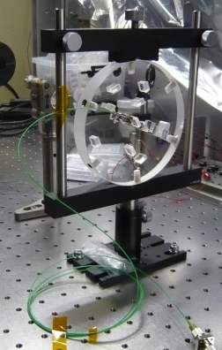

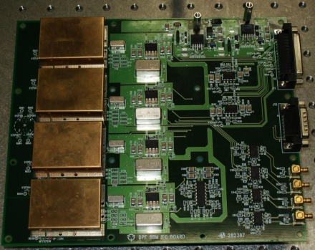
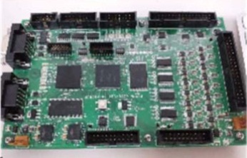
Interferometer Module
IO Optics
Interferometer Module
Monolithic opt. bench by silicate bonding
Test mass module
TM, Capacitive Sensor/Actuator, Launch lock
IFO length
~30cm
Quad-RFPD
SpW signal-processing
board
Quadrant PD + Demod. circuits for
length and alignment
control signals
SpW FPGA +
16bit AD/DA

Slide 26
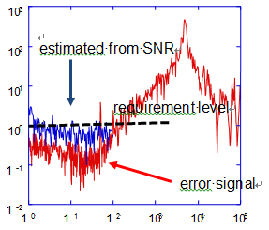
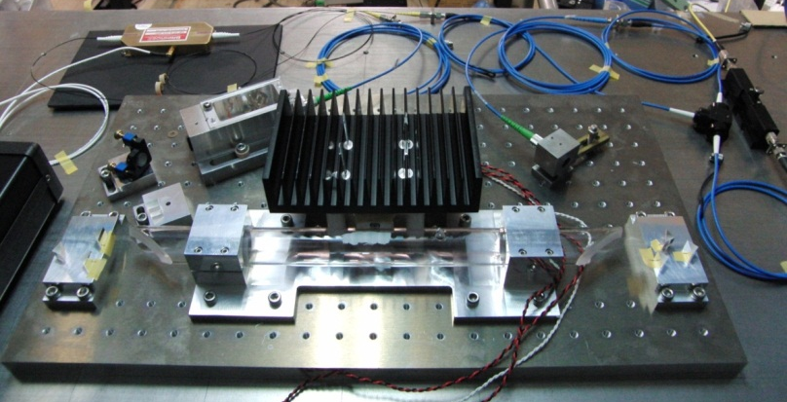
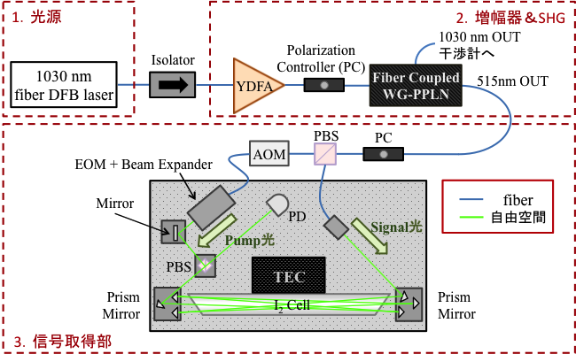
Frequency Stabilization Module
・Frequency Stabilization module BBM2 (at UEC)
- Use absorption line of Iodine molecule.
- Satisfy requirement (0.5 Hz/Hz^{1/2})
in error-signal measurement.
- Preparing one-more module for
relative stability evaluation.
Freq. Stab module
AOM
PC
300mm
Mirror
TEC
Prism Mirror
PBS
Prism Mirror
PBS
I2 Cell
500mm

Slide 27
Mission Selection Result
・AO from JAXA (December 2013)
for small science mission using epsilon rocket.
- The program framework was changed:
~10 M$ payload mission → ~150 M$ mission
- Deadline : End of February.
- 7 mission proposals including DPF.
DPF was dropped in the first down-selection (May)
・Started discussions on the next strategy.

Slide 28
Restructure of Space Program
・ISAS/JAXA decided a new plan for
space science and exploration program (2014)
- Three categories
* Strategic medium-scale missions (~300 M$)
Hayabusa-2, ASTRO-H
* Small-scale missions (100 - 150 M$)
AO in every two years
HISAKI, ERG, …
* Various small projects (~10 M$/year)
ISS missions, International collaboration,
Small rocket, Balloon, …
‘Small-scale’ mission became core program in JAXA

Slide 29
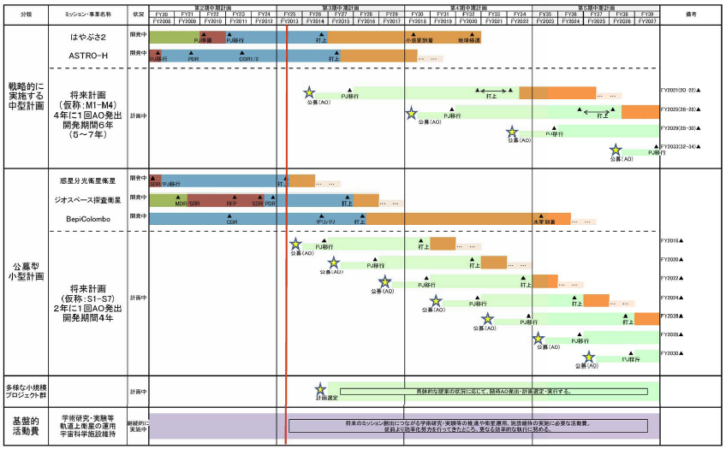
Mission Plan by JAXA
From file submitted to the government by ISAS/JAXA
(内閣府・宇宙政策委員会・宇宙科学・探査部会 2013年9月19日).

Slide 30
Summary

Slide 31
Summary
DECIGO : Fruitful Sciences
Very beginning of the Universe
Dark energy, Dark matter
Galaxy formation
→ Will be realized at last.
DECIGO Pathfinder
Submitted mission proposal,
but failed in the selection.
→ Start discussions on the next strategy.
Notes:
Now, I will summarize my talk.
DECIGO will provide us fruitful knowledge on the beginning of the universe, dark energy,
and formation of galaxies.
DECIGO pathfinder is a first milestone mission for DECIGO, and being a
strong candidates of JAXA's small satellite series.
In addition, we have developed a SWIM module, which is under operation in orbit.
This is our first precursor to space. Though this is only a small module, we have made
a significant step

Slide 32

Original
Picture : Sora
    End
Notes:
Thanks you for your attention.

Slide 33
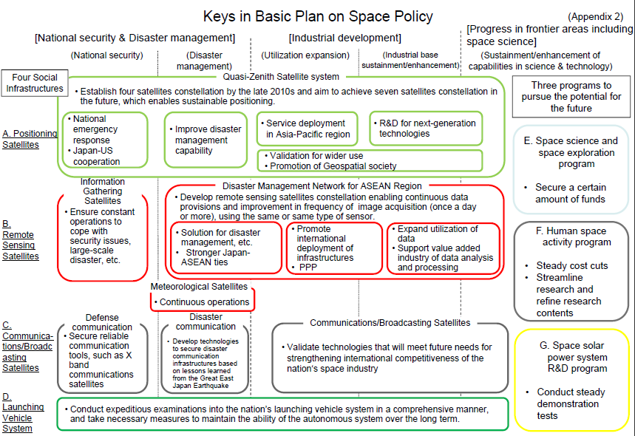
Restructure of space sections
・Restructure of space sections in Japan (2008)
Based on a new law : Basic Plan on Space Policy
ISAS/JAXA : MEXT → Cabinet Office (CAO)
Space Science and
space exploration
program
From CAO Web Page :http://www8.cao.go.jp/space/plan/plan-eng.pdf

Slide 34
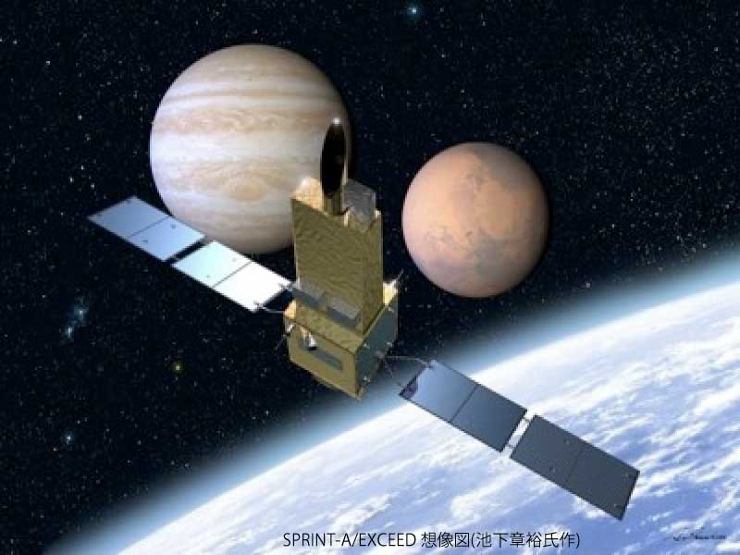

DPF mission status
DPF : One of the candidate of
JAXA’s small satellite series
At least 3 satellite in 5 years with
Standard Bus + M-V follow-on rocket
SPRINT-A /EXCEED
UV telescope mission
1st mission (2012): SPRINT-A/EXCEED
2nd mission (~2015) : SPRINT-B/ERG
3rd mission (~2019) : TBD
Call for proposal : 2014
DPF survived until final two
Next-generation
Solid rocket booster (M-V FO)
Fig. by JAXA
Notes:
Now, I will talk on the current status of the mission selection.
JAXA, the Japanese space agency, has a project to launch at least three small satellites
in five years, using a standard bus system and a next generation solid rocket booster.
At the beginning, there were about fifty proposals four years ago. And fifteen missions
were accepted as official working groups three years ago.
Among them about five missions has been financially supported by JAXA since two years ago.
The first mission has already decided to be a SPRINT-A/EXCEED mission, which is a UV
telescope mission for planetary science. The second mission is now in selection.
DPF is surviving as one of the two final candidates. Another candidate is named ERG,
which is for observation of magnetic fields around the earth during active years of the Sun.
The final hearing was held last month, and the final selection will be made in this month.

Slide 35
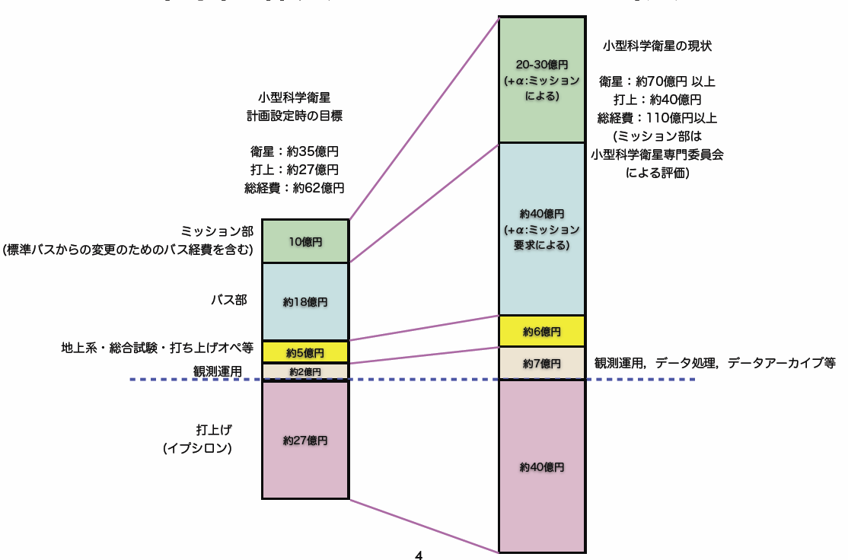
小型科学衛星シリーズ
・小型科学衛星シリーズの位置づけが見直された.
- 小型科学衛星プログラムは 「特徴ある宇宙科学ミッションを迅速かつ
高頻度に実現する」 目的で進められた．
- しかし，2011年にERG （小型科学衛星2号機）の想定資金からの大幅
超過をきっかけとして，小型科学衛星シリーズとしてのプロジェクトは
Termination された．
- 小型科学衛星専門委員会によるコスト
評価，および，SE推進室の評価．
→ 検討中のWGのミッション実現には，
マージン無しで70から120億円の衛星
コスト （当初想定の1.7から3.4倍）が
必要であることが示唆された．
- これまで: ミッション部 10億円以内
→ 今後 ミッション部 20~30+α億円.

Slide 36
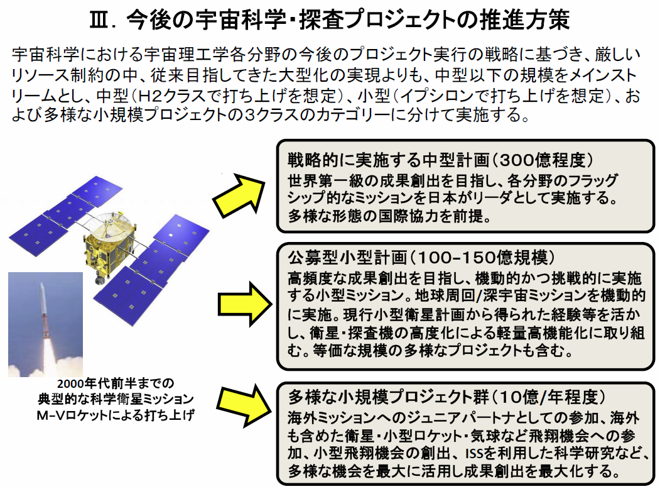
宇宙科学・探査ロードマップ
内閣府・宇宙政策委員会・宇宙科学・探査部会 資料より (2013年9月19日).

Slide 37
Collaboration and support
・Supports from LISA
Technical advices from LISA/LPF experiences
Support Letter for DECIGO/DPF, Joint workshop (2008.11)
・Collab. with Stanford univ. group
Drag-free control of DECIGO/DPF
UV LED Charge Management System for DPF
・Collab. with NASA/GSFC
Fiber Laser , Earth’s gravity observation
・Collab. with JAXA Trajectory and Navigation group
→ Formation flight of DECIGO, DPF drag-free control
・Geophysics group (Kyoto, ERI, UEC, NAOJ)
・Advanced technology center ( ATC) of NAOJ
・JAXA’s fund for small satellite development
・Research Center for the Early Universe (RESCEU), Univ. of Tokyo
Notes:
In addition to this organization, we have collaboration with and supports from other groups.
The LISA/LPF group members are providing us technical advises from their experiences.
In the last autumn, we had the 1st LISA-DECIGO joint workshop at JAXA, Japanese space agency.
This workshop was also helpful for us in political point of view. The JAXA peoples were
really impressed in the success of this workshop and the supports from LISA group.

Slide 38
Astronomy and Cosmology
・Verification of the alternative theories of gravity
Test Brans-Dicke theory by NS/BH binary evolution
→ Stronger constraint by 10⁴ times
K. Yagi and T. Tanaka, Prog. Theor. Phys. 123, 1069 (2010)
・ Black hole dark matter
Gravitational collapse of the primordial density fluctuations
→ Primordial black holes (PBHs)
as a candidate of dark matter
R. Saito and J. Yokoyama, Phys. Rev. Lett. 102 161101 (2009)
・ Neutron-star physics
Determine masses of 10⁵ NSs per year
→ Constrain the EoS of NS
Formation process of NS from the spectrum

Slide 39
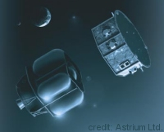
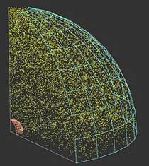
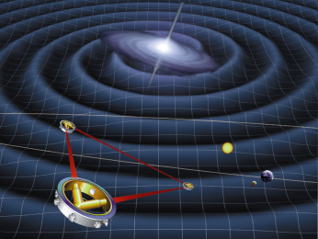
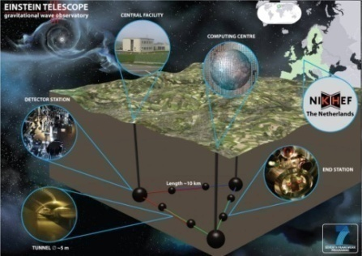
GW observation roadmap
Ground-based Observatory
Better sensitivity (10Hz-1kHz)
Space-borne observatory
Low-freq. observation (<1Hz)
LIGO
TAMA
CLIO
Virgo
Enhanced
LIGO
2010
LPF
DPF
KAGRA
Advanced
Virgo
LPF
Advanced
LIGO
2015
KAGRA
LISA
Pre-DECIGO
Ａｄ. ＬＩＧＯ
ET
LISA
2020
0.1mHz-10mHz
Guaranteed sources
DECIGO
Detection rate
~10 event/yr
BBO
DECIGO
2025
0.1Hz band
Cosmological GWs

Slide 40
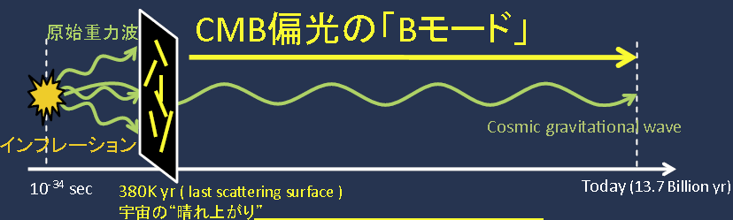
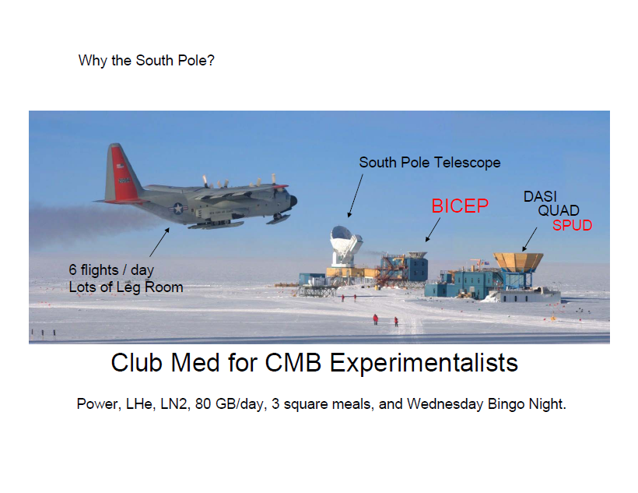
インフレーションの重力波観測
BICEP2, (POLARBEAR,…)
DECIGO, (KAGRA, aLIGO,…)
マイクロ波望遠鏡を用いた
宇宙背景放射 B-mode偏光
成分の観測.
重力波望遠鏡を用いた
宇宙背景重力波の観測.
CMB偏光観測望遠鏡
重力波
重力波観測望遠鏡
図: 田島氏談話会資料より(2011 京都大学)

Slide 41
DECIGO Interferometer
Interferometer Unit:
Differential FP interferometer
Baseline length: 1000 km
3 S/C formation flight
3 FP interferometers
Drag-free control
Arm cavity
1000km
Arm cavity
Laser
Mirror
Photo-
detector
Drag-free S/C
Notes:
DECIGO will be formed by three spacecraft, 1000km apart from one another.
Each spacecraft has test-mass mirrors inside it, and the distances between
them are measured by means of laser interferometers.

Slide 42
Organization
PI: Nakamura (Kyoto)
Deputy: Ando (Tokyo),Seto (Kyoto)
Executive Committee
Kawamura (ICRR), Ando (Tokyo), Seto (Kyoto), Nakamura (Kyoto), Tsubono (Waseda), Tanaka (Kyoto), Funaki (ISAS), Numata (Maryland), Sato (Hosei), Kanda (Osaka city), Takashima (ISAS), Ioka (KEK), Yokoyama (Tokyo), Akutsu (NAOJ)
Pre-DECIGO
Sato (Hosei)
Detector
Akutsu (NAOJ)
Numata (Maryland)
Science, Data
Tanaka (Kyoto)
Seto (Kyoto)
Kanda (Osaka city)
Satellite
Funaki (ISAS)
DECIGO pathfinder
Leader: Ando (Tokyo)
Design phase
Mission phase
Detector
Sato (Hosei)
Akutsu (NAOJ)
Ueda (NAOJ)
Aso (Tokyo)
Laser
Musha (ILS)
Ueda (ILS)
Drag free
Sato (Hosei)
Thruster
Funaki (ISAS)
Satellite
Sato (Hosei)
Data
Kanda (Osaka city)
Notes:
This shows the organization of DECIGO. The leader is Seiji Kawamura.
The upper part is organized as a design team for DECIGO. The organization also includes
a DECIGO pathfinder working group, shown in the lower part. This part is organized
as a mission phase team, and the subgroups are in charge of research and development tasks.

Slide 43
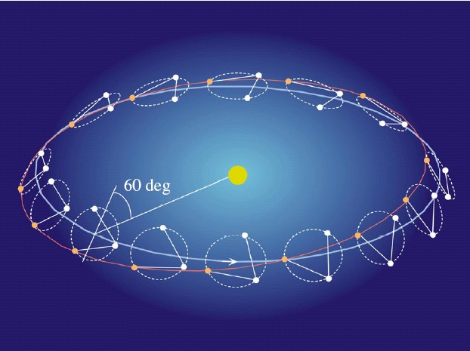
Orbit and Constellation
Separated
unit
Candidate of orbit:
Record-disk orbit around the Sun
Relative acc. 4x10⁻¹² m/s²
(Mirror force ~10⁻⁹ N )
Constellation
Separated
unit
overlapped
units
4 interferometer units
2 overlapped units → Cross correlation
2 separated units → Angular resolution
Notes:
The selection of orbit is a critical issue to suppress the effect of external force noise.
The obit of DECIGO is not decided yet. But the strongest candidate is a record disk
orbit along the Earth orbit around the sun as LISA. With this orbit, the relative acceleration
between test masses will be 4x10-12 m/s^2.
This acceleration corresponds to a force range of 10^-9 N for mirror actuator.
Another candidate is a halo orbit around a Lagrange point between the earth and the sun.
This is known to be a stable orbit. However, The relative acceleration is estimated
to be 4x10^-7 m/s^2, which requires larger actuation force to mirrors by 5 orders.
Thus, we adopted the record-disk orbit in the current pre-conceptual design.
As for the constellation, DECIGO will consist of 4 interferometer units.
Two of them will be placed in an overlapped place. This is required to take cross-correlation
of multiple detectors, and to distinguish the stochastic background signal from detector noises.
The other two units will be arranged at separated point along the same orbit.
These units enables us to increase angular resolution for the sky position of the source.
These are required to identify the sources and determine their redshift parameter.

Slide 44
Targets of DPF
Scientific observations
Gravitational Waves form BH mergers
→ BH formation mechanism
Gravity of the Earth
→ Geophysics, Earth environment
Science technology
Space demonstration for DECIGO
→ Most tech. with single satellite
(IFO, Laser, Drag-free)
Precision measurement in orbit
→ IFO measurement
under stable zero-gravity

Slide 45

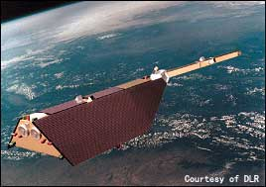
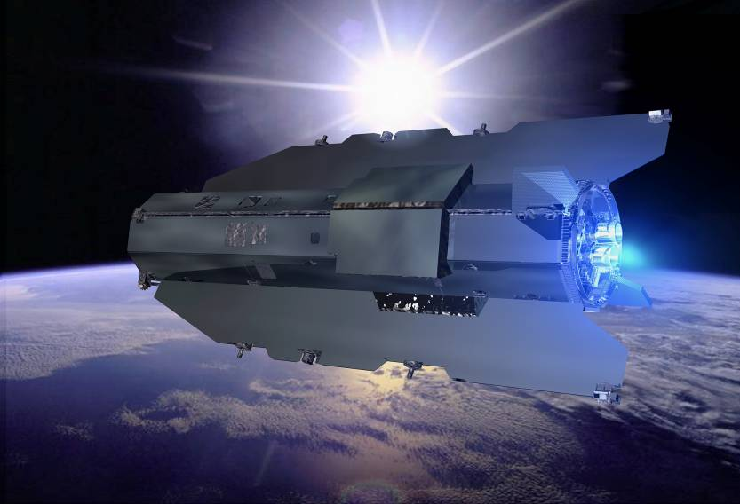
DPF Science
Astronomical observation
GW from merger of IMBHs
→ Formation mechanism
of supermassive BHs
NGC7093
NGC7078
NGC6441
NGC104
NGC6256
~30 GCs within DPF range
By K.Yagi
Observation of the earth
Gravitational potential
→ Shape of the earth
Environment monitor
By A.Shoda
Comparable sensitivity
with other missions
100km
80km
Spatial
Scale

Slide 46
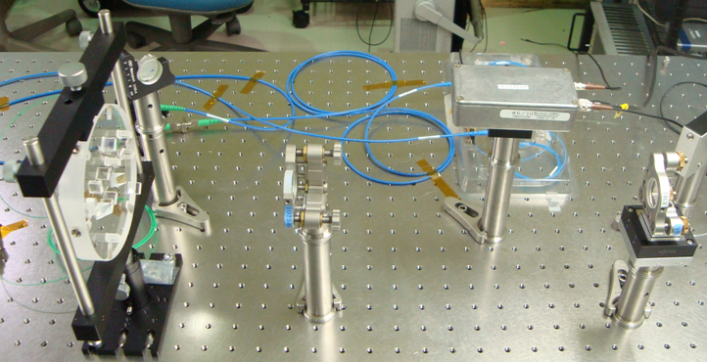
光学系部品だけでの動作テスト
干渉計モジュールについて
この状態でのFabry-Perot光共振器の動作は確認済み。
← 1030 nm laser source + fiber coupler
Fibered EOM
Input optics (BBM2)
Cavity (300mm)
Feedback to the piezo stage at the end mirror and laser source.
The cavity can be operated.
by Kasuga

Slide 47
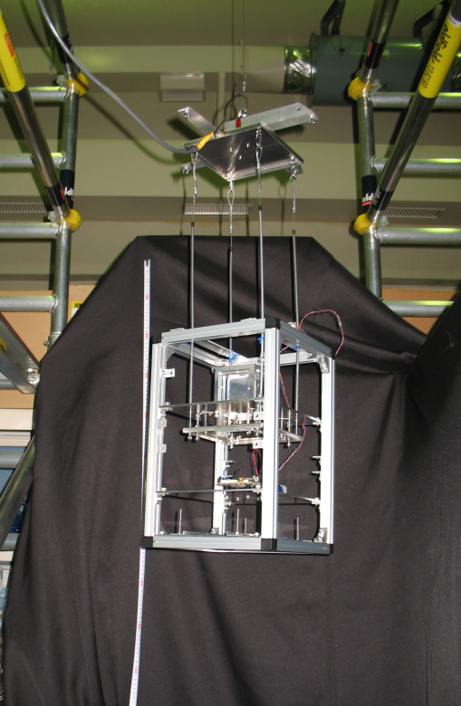
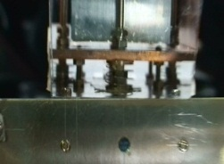
自由落下試験
・無重力下での試験マス制御デモンストレーション (国立天文台)
- 落下モジュール (構造, 電源, センサ,ロガーなど)
- ~3m落下設備 (足場, 切り離し機構, クッションなど)
切り離し機構
自由落下時の様子
試験マス
支持
フィンガー
試験マス
モジュール
約30cm
バッテリー
装置制御
信号記録
フレーム
無重力下で試験マス浮上を確認
落下モジュール
今後,静電S/Aによる制御をめざす.

Slide 48


SWIMによる宇宙実証
Photo：
JAXA
SDS-1搭載のSWIM (Space wire demonstration module)
2009年1月打ち上げ, 2010年9月運用停止
世界で最初の 宇宙重力波検出器
SpaceCube2: Space-qualified Computer
SWIMμν : User Module
CPU: HR5000
(64bit, 33MHz)
System Memory:
2MB Flash Memory
4MB Burst SRAM
4MB Asynch. SRAM
Data Recorder:
1GB SDRAM
1GB Flash Memory
SpW: 3ch
Processor test board
GW+Acc. sensor
FPGA board
DAC 16bit x 8 ch
ADC 16bit x 4 ch
→ 32 ch by MPX
Torsion Antenna x2
~47g test mass
Data Rate : 380kbps
Size: 124 x 224 x 174
Weight: 3.5 kg
Power: ~7W
Size: 71 x 221 x 171
Weight: 1.9 kg
Power: 7W
Photo by JAXA
Photo by JAXA
SDS-1
Bus System
Power +28V
RS422 for CMD/TLM
GPS signal
Power ±15V, +5V
SpW x2 for CMD/TLM

Slide 49
DPF Sensitivity
Laser source : 1030nm, 25mW
IFO length : 30cm
Finesse : 100, Mirror mass : 1kg
Q-factor : 10⁵, Substrate: TBD
Temperature : 293K
Satellite mass : 350kg, Area: 2m²
Altitude: 500km
Thruster noise: 0.1μN/Hz^{1/2}
(Preliminary parameters)
Notes:
With this configuration, DPF will have this sensitivity curve. The black curve represents
the DPF sensitivity to GW signals. This level is mainly limited by laser frequency noise
in high frequency band, and acceleration noise in low frequency band.

Slide 50
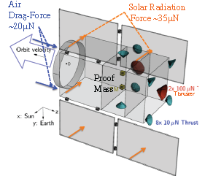
ミッションスラスタ構成
・ミッションスラスタ構成
- 準定常成分 100 μNスラスタ 2台
大気ドラッグ, 太陽輻射圧
- 変動成分 10 μNスラスタ 8台
大気圧変動, 太陽輻射変動
ミッションスラスタ仕様
推力 0.5-100 μN x2 (可変)
0.5-10 μN x 8 (可変)
分解能 0.1 μN
推力雑音 0.1 μN/Hz^{1/2}
制御応答 >10Hz
Isp TBD
電力・質量 <40W, <40kg
運用寿命 4,300 時間

Slide 51
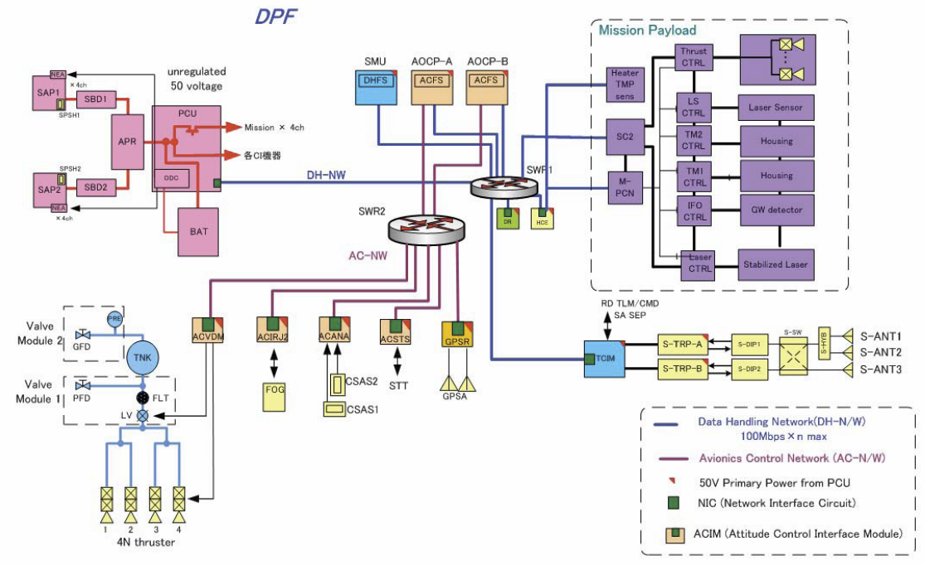
DPFシステムブロック図

Slide 52
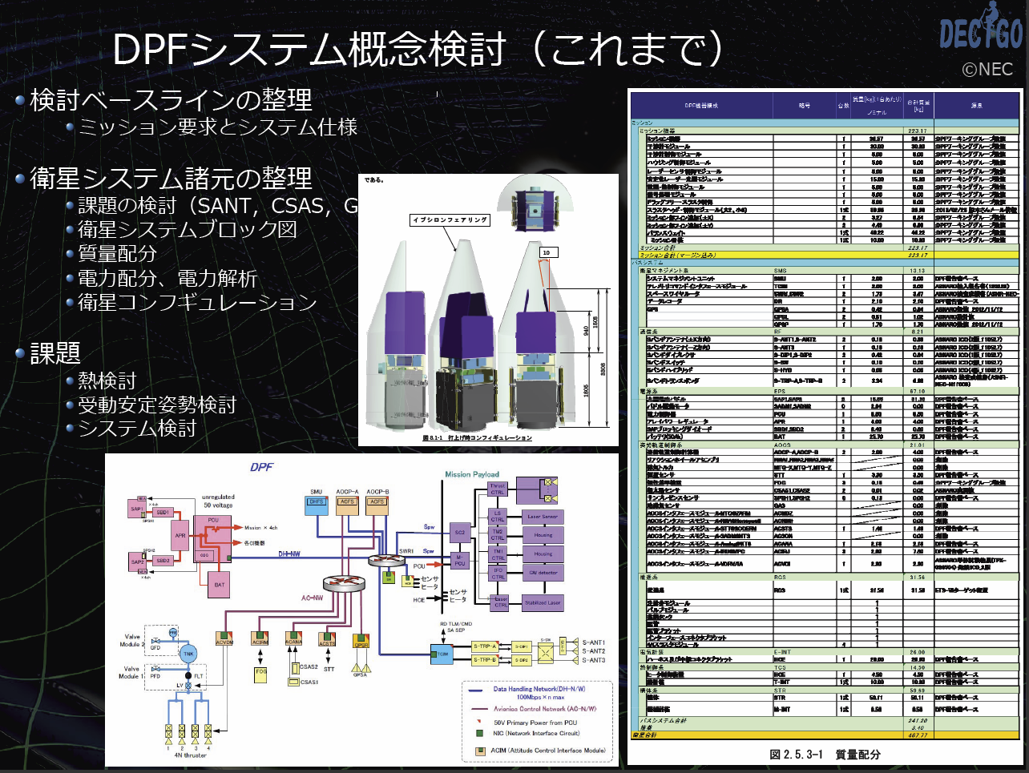
補足

Slide 53
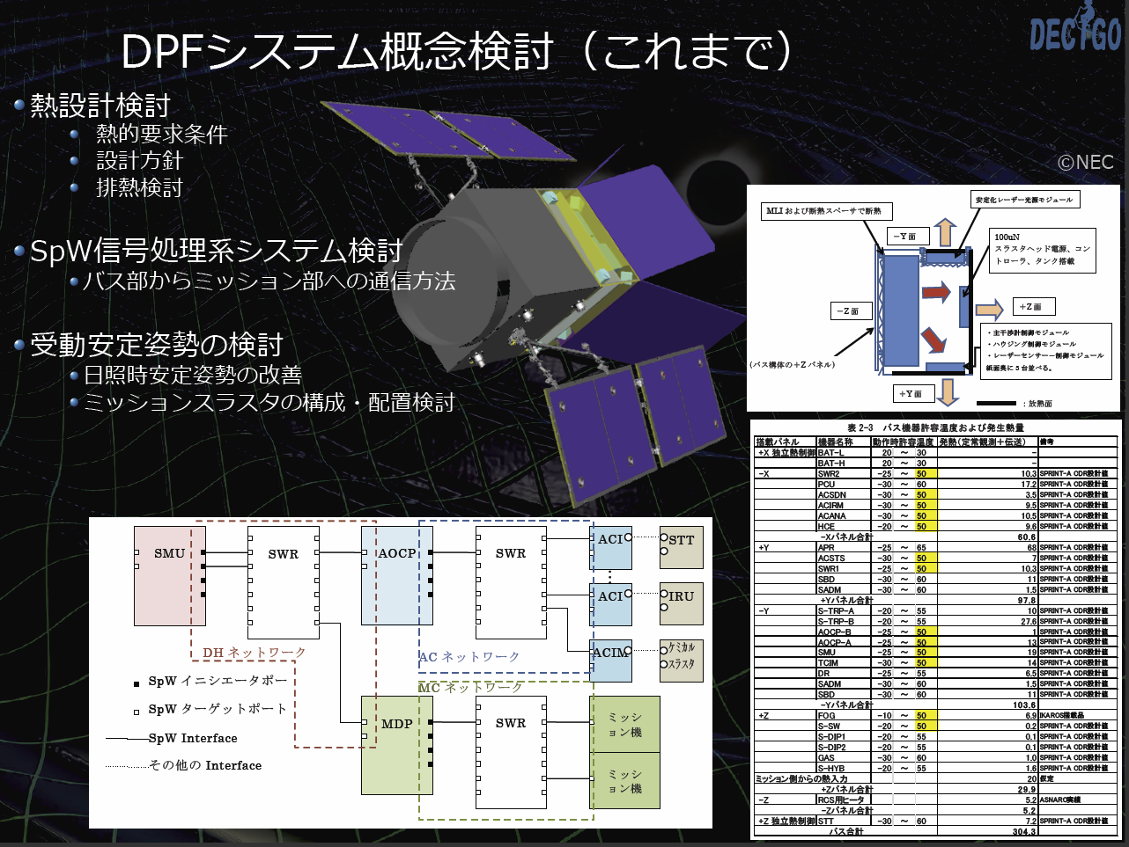
補足

Slide 54
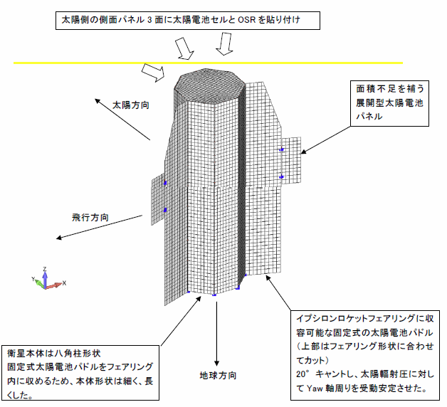
受動安定姿勢のための検討
・衛星構造のオプション案の検討
問題意識: 衛星構造(特にSAP)の共振など剛性を高めた構成の検討.
従来は衛星バスの制約から検討外であったが、ミッションの
枠組み変更に伴い検討を開始.
(SE室との相談でもencourageされた)
結果: 成立する可能性があることを示唆.
- 最低共振周波数
従来 1~2Hz → 今回 26.8 Hzに向上.
- 質量評価 → これまでとほぼ同等.
- SAP面積 従来 4.3 m² → 2.8 m².
- 要検討事項:
搭載機器配置, 質量バランス, 電力,
排熱面設定, ミッションスラスタ配置,
受動姿勢安定, コスト など.

Slide 55
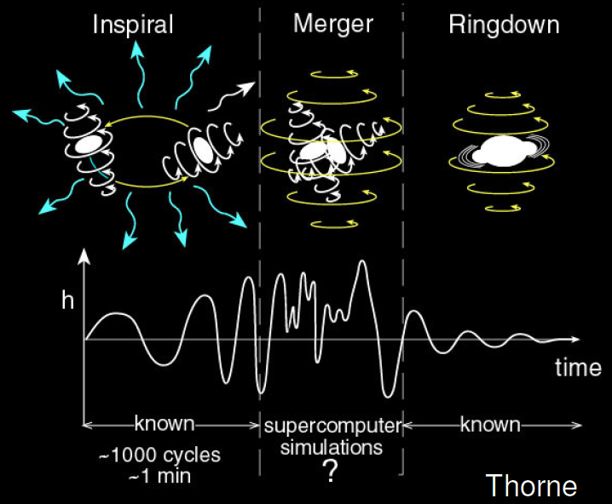

GW target of DPF
Black hole events
in our galaxy
IMBH inspiral and merger
Obs. Distance 40kpc,
for m = 2 x10⁴ M_{sun}
Obs. Duration (~1000sec)
Observable range covers
our Galaxy (SNR~5 )
NGC7093
NGC7078
There may be IMBH at GCs
DPF covers ~30 GCs
NGC6441
NGC104
NGC6256
Hard to access by others
→ Original observation
KAGAYA
(By K.Yagi)
Notes:
However, DPF has scientific targets, which are blackholes in our galaxy.
Inspiral and coalescence of intermediate-mass blackhole is one of the main targets of DECIGO,
and also a main target of DPF. This figure shows the observable range of DPF as a function
of blackhole mass.
The green curve is the range for BH inspirals, and this green curve is for quasi-normal modes.
This red line represents the distance to the galactic center. So this figure shows that
DPF has sufficient sensitivity to observe events at the center of our galaxy, if any.
Since this frequency band, around 0.1Hz, is hard to access by ground-based detectors,
this will be an original observation.

Slide 56
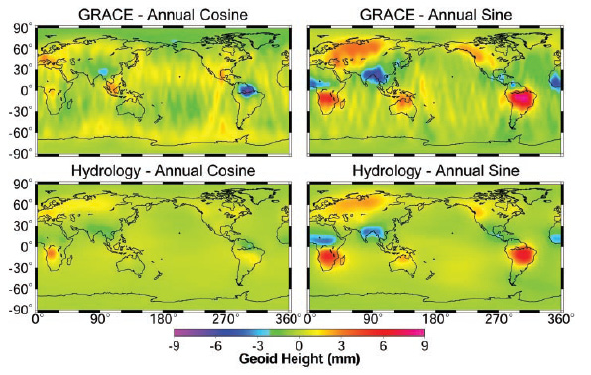
Earth’s Gravity Observation
Measure gravity field of the Earth
from Satellite Orbits, and gravity-gradiometer
comprehensive and homogeneous-quality data
Determine global gravity field
→ Basis of the shape of
the Earth (Geoid)
Monitor of change in time
→ Result of Earth’s dynamics
Ground water motion
Strains in crusts by
earthquakes and volcanoes
Seasonal change of the gravitational potential observed by GRACE

Slide 57
Satellite Gravity missions
3-types of satellite gravity missions
Satellite-to Satellite
tracking High-Low
Satellite-to Satellite
tracking Low-Low
Satellite
Gravity Gradiometry
・Observe satellite orbit
by global positioning
system (GPS,…)
・Cancel drag-effects
by accelerometer
・Distance meas. by
along-track satellites
・Cancel drag-effects
by accelerometer
・Observe potential by
gravity gradiometer
・Drag-free control for
cancellation of drags
CHAMP (GFZ, 2000-)
GRACE (NASA, 2002-)
GOCE (ESA, 2009-)

Slide 58
DPF sensitivity
Comparison of sensitivities
Better in low orders (large scale) ← Sensors
Worse in high orders (small scale) ← Altitude
Report for Mission Selection
Gravity Field and Steady-State
Ocean Circulation Mission
ESA SP-1233(1) July 1999.
400km
100km
80km
Scale
(with margin 10)

Slide 59
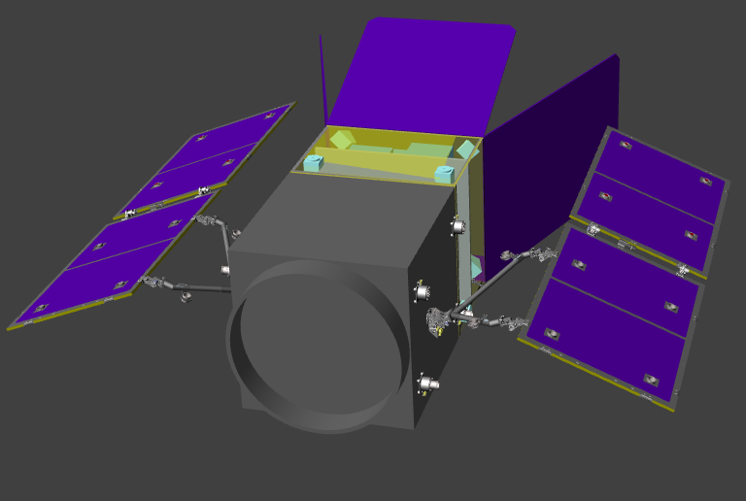
DPF-WG activities
Mission design
・Structure and thermal modeling
・Drag-free control design
Design : NEC

Slide 60
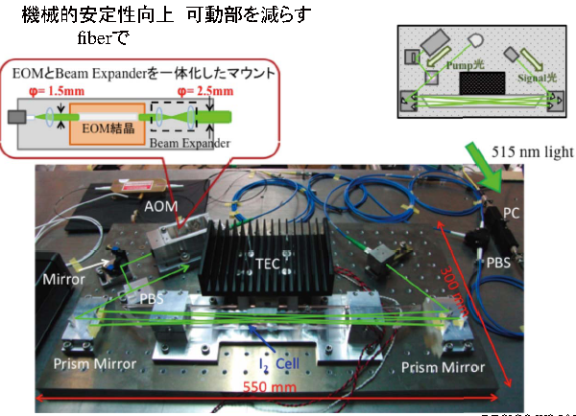
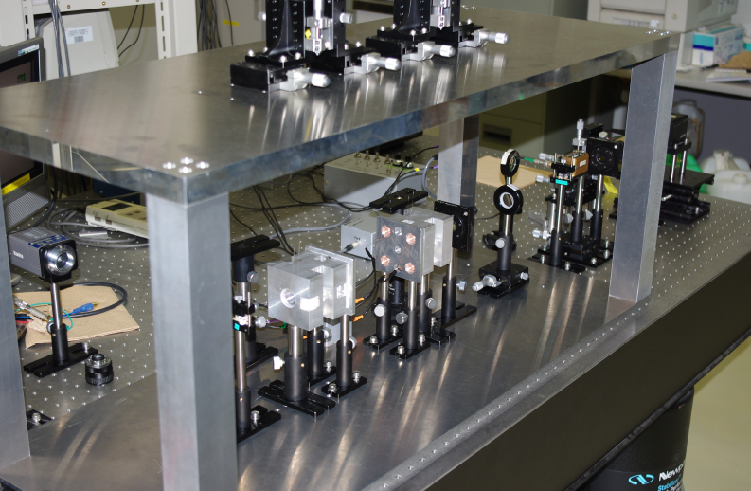
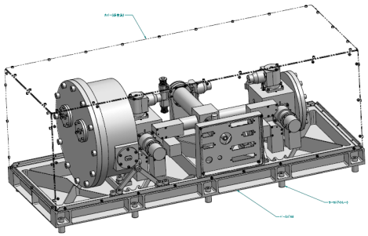
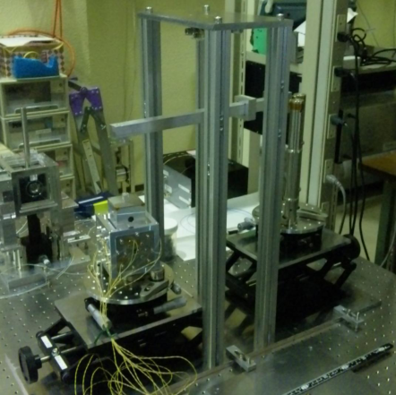
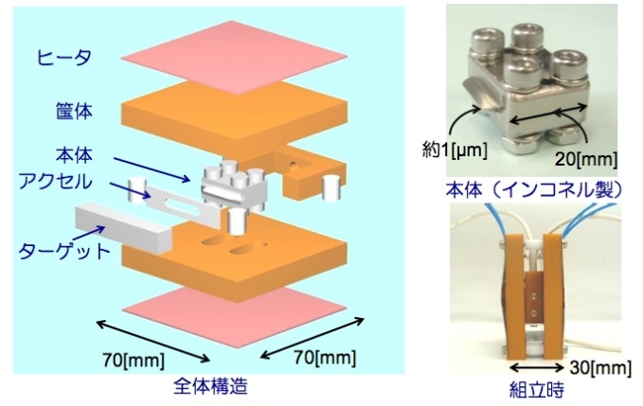
DPF-WG activities
BBMs (Bread-board model) for Core components
Laser stabilization module
Interferometer module
Univ. of Tokyo,NAOJ
Test-mass module
UEC, NICT, NASA/GSFC
NAOJ, Hosei Univ.
Low-noise thruster module
JAXA

Slide 61
SWIM

Slide 62
Roadmap
Figure: S.Kawamura
 | 2010 | 11 | 12 | 13 | 14 | 15 | 16 | 17 |  | 18 | 19 | 20 | 21 | 22 | 23 | 24 | 25 | 26 | 27 | 28 | 29
Mission
Objective | Space test of key tech. GW observation |  |  |  |  |  |  |  | Detect GW with min. spec FP between S/C |  |  |  |  |  |  | GW astronomy
Design | Single small satellite Short FP interferometer |  |  |  |  |  |  |  | 3 S/C 1 interferometer unit |  |  |  |  |  |  | 3 S/C x 3-4 units
R&D
Fabrication
R&D
Fabrication
R&D
Fabrication
DECIGO
Pathfinder
(DPF)
Pre-DECIGO
DECIGO
SDS-1/SWIM

Slide 63


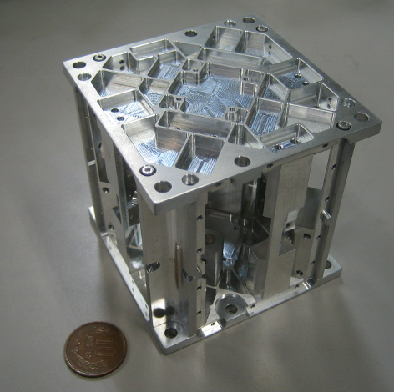


Rotating TOBA : SWIMμν
Small Module SWIMμν on SDS-1
Launched Jan. 2009, Terminated Sept. 2010
Photo：
JAXA
TAM: Torsion Antenna Module with free-falling test mass
(Size : 80mm cube, Weight : ~500g)
Test mass
~47g Aluminum, Surface polished
Small magnets for position control
Spin Axis
(46.5mHz)
Coil
Photo sensor
Reflective-type optical
displacement sensor
Separation to mass ~1mm
Sensitivity ~ 10⁻⁹ m/Hz^{1/2}
6 PSs to monitor mass motion
80mm

Slide 64

Sensitivity
Though limited by non-fundamental noises,
best as a space-borne GW detector.
By W.Kokuyama

Slide 65


Observation by SWIM
Continuous data taking
Tokyo
Kyoto
Jun 17, 2010 ~120 min.
July 15, 2010 ~240 min.
Orbital period
~100min.
Observation band
Orbital Period
10mHz LPF
By W.Kokuyama

Slide 66



Upper Limit on GWB
Upper Limit at two frequencies (two polarizations)
‘Forward’ mode
‘Reverse’ mode
(C.L. 95%, f0 18mHz, BW 4mHz)
By W.Kokuyama

Slide 67

背景重力波探査の現状
BICEP2
Shoda+, PRD D 89, 027101.

Slide 68

KAGRA and DECIGO
KAGRA (~2016)
Terrestrial Detector
→ High frequency events
DECIGO (~2027)
Space observatory
→ Low frequency sources
Target: GW detection
Target: GW astronomy

Slide 69

Roadmap
Figure: S.Kawamura
 | 2010 | 11 | 12 | 13 | 14 | 15 | 16 | 17 |  | 18 | 19 | 20 | 21 | 22 | 23 | 24 | 25 | 26 | 27 | 28 | 29
Mission
Objective | Space test of key tech. GW observation |  |  |  |  |  |  |  | Detect GW with min. spec FP between S/C |  |  |  |  |  |  | GW astronomy
Design | Single small satellite Short FP interferometer |  |  |  |  |  |  |  | 3 S/C 1 interferometer unit |  |  |  |  |  |  | 3 S/C x 3-4 units
R&D
Fabrication
R&D
Fabrication
R&D
Fabrication
DECIGO
Pathfinder
(DPF)
Pre-DECIGO
DECIGO
SDS-1/SWIM
Notes:
As shown in the previous viewgraph, DECIGO requires huge resources. So, we have a roadmap
to realize it step by step. We are planning to launch two milestone missions.
The first one is named DECIGO pathfinder, or DPF in short. This is a single satellite
orbiting around the earth. The purpose of DPF is to test the key technologies for DECIGO,
and also to carry out observation runs. The second milestone mission is named pre-DECIGO.
This will consist of three spacecraft. The purpose of pre-DECIGO is to detect GWs with
minimum interferometer specifications.

