Slide 1
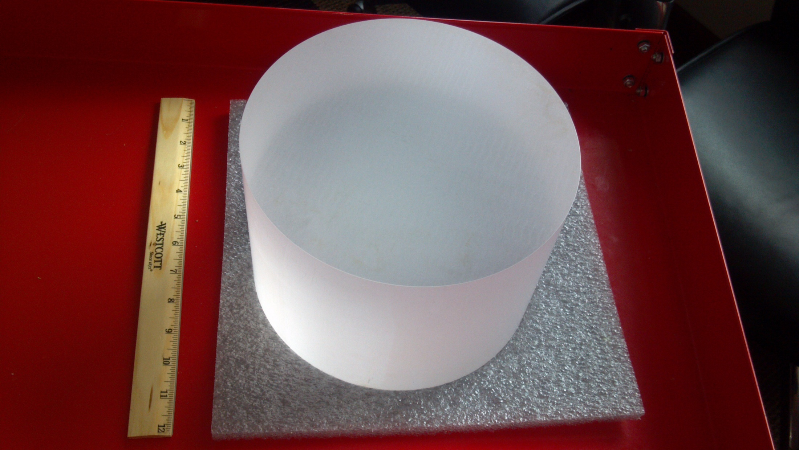
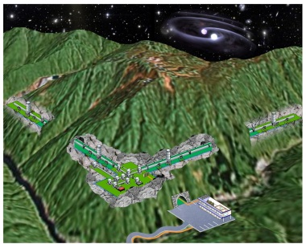
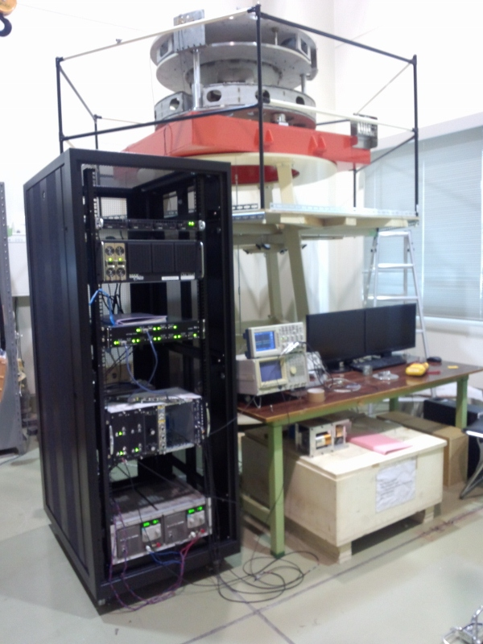
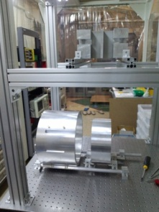


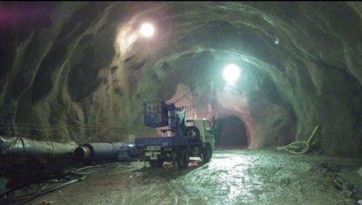
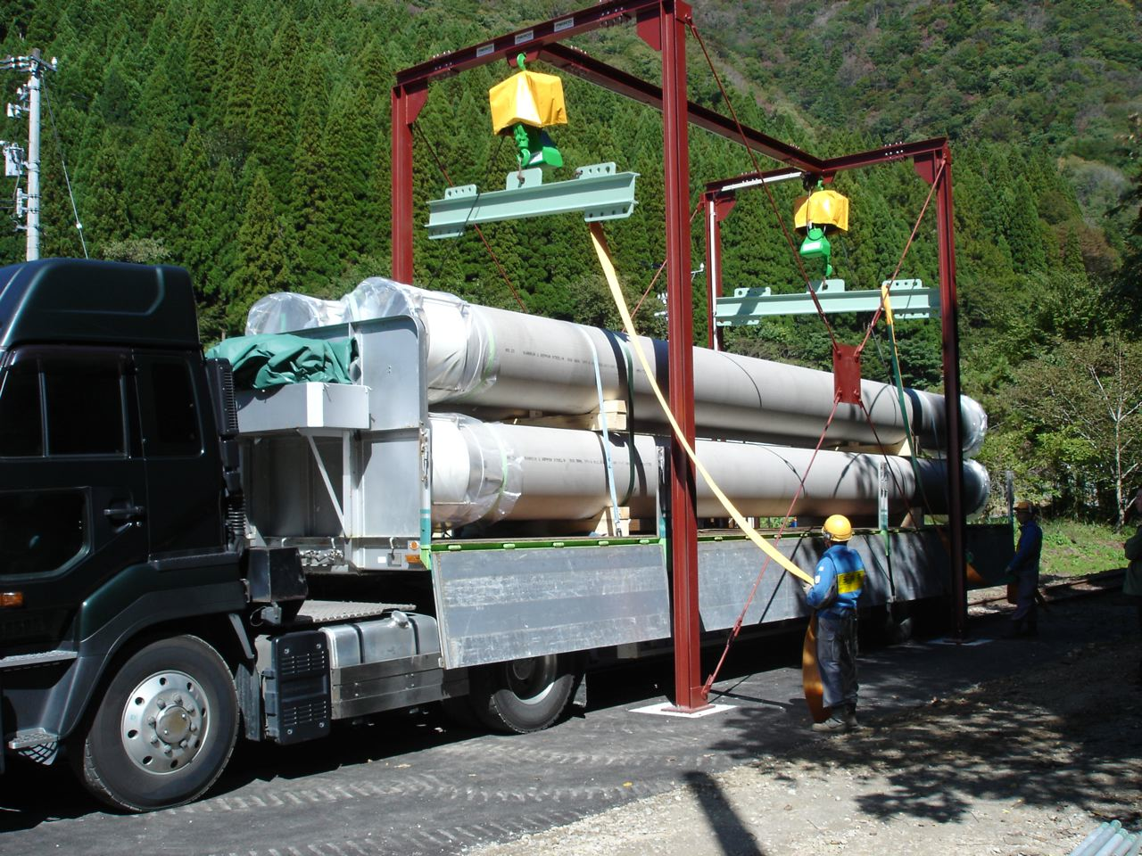
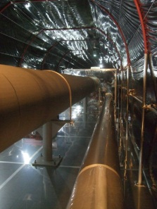
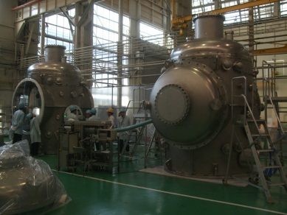
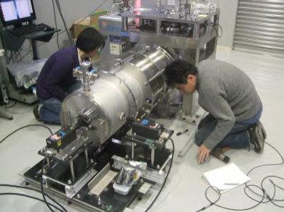
重力波プロジェクト推進室
Gravitational-Wave Project Office
安東 正樹 Masaki Ando

Slide 2
Outline
・Members and Activities
・KAGRA Overview and Status
・Activities of GW group
・Summary

Slide 3
GW Project Office

Slide 4
Purpose of GW Project Office
・Goal : Opening and Expansion of the field of
Gravitational-Wave Astronomy.
・Current Activities
- Large-scale cryogenic GW antenna : KAGRA
* Promotion of the project as a core institute.
* GW astronomy.
- Research and development for future detectors
* Advanced technologies for ground-based detector.
* Space GW antenna.
Project, Research Achievement, Education

Slide 5
Members
Total : 21 Members
・Research Staff
Professor
Raffaele Flaminio
Associate Prof.
Masaki Ando (U. Tokyo)
(Yoichi Aso from April 2014)
Research Associate
Ryutaro Takahashi (ICRR)
Daisuke Tatsumi
Akitoshi Ueda (50%)
Naoko Ohishi (ICRR)
Tomotada Akutsu
・Engineer Staff
Hideharu Ishizaki
Yasuo Torii
Nobuyuki Tanaka
・Postdoctoral Fellow
Kouji Nakamura
Fabian Peña Arellano
Daniel Friedrich (from Sept.30)
・Support Staff
Mihoko Kondo
Mizuho Yoshizumi
Ramsey Lundock
・Professor Emeritus
Masa-Katsu Fujimoto
・Special Guest Researcher
Kazuhiro Hayama
・Students
Ayaka Shoda (D2, U. Tokyo)
Koki Okutomi (M1, Sokendai)
Mizuki Nikaido (B4, Ochanomizu U.)
New!
New!
New!
New!
New!
New!
New!

Slide 6
Changes in Members
・Staffs
* New Professor, R.Flaminio has come (Sept. 1st -) !
* A. Prof. M.Ando moved to UT, but still support GW
office under an agreement between NAOJ and UT.
* New A. Prof. Y.Aso will come in the next April.
・Pos-doc fellows
* Agatsuma finished his term, and moved to NIKEF.
* Hayama moved to Osaka City Univ.
* One additional project fellow post was newly assigned.
→ Two new Pos-docs: F. P. Arellano and D. Friedrich.
・Support Member : R.Lundock (AIC)
・New students: Okutomi (SOKENDAI), Nikaido (Ochanomizu)

Slide 7
Research Activities
・FY2012
Advanced Technologies
KAGRA
・FY2013
Advanced Technologies
KAGRA
※ Sum of Individual efforts
Students are not included

Slide 8
Research Activities
・First priority : Success of KAGRA and GW astronomy.
As one of core institute, promote the project.
- Members of management teams (EO and SEO).
- Chiefs / Sub-chief of key subsystems.
- Astronomical achievements.
・Fundamental research is also important
Continuous growth of the GW field, with achievement
and education of next-generation researchers.
- Novel and challenging scientific value.
- Appealing research activities for nearby field.
Balance the Activities with Broad Outlook

Slide 9
Overview of KAGRA

Slide 10
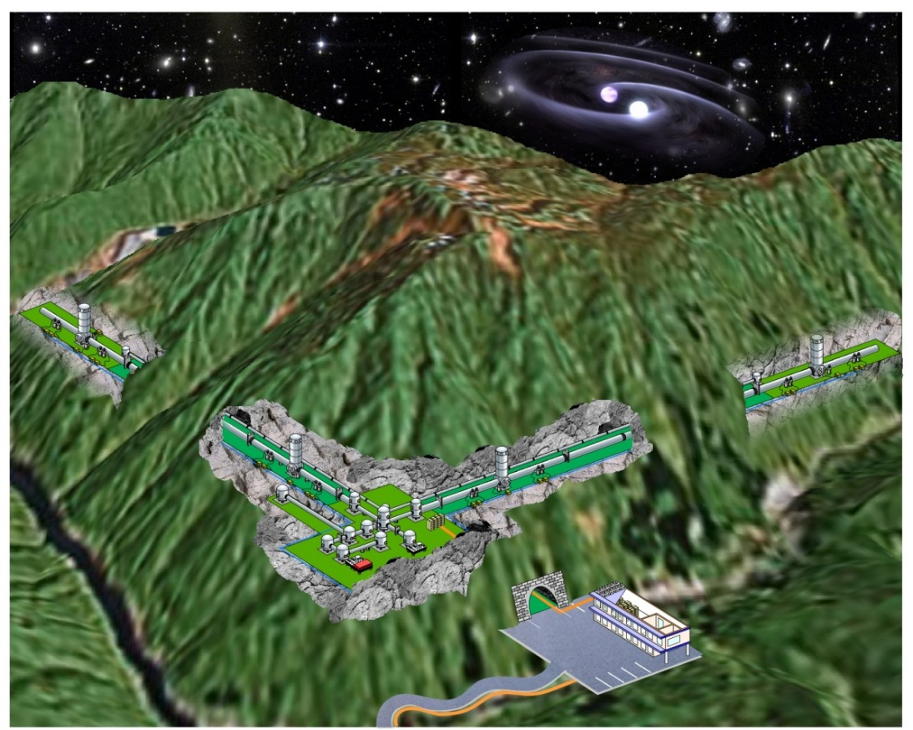
Gravitational-Wave Telescope
KAGRA (かぐら)
2nd Generation Large-scale
Gravitational-Wave Telescope
at Kamioka underground site
(Funded 2010-, Obs. : 2017-)
Open a new field of
‘Gravitational-Wave Astronomy’

Slide 11

KAGRA Collaborations
219 Collaborators from more than 60 institutes
※ on April 2013
・Host:
ICRR/U-Tokyo
・Co-host :
NAOJ and KEK
・Collaborations
U-Tokyo, ERI/U-Tokyo,
Osaka-CU, TITEC, Osaka-U,
Kyoto-U, NICT, AIST, UEC,
Hosei-U, Ochanomizu-U,
Niigata-U, Kyusyu-U, Nihon-
U, Toyama-U, Caltech,
MPQ, UWA, LSU, …

Slide 12
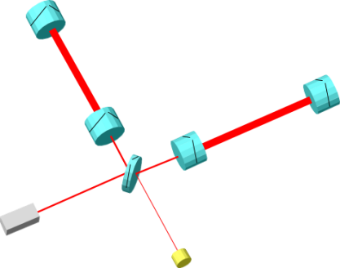
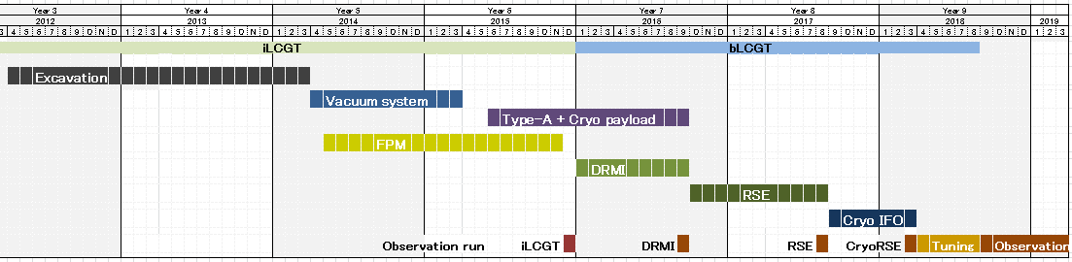
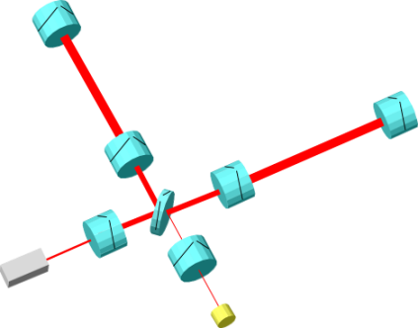
KAGRA Schedule
・iKAGRA (2010.10 – 2015.12)
3-km FPM interferometer
- Baseline 3km room temp.
- Operation of total system
with simplified IFO and VIS.
2012
2013
2014
2015
2016
2017
2018
bKAGRA
iKAGRA
OBS
・bKAGRA (2016.1 – 2018.3)
Operation with full config.
- Final IFO+VIS configuration
- Cryogenic operation.
Cryo-mirrors
Recycling
mirrors

Slide 13
Schedule and Budget
FY2010
FY2011
FY2012
FY2013
FY2014
FY2015
FY2016
FY2017
‘Leading‐edge Research Infrastructure’
program (~$98M) for iKAGRA
‘Specially Promoted Research’ program
(~$5M) for detector upgrade
Budget
Budget from MEXT
(~$37M) for excavation
Budget from MEXT (~$20M)
for detector upgrade
Scientific Research on Priority Areas
(~$8M, ~$3M for GW) for multi-messenger astronomy
Core-to-core program
(<$1M) for traveling and collaboration
iKAGRA
bKAGRA
KAGRA
configuration
Upgrade
・KAGRA facility
・3km simple room-
temp. interferometer
・Cryogenic mirrors
・Full-power RSE configuration
Purpose
Preparation of infrastructure
GW detection and
astronomy

Slide 14
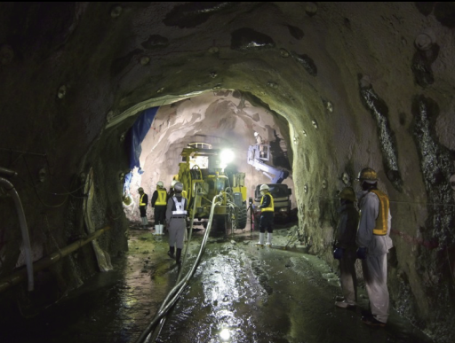
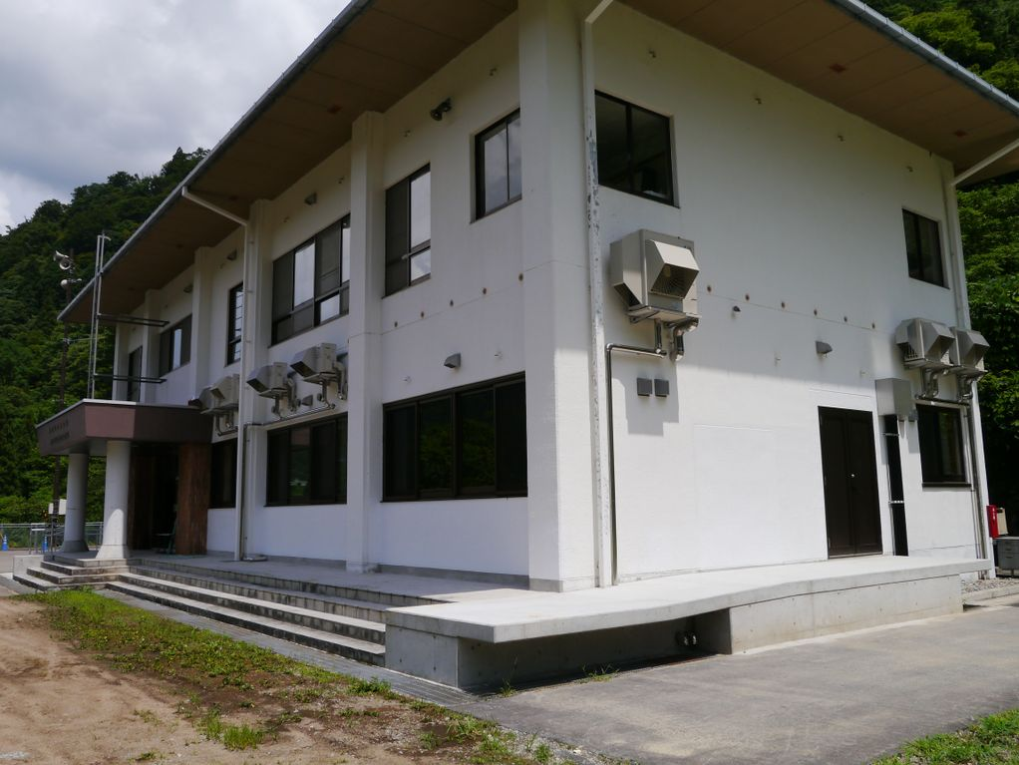
Construction Status of KAGRA
・Infrastructure and large systems mostly finished.
- Tunnel : ~700m to be finished.
- Facility : Kamioka office open.
New building under construction.
- Vacuum : Arm ducts delivered.
Vacuum tanks under construction.
- Cryostat : All of four have been completed.

Slide 15
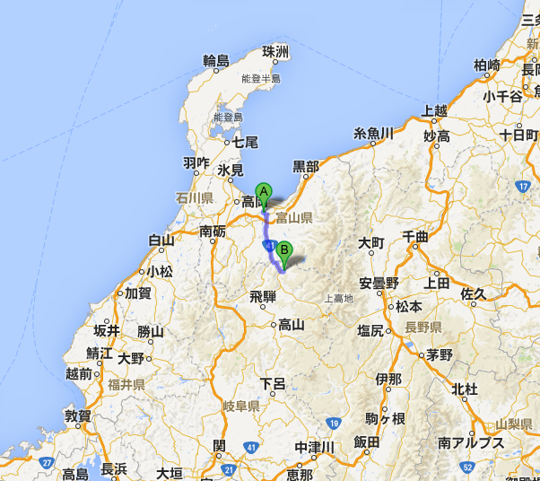
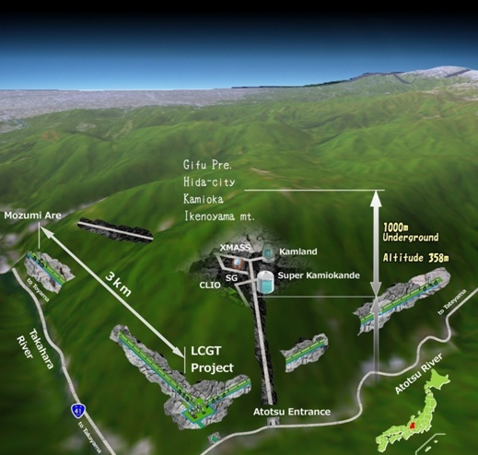
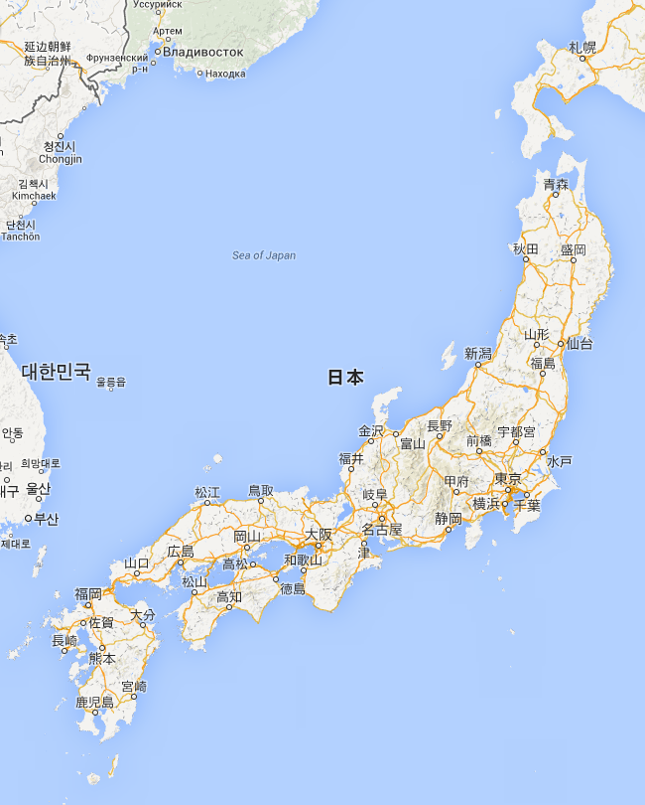
KAGRA Site
Underground site at Kamioka, Gifu
Facility of the Institute of Cosmic-Ray Research (ICRR), Univ. of Tokyo.
Underground Research Facility
Neutrino : SK, Kamland
Dark matter : XMASS
Gravitational Wave : CLIO, KAGRA
Geophysics : Strain meter
1hr from
Toyama by car
Map by Google

Slide 16
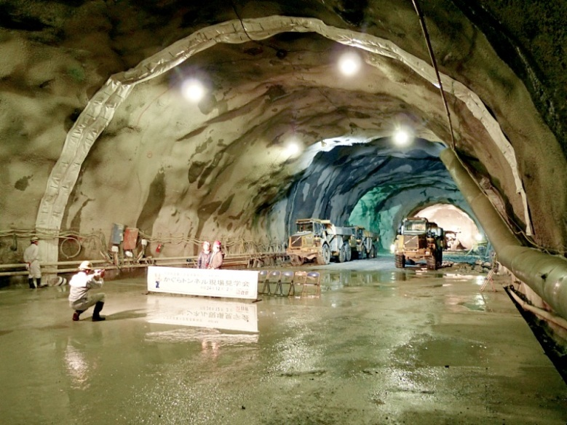
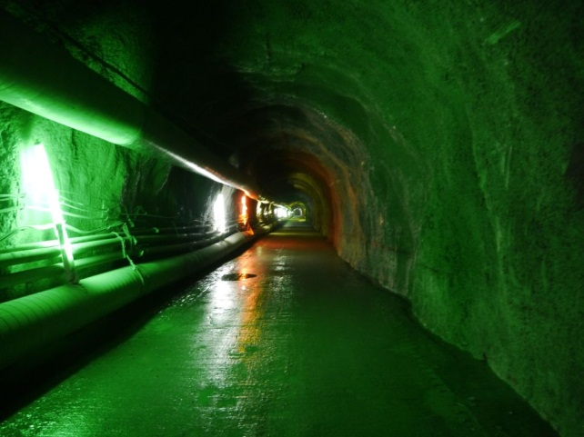
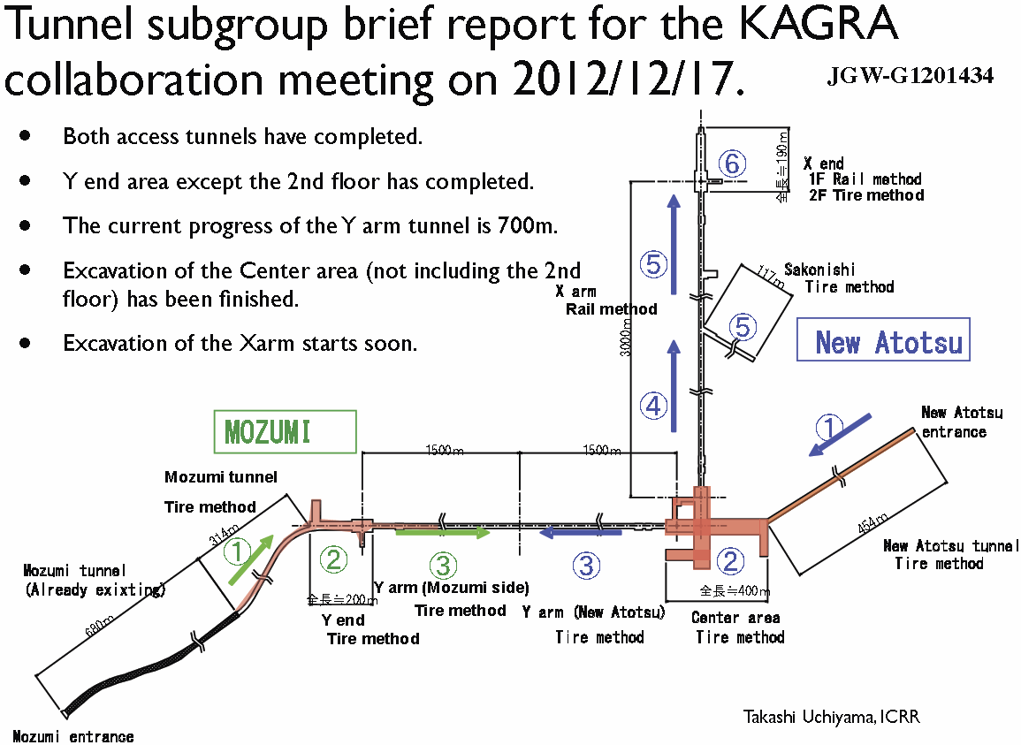
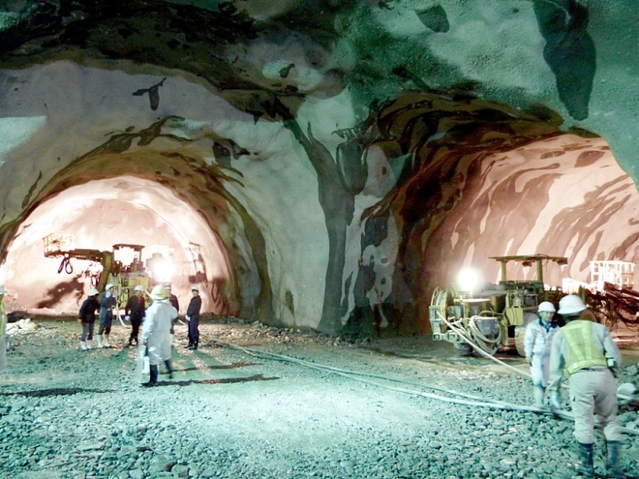
Tunnel Excavation
・Excavation of Y arm to be completed by
the end of November.
・As of November 20, remaining lengths
are 63m (Y-arm) and 627m (X arm).
Center Room
Will be finished by the next March.
Y arm tunnel
BS position

Slide 17
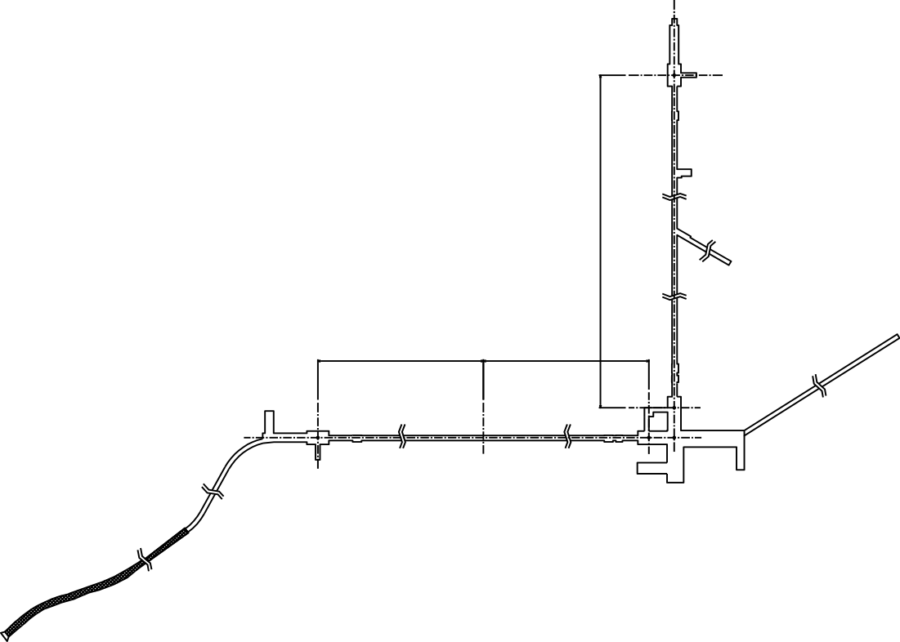
Facility : Safety Management of KAGRA
Ventilation system evaluation:
radon, CO, CO₂, organic solvents
Recommendation for improvement based on relevant laws.
300m^3/h
X End
(Sakonishi)
300m^3/h
fresh air
300m^3/h
300m^3/h
400m^3/h
500m^3/h
Y End
(Mozumi)
100m^3/h
Atotsu
Access
Tunnel
Mozumi
Access
Tunnel
Corner
(Atotsu)
by Ohishi

Slide 18
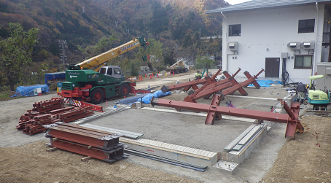
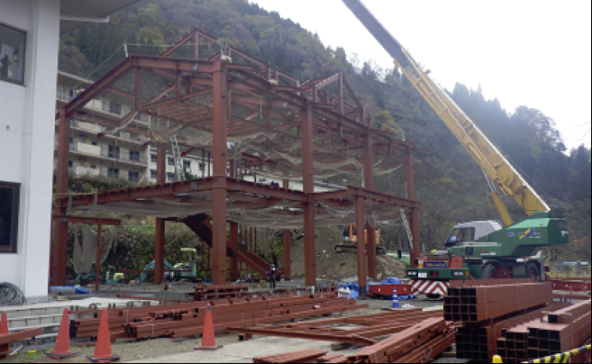
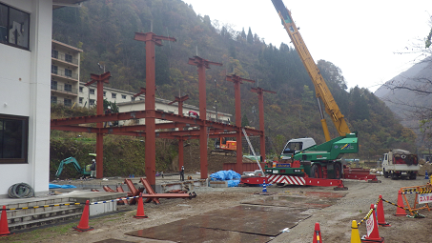
Surface building
by Ohishi
・Office and Laboratory at the Kamioka site.
・The framework of the data-analysis building
next to the existing building is completed.
Nov 19, 2013
Nov 22, 2013
Nov 20, 2013

Slide 19
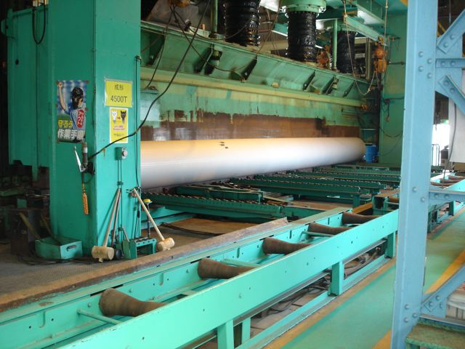
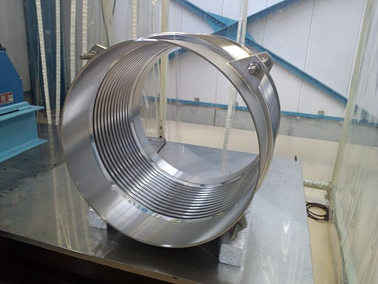
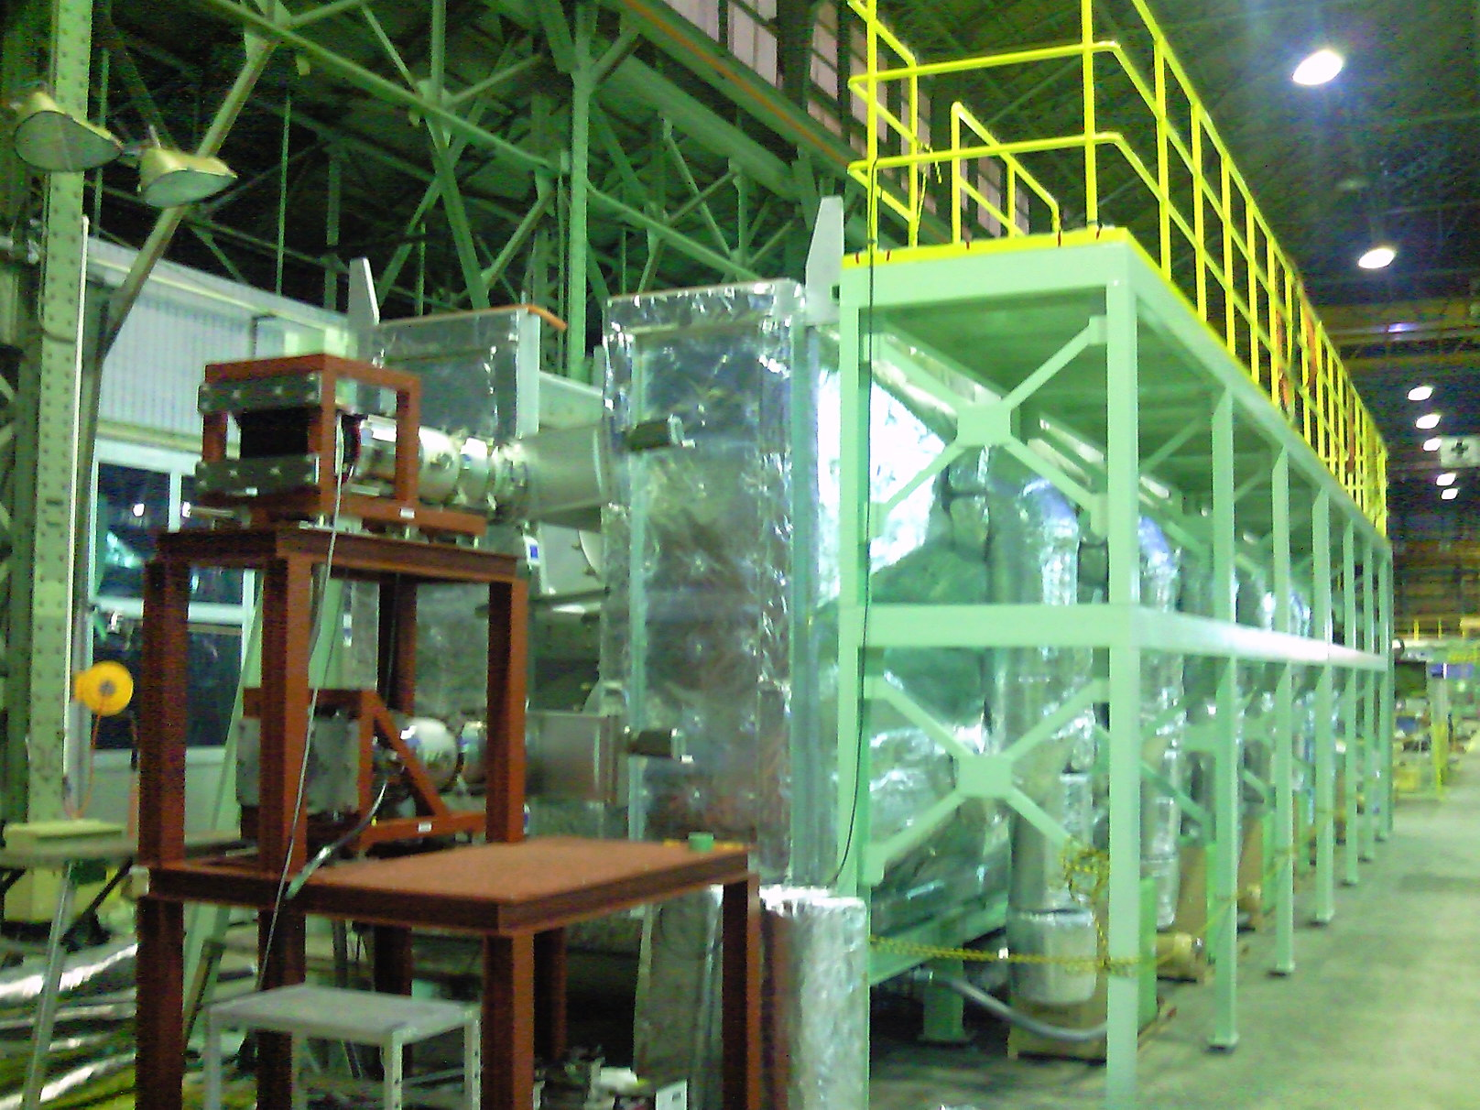
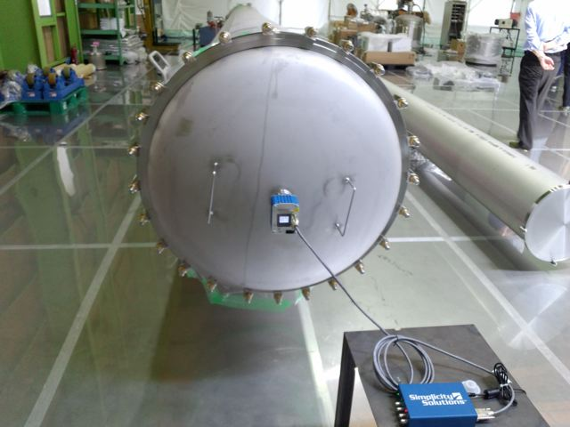
KAGRA Vacuum duct
・12m, Φ800mm ducts for 3km x 2 arms→ Delivered.
Presentation
By Y.Saito (KEK)
Press to form a duct
Bellows for each duct
Baking at MIRAPRO Co.
Noda/MESCO, Kamioka
Transportation to Kamioka
Test at MIRAPRO Co. Noda

Slide 20
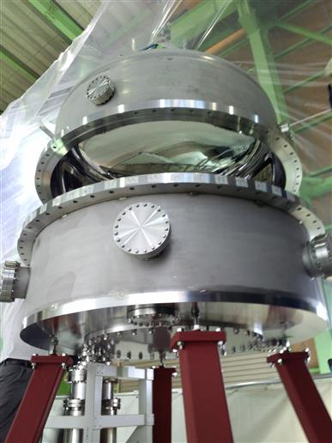
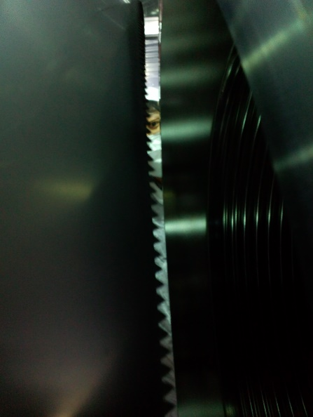
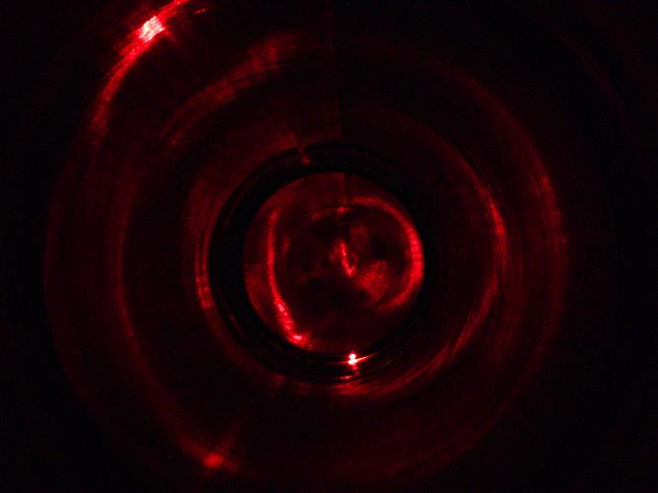
Production of vacuum system for KAGRA
・Production of 19 vacuum chambers is on going.
One of them is used for a prototype test of the
vibration isolation system in TAMA.
・Production of 250 baffles is on going.
Solblack (a kind of Nickel plating) was employed
as surface treatment for shading baffles.
by Takahashi
Leak test of the f1500 chamber in which the pre-isolator is put away.Metal O-rings are used to seal the flanges.
Prototype of shading baffle inserted into f800 tube. The baffle has saw shape edge.
A beam spot on the baffle inside the f800 tube. DLC and Solblack are tested as surface treatment.

Slide 21
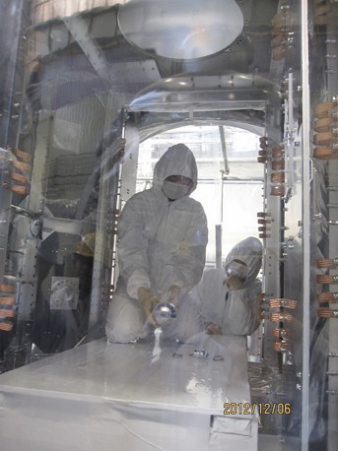

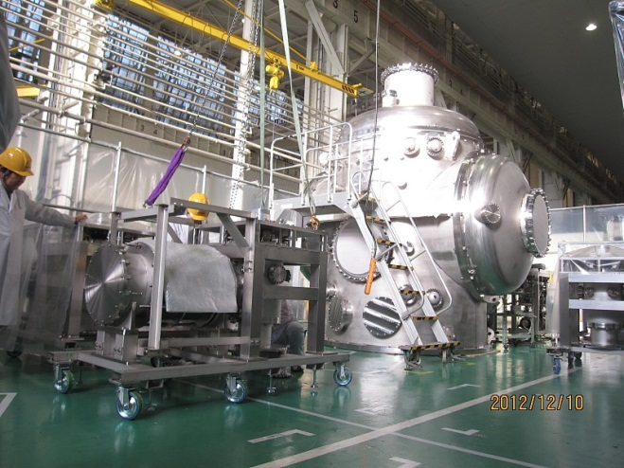
Cryostat Construction and Test
Construction and cooling tests were finished!
Inside the Rad. Shield
Cryostat #1 in preparation for
installation of radiation shield.
Cryostat #2 under leak test.
Toshiba Keihin Factory (Oct 31, 2012)
Cryo-cooler unit

Slide 22
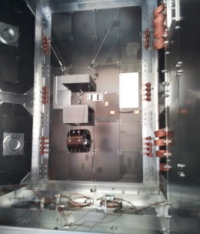
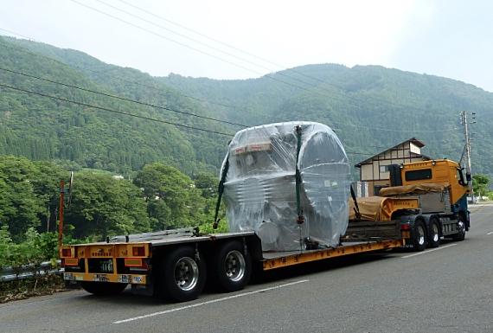
Cooling Test and Delivery
Cooling test with dummy payload
All of 4 cryostats were
in storage near the site (2013.7)
→ Cooling time ~ 2weeks.
Presentation by N.Kimura at Amaldi10 (2013.7)
Photo by C.Tokoku

Slide 23
Sapphire Mirror
2 Sapphire substrates were delivered
(Φ220mm, t 150mm, c-axis)

Slide 24
NAOJ Activities for KAGRA

Slide 25
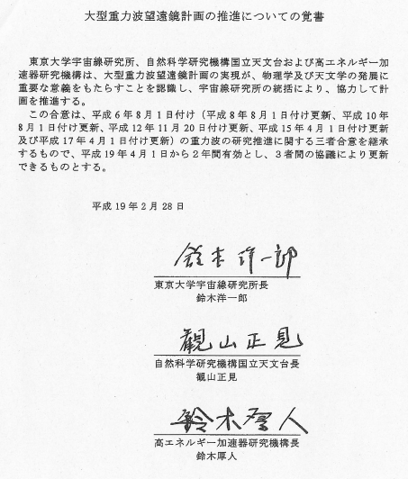
Agreement between 3 institutes
・Agreement between
3 institutes: ICRR-KEK-NAOJ
(3機関覚書) for promotion
of KAGRA project.
- Concluded in August 1994
(平成6年8月)
- Extension of terms in
1996, 1998, 2000, 2003,
2005, 2007, 2009, 2011,
and 2013.
・KAGRA Council Meeting
(KAGRA協議会) every year.

Slide 26
Organization of KAGRA
KAGRA Organization PI: T.Kajita (ICRR), PM: Y.Saito (KEK)
Theory
KAGRA Council
PI
Program Advisory Board
R&D
International Board of Representative
Executive Office
External Review board
Systems
Engineering Office
15 Subsystems
Tunnel
(TUN)
Facility
(FCL)
Vacuum
(VAC)
Cryogenics
(CRY)
Vibration Isolation
(VIS)
Mirror
(MIR)
Laser
(LAS)
Main Interferometer
(MIF)
Input-output
Optics
(IOO)
Auxiliary Optics
(AOS)
Analog Electronics
(AEL)
Digital System
(DGS)
Data Management
(DMG)
Data Analysis
(DAS)
Geophysics Interferometer
(GIF)

Slide 27



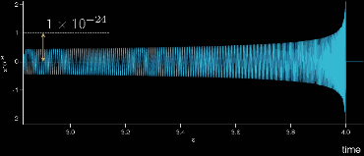
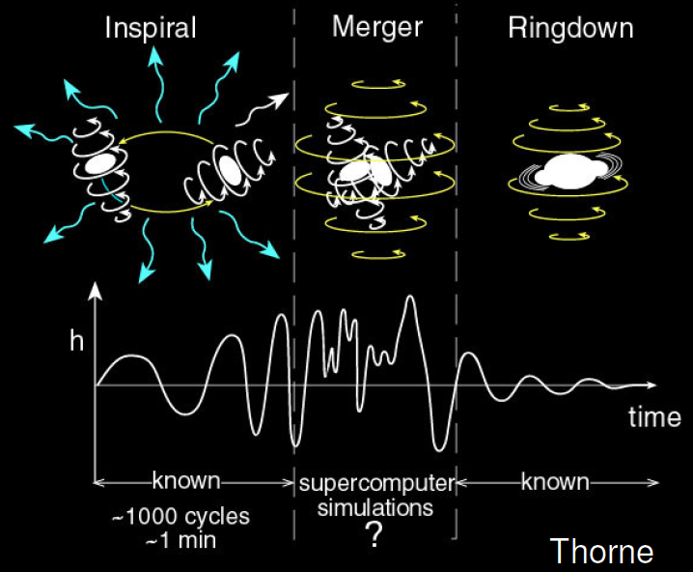
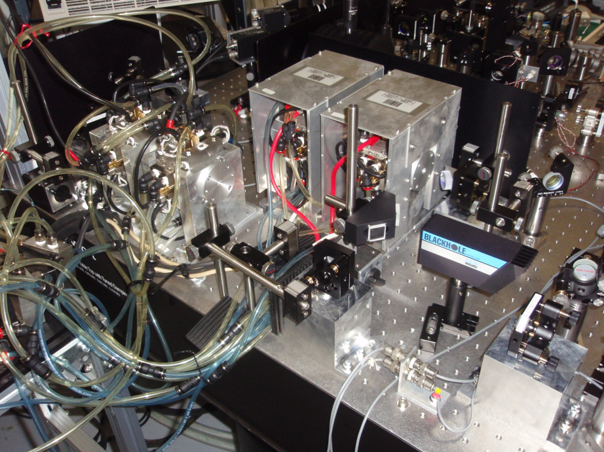
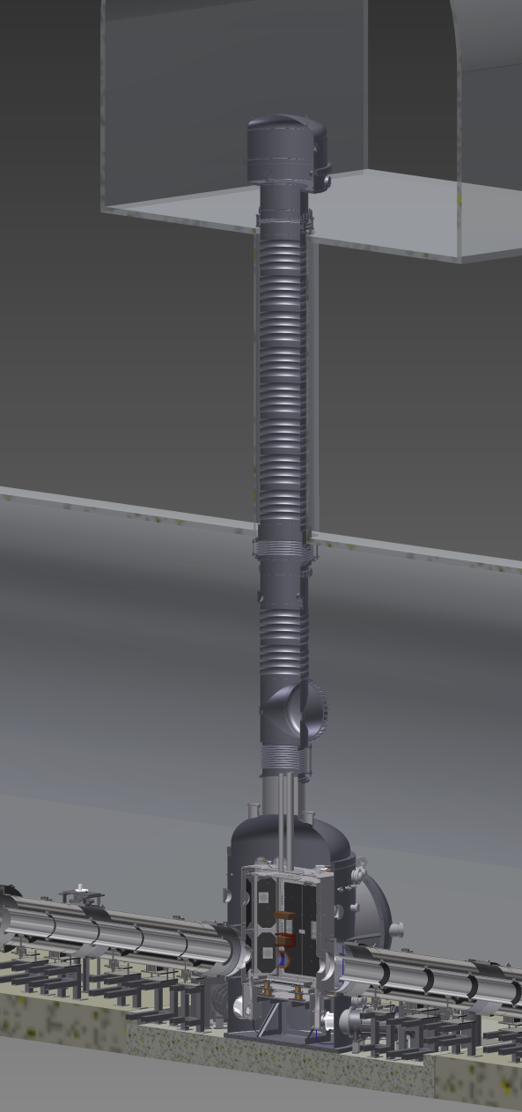
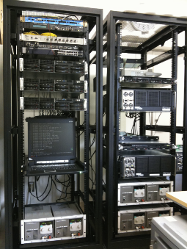
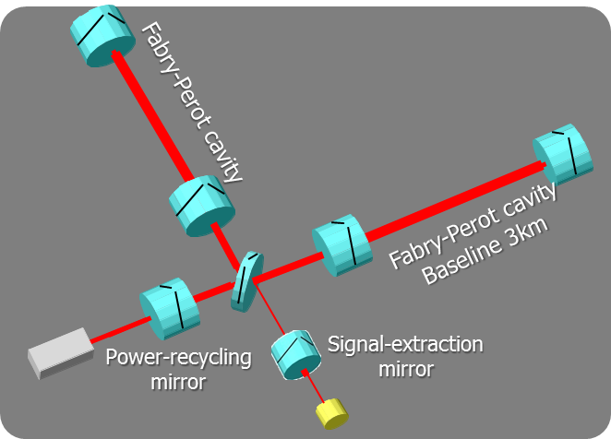
KAGRA 15 Subsystems
・Tunnel ・Facility
・Vacuum system
・Data Management
・Data Analysis
・Geophys. IFO
・Laser source
・Mirror
・Seismic iso.
・Cryogenic sys.
・Analog Elec.
・Digital Elec.
・Main IFO.
・In/Output Opts.
・Aux. Optics

Slide 28
NAOJ Responsibilities
・Project Management : Flaminio, Ando (EO and SEO)
・Vibration Isolation (VIS) : Takahashi (chief)
Ishizaki, Arellano
・Auxiliary Optics (AOS) : Akutsu (Chief), Friedrich
・Mirror (MIR) : Ueda (Sub-chief), Tatsumi
・Vacuum System (VAC) : Takahashi
・Facility and Safety (FCL) : Ohishi
・Data analysis (DAS) and
Data Management (DMG) : Tatsumi, Hayama, Nakamura
・Interferometer (MIF, IOO) : Ando, Tatsumi, Akutsu, Hayama

Slide 29
KAGRA Schedule
2012
2013
2014
2015
2016
2017
2018
2019
bKAGRA
OBS
iKAGRA
Tunnel
(2014.3)
FPMI (2015.12)
obs.
First
Science
run
obs.
obs.
Facility and Vacuum
(2015.3)
DRMI
(2016.9)
RSE
(2017.8)
Tuning and
observation
Type-A
Type-A+Cryo (2016.9)
Cryo RSE
(2018.3)
VIS
Prototype test
Type-C
Type-B
AOS
Baffle, BR Telescope
installation
2 Installation timings
for iKAGRA and bKAGRA.
Duct Baffle
Installation
Start
Silica Mirror (2014.6)
MIR
Sapphire test mass (2016.3)
installation

Slide 30
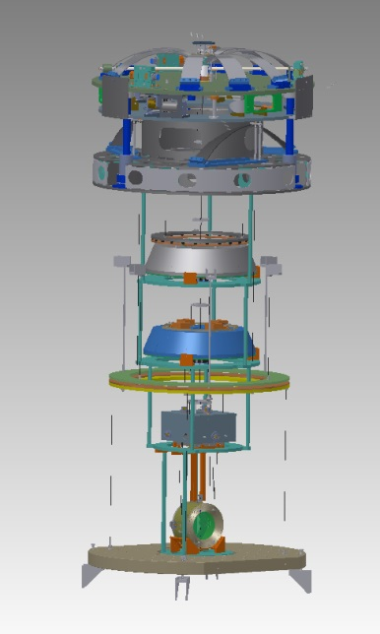
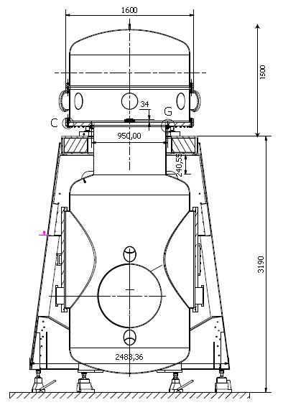
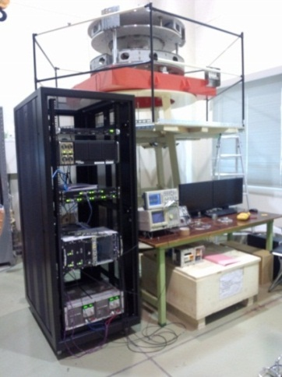
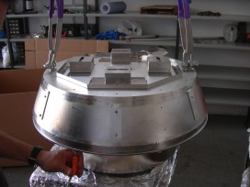
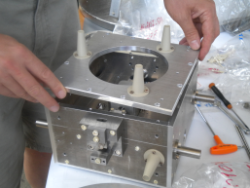
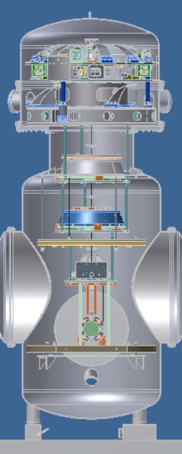


VIS Subsystem
・VIS
- Pre-isolator prototype test with digital
control system at ICRR.
- Assembly of the payload prototype at NAOJ.
- Production of top filters and standard filters
has been finished.
Full prototype test at TAMA300.
GASフィルター
上段マス
Pre-isolator試験
架台支柱試験品
ペイロード
プロトタイプ

Slide 31



Production and test for VIS
by Takahashi
・Production of 6 top filters have been finished.
・Prototype tests are on going in NAOJ and ICRR.
・Full prototype test using TAMA300 is planed.
Result of damping control for the inverted pendulum. 3-DOF (X, Y, YAW) motion was controlled using inertial sensors successfully.
Control test of the pre-isolator prototype. The motion of the pre-isolator is controled by the digital system mountd in the rack.
Tuning of the top filter. The natural frequencies were tuned to 0.2Hz.

Slide 32


Production and test for VIS
by Takahashi, Ishizaki
Assembly and test of the payload prototype. The test mass and the recoil mass were suspended by tungsten wires. Optical sensor and electro manetic actuators (OSEMs) are used to control the test mass.
Preparation for full prototype test in TAMA. The φ1500 chamber is connected to the TAMA chamber with an outer frame in the west-end room.
Development of cryogenic vertical spring. A spring using post-buckling phenomena is tested. Fundamental behavior was confirmed.

Slide 33






Scope of AOS
・AOS
- Stray Light Control (SLC)
- Beam Reducing Telescopes (BRT)
- Optical Levers (OpLevs)
- Viewports
by Akutsu
- Monitors and Illumination
- Automatic Targets
- Other tools for commissioning
(e.g. Beam Profiler, …)
Viewport Measurement
Baffle Design
KOACH Clean Booth System (Class 1)
Actual size : W3200 x D4500 x H2600
BRT Design
Baffle Prototype
Surface Measurement
Opt. Lev. Test

Slide 34

KAGRA Stray-light Control
・Five types of Baffle
by Akutsu
#1 : Arm duct baffles
#2 : Cryo-duct Shield
#3 : Narrow-angle Baffle
#4 : Wide-angle Baffles
#5 : Other
→ In production (VAC/AOS)
→ In production (CRY/AOS)
→ Prototype test (AOS)

Slide 35



Prototype of a Large Baffle
by Akutsu
#3 Narrow-angle baffle
Material: A5052
Smooth surface
treatment by ECB
Radius :400 mm
Surface: electro-chemical buffed (ECB)
- ECB: low scattering
- Solblack: Vacuum Compatibility (10⁻⁷ Pa) - Cryogenic compatibility (<8K)
- Low reflectivity (~2%@1064nm)
- Applicable for a large work
Blackened surface: Solblack

Slide 36
AOS plan in the next year
by Akutsu
・Stray-light control
  - Production of #3 (4pcs) & #4 (4pcs) baffles
・Beam reducing telescope (BRT)
  - Fabrication of large mirror holders
  for iKAGRA BRT (3pcs)
  - Fabrication of bKAGRA BRTs (2pcs)
・Optical levers
  - Optical design and procurements
・Viewports
  - Procurements

Slide 37




Mirror Quality Evaluation
by Tatsumi, Ueda
・MIR
- Mirror qualities investigation by
NAOJ (Ueda Tatsumi), UEC
(Yoneda, Musha), and ATC NAOJ.
- Ability to measure <10ppm
quality mirror for KAGRA core optics.
- High-quality mirrors for input optics.
Scatter-meter at NAOJ TAMA
Optical Loss measure by the cavity
Cavity Ring-Down measurement
Scatter Angle Measurement

Slide 38



Collaboration with ATC
・KAGRA is one of key project for ATC
- Collaborative work from 2012 on AOS
* Design and prototype production
of large-angle baffle.
* Design and production of
primary mirror holder for BRT.
- Newly starting activities:
Regular meetings for VIS and MIR.
* Collaborative works to produce
bottom filters for VIS.
* Test coating using IBS machine
→ Quality measurement.
Covering AOS, VIS and MIR.
by Akutsu, Tatsumi

Slide 39

Multi-messenger Astronomy
・Based on the approved Grants‐in‐Aid for Scientific Research:
‘Scientific Research on Priority Areas’ → 4.5-yr project.
・GW theory, GW data analysis, EM transients, and Neutrino.
(KAGRA and other GW experiment are not included.)
by Tatsumi, Hayama

Slide 40
Clarification of the Role of NAOJ
・For NAOJ
- Explanations at executive meetings in NAOJ.
- KAGRA council meeting (Sept. 17th , 2013).
- Invitation to Program Advisory Board (Nov. 2nd-3rd, 2013).
・For KAGRA
- Flaminio and Ando are members of management
team (EO and SEO).
- Takahashi and Akutsu are subsystem chiefs.
- Ueda became a sub-chief of the MIR subsystem,
redefining the tasks.

Slide 41
Advanced R&Ds

Slide 42
DECIGO
DECIGO
(Deci-hertz interferometer
Gravitational wave Observatory)
・3 FP interferometers
by formation flight S/C
・Baseline length: 1000 km
・Drag-free control
Arm cavity
Arm length: 1000 km
Finesse: 10
Mirror diameter: 1 m
Mirror mass: 100 kg
Laser power: 10 W
Laser wavelength： 532 nm
1000km
Arm cavity
Laser
Mirror
Photo-
detector
Drag-free S/C

Slide 43


Roadmap
Figure: S.Kawamura
 | 2010 | 11 | 12 | 13 | 14 | 15 | 16 | 17 |  | 18 | 19 | 20 | 21 | 22 | 23 | 24 | 25 | 26 | 27 | 28 | 29
Mission
Objective | Space test of key tech. GW observation |  |  |  |  |  |  |  | Detect GW with min. spec FP between S/C |  |  |  |  |  |  | GW astronomy
Design | Single small satellite Short FP interferometer |  |  |  |  |  |  |  | 3 S/C 1 interferometer unit |  |  |  |  |  |  | 3 S/C x 3-4 units
R&D
Fabrication
R&D
Fabrication
R&D
Fabrication
DECIGO
Pathfinder
(DPF)
Pre-DECIGO
DECIGO
SDS-1/SWIM

Slide 44

Targets of DPF
DPF
Weight ~400kg
Orbit : 500km LEO
Scientific observations
Gravitational Waves form BH mergers
→ BH formation mechanism
Gravity of the Earth
→ Geophysics, Earth environment
Science technology
Space demonstration for DECIGO
→ Most tech. with single satellite
(IFO, Laser, Drag-free)
Precision measurement in orbit
→ IFO measurement
under stable zero-gravity

Slide 45




R&D for DPF Interferometer
Optical Bench
Interferometer Module
Monolithic optics
for PDH + WFS
Test-mass module
Test mass, ES sensor/actuator, Launch lock, …
IFO baseline
~30cm
Quadrant RF
Photo Detector
SpW signal-processing board
QPD + Demodulator for IFO signal sensing
SpW FPGA +
16bit AD/DA
for IFO Control

Slide 46



DPF Interferometer module
Components in the interferometer module
Test-mass module
2 test-mass modules (i.e. inertial sensors)
Input optics (monolithic)
Evacuation system
Launch lock system
Clamp & release system
N₂ will be purged after it launched
Characteristics
Rigid structure
Vacuum: 10⁻⁶ Pa
30cm cavity arm length
30 cm
Input optics (BBM2) by A. Ueda
by Akutsu

Slide 47

Experimental setup for optical parts
A test of the optics of the gravitational-wave detector (a Fabry-Perot cavity).
← 1030 nm laser source + fiber coupler
Fibered EOM
Input optics (BBM2)
Cavity (300mm)
Feedback to the piezo stage at the end mirror and laser source.
The cavity can be operated.
by Kasuga
by Akutsu

Slide 48

by Akutsu

Slide 49
Works in the next year
Tests for vibration, impact, and thermal shock
Validation of the new design of inner wall of a test-mass module (for the reduction of a force noise by the squeezed-film damping)
Validation of the Interferometer module
Noise reduction
by Akutsu

Slide 50


Free fall experiment for DECIGO Path Finder
We made equipment to experiment control the test mass position for free fall from 3m high in ATC facility.
We could confirm to make free fall condition and preparing to control the test mass position. The way of the test mass control is used magnets, electro magnets and photo sensors for measuring displacement.
Release system
Test mass
Wind breaker
Acceleration sensor
Shock absorber
by Torii

Slide 51




Test mass for free fall
After releasing
0 sec. (Start)
Test mass
Test mass on the holding finger
Test mass and the housing on a table
Test mass
After
1/15sec.
2/15 sec.
Electric magnet
Magnet
by Torii

Slide 52
Theoretical Researches (1)
Researches on quantum measurements
(Akutsu, Nakamura)
  Quantum Non-Demolition (QND) techniques for GW telescopes.
  Monthly seminar is held to discuss QND theories and experiments.
    Participants are from NAOJ, TITECH, Kyoto Univ., Keio Univ., IMS., Tokyo Univ., KEK, Hiroshima Univ. … . (Members are increasing...)
  Main Achievement :
    Theoretical results discussed in this seminar agree with the experiment by Hiroshima Univ.
    [K. Nakamura and M. Iinuma, PRA88 (2013), 042106.]
  Prospect :
    We are now trying to apply our understanding on quantum measurements to GW detectors.
by Nakamura

Slide 53
Theoretical Researches (2)
General-relativistic higher-order gauge-invariant perturbation theory and its applications (Nakamura)
  Developments of the general framework of the theory
  Classical and Quantum Gravity Highlight letter (last year) was advertized in the CQG brochure :
  Main Achievement :
    The full paper version of this letter is published.
    [K. Nakamura, PTEP2013 (2013), 043E02.]
  Prospect :
    We are now trying to apply our theory to black hole perturbations and cosmology.
by Nakamura

Slide 54
Summary

Slide 55
Summary
・KAGRA is under construction. Large part (tunnel, vacuum
system, cryogenic system, facility) are completed or will
be finished soon. Installation will start in the next year.
・NAOJ GW Project Office is playing a key role in KAGRA.
The activities on KAGRA is increasing.
・Increased collaborative activities with ATC for KAGRA.
・We appreciate the support from NAOJ.

Slide 56
End

Slide 57
Supplementary Slides

Slide 58
Surface building
The framework of the data-analysis building next to the existing building is completed.
Nov 19, 2013
Nov 20, 2013
by Ohishi

Slide 59
Tunnel excavation
Excavation of Y arm is expected to be completed by the end of November.
As of November 20, the remaining length of Y arm is 63m and that of X arm is 627m.
by Ohishi

Slide 60
Safety Management of KAGRA
Ventilation system evaluation:
radon, CO, CO₂, organic solvents
Recommendation for improvement based on relevant laws.
300m^3/h
X End
(Sakonishi)
300m^3/h
fresh air
300m^3/h
300m^3/h
400m^3/h
500m^3/h
Y End
(Mozumi)
100m^3/h
Atotsu
Access
Tunnel
Mozumi
Access
Tunnel
Corner
(Atotsu)
by Ohishi

Slide 61
Production of vacuum system for KAGRA
Production of 19 vacuum chambers is on going.
One of them is used for a prototype test of the vibration isolation system in TAMA.
Solblack (a kind of Nickel plating) was employed as surface treatment for shading baffles.
Production of 250 baffles is on going.
Leak test of the φ1500 chamber in which the pre-isolator is put away.Metal O-rings are used to seal the flanges.
Prototype of shading baffle inserted into φ800 tube. The baffle has saw shape edge.
A beam spot on the baffle inside the φ800 tube. DLC and Solblack are tested as surface treatment.
by Takahashi

Slide 62
Production and test of vibration isolation system for KAGRA (1)
Production of 6 top filters have been finished.
Prototype tests are on going in NAOJ and ICRR.
Full prototype test using TAMA300 is planed.
Control test of the pre-isolator prototype. The motion of the pre-isolator is controled by the digital system mountd in the rack.
Result of damping control for the inverted pendulum. 3-DOF (X, Y, YAW) motion was controlled using inertial sensors successfully.
Tuning of the top filter. The natural frequencies were tuned to 0.2Hz.
by Takahashi

Slide 63
Production and test of vibration isolation system for KAGRA (2)
by Takahashi
Assembly and test of the payload prototype. The test mass and the recoil mass were suspended by tungsten wires. Optical sensor and electro manetic actuators (OSEMs) are used to control the test mass.
Preparation for full prototype test in TAMA. The φ1500 chamber is connected to the TAMA chamber with an outer frame in the west-end room.
Development of cryogenic vertical spring. A spring using post-buckling phenomena is tested. Fundamental behavior was confirmed.

Slide 64


AOS tasks
Stray Light Control (SLC)
Beam Reducing Telescopes (BRT)
Optical Levers (OpLevs)
Viewports
Monitors (CCD cameras) and Illumination
Automatic Targets
Other tools that will be useful for the commissioning phase (e.g. Beam Profiler for large spot size)
透過光モニターテレスコープ
（米国LIGOの同等物）
他、多数
散乱光対策バッフル
（米国LIGOの同等物）
by Akutsu

Slide 65
KAGRA Baffle system
by Akutsu

Slide 66
Example of a large baffle
#3 Narrow-angle baffle
Material: A5052
400 mm radius
Surface: electro-chemical buffed (ECB)
Blackened surface: Solblack
ECB: low scattering
Solblack: Vacuum Compatibility (10⁻⁷ Pa), Cryogenic compatibility (<8K), Low reflectivity (~2%@1064nm), Applicable for a large work
by Akutsu

Slide 67
Works in the next year
Stray-light control
  Production of #3 (4pcs) & #4 (4pcs) baffles
Beam reducing telescope (BRT)
  Fabrication of large mirror holders for iKAGRA BRT (3pcs)
  Fabrication of bKAGRA BRTs (2pcs)
Optical levers
  Optical design and procurements
Viewports
  Procurements
by Akutsu

Slide 68
KAGRA補助光学系サブシステム
干渉計内で生じた迷光の処理
  KAGRAの最終感度を決める。
  大型（Φ800程度）のバッフルの設計、製造が必要
3km 光軸をモニターするテレスコープ
  KAGRAの3km光軸のリファレンスとなる。
  テレスコープ光学系の設計、製造が必要
技術的チャレンジ
  高真空、低温の環境で振動を抑える構造でこれらを達成すること。
人員
  重力波P推進室: 阿久津（ATC併任）、D. Friedrich
  MEショップ: 大渕、池之上、浦口...
by Akutsu

Slide 69
迷光処理
#3と#4について
・ 機械設計: ATC MEショップ
・ 光学設計: ATCのノウハウ（外部企業との連携含む）
by Akutsu

Slide 70
#3 狭角散乱バッフル（プロトタイプ）
#3 Narrow-angle baffle
Material: A5052
400 mm radius
Surface: electro-chemical buffed (ECB)
Blackened surface: Solblack
ECB: low scattering
Solblack: Vacuum Compatibility (10⁻⁷ Pa), Cryogenic compatibility (<8K), Low reflectivity (~2%@1064nm), Applicable for a large work
by Akutsu

Slide 71
Beam Reducing Telescope
Initial KAGRA用の
の主鏡ホルダー
by Akutsu
前面
後面
ATCにて設計
ATCにて製作

Slide 72

by Tatsumi, Ueda
Progress report of NAOJ Mirror group
Akitoshi UEDA NAOJ
Daisuke TATSUMI NAOJ
Hitoki YONEDA ILS, UEC
Mitsuru MUSHA ILS, UEC
We succeed to develop low-loss mirror of the world’s top quality.
At least two domestic companies provide us the mirror.
Mirror qualities are investigated by NAOJ Mirror group collaborated with
the University of Electro-Communication, the University of Tokyo, and
Advanced Technology Center in NAOJ.
High quality mirror for KAGRA Pre-Mode Cleaner will be delivered within this year.
Figure 1: High quality mirror for KAGRA
Figure 2: A picture of coating cross-section

Slide 73
by Tatsumi, Ueda
Mirror qualities are investigated
at TAMA by NAOJ Mirror group.
Picture 2: Scatter Angle Measurement
Picture 1: Scatter-meter at NAOJ TAMA
Picture 3: Optical Loss measure by the cavity
Cavity Ring-Down measurement

Slide 74
Preparations for Multi-messenger Analysis
Daisuke Tatsumi
Kazuhiro Hayama
Background
Together with construction of the KAGRA detector,
preparations for multi-messenger analysis are in progress.
The multi-messenger means collaborative observation with
infra-red light, neutrino, gamma-ray and X-ray detectors.
This activity was adopted as
Grant-in-Aid for Scientific Research on Innovative Areas
“New Developments in Astrophysics Through Multi-Messenger Observations of Gravitational Wave Sources”
by Tatsumi, Hayama

Slide 75
Preparations for Multi-messenger Analysis
Daisuke Tatsumi
Kazuhiro Hayama
by Tatsumi, Hayama

Slide 76
Preparations for Multi-messenger Analysis
Daisuke Tatsumi
Kazuhiro Hayama
It is very important to reduce the false alerts
for such multi-messenger observations.
Our target value is less than 1 events per month.
To realize it we are developing the following systems.
* Detector Charcterization System
(with online veto system)
* Investigation of cryogenic system induced noises
by Tatsumi, Hayama

Slide 77
Detector Characterization
Kazuhiro Hayama
By referring back to TAMA experience of long-term observations,
it is very important to know detector conditions and status.
As a sub-subgroup leader of KAGRA detector characterization
collaboration with Korea group is leading.
[ Recent activities ]
* Systemization of multivariate correlated analysis
* Evaluation of effects from magnetic propagation modes in the earth
* Glitch monitoring
and so on.
[ Talk ]
4th Korea-Japan Workshop on KAGRA, at Osaka Univ., 2013 June
by Hayama

Slide 78

Reduction of cryogenics induced burst noises
Daisuke Tatsumi
KAGRA is a unique cryogenic detector in the world.
Therefore we need to reduce burst noises induced by
cryogenic systems.
Goal
To reduce false alarm rate less than 1 event per month
is out target value.
Budget
Grant-in-Aid for Scientific Research on Innovative Areas
“New Developments in Astrophysics Through Multi-Messenger Observations of Gravitational Wave Sources”
Recent Activity
By referring back to TAMA experience of long-term observations,
it is very important to know detector conditions and status.
We have experience to construct such online analysis system for TAMA300 detector. Together with that, the world’s first cryogenic GW detector CLIO was also developed as a prototype of KAGRA.
Therefore we put these experiences to make monitoring (vetoing) system for cryogenic system induced noises.
The left picture is noise monitoring system developed at TAMA site.
We have plan to install the system together with a vibration sensor for cryogenic part.
[ Talk ]
Boot Camp 2013 for A04 project, at Osaka City Univ. Satellite Campus, 28 -29 June 2013

Slide 79
Effective Use of TAMA facility
・Current status
- No observation run after the damage in optics
by the earthquake in 2011.
- Center room is used for high-quality mirror development.
- West end room is used for prototype test of
Type-B vibration isolation system.
・Plans
- Two vacuum tanks (BS and RM) will be moved to KAGRA.
- One vacuum tank will be upgraded to cryostat,
used as cryogenic test facility for KAGRA.
- Small optical components are ready for use in KAGRA.
- Considering a good usage of 300-m baseline facility.

Slide 80




研究計画 : 低温施設整備
・KAGRA低温部に収められる装置を試験・評価するための設備.
- 防振系・補助光学系 : 最終的に低温部(20K)にインストール.
- 現在、重力波P推進室には試験設備が無い.
→ KEK, ICRRなどに出向いてコンポーネント試験.
- 重力波分野の基礎・応用研究では低温設備は必須になる.
→ 国内・国際的な競争力の維持.
・ 2年計画で整備 (設計, 冷凍機 / 防振, 輻射シールド, 組上げ).
基本的にはKAGRAと同構成. ただし真空槽など現有物を
利用し, コスト削減をはかる.

