Slide 1
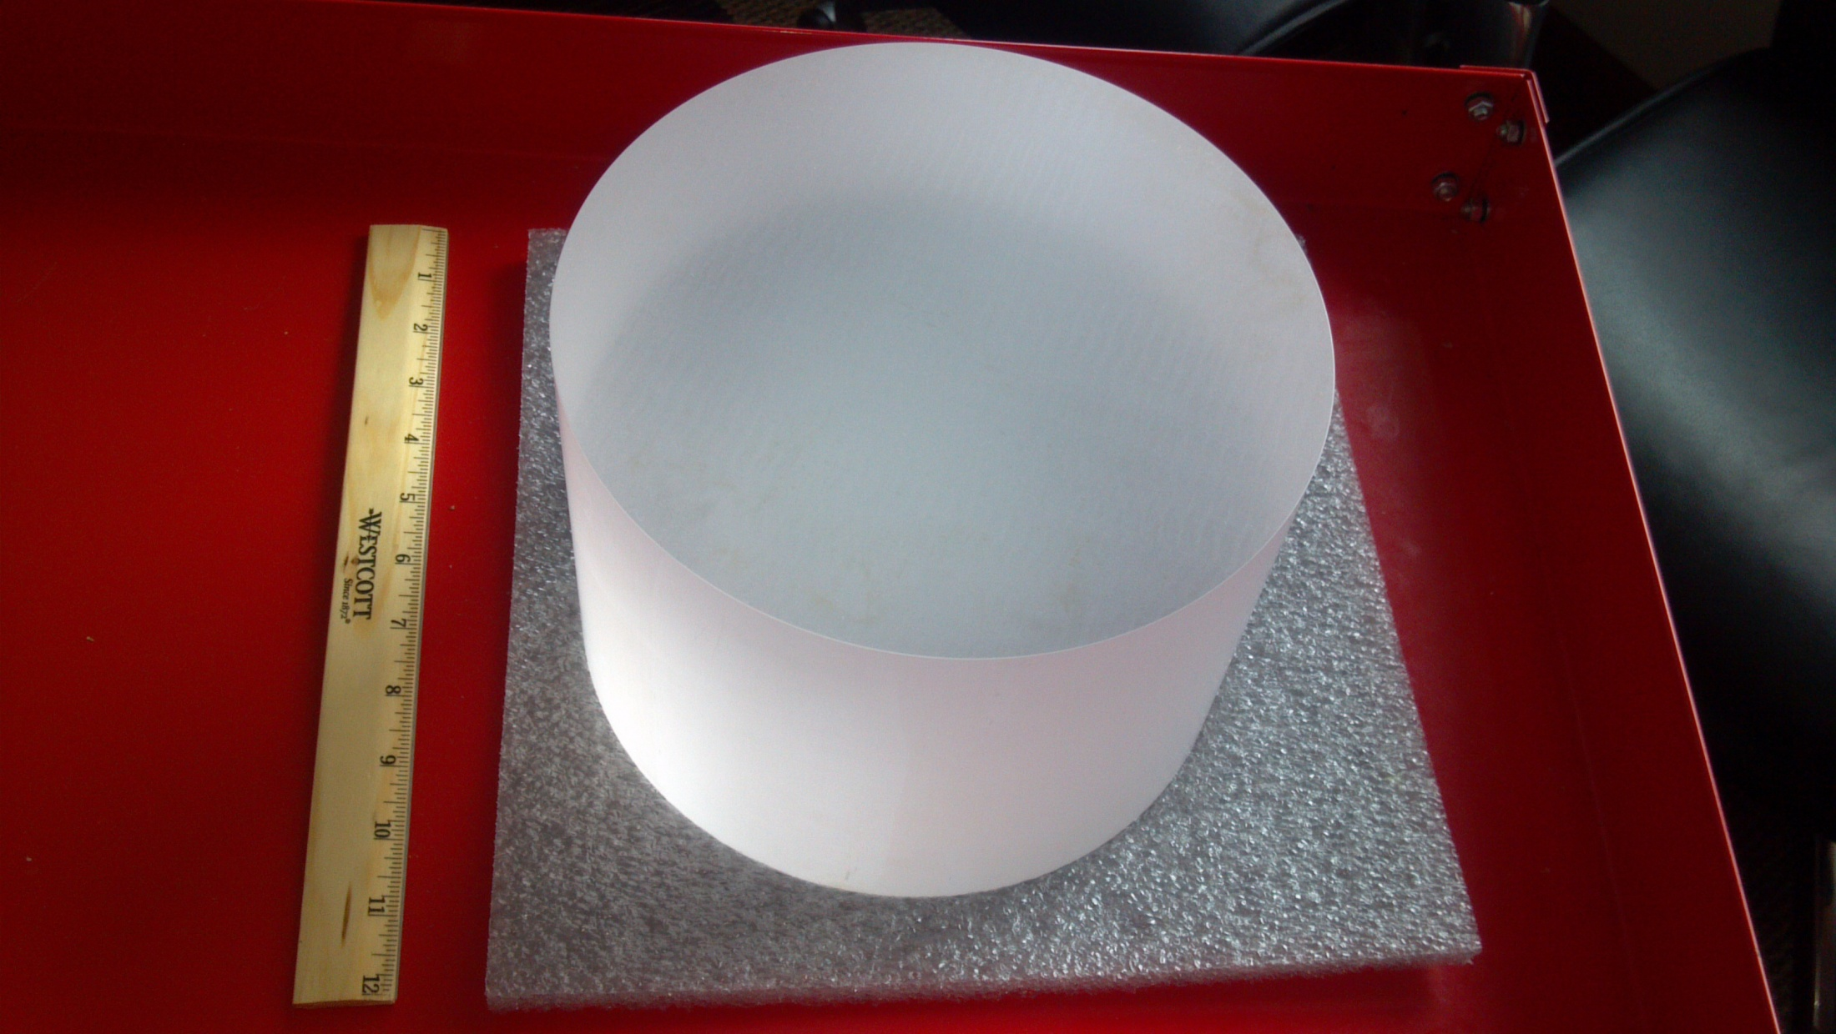
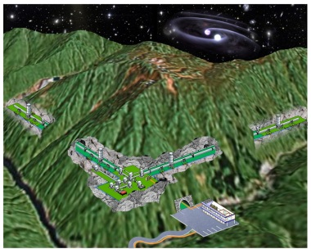
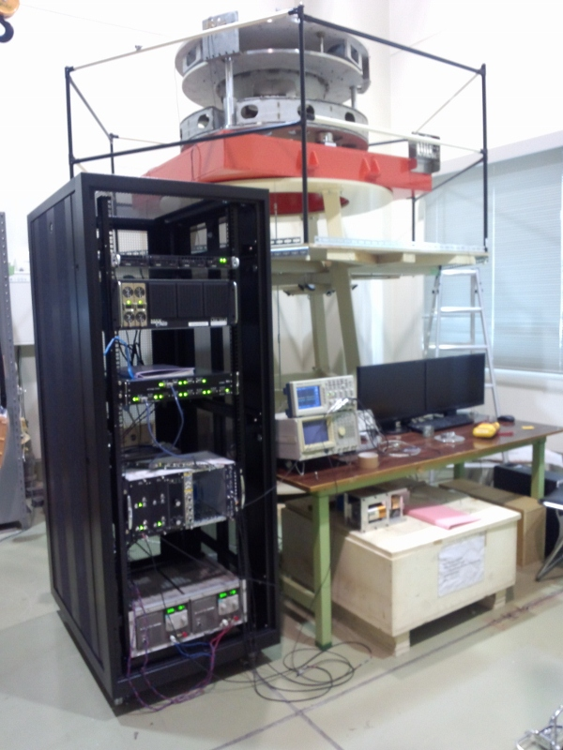
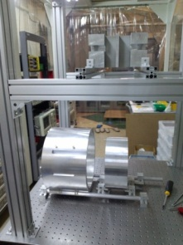


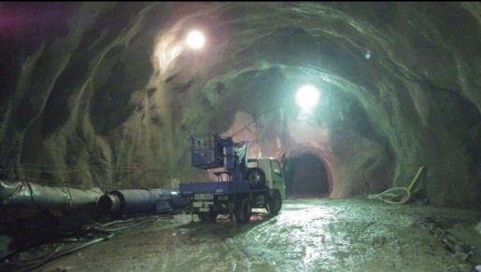
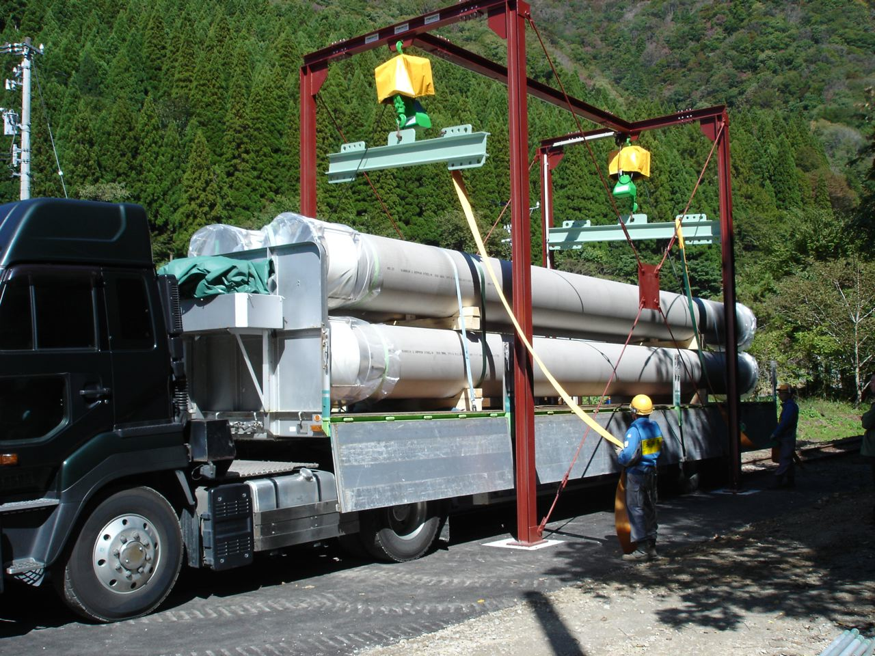
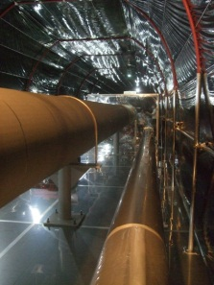
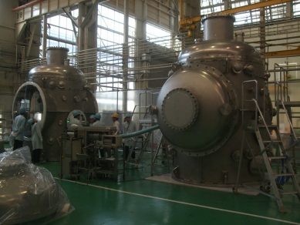
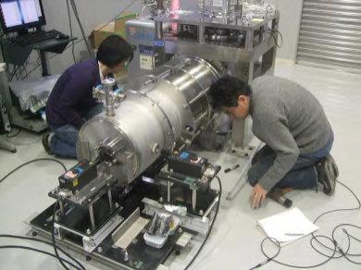
Report on
NAOJ GW Project Office
Masaki Ando

Slide 2
Outline
・Members and Activities
・Budget Status
・KAGRA Development Status
・Collaborations

Slide 3
Members
・Research Staff
Professor
Raffaele Flaminio
Associate Prof.
In selection
Masaki Ando (U. Tokyo)
Research Associate
Ryutaro Takahashi (ICRR)
Daisuke Tatsumi
Akitoshi Ueda (50%)
Naoko Ohishi (ICRR)
Tomotada Akutsu
・Engineer Staff
Hideharu Ishizaki
Yasuo Torii
Nobuyuki Tanaka
・Postdoctoral Fellow
Kouji Nakamura
Fabian Peña Arellano
Daniel Friedrich (from Sept.30)
・Office Support Staff
Mihoko Kondo
Mizuho Yoshizumi
・Professor Emeritus
Masa-Katsu Fujimoto
・Students
Ayaka Shoda (D2, U. Tokyo)
Koki Okutomi (M1, Sokendai)
Mizuki Nikaido (B4, Ochanomizu U.)
New!
New!
New!
New!
New!
New!
Total : 20 Members

Slide 4
Changes in Members
・Staff
* New Professor, R.Flaminio has come (Sept. 1st -) !
* A. Prof. M.Ando moved to UT, but still support
GW office under an agreement between NAOJ and UT.
* New A. Prof. is under selection.
・Pos-doc fellows
* Agatsuma finished his term, and moved to NIKEF.
* One project fellow post was newly assigned.
→ Two new Pos-docs: F. Arellano and D. Friedrich.
・Re-employed support staff Kondo-san.
・New students: Okutomi, Nikaido.

Slide 5
Activities
● Research Efforts (FY2012)
※Sum of individual efforts
Advanced Technologies
KAGRA
・About 2/3 efforts were for KAGRA
→ To be increased in FY2013
(New Professor, Project research fellows)

Slide 6
Budget Status
・NAOJ GW office is mainly responsible for
key subsystems (VIS, AOS, MIR), in which
total procurement costs will be ~1 Byen.
・Prototype development and tests,
as well as design, are supported by NAOJ.
・In FY2013, our budget request
related to KAGRA was fully approved by NAOJ.
・Budget from external grants were decreased.

Slide 7
FY2012 Budget Status
● FY2012 Total 5,207 万円 (~ 0.5 M＄)
・NAOJ Administration 1,715 万円
Additional 820 万円 (+1500万円 to ACT)
Other 370 万円
・From other JSPS 1,085 万円
Other 1,220 万円
Advanced
Technologies
KAGRA and
Lab. Facility

Slide 8
FY2013 Budget Status
● FY2013 Total 5,855 万円 (~ 0.5 M＄)
・NAOJ Administration 5,125 万円
Additional 0 万円
Other 230 万円
・From other JSPS 340 万円
Other 160 万円
Advanced
Technologies
KAGRA and
Lab. Facility

Slide 9
R&D Expenditures
・R&D Expenditures for KAGRA (Total : 3,800 万円)
*Long-term expenditures 2,300 万円
- VIS 500 万円 (Type-B 300, Opt.Lever 200)
- AOS 1,000 万円 (BRT 800, Scatter 200)
- MIR 800 万円 (Evaluation 400, Sample mirror 400)
*Short-term expenditures 1,500 万円
- Cryogenic Test Facility 1,500 万円
(Cryo-cooler 1000, Design and development 500)

Slide 10
Organization of KAGRA
Theory
KAGRA Council
PI
Program Advisory Board
R&D
International Board of Representative
Executive Office
External Review board
Systems
Engineering Office
Subsystems
Tunnel
(TUN)
Facility
(FCL)
Vacuum
(VAC)
Cryogenics
(CRY)
Vibration Isolation
(VIS)
Mirror
(MIR)
Laser
(LAS)
Main Interferometer
(MIF)
Input-output
Optics
(IOO)
Auxiliary Optics
(AOS)
Analog Electronics
(AEL)
Digital System
(DGS)
Data Management
(DMG)
Data Analysis
(DAS)
Geophysics Interferometer
(GIF)

Slide 11
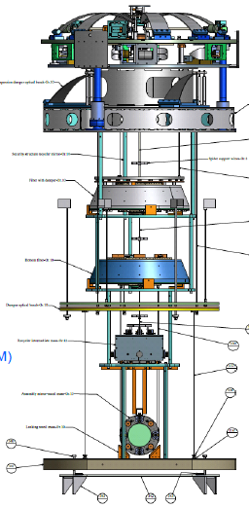
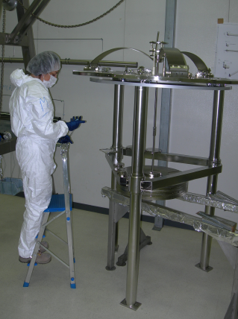
KAGRA Activities at NAOJ (1/3)
VIS (Leader: R.Takahashi)
・The pre-isolator prototype test
with digital control system at ICRR.
・Assembly of the payload prototype at NAOJ.
・Production of 6 top filters has been finished.
・Full prototype test in preparation at TAMA300.
Pre-Isolator Prototype
Top filter assembly
Payload Prototype Assembly
TAMA end room preparation

Slide 12
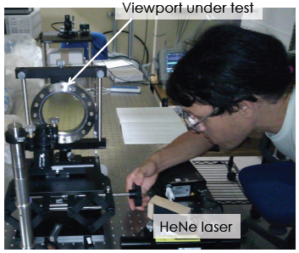
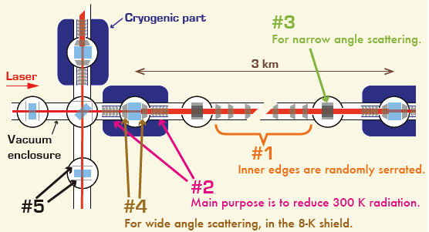
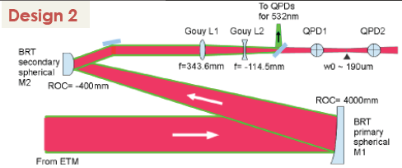
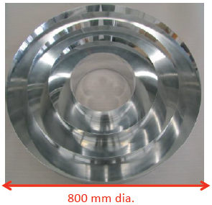
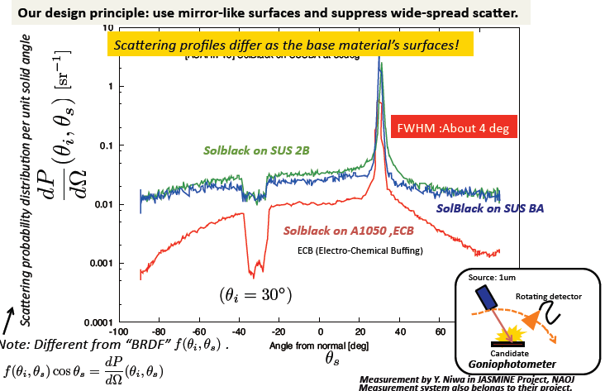
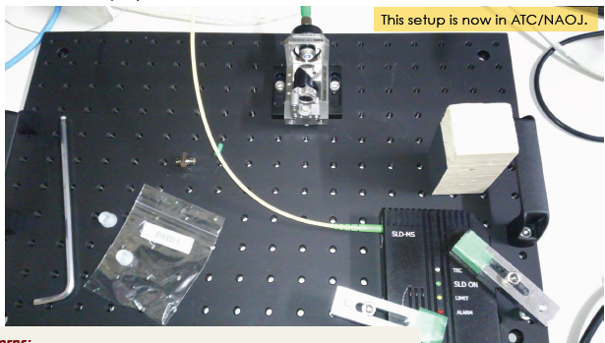
KAGRA Activities at NAOJ (2/3)
AOS (Leader: T. Akutsu)
・New Clean Booth for AOS test at ATC/NAOJ (FY2012).
・Optical Baffle design and prototypes (Layout, Surface, Shape).
・Beam-Reducing Telescope (BRT) design.
・Optical Lever prototype test, Viewport measurement.
Viewport Measurement
Baffle Design
KOACH Clean Booth System (Class 1)
Actual size : W3200 x D4500 x H2600
BRT Design
Baffle Prototype
Surface Measurement
Opt. Lev. Test

Slide 13
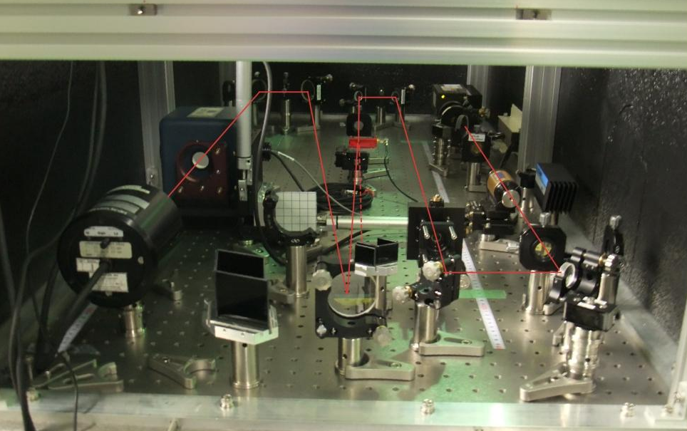
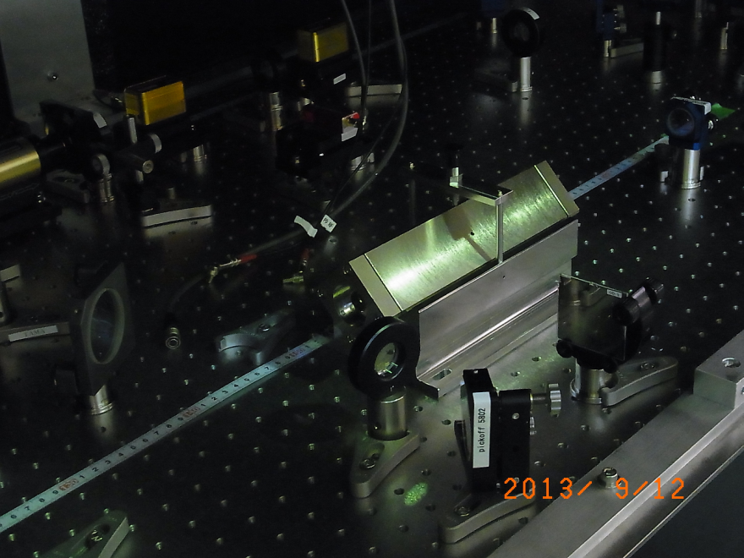
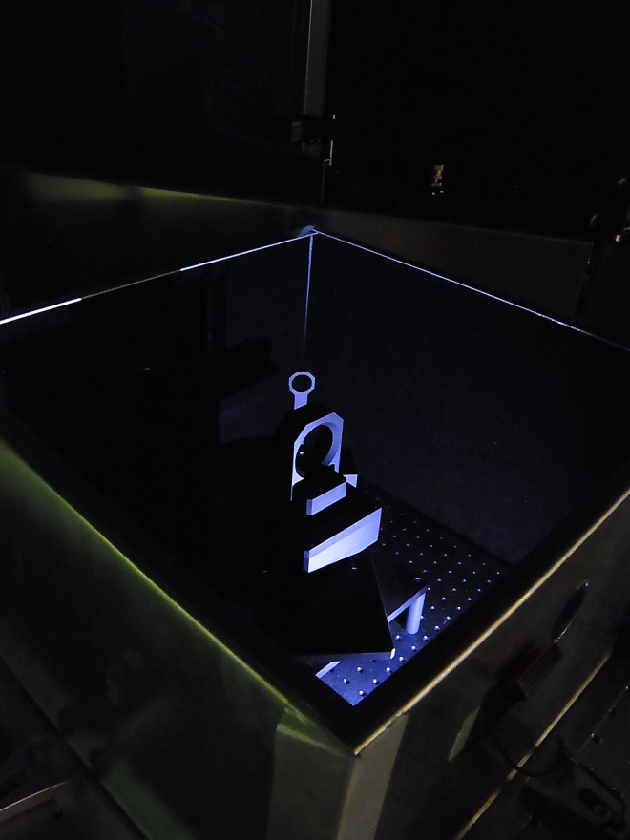
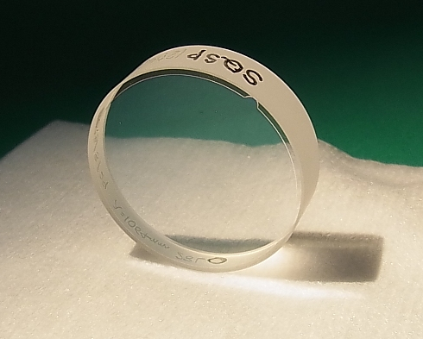
KAGRA Activities at NAOJ (3/3)
MIR (Sub-Leader A. Ueda)
・Mirror qualities investigation by
NAOJ (Ueda Tatsumi), UEC
(Yoneda, Musha), and ATC NAOJ.
・Ability to measure <10ppm
quality mirror for KAGRA core optics.
・High-quality mirrors for input optics.
Scatter-meter at NAOJ TAMA
Optical Loss measure by the cavity
Cavity Ring-Down measurement
Scatter Angle Measurement

Slide 14
Effective Use of TAMA facility
・Current status
- No observation run after the damage in optics
by the earthquake in 2011.
- Center room is used for high-quality mirror development.
- West end room is used for prototype test of
Type-B vibration isolation system.
・Plans
- Two vacuum tanks (BS and RM) will be moved to KAGRA.
- One vacuum tank will be upgraded to cryostat,
used as cryogenic test facility for KAGRA.
- Small optical components are ready for use in KAGRA.
- Considering a good usage of 300-m baseline facility.

Slide 15
Collaborations
・Collaboration between ATC and GW group at NAOJ.
・MoU between GW group-LSC
- Submitted proposal to extend the term (leader Fujimoto).
- Mainly for multi-messenger astronomy.
・Agreement between NAOJ and Univ. of Tokyo.
- Close cooperation in research and education.
- M.Ando is supporting GW group under this agreement.
・Agreement between NAOJ and Ochanomizu Univ.
- Form was approved by both side and is to be active soon.
- Nikaido (B4) will finish her graduation thesis at NAOJ.
- GW group will officially accept students.

Slide 16
Summary
・NAOJ GW Project Office is playing a key role in KAGRA.
The activities on KAGRA is increasing.
・We appreciate the increased financial, man-power,
and organization supports by NAOJ.
・But still, the financial situation in KAGRA is not so
optimistic.

Slide 17
End

Slide 18
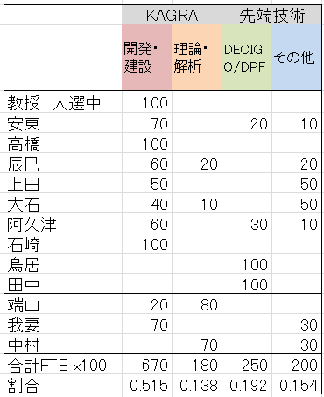
Effort Estimation (FY2012)
Advanced Tech.
Experimental
Analysis, Theory
New Professor
M. Ando
R. Takahashi
D. Tatsumi
A. Ueda
N. Ohishi
T. Akutsu
H. Ishizaki
Y. Torii
N. Tanaka
K. Hayama
K. Agatsuma
K. Nakamura
Ratio

