Slide 1
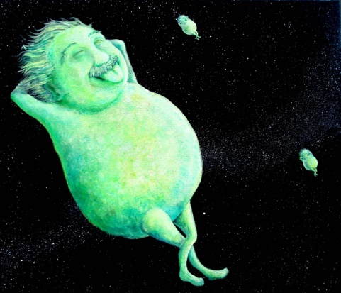
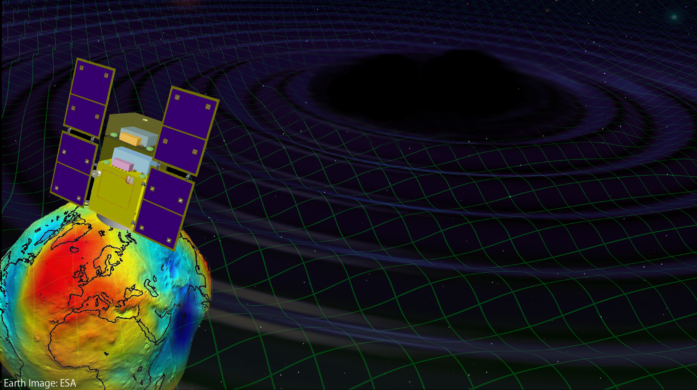
Space Gravitational-wave observatory: DECIGO
Original
Picture : Sora
Masaki Ando
(National Astronomical Observatory of Japan)
On behalf of
DECIGO working group

Slide 2
DECIGO Working Group
Koh-suke Aoyanagi, Kazuhiro Agatsuma, Hideki Asada, Yoichi Aso, Koji Arai, Akito Araya, Masaki Ando, Kunihito, Ioka, Takeshi Ikegami, Takehiko Ishikawa, Hideharu Ishizaki, Hideki Ishihara, Kiwamu Izumi, Kiyotomo Ichiki, Hiroyuki Ito, Yousuke Itoh, Kaiki T. Inoue, Akitoshi Ueda, Ken-ichi Ueda, Masayoshi Utashima, Yumiko Ejiri, Motohiro Enoki, Toshikazu Ebisuzaki, Yoshiharu Eriguchi, Naoko Ohishi, Masashi Ohkawa, Masatake Ohashi, Kenichi Oohara, Yoshiyuki Obuchi, Kenshi Okada, Norio Okada, Nobuki Kawashima, Fumiko Kawazoe, Isao Kawano, Seiji Kawamura, Nobuyuki Kanda, Kenta Kiuchi, Naoko Kishimoto, Hitoshi Kuninaka, Hiroo Kunimori, Kazuaki Kuroda, Hiroyuki Koizumi, Feng-Lei Hong, Kazunori Kohri, Wataru Kokuyama, Keiko Kokeyama, Yoshihide Kozai, Yasufumi Kojima, Kei Kotake, Shiho Kobayashi, Motoyuki Saijo, Ryo Saito, Shin-ichiro Sakai, Masaaki Sakagami, Shihori Sakata, Norichika Sago, Misao Sasaki, Shuichi Sato, Takashi Sato, Masaru Shibata, Hisaaki Shinkai, Naoshi Sugiyama, Rieko Suzuki, Yudai Suwa, Naoki Seto, Kentaro Somiya, Hajime Sotani, Takeshi Takashima, Tadashi Takano, Kakeru Takahashi, Keitaro Takahashi, Tadayuki Takahashi, Hirotaka Takahashi, Fuminobu Takahashi, Ryuichi Takahashi, Ryutaro Takahashi, Takamori Akiteru, Hideyuki Tagoshi, Hiroyuki Tashiro, Takahiro Tanaka, Keisuke Taniguchi, Atsushi Taruya, Takeshi Chiba, Shinji Tsujikawa, Yoshiki Tsunesada, Kimio Tsubono, Morio Toyoshima, Yasuo Torii, Kenichi Nakao, Kazuhiro Nakazawa, Shinichi Nakasuka, Hiroyuki Nakano, Shigeo Nagano, Kouji Nakamura, Takashi Nakamura, Yoshinori Nakayama, Atsushi Nishizawa, Erina Nishida, Kazutaka Nishiyama, Yoshito Niwa, Kenji Numata, Taiga Noumi, Tatsuaki Hashimoto, Kazuhiro Hayama, Tomohiro Harada, Wataru Hikida, Yoshiaki Himemoto, Hisashi Hirabayashi, Takashi Hiramatsu, Mitsuhiro Fukushima, Ryuichi Fujita, Masa-Katsu Fujimoto, Toshifumi Futamase, Ikkoh Funaki, Mizuhiko Hosokawa, Hideyuki Horisawa, Kei-ichi Maeda, Hideo Matsuhara, Osamu Miyakawa, Umpei Miyamoto, Shinji Miyoki, Shinji Mukohyama, Mitsuru Musha, Toshiyuki Morisawa, Mutsuko Y. Morimoto, Shigenori Moriwaki, Kent Yagi, Hiroshi Yamakawa, Toshitaka Yamazaki, Kazuhiro Yamamoto, Chul-Moon Yoo, Jun'ichi Yokoyama, Shijun Yoshida, Taizoh Yoshino, Yaka Wakabayashi, Tomotada Akutsu, Nobuyuki Matsumoto, Ayaka Shoda, Yuta Michimura, Nobuyuki Tanaka, Sachiko Kuroyanagi, Dan Chen, Satoshi Eguchi, Rina Gondo, Kazunori Shibata, Takafumi Ushiba,

Slide 3

    ・ DECIGO
    ・ DECIGO Pathfinder
    ・ SWIM
Notes:
This talk contains two parts.
The first part is for DECIGO. I will present overview, science , and conceptual design of DECIGO.
The second part is for DECIGO pathfinder, which is the first milestone mission for DECIGO.
In this part, I will present overview, science, and current status of DECIGO pathfinder.

Slide 4
DECIGO

Slide 5
DECIGO
DECIGO
(Deci-hertz interferometer Gravitational wave Observatory)
Space GW antenna (~2027)
Obs. band around 0.1 Hz
‘Bridge’ the obs.gap between
LISA and Terrestrial detectors
Terrestrial Detectors
(Ad. LIGO, KAGRA, etc)
LISA
DECIGO
Notes:
The first topic is sciences of DECIGO.
DECIGO stands for Deci-hertz....., firstly proposed in 2001.
This is a space GW antenna with observation band around 0.1Hz.
Since this frequency band is between the terrestrial detectors and LISA,
DECIGO will bridge the observation gap between them.

Slide 6
DECIGO Interferometer
Interferometer Unit:
Differential FP interferometer
Baseline length: 1000 km
3 S/C formation flight
3 FP interferometers
Drag-free control
Arm cavity
1000km
Arm cavity
Laser
Mirror
Photo-
detector
Drag-free S/C
Notes:
DECIGO will be formed by three spacecraft, 1000km apart from one another.
Each spacecraft has test-mass mirrors inside it, and the distances between
them are measured by means of laser interferometers.

Slide 7
Targets and Science
IMBH binary inspiral
NS binary inspiral
Stochastic background
Galaxy formation (Massive BH)
Cosmology (Inflation, Dark energy)
Fundamental physics
10⁻¹⁶
10⁻¹⁸
IMBH inspiral (z~1)
10⁻²⁰
GW amplitude [Hz^{-1/2}]
Background GW
(Ωgw ~ 2 x 10⁻¹⁵)
Merger
DECIGO
(1 unit)
10⁻²²
3month
10⁻²⁴
Merger
DECIGO
(Correlation)
10⁻²⁶
NS inspiral (z~1)
10⁻⁴
10⁻²
10⁰
10²
10⁴
Frequency [Hz]
Notes:
With this configuration, DECIGO will have this sensitivity curve.
The horizontal axis is frequency, and the vertical axis is sensitivity to GWs in unit of per-root-hertz.
DECIGO has three main targets.
The first one is inspiral of intermediate-mass BHs.
This line represents the amplitude of signal from 1000 solar mass blackhole
binaries at the distance of redshift of one. The binary will merge at the center of the DECIGO band.
This observation may bring us information on the formation of supermassive BHs at the center of galaxies.
The second target is inspiral of neutron star binaries. This yellow line shows
the GW signal amplitude for NS binary at distance of redshift one. The signal is
in the DECIGO band about several years before the merger. The signal moves to higher
frequency in time, and the merger signal will radiated in the band of ground-based
detectors. So DECIGO will work as a predictor for ground based detectors.
The third target is stochastic background GWs from the early universe.
For this target, we need multiple detectors, in order to distinguish the signal
from detectors noise, This green curve represents the noise level by one-year
cross-correlation observation with two interferometer units.
This level reaches to gravitational-wave energy density ratio of 2 times 10^-16.

Slide 8
Astronomy and Cosmology
・Verification of the alternative theories of gravity
Test Brans-Dicke theory by NS/BH binary evolution
→ Stronger constraint by 10⁴ times
K. Yagi and T. Tanaka, Prog. Theor. Phys. 123, 1069 (2010)
・ Black hole dark matter
Gravitational collapse of the primordial density fluctuations
→ Primordial black holes (PBHs)
as a candidate of dark matter
R. Saito and J. Yokoyama, Phys. Rev. Lett. 102 161101 (2009)
・ Neutron-star physics
Determine masses of 10⁵ NSs per year
→ Constrain the EoS of NS
Formation process of NS from the spectrum

Slide 9
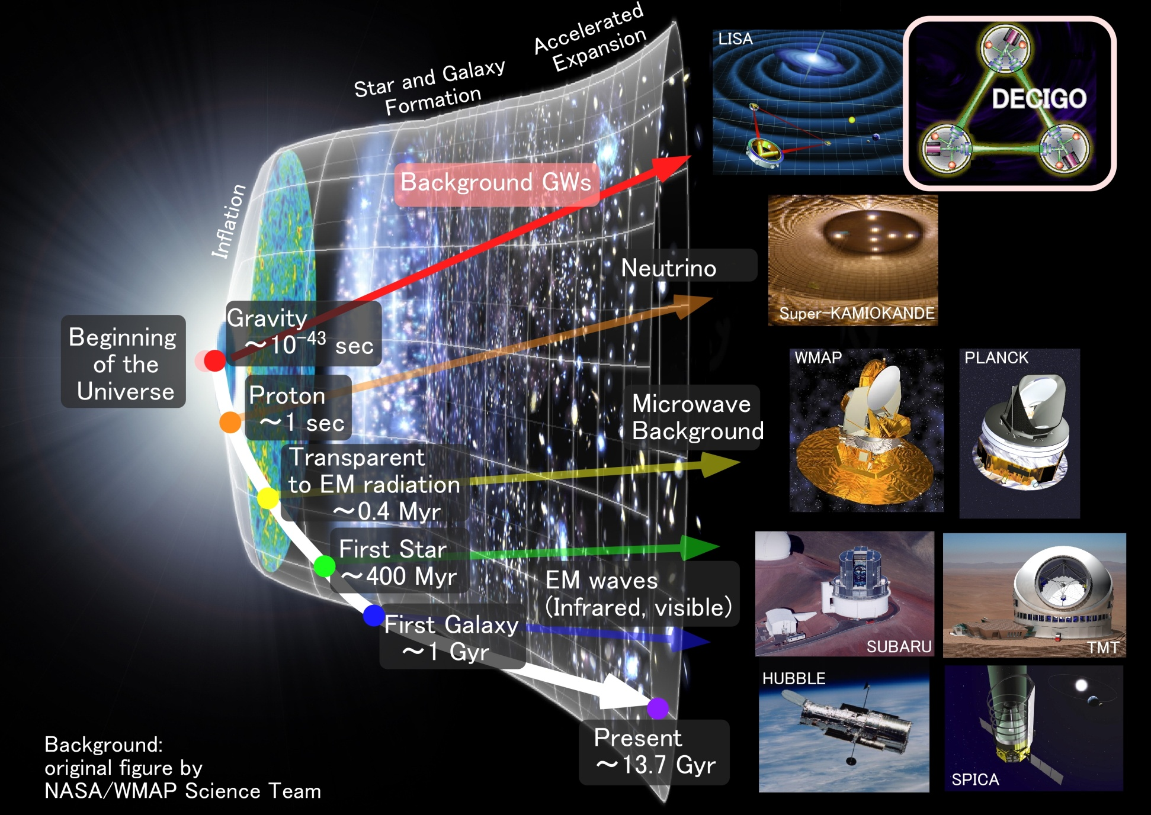
Characterization of inflation
Stochastic
Background GWs
35
Direct probe to
the history of the Universe
Notes:
As for the stochastic background gravitational waves, DECIGO has a potential to see
directory the very beginning of the universe. The picture of the earliest universe we have
is obtained from cosmic microwave background. This is a picture of 0.4 million years after the
beginning of the universe. There are several proposals to observe the first stars and first galaxies
using infrared and optical telescopes. These targets were formed about hundred millions to billion
years after the beginning of the universe. Using gravitational waves, DECIGO would watch the
very beginning, less than one seconds from the beginning of the universe.

Slide 10
Pre-Conceptual Design
Interferometer Unit:
Differential FP interferometer
Arm length: 1000 km
Finesse: 10
Mirror diameter: 1 m
Mirror mass: 100 kg
Laser power: 10 W
Laser wavelength： 532 nm
Arm cavity
Arm cavity
S/C: drag free
3 interferometers
Laser
Mirror
Photo-
detector
Drag-free S/C
Notes:
Next, I will talk on the pre-conceptual design of DECIGO.
One interferometer unit is formed by three spacecraft.
Each spacecraft has test-mass mirrors inside it.
A mirror has a diameter of 1m and weight of 100kg.
These mirrors forms Fabry-Perot interferometers with a finesse of 10 and a baseline length of 1000km.
As light sources, we will use green lasers with output power of 10W.
So as to suppress the effect of external disturbances on test mass mirrors,
such as solar radiations, each spacecraft is drag-free-controlled.
I mean, the position of spacecraft is controlled to follow the test mass position.

Slide 11
Interferometer Design
Transponder type vs Direct-reflection type
Compare : Sensitivity curves and Expected Sciences
Decisive factor: Binary confusion noise
WD-WD
confusion noise
Notes:
One of the key features of DECIGO is to use Fabry-Perot cavities for the baseline
length change measurement. Since DECIGO has between the observation band of LISA and
ground-based detectors, we have two choices in the selection of interferometer configuration.
One choice is to adopt optical transponder-type interferometer and shorten the
baseline from LISA. The estimated noise level is shown by this orange curve.
Another choice is to adopt Fabry-Perot interferometer as ground based detectors,
and expand the baseline. The noise level with this configuration is shown
by this red curve. Optical-transponder type has advantage in low frequencies,
because it can have longer baselines, and the acceleration noises on the
test mass can be relatively suppressed. The Fabry-Perot type has an advantage in
high-frequency band and best floor sensitivity. This is because the laser power
is effectively accumulated in the cavities, and the shot noise level can be suppressed.

Slide 12
Arm length
Cavity arm length : Limited by diffraction loss
Effective reflectivity (TEM₀₀ → TEM₀₀)
Laser wavelength : 532nm
Mirror diameter: 1m
Optimal beam size
1000 km
is almost max.

Slide 13
Cavity and S/C control
Cavity length change
PDH error signal → Mirror position (and Laser frequency)
Relative motion between mirror and S/C
Local sensor → S/C thruster
Displacement Signal between S/C and Mirror
Local Sensor
S/C 1
S/C 2
Mirror
Thruster
Thruster
Actuator
Fig: S. Kawamura
Displacement signal between the two Mirrors
Notes:
Here, I will talk a little more on the compatibility of Fabry-Perot cavity length
control and drag-free control of the space craft position.
This figure shows one arm cavity of DECIGO.
The distance between the mirrors is measured by Fabry-Perot cavity. The signal
is fed back to the mirror position to keep the cavity length, using mirror actuators.
On the other hand, relative displacement between a mirror and S/C are measured by
local sensors around the mirrors, These signals are fed back to the thrusters attached
to the S/C. In short, this mirror follows the motion of this mirror, and each S/C
follows the mirror inside it. So, cavity control and drag-free controls are compatible.

Slide 14
Requirements
Sensor Noise
Shot noise 3 x 10⁻¹⁸ m/Hz^{1/2} (0.1 Hz)
x 10 of KAGRA in phase noise
Other noises should be well below the shot noise
Laser freq. noise: 1 Hz/Hz^{1/2} (1Hz)
Stab. Gain 10⁵, CMRR 10⁵
Acceleration Noise
Force noise 4x10⁻¹⁷ N/Hz^{1/2} (0.1 Hz)
x 1/50 of LISA
External force sources
Fluctuation of magnetic field, electric field,
gravitational field, temperature, pressure, etc.
Notes:
This viewgraph shows important requirements to reach the target sensitivity of DECIGO.
For displacement noise, 3x10^-18 m/sqrt of Hz is requires at the frequency band of 0.1Hz.
This level is about 10 times easer than that of ground based detectors.
For laser frequency noise, 1 Hz/sqrt Hz is requires for laser source,
and 10^5 gain is required for stabilization by arm cavities assuming 10^5 CMRR.
As for the acceleration noise, 4x10^-17 N/Hz^1/2 is required. This is 50 times
stringent requirement than LISA. This will be one of the most challenging requirement
in DECIGO. To realize this, we have to deeply investigate various kinds of noise sources.

Slide 15
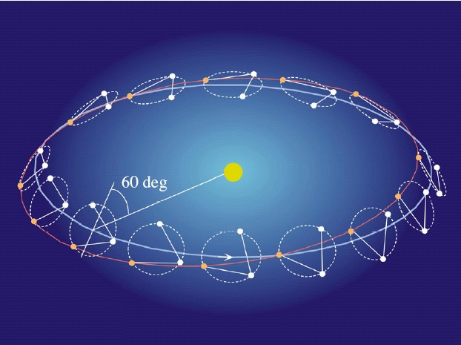
Orbit and Constellation
Separated
unit
Candidate of orbit:
Record-disk orbit around the Sun
Relative acc. 4x10⁻¹² m/s²
(Mirror force ~10⁻⁹ N )
Constellation
Separated
unit
overlapped
units
4 interferometer units
2 overlapped units → Cross correlation
2 separated units → Angular resolution
Notes:
The selection of orbit is a critical issue to suppress the effect of external force noise.
The obit of DECIGO is not decided yet. But the strongest candidate is a record disk
orbit along the Earth orbit around the sun as LISA. With this orbit, the relative acceleration
between test masses will be 4x10-12 m/s^2.
This acceleration corresponds to a force range of 10^-9 N for mirror actuator.
Another candidate is a halo orbit around a Lagrange point between the earth and the sun.
This is known to be a stable orbit. However, The relative acceleration is estimated
to be 4x10^-7 m/s^2, which requires larger actuation force to mirrors by 5 orders.
Thus, we adopted the record-disk orbit in the current pre-conceptual design.
As for the constellation, DECIGO will consist of 4 interferometer units.
Two of them will be placed in an overlapped place. This is required to take cross-correlation
of multiple detectors, and to distinguish the stochastic background signal from detector noises.
The other two units will be arranged at separated point along the same orbit.
These units enables us to increase angular resolution for the sky position of the source.
These are required to identify the sources and determine their redshift parameter.

Slide 16
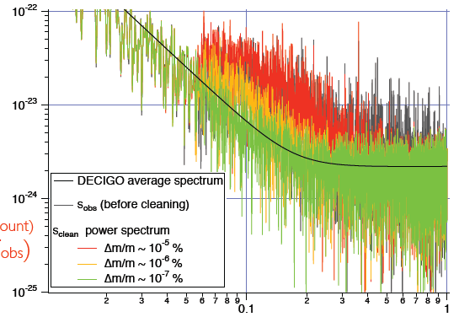
Foreground Cleaning
DECIGO obs. band: free from WD binary foreground
→ Open for cosmological observation
DECIGO will watch
~ 10⁵ NS binaries
Foreground for GWB
In principle, possible
to remove them.
Require accurate waveform
→ Δm/m < ~10⁻⁷ %
Fig: N. Kanda

Slide 17
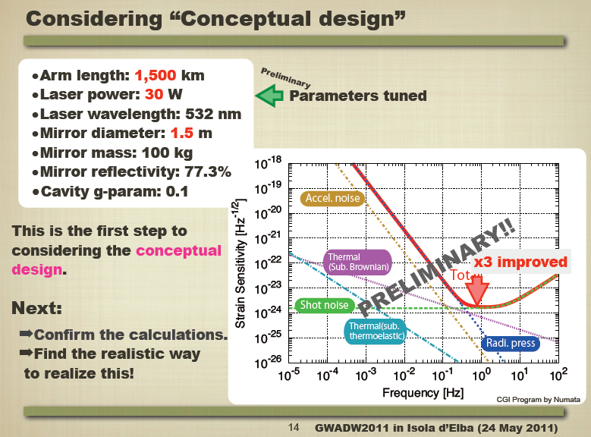
Design Update
By T.Akutsu

Slide 18
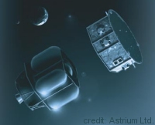
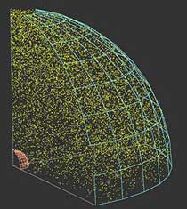
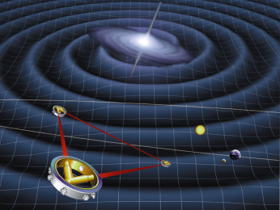
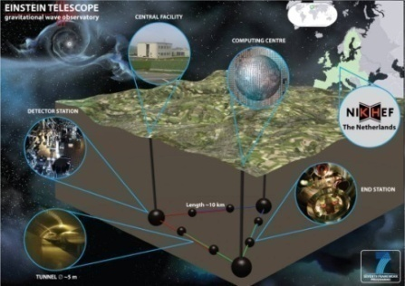
GW observation roadmap
Ground-based Observatory
Better sensitivity (10Hz-1kHz)
Space-borne observatory
Low-freq. observation (<1Hz)
LIGO
TAMA
CLIO
Virgo
Enhanced
LIGO
2010
LPF
DPF
KAGRA
Advanced
Virgo
LPF
Advanced
LIGO
2015
KAGRA
LISA
Pre-DECIGO
Ａｄ. ＬＩＧＯ
ET
LISA
2020
0.1mHz-10mHz
Guaranteed sources
DECIGO
Detection rate
~10 event/yr
BBO
DECIGO
2025
0.1Hz band
Cosmological GWs

Slide 19
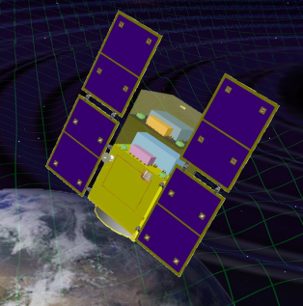

Roadmap
Figure: S.Kawamura
 | 2010 | 11 | 12 | 13 | 14 | 15 | 16 | 17 |  | 18 | 19 | 20 | 21 | 22 | 23 | 24 | 25 | 26 | 27 | 28 | 29
Mission
Objective | Space test of key tech. GW observation |  |  |  |  |  |  |  | Detect GW with min. spec FP between S/C |  |  |  |  |  |  | GW astronomy
Design | Single small satellite Short FP interferometer |  |  |  |  |  |  |  | 3 S/C 1 interferometer unit |  |  |  |  |  |  | 3 S/C x 3-4 units
R&D
Fabrication
R&D
Fabrication
R&D
Fabrication
DECIGO
Pathfinder
(DPF)
Pre-DECIGO
DECIGO
SDS-1/SWIM

Slide 20
DECIGO Pathfinder

Slide 21
DECIGO-PF
DECIGO Pathfinder (DPF)
DECIGO
First milestone mission for DECIGO
Shrink arm cavity
DECIGO 1000km → DPF 30cm
1000km
Single satellite
(Payload ~1m³ , 350kg)
Low-earth orbit
(Altitude 500km, sun synchronous)
30cm FP cavity with 2 test masses
Stabilized laser source
Drag-free control
Local Sensor
Laser
30cm
Actuator
DPF
Thruster
Notes:
Here, I will go on to the second part of my talk, on the DECIGO pathfinder.
DPF is the first milestone mission for DECIGO. The original purpose is to test the
key technologies for DECIGO. For this purpose, DPF is designed to be a prototype
of DECIGO. In DPF, one 1000km arm of DECIGO is shrunk down to 30cm, and placed
inside one small satellite orbiting around the earth.
A 30cm Fabry-Perot cavity is formed by two test mass mirrors. And the length change
is measured by means of stabilized laser. The relative displacement between the test
mass and the satellite is measured by a local sensor, and the signals are fed back to the
satellite thrusters to realize drag-free control.

Slide 22
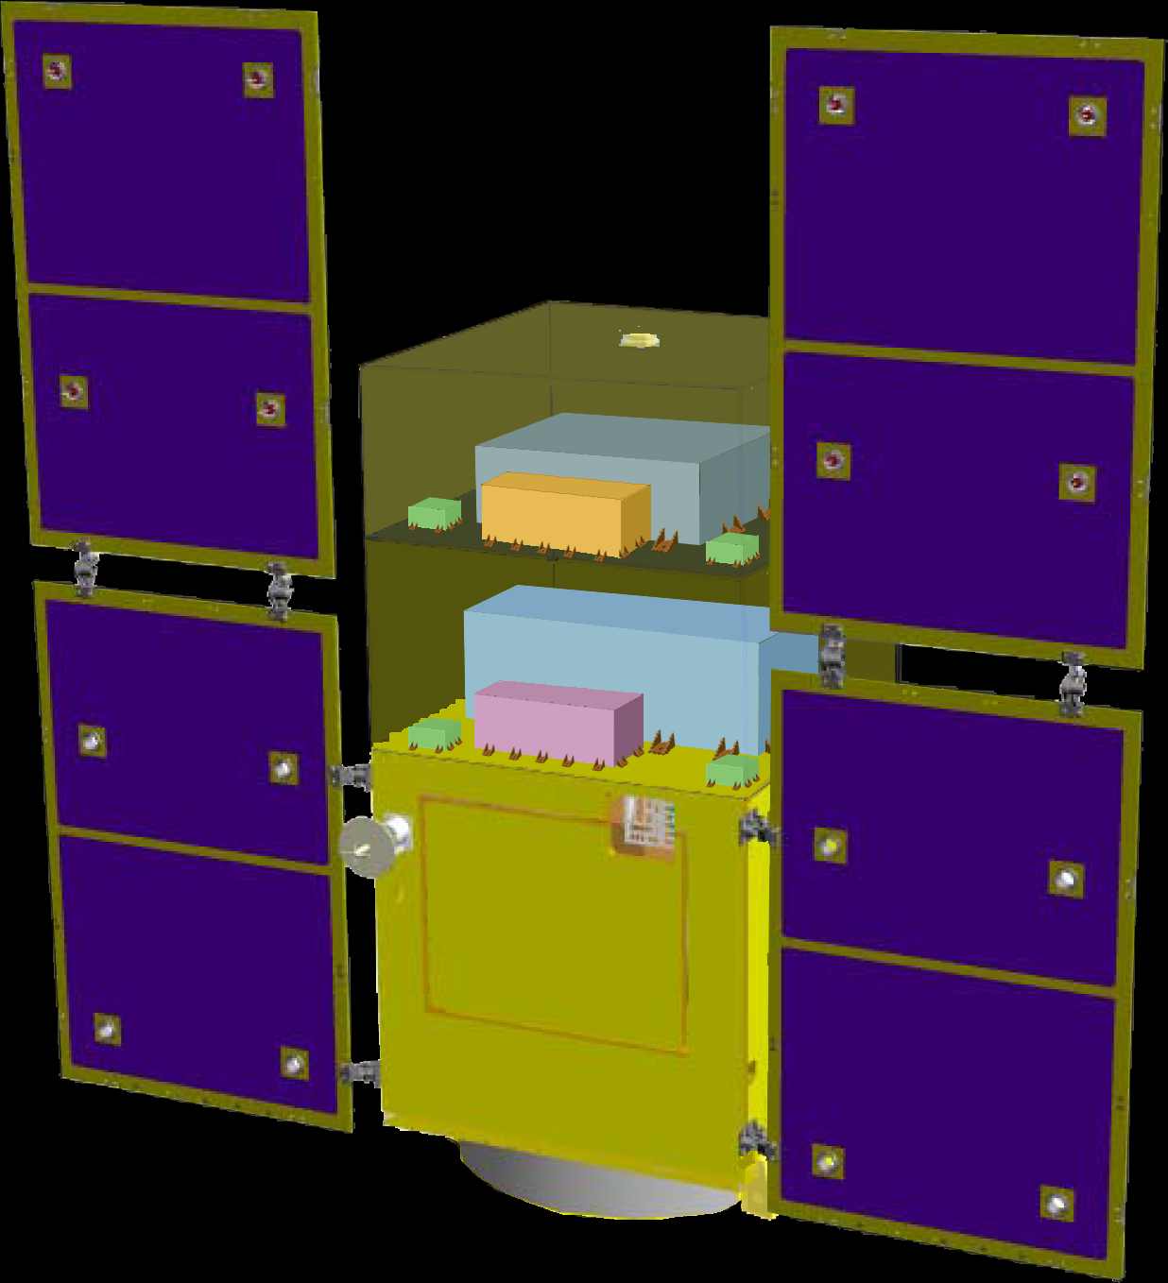
DPF satellite
DPF Payload
Size : 950mm cube
Weight : 150kg
Power : 130W
Data Rate: 800kbps
Mission thruster x12
Mission
Thruster head
Stabilized.
Laser source
On-board
Computer
Power Supply
SpW Comm.
Satellite Bus
(‘Standard bus’ system)
Size :
950x950x1100mm
Weight : 200kg
SAP : 960W
Battery: 50AH
Downlink : 2Mpbs
DR: 1GByte
3N Thrusters x 4
Interferometer
module
Satellite
Bus system
Bus thruster
Solar Paddle
Notes:
DPF satellite will look like this figure. The satellite is comprised of two parts.
The bottom part contains the bus system with solar puddles, batteries, data processing system,
temperature control system, and telecommunication system with ground station.
The upper part is a mission payload. The interferometer module is placed in the first floor,
and stabilized laser system is placed in the second floor. 10 small low-noise thrusters
are attached at the corners of the payload.

Slide 23

DPF mission payload
Mission weight : ~150kg
Mission space : ~95 x 95 x 90 cm
Drag-free control
Local sensor signal
→ Feedback to thrusters
Thruster
Fabry-Perot interferometer
Finesse : 100
Length : 30cm
Test mass : ~a few kg
Signal extraction by PDH
Laser source
Yb:YAG laser (1030nm)
Power : 25mW
Freq. stab. by Iodine abs. line
Notes:
This figure show the design of mission payload part.
As a laser source, we will use a Yb:YAG laser stabilized using iodine absorption line.
The stabilized beam is introduced to the 30cm main interferometer,
formed by two test mass mirrors.
The length change signal is extracted by a Pound-Drever-Hall scheme. The signal is fed back
to the mirror using electro-static-type actuators. The relative displacement between the
test mass and the satellite is monitored by electro-static-type local sensors and fed back to
the mission thrusters to realize dreg-free-control.

Slide 24
DPF Sensitivity
Laser source : 1030nm, 25mW
IFO length : 30cm
Finesse : 100, Mirror mass : 1kg
Q-factor : 10⁵, Substrate: TBD
Temperature : 293K
Satellite mass : 350kg, Area: 2m²
Altitude: 500km
Thruster noise: 0.1μN/Hz^{1/2}
(Preliminary parameters)
Notes:
With this configuration, DPF will have this sensitivity curve. The black curve represents
the DPF sensitivity to GW signals. This level is mainly limited by laser frequency noise
in high frequency band, and acceleration noise in low frequency band.

Slide 25
Targets of DPF
Scientific observations
Gravitational Waves form BH mergers
→ BH formation mechanism
Gravity of the Earth
→ Geophysics, Earth environment
Science technology
Space demonstration for DECIGO
→ Most tech. with single satellite
(IFO, Laser, Drag-free)
Precision measurement in orbit
→ IFO measurement
under stable zero-gravity

Slide 26

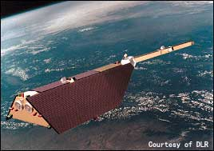
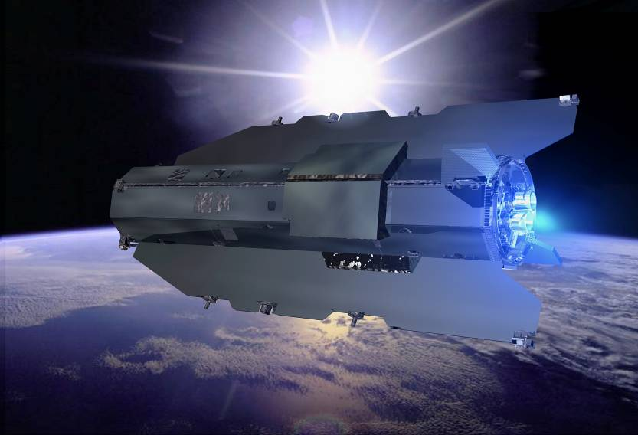
DPF Science
Astronomical observation
GW from merger of IMBHs
→ Formation mechanism
of supermassive BHs
NGC7093
NGC7078
NGC6441
NGC104
NGC6256
~30 GCs within DPF range
By K.Yagi
Observation of the earth
Gravitational potential
→ Shape of the earth
Environment monitor
By A.Shoda
Comparable sensitivity
with other missions
100km
80km
Spatial
Scale

Slide 27
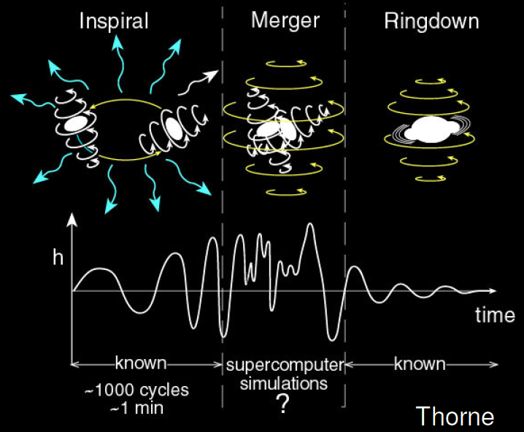

GW target of DPF
Black hole events
in our galaxy
IMBH inspiral and merger
Obs. Distance 40kpc,
for m = 2 x10⁴ M_{sun}
Obs. Duration (~1000sec)
Observable range covers
our Galaxy (SNR~5 )
NGC7093
NGC7078
There may be IMBH at GCs
DPF covers ~30 GCs
NGC6441
NGC104
NGC6256
Hard to access by others
→ Original observation
KAGAYA
(By K.Yagi)
Notes:
However, DPF has scientific targets, which are blackholes in our galaxy.
Inspiral and coalescence of intermediate-mass blackhole is one of the main targets of DECIGO,
and also a main target of DPF. This figure shows the observable range of DPF as a function
of blackhole mass.
The green curve is the range for BH inspirals, and this green curve is for quasi-normal modes.
This red line represents the distance to the galactic center. So this figure shows that
DPF has sufficient sensitivity to observe events at the center of our galaxy, if any.
Since this frequency band, around 0.1Hz, is hard to access by ground-based detectors,
this will be an original observation.

Slide 28
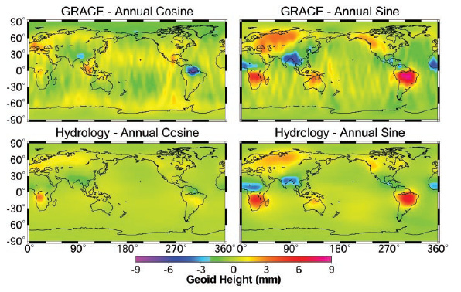
Earth’s Gravity Observation
Measure gravity field of the Earth
from Satellite Orbits, and gravity-gradiometer
comprehensive and homogeneous-quality data
Determine global gravity field
→ Basis of the shape of
the Earth (Geoid)
Monitor of change in time
→ Result of Earth’s dynamics
Ground water motion
Strains in crusts by
earthquakes and volcanoes
Seasonal change of the gravitational potential observed by GRACE

Slide 29
Satellite Gravity missions
3-types of satellite gravity missions
Satellite-to Satellite
tracking High-Low
Satellite-to Satellite
tracking Low-Low
Satellite
Gravity Gradiometry
・Observe satellite orbit
by global positioning
system (GPS,…)
・Cancel drag-effects
by accelerometer
・Distance meas. by
along-track satellites
・Cancel drag-effects
by accelerometer
・Observe potential by
gravity gradiometer
・Drag-free control for
cancellation of drags
CHAMP (GFZ, 2000-)
GRACE (NASA, 2002-)
GOCE (ESA, 2009-)

Slide 30
DPF sensitivity
Comparison of sensitivities
Better in low orders (large scale) ← Sensors
Worse in high orders (small scale) ← Altitude
Report for Mission Selection
Gravity Field and Steady-State
Ocean Circulation Mission
ESA SP-1233(1) July 1999.
400km
100km
80km
Scale
(with margin 10)

Slide 31
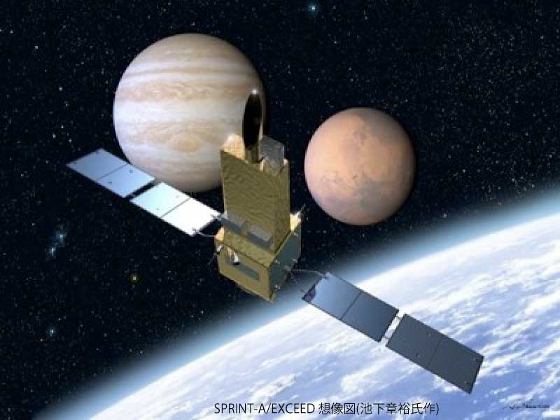

DPF mission status
DPF : One of the candidate of
JAXA’s small satellite series
At least 3 satellite in 5 years with
Standard Bus + M-V follow-on rocket
1st mission (2012): SPRINT-A/EXCEED
2nd mission (~2015) : SPRINT-B/ERG
3rd mission (~2016/17) : TBD
Call for proposal : 2012
SPRINT-A /EXCEED
UV telescope mission
DPF survived until final two
DPF is one of the strongest
candidates of the 3rd mission
Next-generation
Solid rocket booster (M-V FO)
Fig. by JAXA
Notes:
Now, I will talk on the current status of the mission selection.
JAXA, the Japanese space agency, has a project to launch at least three small satellites
in five years, using a standard bus system and a next generation solid rocket booster.
At the beginning, there were about fifty proposals four years ago. And fifteen missions
were accepted as official working groups three years ago.
Among them about five missions has been financially supported by JAXA since two years ago.
The first mission has already decided to be a SPRINT-A/EXCEED mission, which is a UV
telescope mission for planetary science. The second mission is now in selection.
DPF is surviving as one of the two final candidates. Another candidate is named ERG,
which is for observation of magnetic fields around the earth during active years of the Sun.
The final hearing was held last month, and the final selection will be made in this month.

Slide 32
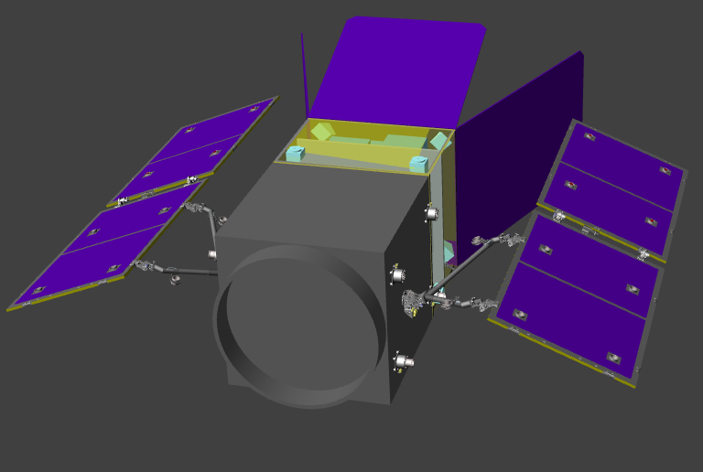
DPF-WG activities
Mission design
・Structure and thermal modeling
・Drag-free control design
Design : NEC

Slide 33
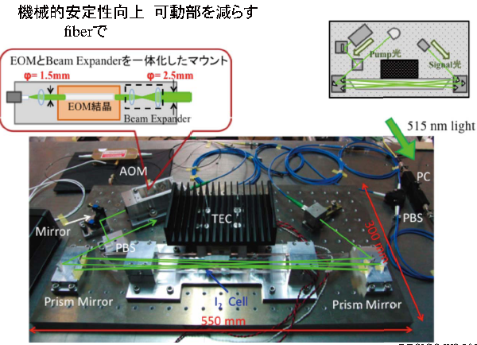
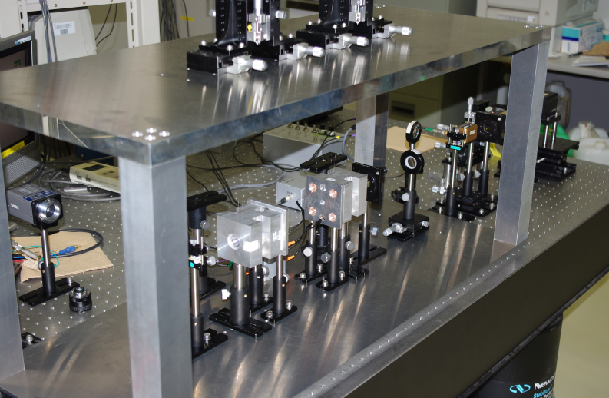
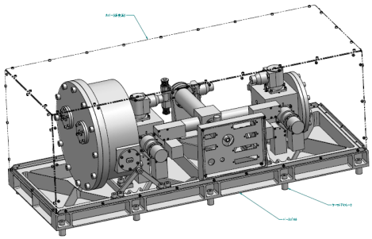

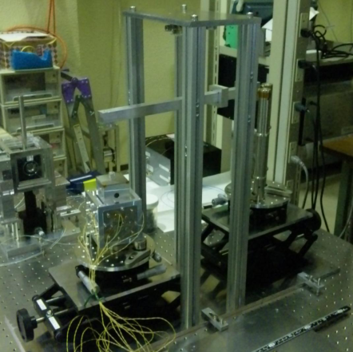
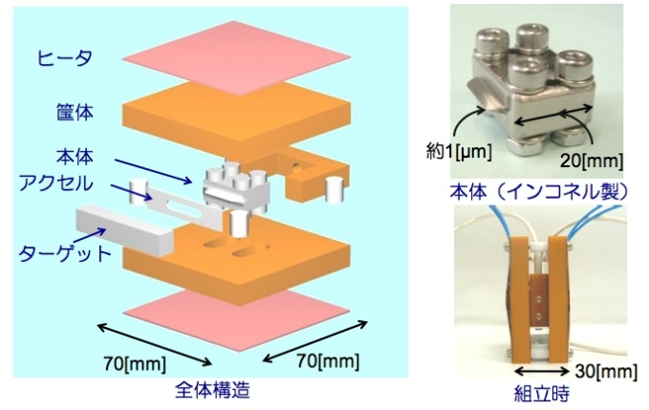
DPF-WG activities
BBMs (Bread-board model) for Core components
Laser stabilization module
Interferometer module
Univ. of Tokyo,NAOJ
Test-mass module
UEC, NICT, NASA/GSFC
NAOJ, Hosei Univ.
Low-noise thruster module
JAXA

Slide 34
SWIM

Slide 35
Roadmap
Figure: S.Kawamura
 | 2010 | 11 | 12 | 13 | 14 | 15 | 16 | 17 |  | 18 | 19 | 20 | 21 | 22 | 23 | 24 | 25 | 26 | 27 | 28 | 29
Mission
Objective | Space test of key tech. GW observation |  |  |  |  |  |  |  | Detect GW with min. spec FP between S/C |  |  |  |  |  |  | GW astronomy
Design | Single small satellite Short FP interferometer |  |  |  |  |  |  |  | 3 S/C 1 interferometer unit |  |  |  |  |  |  | 3 S/C x 3-4 units
R&D
Fabrication
R&D
Fabrication
R&D
Fabrication
DECIGO
Pathfinder
(DPF)
Pre-DECIGO
DECIGO
SDS-1/SWIM

Slide 36


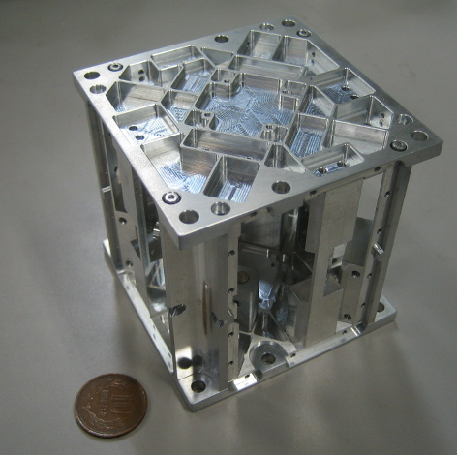


Rotating TOBA : SWIMμν
Small Module SWIMμν on SDS-1
Launched Jan. 2009, Terminated Sept. 2010
Photo：
JAXA
TAM: Torsion Antenna Module with free-falling test mass
(Size : 80mm cube, Weight : ~500g)
Test mass
~47g Aluminum, Surface polished
Small magnets for position control
Spin Axis
(46.5mHz)
Coil
Photo sensor
Reflective-type optical
displacement sensor
Separation to mass ~1mm
Sensitivity ~ 10⁻⁹ m/Hz^{1/2}
6 PSs to monitor mass motion
80mm

Slide 37
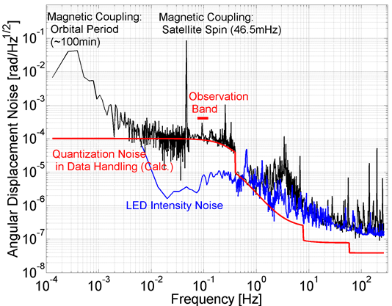
Sensitivity
Though limited by non-fundamental noises,
best as a space-borne GW detector.
By W.Kokuyama

Slide 38
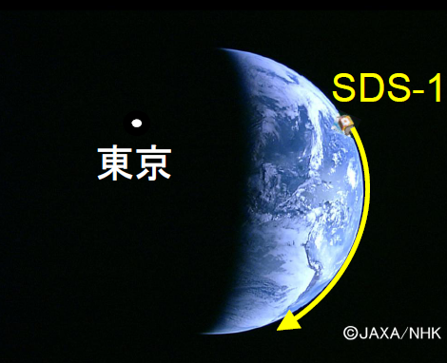
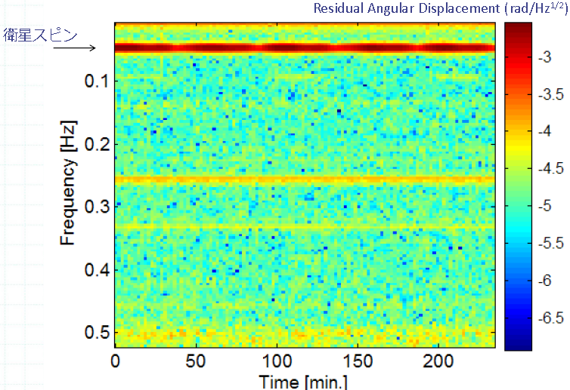
Observation by SWIM
Continuous data taking
Tokyo
Kyoto
Jun 17, 2010 ~120 min.
July 15, 2010 ~240 min.
Orbital period
~100min.
Observation band
Orbital Period
10mHz LPF
By W.Kokuyama

Slide 39
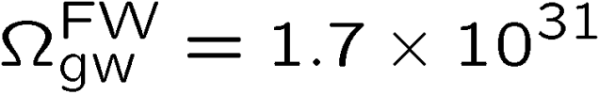
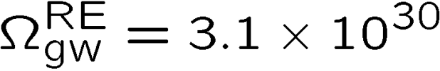
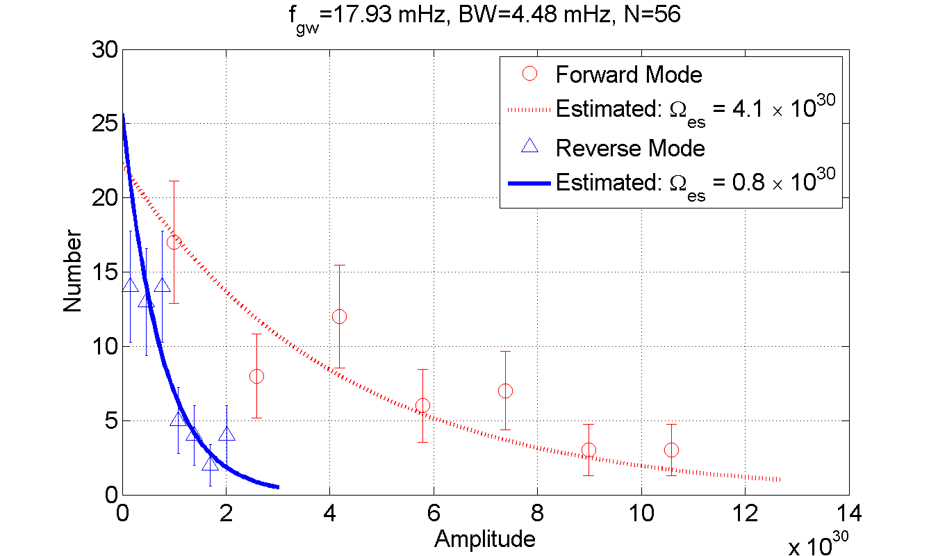
Upper Limit on GWB
Upper Limit at two frequencies (two polarizations)
‘Forward’ mode
‘Reverse’ mode
(C.L. 95%, f0 18mHz, BW 4mHz)
By W.Kokuyama

Slide 40
Summary

Slide 41
Summary
DECIGO : Fruitful Sciences
Very beginning of the Universe
Dark energy, Dark matter
Galaxy formation
DECIGO Pathfinder
Important milestone for DECIGO
Observation of GWs and Earth’s gravity
Strong candidate of JAXA’s satellite series
SWIM – Operation in orbit
first precursor to space!
Notes:
Now, I will summarize my talk.
DECIGO will provide us fruitful knowledge on the beginning of the universe, dark energy,
and formation of galaxies.
DECIGO pathfinder is a first milestone mission for DECIGO, and being a
strong candidates of JAXA's small satellite series.
In addition, we have developed a SWIM module, which is under operation in orbit.
This is our first precursor to space. Though this is only a small module, we have made
a significant step

Slide 42
Collaboration and support
・Supports from LISA
Technical advices from LISA/LPF experiences
Support Letter for DECIGO/DPF, Joint workshop (2008.11)
・Collab. with Stanford univ. group
Drag-free control of DECIGO/DPF
UV LED Charge Management System for DPF
・Collab. with NASA/GSFC
Fiber Laser , Earth’s gravity observation
・Collab. with JAXA Trajectory and Navigation group
→ Formation flight of DECIGO, DPF drag-free control
・Geophysics group (Kyoto, ERI, UEC, NAOJ)
・Advanced technology center ( ATC) of NAOJ
・JAXA’s fund for small satellite development
・Research Center for the Early Universe (RESCEU), Univ. of Tokyo
Notes:
In addition to this organization, we have collaboration with and supports from other groups.
The LISA/LPF group members are providing us technical advises from their experiences.
In the last autumn, we had the 1st LISA-DECIGO joint workshop at JAXA, Japanese space agency.
This workshop was also helpful for us in political point of view. The JAXA peoples were
really impressed in the success of this workshop and the supports from LISA group.

Slide 43

    End
Original
Picture : Sora
Notes:
Thanks you for your attention.

Slide 44
Organization
PI: Kawamura (NAOJ)
Deputy: Ando (Kyoto)
Executive Committee
Kawamura (NAOJ), Ando (Kyoto), Seto (Kyoto), Nakamura (Kyoto), Tsubono (Tokyo), Tanaka (Kyoto), Funaki (ISAS), Numata (Maryland), Sato (Hosei), Kanda (Osaka city), Takashima (ISAS), Ioka (KEK), Yokoyama (Tokyo)
Pre-DECIGO
Sato (Hosei)
Detector
Akutsu (NAOJ)
Numata (Maryland)
Science, Data
Tanaka (Kyoto)
Seto (Kyoto)
Kanda (Osaka city)
Satellite
Funaki (ISAS)
DECIGO pathfinder
Leader: Ando (Kyoto)
Design phase
Mission phase
Detector
Sato (Hosei)
Akutsu (NAOJ)
Ueda (NAOJ)
Aso (Tokyo)
Laser
Musha (ILS)
Ueda (ILS)
Drag free
Sato (Hosei)
Thruster
Funaki (ISAS)
Bus
Takashima (ISAS)
Data
Kanda (Osaka city)
Notes:
This shows the organization of DECIGO. The leader is Seiji Kawamura.
The upper part is organized as a design team for DECIGO. The organization also includes
a DECIGO pathfinder working group, shown in the lower part. This part is organized
as a mission phase team, and the subgroups are in charge of research and development tasks.

Slide 45
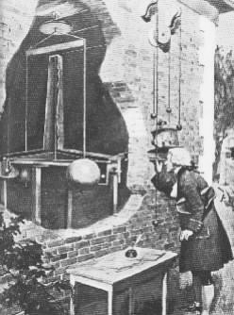
Supplementary topic

Slide 46

KAGRA and DECIGO
KAGRA (~2016)
Terrestrial Detector
→ High frequency events
DECIGO (~2027)
Space observatory
→ Low frequency sources
Target: GW detection
Target: GW astronomy

Slide 47
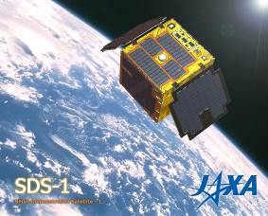
Roadmap
Figure: S.Kawamura
 | 2010 | 11 | 12 | 13 | 14 | 15 | 16 | 17 |  | 18 | 19 | 20 | 21 | 22 | 23 | 24 | 25 | 26 | 27 | 28 | 29
Mission
Objective | Space test of key tech. GW observation |  |  |  |  |  |  |  | Detect GW with min. spec FP between S/C |  |  |  |  |  |  | GW astronomy
Design | Single small satellite Short FP interferometer |  |  |  |  |  |  |  | 3 S/C 1 interferometer unit |  |  |  |  |  |  | 3 S/C x 3-4 units
R&D
Fabrication
R&D
Fabrication
R&D
Fabrication
DECIGO
Pathfinder
(DPF)
Pre-DECIGO
DECIGO
SDS-1/SWIM
Notes:
As shown in the previous viewgraph, DECIGO requires huge resources. So, we have a roadmap
to realize it step by step. We are planning to launch two milestone missions.
The first one is named DECIGO pathfinder, or DPF in short. This is a single satellite
orbiting around the earth. The purpose of DPF is to test the key technologies for DECIGO,
and also to carry out observation runs. The second milestone mission is named pre-DECIGO.
This will consist of three spacecraft. The purpose of pre-DECIGO is to detect GWs with
minimum interferometer specifications.

Slide 48
Introduction

Slide 49
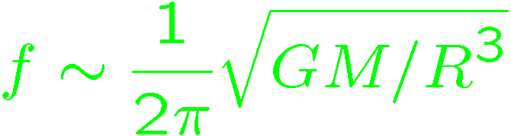
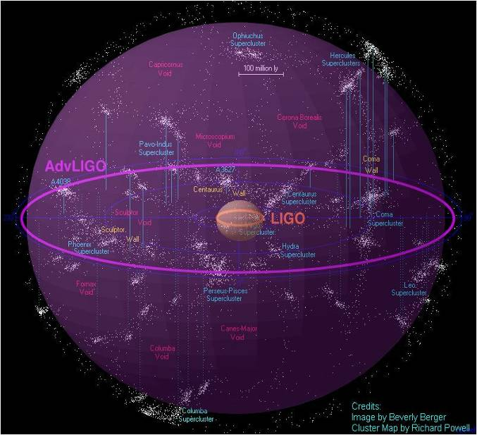
Expanding the Horizon
First-gen. GW detectors : ~ 20Mpc obs. range
However… we can expect only rare events
(10⁻⁴-10⁻² event/yr)
Next generation detectors
Better sensitivity
to cover more galaxies
Wider observation band
for various sources
Massive BH
inspirals
DPF limit
LISA
Galaxy
binaries
NS binary
inspiral
Core-collapse
Supernovae
Foreground GWs
Pulsar
(1yr)
DECIGO
ScoX-1
(1yr)
Background GWs
from early universe
(W_{gw}=10⁻¹⁴)
LCGT
Gravity-gradient noise
(Terrestrial detectors)

Slide 50
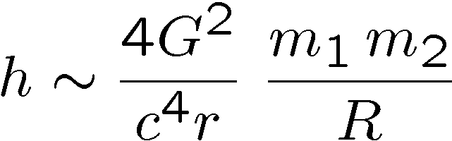
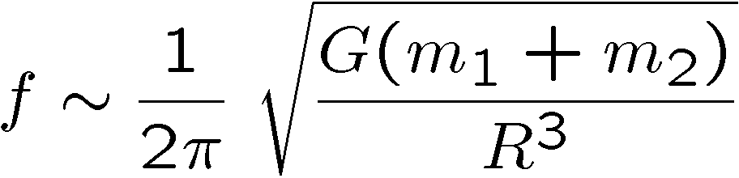
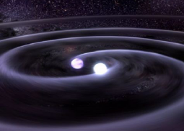

Expanding the observation band
GW frequency ~ 1/ (time scale of the source)
Observation at low frequency
- Larger-mass events → larger amplitude GW
- (Almost) stationary source → Do not have to wait for ‘events’
Different or complementary science
(Example) GW from compact binary inspiral
Separation
Mass
- Large separation
→ stationary, low-freq. GWs
- Just before merger ( )
→ Large mass, large amplitude GWs at low freq.

Slide 51
Sources and detectors
Ground-based detectors : 10Hz - 1kHz → Neutron star, Supernova, …
DECIGO/BBO : 0.1 - 1Hz → IMBH, Background GWs, …
LISA : 1mHz – 0.1Hz → SMBH, Compact binary,...
Massive BH
inspirals
LISA
Galactic
binaries
NS binary
inspiral
Core-collapse
Supernovae
Foreground GWs
Pulsar
(1yr)
ScoX-1
(1yr)
DECIGO
Background GWs
from early universe
(Ω_{gw}=10⁻¹⁴)
LCGT
Gravity-gradient noise
(Terrestrial detectors)
Notes:
DPF has almost the same observation band with that of DECIGO. But the floor level is worse by 8 orders.

Slide 52
Space GW detector
Advantages of a space detector for low-freq. observation
- Free from noises by the earth
Seismic noise, gravity-gradient noise
- Longer baseline
Observation freq. band
∝ 1 / (Beam storage time) ∝ Baseline length
Suppression of displacement noise
Strain sensitivity ~ (disp. noise) / (Baseline length)
Disadvantages of a space detector
- Cost, Development time
- Maintenance and upgrade are almost impossible after launch

Slide 53
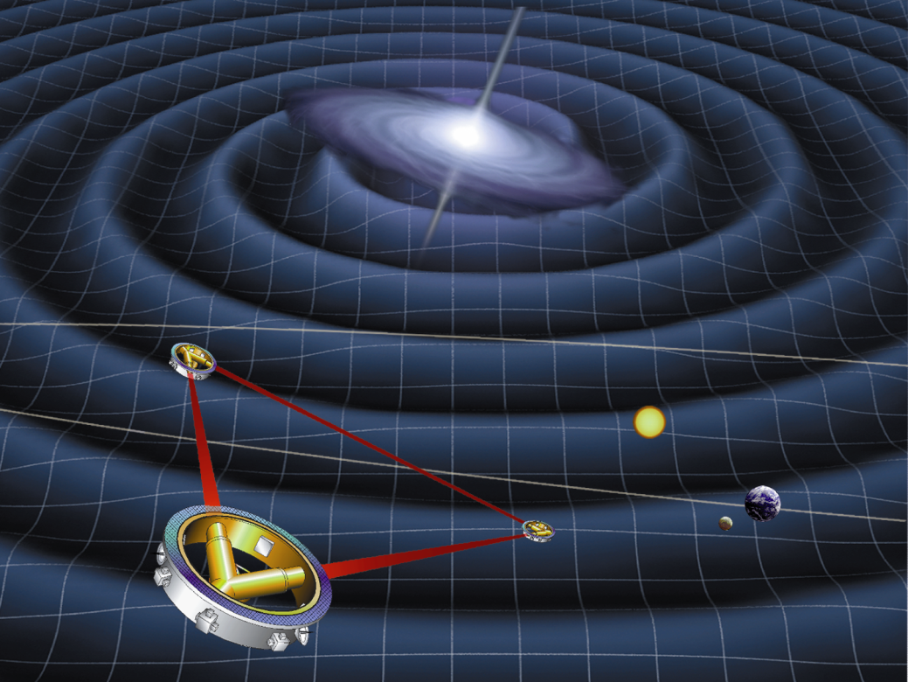
Space-borne observatories
LISA (Laser Interferometer Space Antenna)
Obs. band around 1mHz
~Million km baseline length
Recent change : ESA/NASA → ESA mission
Design updates underway
→ changing name to
NGO (New Gravitational-wave Observatory)
DECIGO
(Deci-hertz Interferometer
Gravitational Wave Observatory)
Obs. Band around 0.1Hz
1000km baseline length
Arm cavity
Arm cavity
Laser
Mirror
Photo-
detector
Drag-free S/C

Slide 54
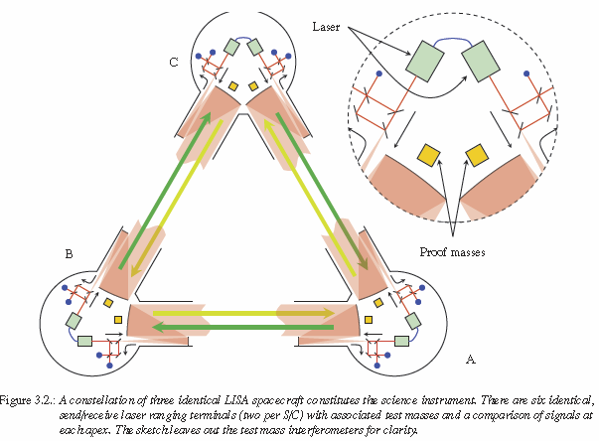
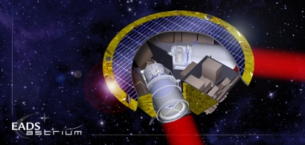
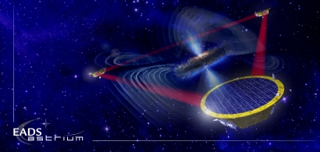
NGO (LISA) Interferometry
Interferometer design
- Optical transponder configuration
Long baseline (~1 million km) →power loss by diffraction
Each S/C has laser source →Phase-lock to incoming beam
LISA web page : http://sci.esa.int/lisa
LISA assessment study report (Yellow Book), ESA/SRE (2011) 3, February 2011

Slide 55
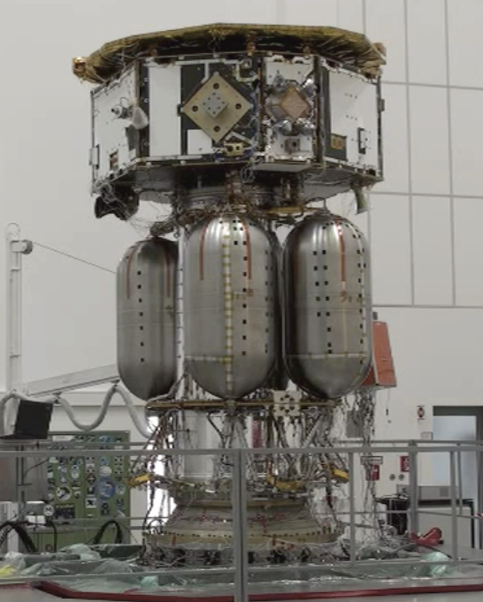
LISA Pathfinder
LISA Pathfinder
- Technical test for LISA
Obtain the best geodesic motion possible
Differential acceleration of the two TMs
3 x 10⁻¹⁴ m s⁻² at 1 mHz
Determine best configuration by experiments
Develop a noise model of the system
Allows the projection of the performance of
technologies to LISA
- Status
Most of the hardware is there.
Awaiting thrusters and launch lock.
Most of the experiments
are already defined.
- Launch in 2014
M Hewitson for the LPF team, AMALDI, July 15th 2011

Slide 56
Dark energy
DECIGO will observe
5x10⁴ NS binaries for z<1
Precise ‘clock’ at cosmological distance
‘Standard Siren’
Relationship between
distance and redshift
Expansion ＋Acceleration?
DECIGO
Distance:
chirp waveform
GW
Redshift:
host galaxy
NS-NS (z～1)
Output
→ Information on acceleration
of expansion of the universe
Seto, Kawamura, Nakamura,
PRL 87, 221103 (2001)
Determine cosmological parameters
Angular resolution
～10arcmin² （1 detector）
～10arcsec² （3 detectors）
Absolute and independent measurement
at z=1
Notes:
I will talk a little more on the sciences form the NS binaries and stochastic background.
For Newton-star binaries, DECIGO is not just a predictor of merger for ground-based detectors.
DECIGO will observe 10 thousand to hundred thousand binaries at a distance of redshift of one.
This means that we have plenty of precise clocks at cosmological distance.
These clocks can be used as standard sirens. The distance to the source is directory
measured by the gravitational waveform. And the redshift is measured by EM wave counterpart
observation by identifying the source. From this distance-to-redshift measurement,
we will be able to observe the acceleration of the expansion of the universe by dark energy.

Slide 57
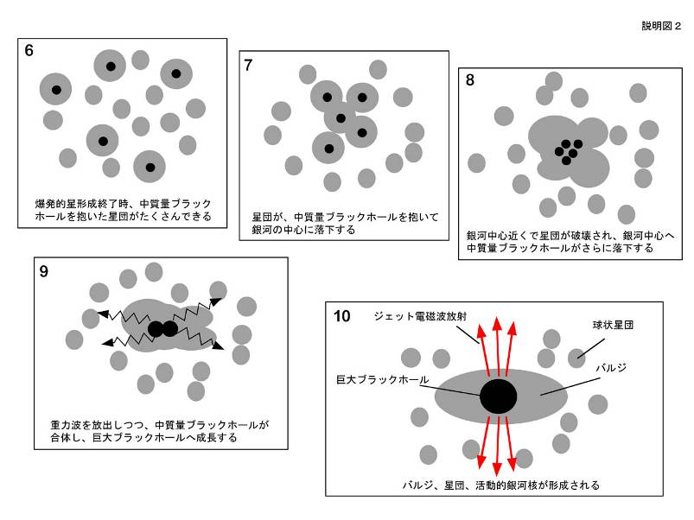
Galaxy formation
DECIGO will observe
Intermediate-mass BH (IMBH)
binary merger with
SNR>10³ for z~10 source
Information on the
formation of
Supermassive BHs
at the center of galaxies
戎崎俊一(理化学研究所) 先生のwebページより引用 http://atlas.riken.go.jp/~ebisu/smbh.html

Slide 58
Roadmap
Figure: S.Kawamura
 | 2010 | 11 | 12 | 13 | 14 | 15 | 16 | 17 |  | 18 | 19 | 20 | 21 | 22 | 23 | 24 | 25 | 26 | 27 | 28 | 29
Mission
Objective | Space test of key tech. GW observation |  |  |  |  |  |  |  | Detect GW with min. spec FP between S/C |  |  |  |  |  |  | GW astronomy
Design | Single small satellite Short FP interferometer |  |  |  |  |  |  |  | 3 S/C 1 interferometer unit |  |  |  |  |  |  | 3 S/C x 3-4 units
R&D
Fabrication
R&D
Fabrication
R&D
Fabrication
DECIGO
Pathfinder
(DPF)
Pre-DECIGO
DECIGO
SDS-1/SWIM

Slide 59
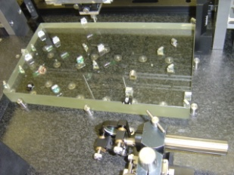
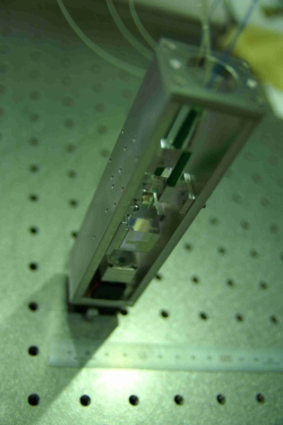
Interferometer Module
Interferometer Module : Test mass + IFO
Interferometer
Module
Test-mass module
→ Gravity reference
・BBM of Module,
Sensor, Actuator,
Clump/Release
・μ-Grav. Exp.
Hosei, NAOJ,
Ochanomizu, Stanford
Interferometer
→ GW, Gravity observation
・30cm IFO BBM ・Packaging
Digital control ・Monolithic Opt.
Laser sensor
→ Small MI
・BBM test
・Sensitivity meas.
NAOJ, U-Tokyo
ERI, U-Tokyo
Notes:
The prototype of the test mass mirror and the housing for it are shown in this picture.
The details of this part will be presented by S.Sato san in this afternoon in the parallel session
number two and also was presented by Yuka Wakabayashi san in a poster session.

Slide 60
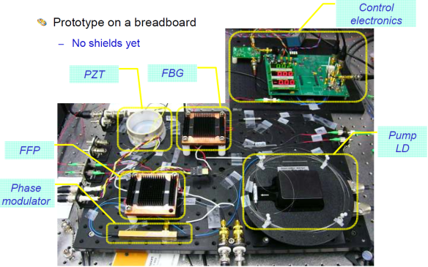
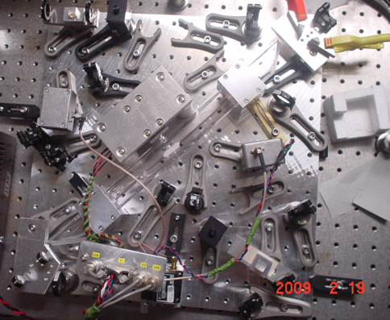
Stabilized Laser Module
Stabilized Laser : Laser source + Stabilization system
Yb:YAG (NPRO or Fiber laser)
→ Laser source
・BBM
development
UEC, NASA/GSFC
I₂ absorption line
→ Frequency
reference
Stabilized
Laser Module
・BBM development
・Stability meas.
UEC, NICT
Notes:
The laser stabilization system using iodine absorption line is being developed as BBM in
the same size as flight model. This system is working well, and evaluation of the stability
and development of automatic control system are going on.

Slide 61
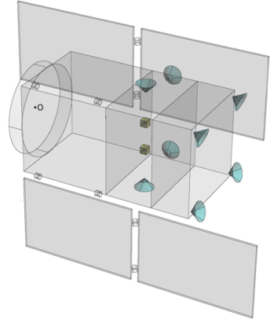
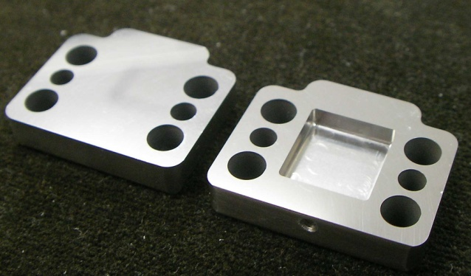
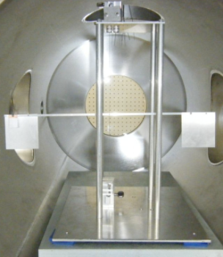


Attitude and Drag-free control
Attitude and Drag-free control : Structure, Thrusters, Control
Structure, thermal stability
・Passive
attitude stability
・Drag-free control
Low-noise
Thruster
Mass balance
U-Tokyo, JAXA
Low-noise Thruster
→ Actuators for satellite control
・BBM and system design
JAXA, NDAJ, Tokai-U
Notes:
The attitude and drag-free control system is being designed as shown in this figure.
DOF will have a hybrid drag-free control configuration with passive stabilization with
gravity gradient, and active control using mission thrusters.
As for the low-noise thruster, we are designing the system with existing technologies,
and developing a thruster stand used for the evaluation of thrust noises.
In addition, as a R&D for future missions, we are developing a new slit-type FEEP thruster.

Slide 62




Signal processing and Control
Signal Processing and Control : SpaceWire-based system
SpC2 + SpW system
→ Signal processing and install. ctrl
Signal processor
SpC2
SWIMmn
Photo
by JAXA
Test-mass
control
Space demonstration
bySDS-1/SWIM
SDS-1
(Jan. 2009)
JAXA, U-Tokyo, Kyoto
SWIMmn demonstration
→ Test mass control in orbit
Satellite Bus
JAXA, U-Tokyo, Kyoto
Notes:
As one of R&D for DPF and also DECIGO, we have made a significant step recently.
We developed a small test-mass and signal-processing module, named SWIM.
This module was loaded on a small technology demonstration satellite, and launched
in this January. We had several in-orbit operation after that, and we are obtaining
good results. In short, it is working well. Details will be presented by W.Kokuyama
in this afternoon in the parallel session number 2. I believe that this will be an
exciting talk for most of you.

Slide 63

Gravity of the Earth
Measure gravity field of the Earth
from Satellite Orbits, and gravity-gradiometer
GPS satellite
Determine global gravity field
→ Density distribution
Monitor of change in time
Ground water motion
Strains in crusts by
earthquakes and volcanoes
Observation Gap
between GRACE and GRACE-FO
(2012-16)
→ DPF contribution
in international network
By Araya and Fukuda
Notes:
DPF has another scientific target, which is the gravity of the earth. Changes of the global
gravity field of the earth is being monitored by several satellite missions. However,
it is said that there will be an observation gap time between the end of the GRACE mission and
the start of GRACE follow-on. DPF would be able to contribute to bridge the gap time.

Slide 64

地球重力場観測の観測網
GRACE, GOCEが稼働中
次世代計画 GRACE-FO
GRACEと同等 (マイクロ波測距)
GRACE
L ~ 220km, ΔL ~ 5μm
→ ΔL/L ~ 2 x 10⁻¹¹
DPF
L ~ 0.3m, ΔL ~ 10⁻¹¹ m
→ ΔL/L ~ 3 x 10⁻¹¹
GRACEとGRACE-FOの間
(2012-16年) の空白を埋める可能性
→ 独自の成果, 国際貢献

Slide 65

R&D for DPF (1)
By M.Musha
Stabilized Laser
BBM development
Yb:YAG (NPRO) source
Saturated absorption by I₂
→ Stability test, Packaging
IFO and housing
BBM-EM development
→ Test of concepts
+ Earth gravity sensors
By S.Sato
By A.Araya

Slide 66
R&D for DPF (1)
By M.Michimura
Main interferometer
BBM development
Locked with digital control
→ Stability test, Packaging
IFO and housing
BBM-EM development
→ Test of concepts
+ Earth gravity sensors
By S.Sato
By A.Araya

Slide 67


R&D for DPF (2)
By
S.Moriwaki
Attitude control and Drag-free
Satellite structure (mass distribution)
Passive attitude stabilization
by gravity gradient
Mission thruster position
Control topology
Thruster
System design
with existing tech.
Noise meas. system
(thruster stand)
Development of Slit FEEP
By I.Funaki

Slide 68




DPF and DECIGO
DPF requirements
DECIGO
requirements
Disp. noise
6x10⁻¹⁶ m/Hz^{1/2}
Precise meas.
by IFO
4x10⁻¹⁸ m/Hz^{1/2}
1000km FP cavity
IFO control in space
Low external force
Large optics
Force noise
10⁻¹⁴ N/Hz^{1/2}
10⁻¹⁷ N/Hz^{1/2}
Ultra stable Laser
Stabilization of source
Stabilization by long arm
Stab. Laser
Freq. Stability
0.5 Hz/Hz^{1/2}
1 Hz/Hz^{1/2}
Formation flight
Stable orbit
Inter S/C Ranging
Drag-free control
Low-noise thruster
Drag-free
control
Satellite disp.
10⁻⁹ m/Hz^{1/2}
Thruster noise
10⁻⁷ N/Hz^{1/2}
Observation
Data procession
Data analysis
Triggered search
GW Obs.
0.1 Hz band
Observation and
Data analysis

Slide 69
IMBH inspiral and Merger
DECIGO will observe
Intermediate-mass BH (IMBH)
binary merger with
SNR>6000 for z~1 source
Information on the
formation of
Supermassive BHs
at the center of galaxies
戎崎俊一(理化学研究所) 先生のwebページより引用 http://atlas.riken.go.jp/~ebisu/smbh.html

Slide 70

Standard Sources
Fig. from
SNAP
web page
Supernova (EM wave) Neutron-star binary (GW)
‘Standard Candle’ ‘Standard Siren’
Absolute power
or amplitude
Extrapolated from
nearby events
General Relativity
＜
Event rate
2000/yr （SNAP）
＜
10⁴⁻⁵/yr （DECIGO）
Error in distance
~10%
～
10% at z=1
～
Identification
of host galaxy
Require multiple detectors
or statistics
Easy?
＞
Others
Uncertainty by
dust absorption
Negligible interaction
with matters
＜
R.Takahashi (2006)

Slide 71


DPF targets
BHs in Globular clusters
BH masses estimated from star motion
Estimate SNR of GW signals
Equal mass, Mass ratio 1:1/3, 100Msun BH capture
Credit: NASA, STScI
(~150 Globular Clusters
in our Galaxy)
(By N.Seto)

Slide 72


Comparison with LPF
LPF (LISA Pathfinder)
DPF (DECIGO Pathfinder)
Purpose
Launch
Weight
Orbit
Test Mass
Laser source
Interferometer
Sensitivity
Demonstration for LISA
2010
Dedicated launcher (Vega)
1,900 kg
Halo orbit around L1
Drag-free attitude control
Au-Pt alloy x2
Nd:YAG (1064nm)
Mach-Zehnder
3x10⁻¹⁴ m/s²/Hz^{1/2} (1mHz)
Demonstration for DECIGO
GW observation
~2013
Dedicated launcher (M-V follow-on)
350 kg
SSO altitude 500km
Drag-free attitude control
TBD x2
Yb:YAG (1030nm)
Fabry-Perot
1x10⁻¹⁵ m/s²/Hz^{1/2} (0.1Hz)
Thruster
Control Unit
Stabilized Laser
Central
Processing Unit
Mission
Thrusters
Housing
Control Unit
Interferometer
Module
Interfererometer
Control Unit
Bus Thrusters
Solar Paddle

Slide 73
Pre-DECIGO
 | Pre-DECIGO | DECIGO
Arm length | 100 km | 1000 km
Mirror diameter | 30 cm | 1 m
Laser wavelength | 0.532 μm | 0.532 μm
Finesse | 30 | 10
Laser power | 1 W | 10 W
Mirror mass | 30 kg | 100 kg
# of interferometers in each cluster | 1 | 3
# of clusters | 1 | 4

Slide 74
Sensitivity of Pre-DECIGO
S/N~14 for NS-NS@300Mpc, 10-20 events/year

Slide 75
SWIM in-orbit operation
SWIM (Space-wire Demonstration module)
on SDS-1 satellite
Launched in Jan. 23, 2009
Decommission in Sept. 2010
Photo：
JAXA
- Test of signal processing and control system
- Demonstration of space GW detector
SpaceCube2: Space-qualified Computer
SWIMμν : User Module
CPU: HR5000
(64bit, 33MHz)
System Memory:
2MB Flash Memory
4MB Burst SRAM
4MB Asynch. SRAM
Data Recorder:
1GB SDRAM
1GB Flash Memory
SpW: 3ch
Processor test board
GW+Acc. sensor
FPGA board
DAC 16bit x 8 ch
ADC 16bit x 4 ch
→ 32 ch by MPX
Torsion Antenna x2
~47g test mass
Data Rate : 380kbps
Size: 124 x 224 x 174
Weight: 3.5 kg
Power: ~7W
Size: 71 x 221 x 171
Weight: 1.9 kg
Power: 7W
Photo by JAXA
Photo by JAXA

Slide 76



SWIMμν
Tiny GW detector (TOBA)
Test mass bar (5cm length)
→ Levitated control in space
See A. Shoda’s talk
on Tuesday
TAM: Torsion Antenna Module with free-falling test mass
(Size : 80mm cube, Weight : ~500g)
Test mass
SWIMmn Module
~47g Aluminum, Surface polished
Small magnets for position control
2 TAMs
in the frame
Coil
Used for test-mass
position control
Max current ~100mA
Photo sensor
Reflective-type optical
displacement sensor
Separation to mass ~1mm
Sensitivity ~ 10⁻⁹ m/Hz^{1/2}
6 PSs to monitor mass motion

Slide 77
Successful control
SWIM
In-orbit operation
z control on
Test mass controlled
Error signal → zero
Damped oscillation
(in pitch DoF)
yaw control on
Free oscillation
in x and y DoF
Signal injection
→ OL trans. Fn.
Operation: May 12, 2009
Downlink: ~ a week
By
W.Kokuyama

Slide 78




SWIMμν初期運用(5)
XY平面上のマスの動きと衛星スピンの効果
マスが浮上した時、XY平面上で自由振動を行っている様子が観測
X
Y
楕円が回転
Time [sec]
Time [sec]
2Hzの共振＋うなり(~0.05Hz)
スピン安定
X-Yプロット
コリオリ力により
振動軸が回転
→ 「フーコーの振り子」
Z
0.2mm
データからフィッティング：-16.8deg/s
衛星スピンレート：-16.7deg/s
よく一致
センサ固定座標系でみると

Slide 79
SWIMμν初期運用(1)
3回目 例：09/03/14 14時(JST)頃 ノルウェー上空
浮上マスの制御
OFF
Z ON
Yaw ON
そのまま地上では制御できない
(飛行機実験で20秒間の
制御を実証していた)
2月運用時に2回、
3月運用時に2回、
制御を実施
鉛直制御
４回とも宇宙空間での
制御に成功(TAM1)
フォトセンサ(変位センサ)
のオフセット最適化も実施
回転制御
TAM2は動作確認中
(注：データ処理のせいで
過渡応答は一部汚く見える)

Slide 80

SWIMμν初期運用(2)
制御時残留ノイズスペクトル
Z方向に矩形波信号注入時
XY平面内共振(後述)と倍波
8.4Hz注入信号と3倍波
Pitch
10⁻⁴
10⁻⁵
Rotational Displacement [rad/rHz]
10⁻⁶
10⁻⁷
その他のピーク：解析中
データの取得に成功・解析を実施中

Slide 81


球状星団のブラックホール
中心付近の星の速度分布の観測
中心付近の星の速度分布
と BH質量の関係
Core velocity dispersions for 25 Galactic and 10 old Magellanic globular clusters?
Pierre Dubath et al.,
Astron. Astrophys. 324, 505–522 (1997)
GEMINI AND HUBBLE SPACE TELESCOPE EVIDENCE FOR AN INTERMEDIATE-MASS
BLACK HOLE IN ω CENTAURI
Eva Noyola et al., ApJ 676 (2008) 1008Y1015

Slide 82

DECIGOによる初期宇宙BH観測

Slide 83

推進体制
DPF-WG 84名
DECIGO 137名

Slide 84

Main interferometer
Test-mass module
Keeps a test inside
Local sensor/actuator
Launch-lock system
Interferometer sensors
for fine measurement
Fabry-Perot interferometer
Finesse : 100
Length : 30cm
Test mass : ~1kg
Signal extraction by PDH

Slide 85
DECIGOのための根幹技術実証
DPFで実証される技術
DECIGOで必要
とされる主要技術
6x10⁻¹⁶ m/Hz^{1/2}
の変位感度
宇宙干渉計
による
精密計測
4x10⁻¹⁸ m/Hz^{1/2}
の変位感度
基線長1000kmのFP干渉計
宇宙における干渉計制御
試験マスに対する外乱抑圧
大型光学系の製作・制御
10⁻¹⁴ N/Hz^{1/2}
の外力雑音
10⁻¹⁷ N/Hz^{1/2}
の外力雑音
安定化レーザー
の宇宙実証
安定化レーザー光源による精密計測
光源の周波数・強度安定化
長基線長を利用した安定化制御
0.5 Hz/Hz^{1/2}
の周波数安定度
フォーメーションフライト
安定な軌道の実現
宇宙機間の距離制御
ドラッグフリー制御
低雑音スラスタ
ドラッグフリー
制御の実現
衛星変動安定度
10⁻⁹ m/Hz^{1/2}
スラスタ雑音
10⁻⁷ N/Hz^{1/2}
観測運用
時系列連続データの処理
データの解析
理論予測・他の観測との比較
重力波観測
0.1 Hz帯の連続
観測とデータ解析

Slide 86
DECIGOのための根幹技術実証
DPFで実証される技術
DECIGOで必要
とされる主要技術
6x10⁻¹⁶ m/Hz^{1/2}
の変位感度
宇宙干渉計
による
精密計測
4x10⁻¹⁸ m/Hz^{1/2}
の変位感度
基線長1000kmのFP干渉計
宇宙における干渉計制御
試験マスに対する外乱抑圧
大型光学系の製作・制御
10⁻¹⁴ N/Hz^{1/2}
の外力雑音
10⁻¹⁷ N/Hz^{1/2}
の外力雑音
安定化レーザー
の宇宙実証
安定化レーザー光源による精密計測
光源の周波数・強度安定化
長基線長を利用した安定化制御
0.5 Hz/Hz^{1/2}
の周波数安定度
フォーメーションフライト
安定な軌道の実現
宇宙機間の距離制御
ドラッグフリー制御
低雑音スラスタ
ドラッグフリー
制御の実現
衛星変動安定度
10⁻⁹ m/Hz^{1/2}
スラスタ雑音
10⁻⁷ N/Hz^{1/2}
観測運用
時系列連続データの処理
データの解析
理論予測・他の観測との比較
重力波観測
0.1 Hz帯の連続
観測とデータ解析

Slide 87
DPFで実証される科学技術
意義・波及効果
DPFで実証される技術
宇宙空間での精密計測技術
→ 基礎物理学実験
無重力環境下での精密計測
6x10⁻¹⁶ m/Hz^{1/2}
の変位感度
宇宙干渉計
による
精密計測
10⁻¹⁴ N/Hz^{1/2}
の外力雑音
宇宙・衛星内環境のより深い理解
宇宙空間での高い安定度の実現
さまざまな応用
地球環境観測 (ADM-Aeolus, GIFTS),
基礎物理実験, マイクロ波標準, 通信
(ACES), 惑星探査 (TPF-C), X線観測
(MAXIM), フォーメーションフライト (LISA,
GRACE-follow-on)
安定化レーザー
の宇宙実証
0.5 Hz/Hz^{1/2}
の周波数安定度
長時間安定な無重力環境
→宇宙環境利用の新しい可能性
基礎物理学実験, 材料工学
ドラッグフリー
制御の実現
衛星変動安定度
10⁻⁹ m/Hz^{1/2}
フォーメーションフライト
のための基礎技術
(TPF-C, LISA, GRACE follow-on)
スラスタ雑音
10⁻⁷ N/Hz^{1/2}
小型低雑音スラスタの宇宙実証

