Slide 1
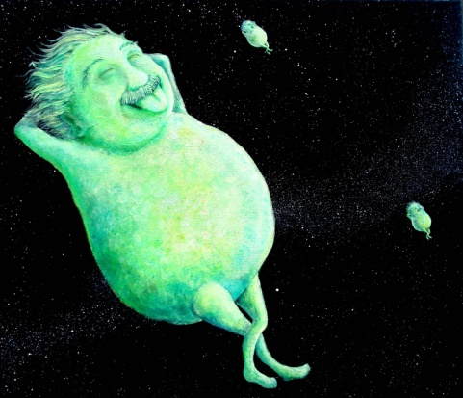
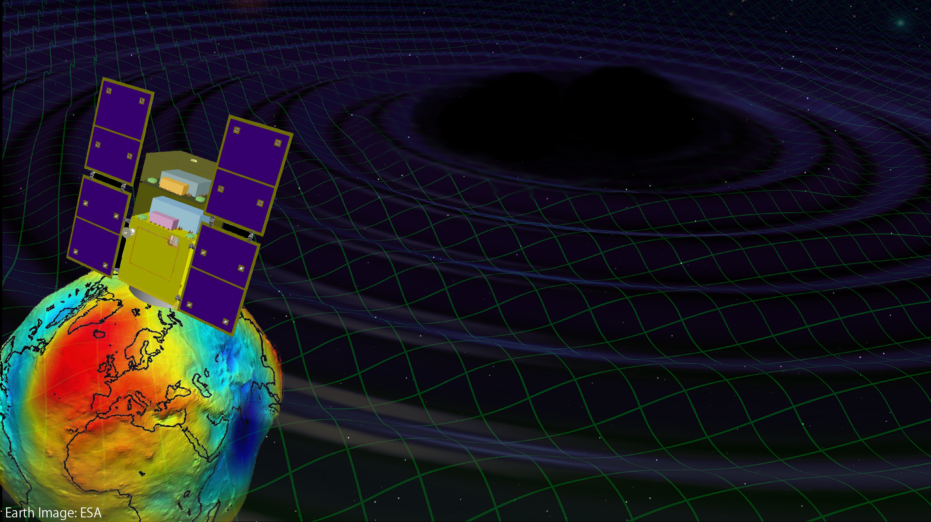
DECIGO and DECIGO Pathfinder
Original
Picture : Sora
Masaki Ando
(Department of Physics, Kyoto University)
On behalf of
DECIGO working group

Slide 2

    1. DECIGO
    Overview and Science
    Pre-conceptual Design
    2. DECIGO Pathfinder
    Overview and Science
    Design and Status
    Space Demonstration
    3. Summary
Notes:
This talk contains two parts.
The first part is for DECIGO. I will present overview, science , and conceptual design of DECIGO.
The second part is for DECIGO pathfinder, which is the first milestone mission for DECIGO.
In this part, I will present overview, science, and current status of DECIGO pathfinder.

Slide 3
    1. DECIGO
    Overview and Science
    Pre-conceptual Design
    2. DECIGO Pathfinder
    Overview and Science
    Design and Status
    Space Demonstration
    3. Summary

Slide 4
DECIGO
DECIGO
(Deci-hertz interferometer Gravitational wave Observatory)
Space GW antenna (~2027)
Obs. band around 0.1 Hz
‘Bridge’ the obs.gap between
LISA and Terrestrial detectors
Terrestrial Detectors
(Ad. LIGO, LCGT, etc)
LISA
DECIGO
Notes:
The first topic is sciences of DECIGO.
DECIGO stands for Deci-hertz....., firstly proposed in 2001.
This is a space GW antenna with observation band around 0.1Hz.
Since this frequency band is between the terrestrial detectors and LISA,
DECIGO will bridge the observation gap between them.

Slide 5
DECIGO Interferometer
Interferometer Unit:
Differential FP interferometer
Baseline length: 1000 km
3 S/C formation flight
3 FP interferometers
Drag-free control
Arm cavity
1000km
Arm cavity
Laser
Mirror
Photo-
detector
Drag-free S/C
Notes:
DECIGO will be formed by three spacecraft, 1000km apart from one another.
Each spacecraft has test-mass mirrors inside it, and the distances between
them are measured by means of laser interferometers.

Slide 6
Targets and Science
IMBH binary inspiral
NS binary inspiral
Stochastic background
Galaxy formation (Massive BH)
Cosmology (Inflation, Dark energy)
Fundamental physics
10⁻¹⁶
10⁻¹⁸
IMBH inspiral (z~1)
10⁻²⁰
GW amplitude [Hz^{-1/2}]
Background GW
(Ωgw ~ 2 x 10⁻¹⁶)
Merger
DECIGO
(1 unit)
10⁻²²
3month
10⁻²⁴
Merger
DECIGO
(Correlation)
10⁻²⁶
NS inspiral (z~1)
10⁻⁴
10⁻²
10⁰
10²
10⁴
Frequency [Hz]
Notes:
With this configuration, DECIGO will have this sensitivity curve.
The horizontal axis is frequency, and the vertical axis is sensitivity to GWs in unit of per-root-hertz.
DECIGO has three main targets.
The first one is inspiral of intermediate-mass BHs.
This line represents the amplitude of signal from 1000 solar mass blackhole
binaries at the distance of redshift of one. The binary will merge at the center of the DECIGO band.
This observation may bring us information on the formation of supermassive BHs at the center of galaxies.
The second target is inspiral of neutron star binaries. This yellow line shows
the GW signal amplitude for NS binary at distance of redshift one. The signal is
in the DECIGO band about several years before the merger. The signal moves to higher
frequency in time, and the merger signal will radiated in the band of ground-based
detectors. So DECIGO will work as a predictor for ground based detectors.
The third target is stochastic background GWs from the early universe.
For this target, we need multiple detectors, in order to distinguish the signal
from detectors noise, This green curve represents the noise level by one-year
cross-correlation observation with two interferometer units.
This level reaches to gravitational-wave energy density ratio of 2 times 10^-16.

Slide 7
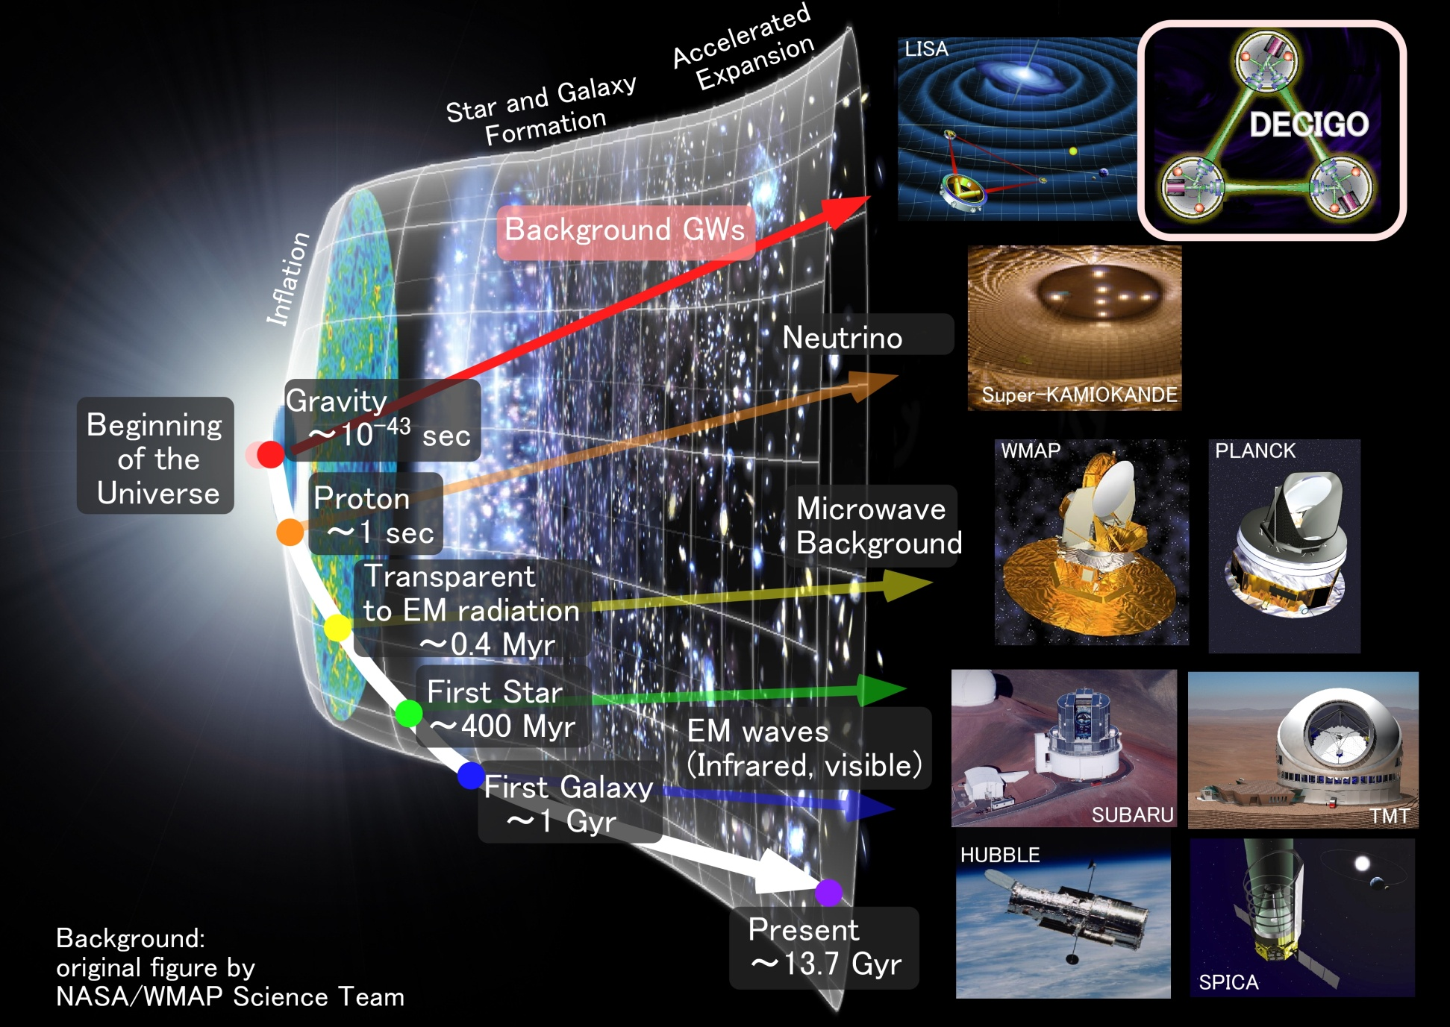
Characterization of inflation
Stochastic
Background GWs
Direct probe to
the history of the Universe
Notes:
As for the stochastic background gravitational waves, DECIGO has a potential to see
directory the very beginning of the universe. The picture of the earliest universe we have
is obtained from cosmic microwave background. This is a picture of 0.4 million years after the
beginning of the universe. There are several proposals to observe the first stars and first galaxies
using infrared and optical telescopes. These targets were formed about hundred millions to billion
years after the beginning of the universe. Using gravitational waves, DECIGO would watch the
very beginning, less than one seconds from the beginning of the universe.

Slide 8
Dark energy
DECIGO will observe
5x10⁴ NS binaries for z<1
Precise ‘clock’ at cosmological distance
‘Standard Siren’
Relationship between
distance and redshift
Expansion ＋Acceleration?
DECIGO
Distance:
chirp waveform
GW
Redshift:
host galaxy
NS-NS (z～1)
Output
→ Information on acceleration
of expansion of the universe
Seto, Kawamura, Nakamura,
PRL 87, 221103 (2001)
Determine cosmological parameters
Angular resolution
～10arcmin² （1 detector）
～10arcsec² （3 detectors）
Absolute and independent measurement
at z=1
Notes:
I will talk a little more on the sciences form the NS binaries and stochastic background.
For Newton-star binaries, DECIGO is not just a predictor of merger for ground-based detectors.
DECIGO will observe 10 thousand to hundred thousand binaries at a distance of redshift of one.
This means that we have plenty of precise clocks at cosmological distance.
These clocks can be used as standard sirens. The distance to the source is directory
measured by the gravitational waveform. And the redshift is measured by EM wave counterpart
observation by identifying the source. From this distance-to-redshift measurement,
we will be able to observe the acceleration of the expansion of the universe by dark energy.

Slide 9
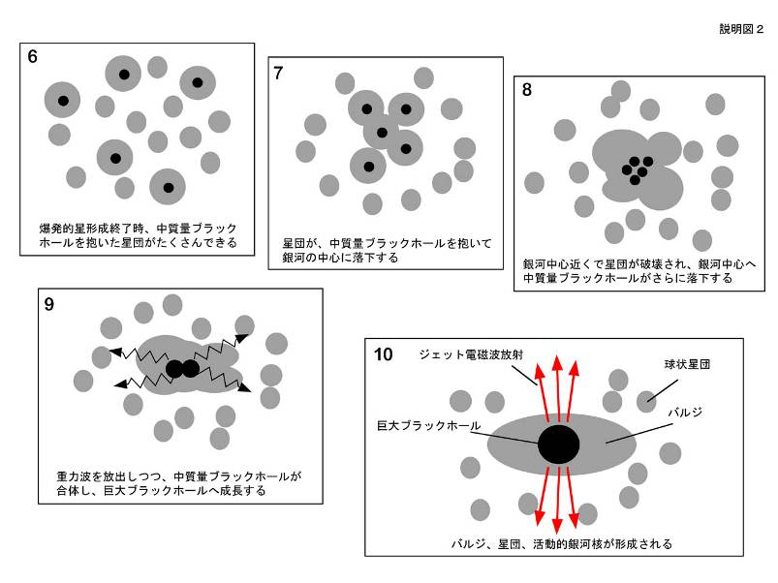
Galaxy formation
DECIGO will observe
Intermediate-mass BH (IMBH)
binary merger with
SNR>10³ for z~10 source
Information on the
formation of
Supermassive BHs
at the center of galaxies
戎崎俊一(理化学研究所) 先生のwebページより引用 http://atlas.riken.go.jp/~ebisu/smbh.html

Slide 10
Astronomy and Cosmology
・Verification of the alternative theories of gravity
Test Brans-Dicke theory by NS/BH binary evolution
→ Stronger constraint by 10⁴ times
K. Yagi and T. Tanaka, Prog. Theor. Phys. 123, 1069 (2010)
・ Black hole dark matter
Gravitational collapse of the primordial density fluctuations
→ Primordial black holes (PBHs)
as a candidate of dark matter
R. Saito and J. Yokoyama, Phys. Rev. Lett. 102 161101 (2009)
・ Neutron-star physics
Determine mass of 10⁵ NSs per year
→ Constrain the EOS of NS
Formation process of NS from the spectrum

Slide 11
    1. DECIGO
    Overview and Science
    Pre-conceptual Design
    2. DECIGO Pathfinder
    Overview and Science
    Design and Status
    Space Demonstration
    3. Summary

Slide 12
Pre-Conceptual Design
Interferometer Unit:
Differential FP interferometer
Arm length: 1000 km
Finesse: 10
Mirror diameter: 1 m
Mirror mass: 100 kg
Laser power: 10 W
Laser wavelength：532 nm
Arm cavity
Arm cavity
S/C: drag free
3 interferometers
Laser
Mirror
Photo-
detector
Drag-free S/C
Notes:
Next, I will talk on the pre-conceptual design of DECIGO.
One interferometer unit is formed by three spacecraft.
Each spacecraft has test-mass mirrors inside it.
A mirror has a diameter of 1m and weight of 100kg.
These mirrors forms Fabry-Perot interferometers with a finesse of 10 and a baseline length of 1000km.
As light sources, we will use green lasers with output power of 10W.
So as to suppress the effect of external disturbances on test mass mirrors,
such as solar radiations, each spacecraft is drag-free-controlled.
I mean, the position of spacecraft is controlled to follow the test mass position.

Slide 13
Interferometer Design
Transponder type vs Direct-reflection type
Compare : Sensitivity curves and Expected Sciences
Decisive factor: Binary confusion noise
WD-WD
confusion noise
Notes:
One of the key features of DECIGO is to use Fabry-Perot cavities for the baseline
length change measurement. Since DECIGO has between the observation band of LISA and
ground-based detectors, we have two choices in the selection of interferometer configuration.
One choice is to adopt optical transponder-type interferometer and shorten the
baseline from LISA. The estimated noise level is shown by this orange curve.
Another choice is to adopt Fabry-Perot interferometer as ground based detectors,
and expand the baseline. The noise level with this configuration is shown
by this red curve. Optical-transponder type has advantage in low frequencies,
because it can have longer baselines, and the acceleration noises on the
test mass can be relatively suppressed. The Fabry-Perot type has an advantage in
high-frequency band and best floor sensitivity. This is because the laser power
is effectively accumulated in the cavities, and the shot noise level can be suppressed.

Slide 14
Arm length
Cavity arm length : Limited by diffraction loss
Effective reflectivity (TEM₀₀ → TEM₀₀)
Laser wavelength : 532nm
Mirror diameter: 1m
Optimal beam size
1000 km
is almost max.

Slide 15
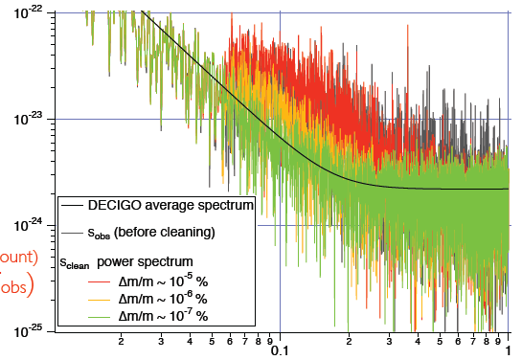
Foreground Cleaning
DECIGO obs. band: free from WD binary foreground
→ Open for cosmological observation
DECIGO will watch
~ 10⁵ NS binaries
Foreground for GWB
In principle, possible
to remove them.
Require accurate waveform
→ Δm/m < ~10⁻⁷ %
Fig: N. Kanda

Slide 16
Cavity and S/C control
Cavity length change
PDH error signal → Mirror position (and Laser frequency)
Relative motion between mirror and S/C
Local sensor → S/C thruster
Displacement Signal between S/C and Mirror
Local Sensor
S/C 1
S/C 2
Mirror
Thruster
Thruster
Actuator
Fig: S. Kawamura
Displacement signal between the two Mirrors
Notes:
Here, I will talk a little more on the compatibility of Fabry-Perot cavity length
control and drag-free control of the space craft position.
This figure shows one arm cavity of DECIGO.
The distance between the mirrors is measured by Fabry-Perot cavity. The signal
is fed back to the mirror position to keep the cavity length, using mirror actuators.
On the other hand, relative displacement between a mirror and S/C are measured by
local sensors around the mirrors, These signals are fed back to the thrusters attached
to the S/C. In short, this mirror follows the motion of this mirror, and each S/C
follows the mirror inside it. So, cavity control and drag-free controls are compatible.

Slide 17
Requirements
Sensor Noise
Shot noise 3 x 10⁻¹⁸ m/Hz^{1/2} (0.1 Hz)
x 10 of LCGT in phase noise
Other noises should be well below the shot noise
Laser freq. noise: 1 Hz/Hz^{1/2} (1Hz)
Stab. Gain 10⁵, CMRR 10⁵
Acceleration Noise
Force noise 4x10⁻¹⁷ N/Hz^{1/2} (0.1 Hz)
x 1/50 of LISA
External force sources
Fluctuation of magnetic field, electric field, gravitational field, temperature, pressure, etc.
Notes:
This viewgraph shows important requirements to reach the target sensitivity of DECIGO.
For displacement noise, 3x10^-18 m/sqrt of Hz is requires at the frequency band of 0.1Hz.
This level is about 10 times easer than that of ground based detectors.
For laser frequency noise, 1 Hz/sqrt Hz is requires for laser source,
and 10^5 gain is required for stabilization by arm cavities assuming 10^5 CMRR.
As for the acceleration noise, 4x10^-17 N/Hz^1/2 is required. This is 50 times
stringent requirement than LISA. This will be one of the most challenging requirement
in DECIGO. To realize this, we have to deeply investigate various kinds of noise sources.

Slide 18
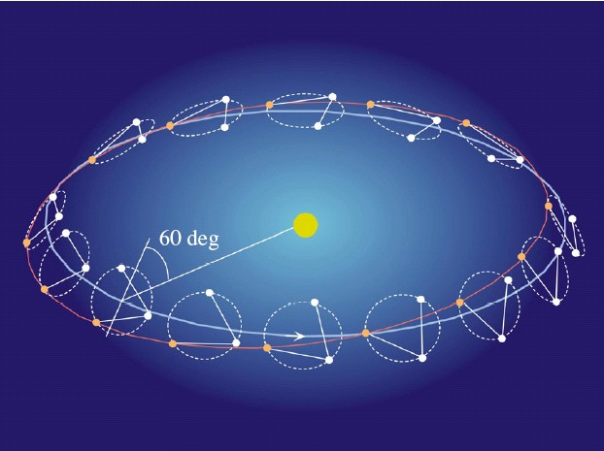
Orbit and Constellation
Separated
unit
Candidate of orbit:
Record-disk orbit around the Sun
Relative acc. 4x10⁻¹² m/s²
(Mirror force ~10⁻⁹ N )
Constellation
Separated
unit
overlapped
units
4 interferometer units
2 overlapped units → Cross correlation
2 separated units → Angular resolution
Notes:
The selection of orbit is a critical issue to suppress the effect of external force noise.
The obit of DECIGO is not decided yet. But the strongest candidate is a record disk
orbit along the Earth orbit around the sun as LISA. With this orbit, the relative acceleration
between test masses will be 4x10-12 m/s^2.
This acceleration corresponds to a force range of 10^-9 N for mirror actuator.
Another candidate is a halo orbit around a Lagrange point between the earth and the sun.
This is known to be a stable orbit. However, The relative acceleration is estimated
to be 4x10^-7 m/s^2, which requires larger actuation force to mirrors by 5 orders.
Thus, we adopted the record-disk orbit in the current pre-conceptual design.
As for the constellation, DECIGO will consist of 4 interferometer units.
Two of them will be placed in an overlapped place. This is required to take cross-correlation
of multiple detectors, and to distinguish the stochastic background signal from detector noises.
The other two units will be arranged at separated point along the same orbit.
These units enables us to increase angular resolution for the sky position of the source.
These are required to identify the sources and determine their redshift parameter.

Slide 19
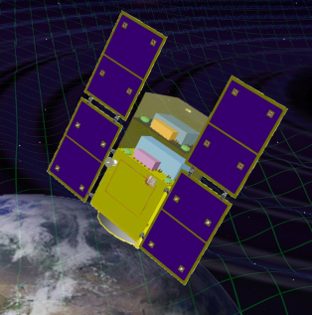
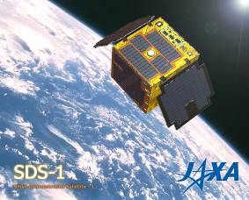
Roadmap
Figure: S.Kawamura
 | 2010 | 11 | 12 | 13 | 14 | 15 | 16 | 17 |  | 18 | 19 | 20 | 21 | 22 | 23 | 24 | 25 | 26 | 27 | 28 | 29
Mission
Objective | Space test of key tech. GW observation |  |  |  |  |  |  |  | Detect GW with min. spec FP between S/C |  |  |  |  |  |  | GW astronomy
Design | Single small satellite Short FP interferometer |  |  |  |  |  |  |  | 3 S/C 1 interferometer unit |  |  |  |  |  |  | 3 S/C x 3-4 units
R&D
Fabrication
R&D
Fabrication
R&D
Fabrication
DECIGO
Pathfinder
(DPF)
Pre-DECIGO
DECIGO
SDS-1/SWIM
Notes:
As shown in the previous viewgraph, DECIGO requires huge resources. So, we have a roadmap
to realize it step by step. We are planning to launch two milestone missions.
The first one is named DECIGO pathfinder, or DPF in short. This is a single satellite
orbiting around the earth. The purpose of DPF is to test the key technologies for DECIGO,
and also to carry out observation runs. The second milestone mission is named pre-DECIGO.
This will consist of three spacecraft. The purpose of pre-DECIGO is to detect GWs with
minimum interferometer specifications.

Slide 20
Organization
PI: Kawamura (NAOJ)
Deputy: Ando (Kyoto)
Executive Committee
Kawamura (NAOJ), Ando (Kyoto), Seto (Kyoto), Nakamura (Kyoto), Tsubono (Tokyo), Tanaka (Kyoto), Funaki (ISAS), Numata (Maryland), Sato (Hosei), Kanda (Osaka city), Takashima (ISAS), Ioka (KEK), Yokoyama (Tokyo)
Pre-DECIGO
Sato (Hosei)
Detector
Akutsu (NAOJ)
Numata (Maryland)
Science, Data
Tanaka (Kyoto)
Seto (Kyoto)
Kanda (Osaka city)
Satellite
Funaki (ISAS)
DECIGO pathfinder
Leader: Ando (Kyoto)
Design phase
Mission phase
Detector
Sato (Hosei)
Ueda (NAOJ)
Aso (Tokyo)
Laser
Musha (ILS)
Ueda (ILS)
Drag free
Moriwaki (Tokyo)
Sakai (ISAS)
Signal Process
Funaki (ISAS)
Thruster
Funaki (ISAS)
Bus
Takashima (ISAS)
Data
Kanda (Osaka city)
Notes:
This shows the organization of DECIGO. The leader is Seiji Kawamura.
The upper part is organized as a design team for DECIGO. The organization also includes
a DECIGO pathfinder working group, shown in the lower part. This part is organized
as a mission phase team, and the subgroups are in charge of research and development tasks.

Slide 21
Collaboration and support
・Supports from LISA
Technical advices from LISA/LPF experiences
Support Letter for DECIGO/DPF, Joint workshop (2008.11)
・Collab. with Stanford univ. group
Drag-free control of DECIGO/DPF
UV LED Charge Management System for DPF
・Collab. with NASA/GSFC
Fiber Laser , started discussion
・Collab. with JAXA navigation-control section
→ formation flight of DECIGO, DPF drag-free control
・Research Center for the Early Universe (RESCEU), Univ. of Tokyo
Support DECIGO as ones of main projects (2009.4-)
・Advanced technology center (ATC) of NAOJ
Will make it a main nucleus of DPF
Notes:
In addition to this organization, we have collaboration with and supports from other groups.
The LISA/LPF group members are providing us technical advises from their experiences.
In the last autumn, we had the 1st LISA-DECIGO joint workshop at JAXA, Japanese space agency.
This workshop was also helpful for us in political point of view. The JAXA peoples were
really impressed in the success of this workshop and the supports from LISA group.

Slide 22

LCGT and DECIGO
LCGT (~2016)
Terrestrial Detector
→ High frequency events
DECIGO (~2027)
Space observatory
→ Low frequency sources
Target: GW detection
Target: GW astronomy

Slide 23
    1. DECIGO
    Overview and Science
    Pre-conceptual Design
    2. DECIGO Pathfinder
    Overview and Science
    Design and Status
    Space Demonstration
    3. Summary

Slide 24

Roadmap
Figure: S.Kawamura
 | 2010 | 11 | 12 | 13 | 14 | 15 | 16 | 17 |  | 18 | 19 | 20 | 21 | 22 | 23 | 24 | 25 | 26 | 27 | 28 | 29
Mission
Objective | Space test of key tech. GW observation |  |  |  |  |  |  |  | Detect GW with min. spec FP between S/C |  |  |  |  |  |  | GW astronomy
Design | Single small satellite Short FP interferometer |  |  |  |  |  |  |  | 3 S/C 1 interferometer unit |  |  |  |  |  |  | 3 S/C x 3-4 units
R&D
Fabrication
R&D
Fabrication
R&D
Fabrication
DECIGO
Pathfinder
(DPF)
Pre-DECIGO
DECIGO
SDS-1/SWIM

Slide 25
DECIGO-PF
DECIGO Pathfinder (DPF)
DECIGO
First milestone mission for DECIGO
Shrink arm cavity
DECIGO 1000km → DPF 30cm
1000km
Single satellite
(Payload ~1m³ , 350kg)
Low-earth orbit
(Altitude 500km, sun synchronous)
30cm FP cavity with 2 test masses
Stabilized laser source
Drag-free control
Local Sensor
Laser
30cm
Actuator
DPF
Thruster
Notes:
Here, I will go on to the second part of my talk, on the DECIGO pathfinder.
DPF is the first milestone mission for DECIGO. The original purpose is to test the
key technologies for DECIGO. For this purpose, DPF is designed to be a prototype
of DECIGO. In DPF, one 1000km arm of DECIGO is shrunk down to 30cm, and placed
inside one small satellite orbiting around the earth.
A 30cm Fabry-Perot cavity is formed by two test mass mirrors. And the length change
is measured by means of stabilized laser. The relative displacement between the test
mass and the satellite is measured by a local sensor, and the signals are fed back to the
satellite thrusters to realize drag-free control.

Slide 26
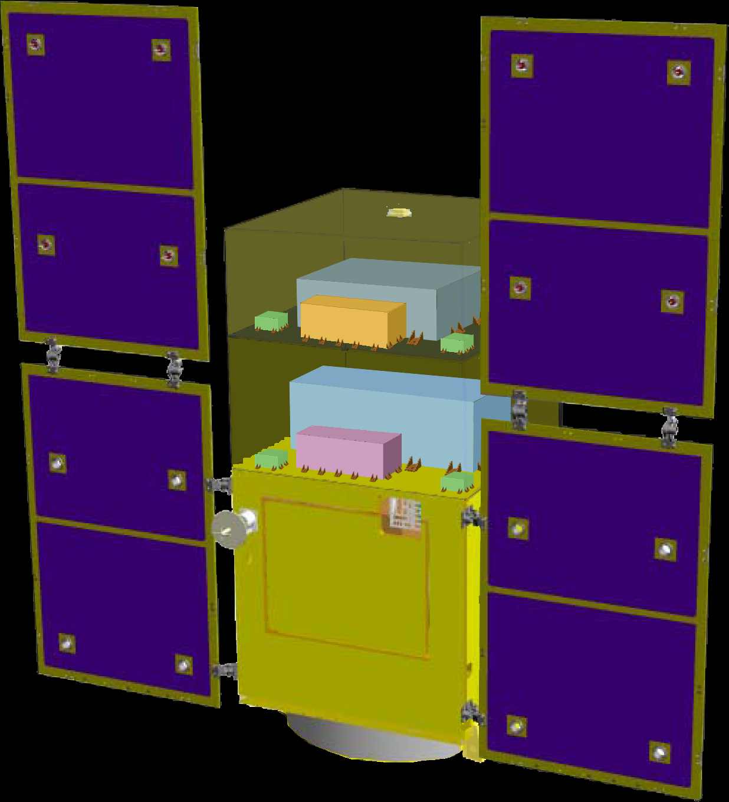
DPF satellite
DPF Payload
Size : 950mm cube
Weight : 150kg
Power : 130W
Data Rate: 800kbps
Mission thruster x12
Mission
Thruster head
Stabilized.
Laser source
On-board
Computer
Power Supply
SpW Comm.
Satellite Bus
(‘Standard bus’ system)
Size :
950x950x1100mm
Weight : 200kg
SAP : 960W
Battery: 50AH
Downlink : 2Mpbs
DR: 1GByte
3N Thrusters x 4
Interferometer
module
Satellite
Bus system
Bus thruster
Solar Paddle
Notes:
DPF satellite will look like this figure. The satellite is comprised of two parts.
The bottom part contains the bus system with solar puddles, batteries, data processing system,
temperature control system, and telecommunication system with ground station.
The upper part is a mission payload. The interferometer module is placed in the first floor,
and stabilized laser system is placed in the second floor. 12 small low-noise thrusters
are attached at the corners of the payload.

Slide 27
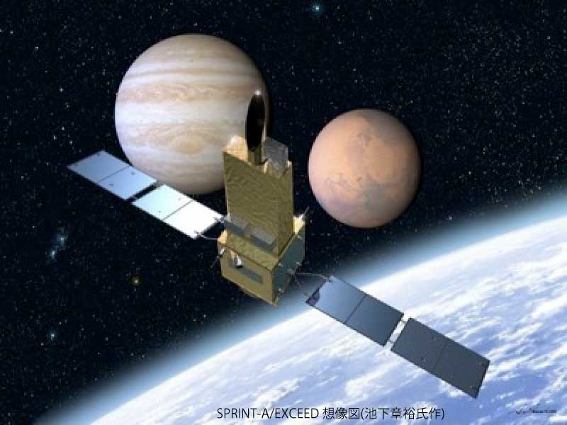

DPF mission status
DPF : One of the candidate of
JAXA’s small satellite series
At least 3 satellite in 5 years with
Standard Bus + M-V follow-on rocket
SPRINT-A /EXCEED
UV telescope mission
1st mission (2012): SPRINT-A/EXCEED
2nd mission (~2013/14) : ERG
3rd mission (~2015/16) : TBD
DPF survived until final two
DPF is one of the strongest
candidates of the 3rd mission
Next-generation
Solid rocket booster (M-V FO)
Fig. by JAXA

Slide 28
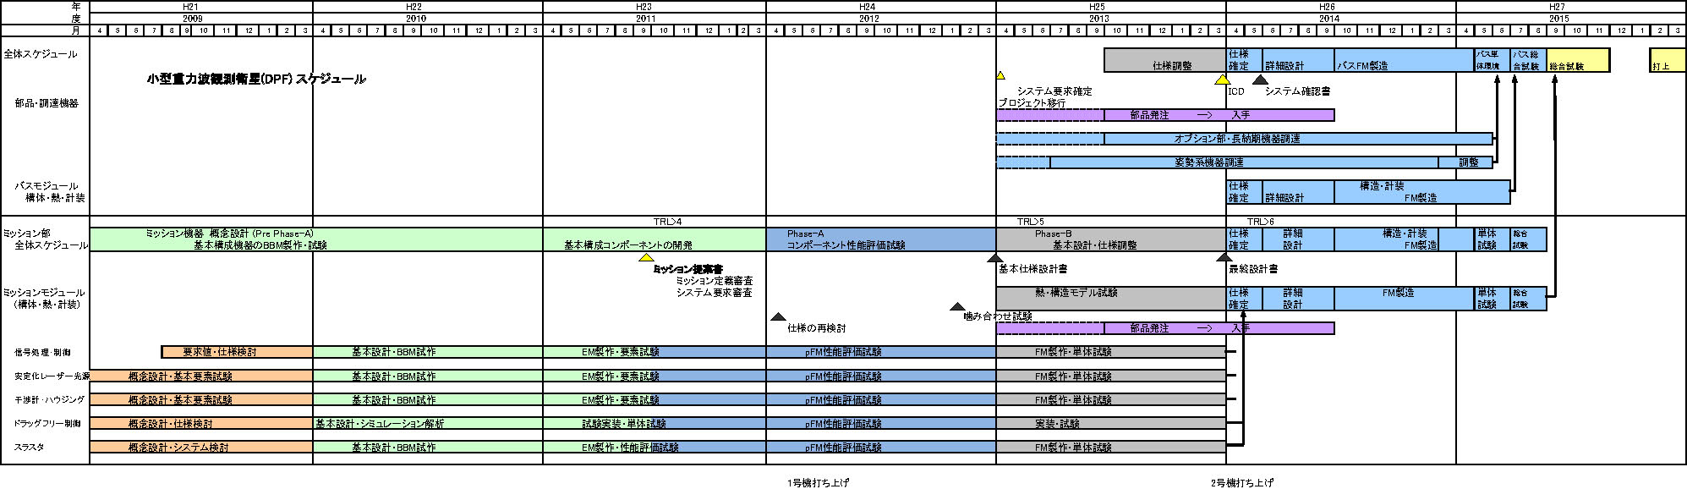
DPF Schedule
2009
2010
2011
2012
2013
2014
2015
Conceptual
design
BBM
EM
/ pFM
Component
FM
Satellite
FM
Tests and
Launch
Mission proposal
Require >TRL 4
Complete component FM

Slide 29
Orbit and attitude
Satellite Orbit
Low-earth orbit
Altitude 500km, Inclination 98 deg
Eccentricity < 10⁻³ (accuracy of the launcher)
Orbital period ~100min
Sun-synchronous, dusk-dawn orbit
for thermal stability
(eclipse ~100days/yr, 25 min max)
Satellite Attitude (under discussion)
Sun and Earth synchronous attitude
IFO optical axis parallel
to the earth-vertical line

Slide 30

DPF mission payload
Mission weight : ~150kg
Mission space : ~95 x 95 x 90 cm
Drag-free control
Local sensor signal
→ Feedback to thrusters
Thruster
Fabry-Perot interferometer
Finesse : 100
Length : 30cm
Test mass : ~a few kg
Signal extraction by PDH
Laser source
Yb:YAG laser (1030nm)
Power : 25mW
Freq. stab. by Iodine abs. line
Notes:
This figure show the design of mission payload part.
As a laser source, we will use a Yb:YAG laser stabilized using iodine absorption line.
The stabilized beam is introduced to the 30cm main interferometer,
formed by two test mass mirrors.
The length change signal is extracted by a Pound-Drever-Hall scheme. The signal is fed back
to the mirror using electro-static-type actuators. The relative displacement between the
test mass and the satellite is monitored by electro-static-type local sensors and fed back to
the mission thrusters to realize dreg-free-control.

Slide 31
DPF Sensitivity
Laser source : 1030nm, 25mW
IFO length : 30cm
Finesse : 100, Mirror mass : 1kg
Q-factor : 10⁵, Substrate: TBD
Temperature : 293K
Satellite mass : 350kg, Area: 2m²
Altitude: 500km
Thruster noise: 0.1μN/Hz^{1/2}
(Preliminary parameters)
Notes:
With this configuration, DPF will have this sensitivity curve. The black curve represents
the DPF sensitivity to GW signals. This level is mainly limited by laser frequency noise
in high frequency band, and acceleration noise in low frequency band.

Slide 32
Key requirements
Sensor Noise
Disp. noise 6 x 10⁻¹⁶ m/Hz^{1/2} (0.1 Hz)
x 200 of DECIGO in disp. noise
Other noises
Laser freq. noise: 0.5 Hz/Hz^{1/2} (1Hz)
Acceleration Noise
Force noise 1x10⁻¹⁵ m/s²/Hz^{1/2} (0.1 Hz)
x 250 of DECIGO
Satellite motion
Disp. noise 1x10⁻⁹ m/Hz^{1/2} (0.1 Hz)
External force sources
Fluctuation of magnetic field, electric field, gravitational field, temperature, pressure, etc.

Slide 33
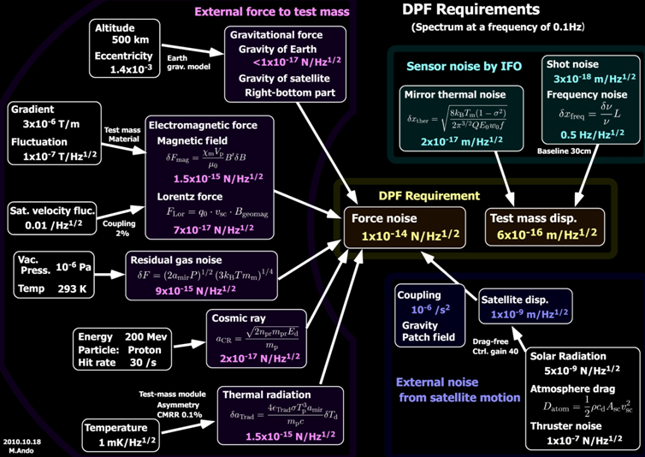
DPF Requirements

Slide 34
Some examples
Fluctuation (spectrum) is important
at observation band (0.1-1 Hz)
Mechanical fluctuation
Test mass fluctuation by
coupling by electromagnetic
field, gravity, etc.
Satellite 1 x 10⁻⁹ m/Hz^{1/2}
Magnetic field
Fluctuation 1 x 10⁻⁷ T/Hz^{1/2}
Test mass fluctuation
by magnetic field
Divergence 3 x 10⁻⁶ T/m
Temperature
Test mass fluctuation
by thermal radiation
Fluctuation 1 x 10⁻³ K/Hz^{1/2}
(Inner surface of TMM)

Slide 35
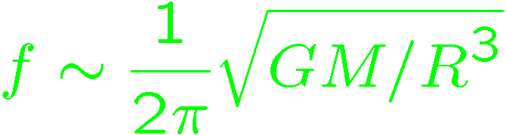
DPF sensitivity
DPF sensitivity h ~ 2x10⁻¹⁵ Hz^{1/2}
(x10 of quantum noises)
Massive BH
inspirals
DPF limit
LISA
Galaxy
binaries
NS binary
inspiral
Core-collapse
Supernovae
Foreground GWs
Pulsar
(1yr)
ScoX-1
(1yr)
DECIGO
Background GWs
from early universe
(Ω_{gw}=10⁻¹⁴)
LCGT
Gravity-gradient noise
(Terrestrial detectors)
Notes:
DPF has almost the same observation band with that of DECIGO. But the floor level is worse by 8 orders.

Slide 36
Targets of DPF
Scientific observations
Gravitational Waves form BH mergers
→ BH formation mechanism
Gravity of the Earth
→ Geophysics, Earth environment
Science technology
Space demonstration for DECIGO
→ Most tech. with single satellite
(IFO, Laser, Drag-free)
Precision measurement in orbit
→ IFO measurement
under stable zero-gravity

Slide 37

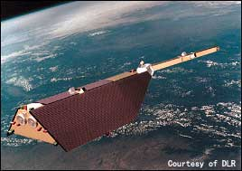
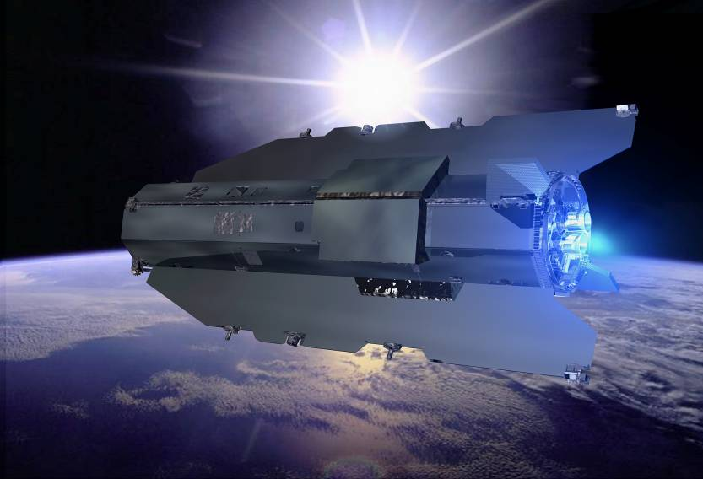
DPF Targets
Astronomical observation
GW from merger of IMBHs
→ Formation mechanism
of supermassive BHs
NGC7093
NGC7078
NGC6441
NGC104
NGC6256
~30 GCs within DPF range
Observation of the earth
Gravitational potential
→ Shape of the earth
Environment monitor
100km
80km
Spatial
Scale
Comparable sensitivity
with other missions

Slide 38
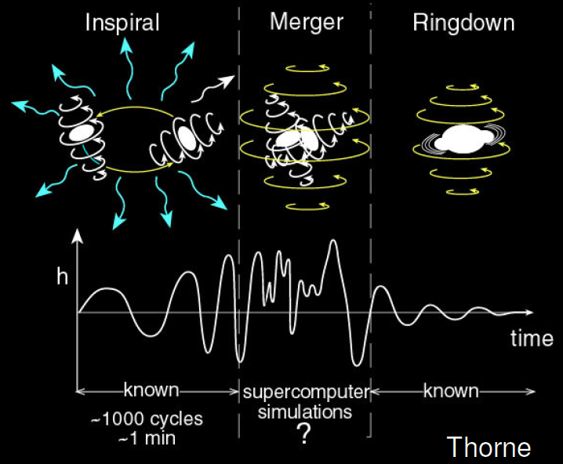

GW target of DPF
Blackholes events
in our galaxy
IMBH inspiral and merger
h ~ 10⁻¹⁵ , f ~ 4 Hz
Distance 10kpc, m = 10³ M_{sun}
Obs. Duration (~1000sec)
BH QNM
h ~ 10⁻¹⁵ , f ~ 0.3 Hz
Distance 1Mpc, m = 10⁵ M_{sun}
NGC7093
NGC7078
Observable range covers
our Galaxy (SNR~5 )
NGC6441
NGC104
NGC6256
Hard to access by others
→ Original observation
KAGAYA
(By K.Yagi)
Notes:
However, DPF has scientific targets, which are blackholes in our galaxy.
Inspiral and coalescence of intermediate-mass blackhole is one of the main targets of DECIGO,
and also a main target of DPF. This figure shows the observable range of DPF as a function
of blackhole mass.
The green curve is the range for BH inspirals, and this green curve is for quasi-normal modes.
This red line represents the distance to the galactic center. So this figure shows that
DPF has sufficient sensitivity to observe events at the center of our galaxy, if any.
Since this frequency band, around 0.1Hz, is hard to access by ground-based detectors,
this will be an original observation.

Slide 39
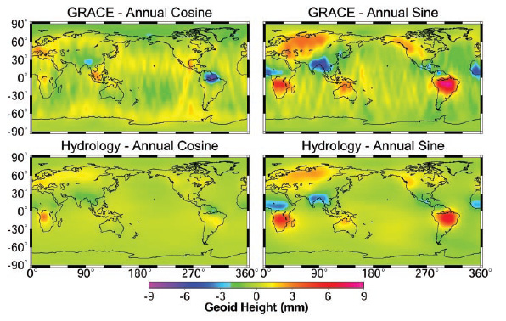
Earth’s Gravity Observation
Measure gravity field of the Earth
from Satellite Orbits, and gravity-gradiometer
comprehensive and homogeneous-quality data
Determine global gravity field
→ Basis of the shape of
the Earth (Geoid)
Monitor of change in time
→ Result of Earth’s dynamics
Ground water motion
Strains in crusts by
earthquakes and volcanoes
Seasonal change of the gravitational potential observed by GRACE
Observation Gap between
GRACE and GRACE-FO (2012-16)
→ DPF contribution
in international network

Slide 40
Satellite Gravity missions
3-types of satellite gravity missions
Satellite-to Satellite
tracking High-Low
Satellite-to Satellite
tracking Low-Low
Satellite
Gravity Gradiometry
・Observe satellite orbit
by global positioning
system (GPS,…)
・Cancel drag-effects
by accelerometer
・Distance meas. by
along-track satellites
・Cancel drag-effects
by accelerometer
・Observe potential by
gravity gradiometer
・Drag-free control for
cancellation of drags
CHAMP (GFZ, 2000-)
GRACE (NASA, 2002-)
GOCE (ESA, 2009-)

Slide 41
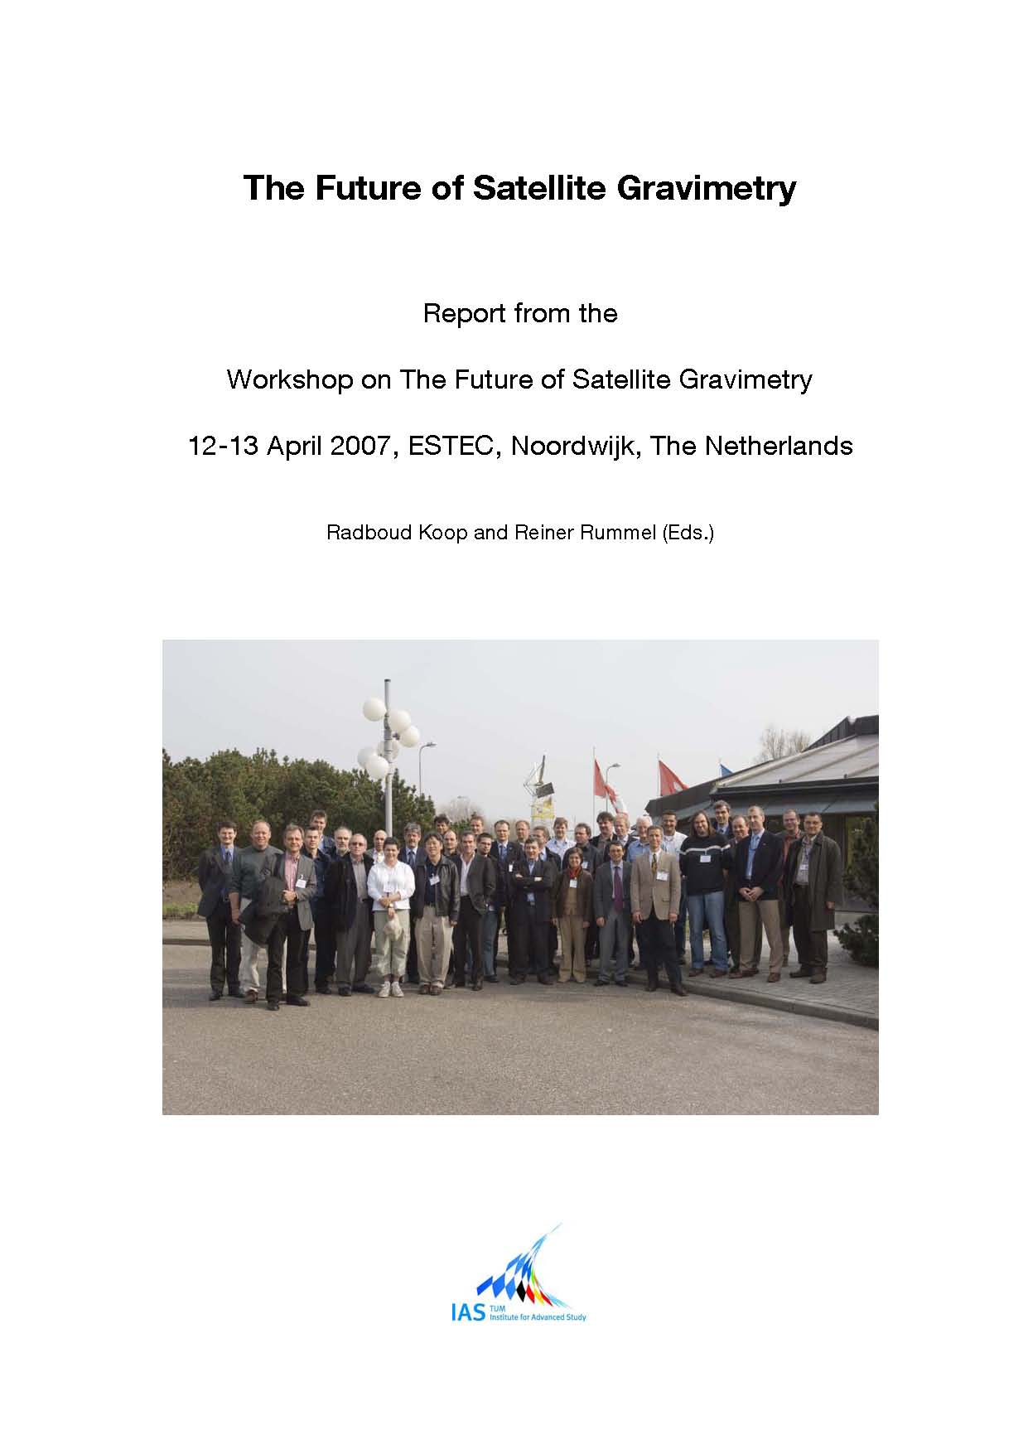
Results and plans
CHAMP,GRACE, GOCE in operation
・Shape of the Earth
Coefficients up to 2190 orders
(GRACE etc., 2008)
Earth standard with high
precision and resolution
・Changes in time
Seasonal movement of waters
Crust deformation by earthquakes
(Sumatera 2004)
Will be ended by around by 2012
GRACE-FO (NASA)
Based on GRACE,
Add laser interferometer
To be launched in2016

Slide 42
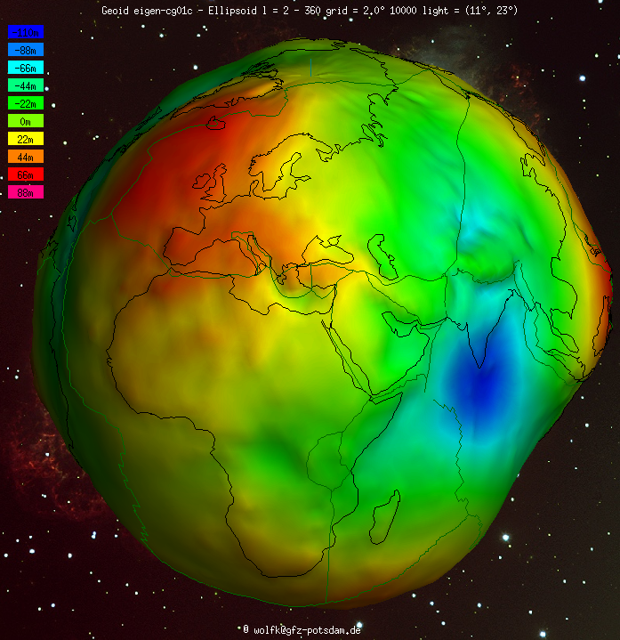

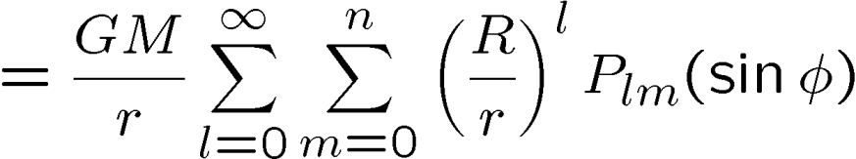



Earth Gravity model
Describe gravity potential by
Spherical harmonic functions
: Grav. Const., Mass
and radius of the Earth
: Orbital radius, longitude, altitude
: Associated Legendre functions
Coefficients C_{lm} , S_{lm} :
Describe the mass distribution
Determined by satellite missions, etc.
International Centre for Global Earth Models (ICGEM)
http://icgem.gfz-potsdam.de/ICGEM/ICGEM.html

Slide 43
DPF sensitivity
Comparison of sensitivities
Better in low orders (large scale) ← Sensors
Report for Mission Selection
Gravity Field and Steady-State
Ocean Circulation Mission
ESA SP-1233(1) July 1999.
Worse in high orders (small scale) ← Altitude
400km
100km
80km
Scale
(with margin 10)

Slide 44
Acceleration spectrum
Estimation of observed acceleration
EGM2008 (order 2190) data
→ Calculate potential
DPF orbit
altitude 500km, polar-orbit
→ Estimate observed acceleration
Gravity acceleration in mgal
(l>2 500km altitude)
Orbital Freq. (0.176 mHz)
Obs. of
GWs
Earth gravity

Slide 45
    1. DECIGO
    Overview and Science
    Pre-conceptual Design
    2. DECIGO Pathfinder
    Overview and Science
    Design and Status
    Space Demonstration
    3. Summary
Notes:
From now on, I will briefly review the current status of R&Ds and the mission selection.

Slide 46

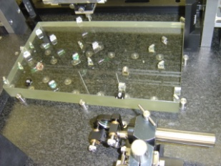
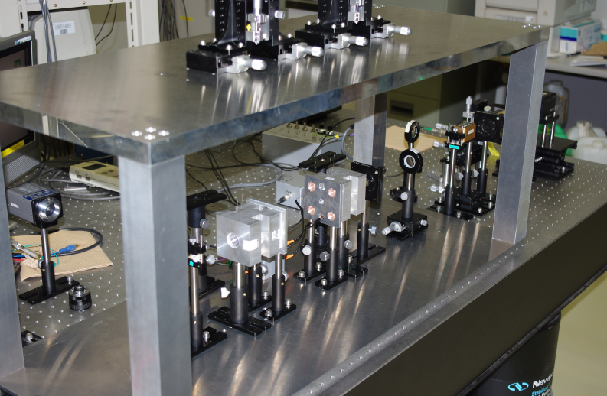
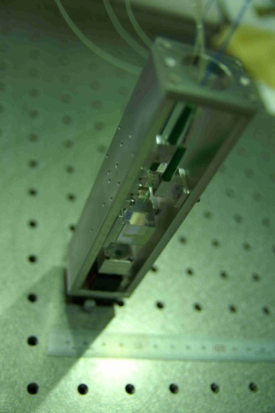
Interferometer Module
Interferometer Module : Test mass + IFO
Interferometer
Module
Test-mass module
→ Gravity reference
・BBM of Module,
Sensor, Actuator,
Clump/Release
・μ-Grav. Exp.
Hosei, NAOJ,
Ochanomizu, Stanford
Interferometer
→ GW, Gravity observation
・30cm IFO BBM ・Packaging
Digital control ・Monolithic Opt.
Laser sensor
→ Small MI
・BBM test
・Sensitivity meas.
NAOJ, U-Tokyo
ERI, U-Tokyo
Notes:
The prototype of the test mass mirror and the housing for it are shown in this picture.
The details of this part will be presented by S.Sato san in this afternoon in the parallel session
number two and also was presented by Yuka Wakabayashi san in a poster session.

Slide 47
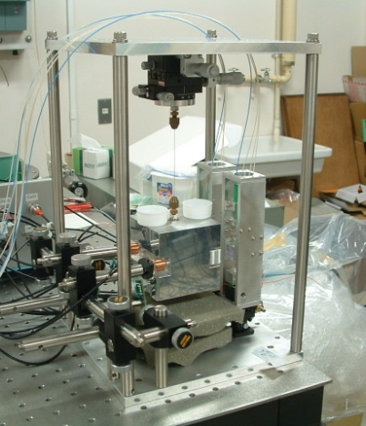
Interferometer Module
By M.Michimura
Main interferometer
30cm Fabry-Perot interferometer
Finesse ~100, Two test masses
Monolithic input bench
PDH and WFS for length and
alignment signal extraction
Test-mass module
Reference for geodesy
Test mass ~1kg ~50mm cubic
Mirrors will be glued
ES sensor-and-actuators
Laser sensors
Launch lock, clump/release
Discharge with UV LED
By S.Sato
By A.Araya

Slide 48
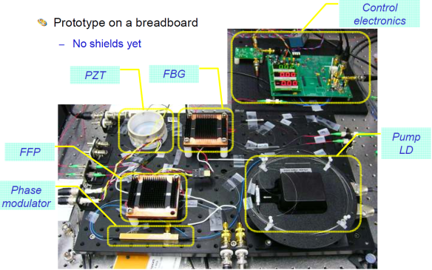
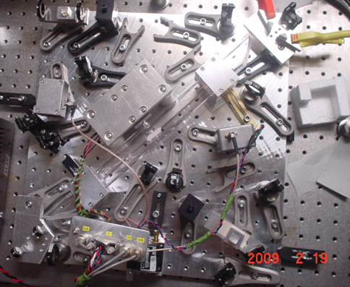
Stabilized Laser Module
Stabilized Laser : Laser source + Stabilization system
Yb:YAG (NPRO or Fiber laser)
→ Laser source
・BBM
development
UEC, NASA/GSFC
I₂ absorption line
→ Frequency
reference
Stabilized
Laser Module
・BBM development
・Stability meas.
UEC, NICT
Notes:
The laser stabilization system using iodine absorption line is being developed as BBM in
the same size as flight model. This system is working well, and evaluation of the stability
and development of automatic control system are going on.

Slide 49
Stabilized Laser Module
Laser source
Yb:YAG laser
wavelength 1030nm
output 100mW
Candidates
NPRO, fiber laser
By
K.Numata
Stabilization
Freq. Stabilization
by Saturated absorption with I₂
Requirement: 0.5 Hz/Hz^{1/2}
Required freq.-doubled beam (515nm)
Multi-path in 40cm-length cell
Option: monolithic reference cavity
Intensity stabilization
Requirement: 10⁻⁸ Hz^{-1/2}
By M.Musha

Slide 50
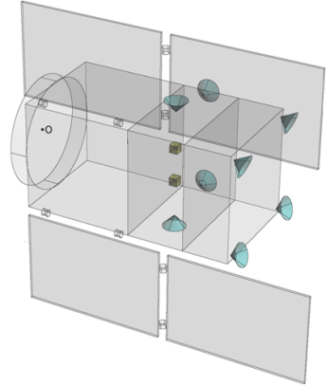
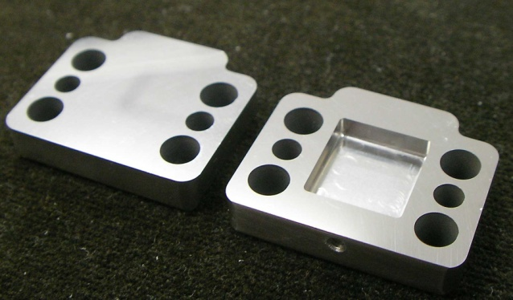
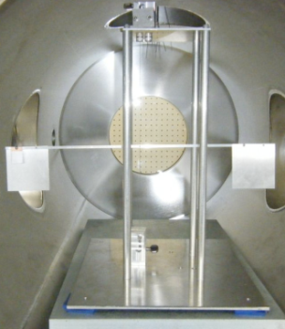
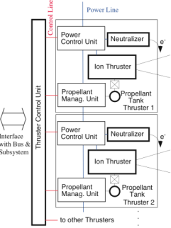
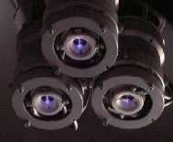
Attitude and Drag-free control
Attitude and Drag-free control : Structure, Thrusters, Control
Structure, thermal stability
・Passive
attitude stability
・Drag-free control
Low-noise
Thruster
Mass balance
U-Tokyo, JAXA
Low-noise Thruster
→ Actuators for satellite control
・BBM and system design
JAXA, NDAJ, Tokai-U
Notes:
The attitude and drag-free control system is being designed as shown in this figure.
DOF will have a hybrid drag-free control configuration with passive stabilization with
gravity gradient, and active control using mission thrusters.
As for the low-noise thruster, we are designing the system with existing technologies,
and developing a thruster stand used for the evaluation of thrust noises.
In addition, as a R&D for future missions, we are developing a new slit-type FEEP thruster.

Slide 51
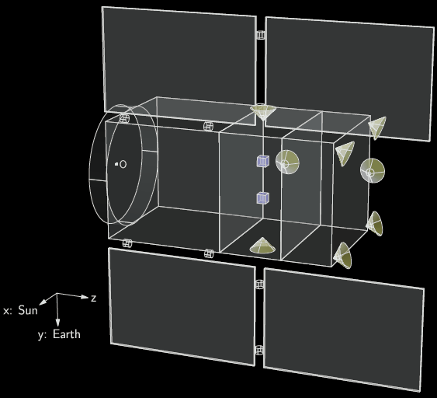
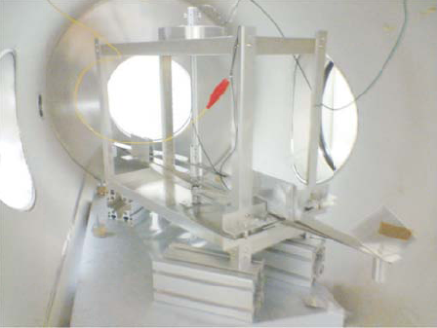
Attitude and Drag-free control
Attitude control and Drag-free
Satellite structure (mass distribution)
Passive attitude stabilization
by gravity gradient
Thruster position and control topology:
under consideration
Thruster (tentative)
12 (TBD) mission thrusters
Low-noise small thruster
Max. thrust 10μN (tunable)
Noise 0.1 μN/Hz^{1/2}
>10Hz response
FEEP system, Gas jet backup
By
S.Moriwaki
By I.Funaki

Slide 52
    1. DECIGO
    Overview and Science
    Pre-conceptual Design
    2. DECIGO Pathfinder
    Overview and Science
    Design and Status
    Space Demonstration
    3. Summary

Slide 53


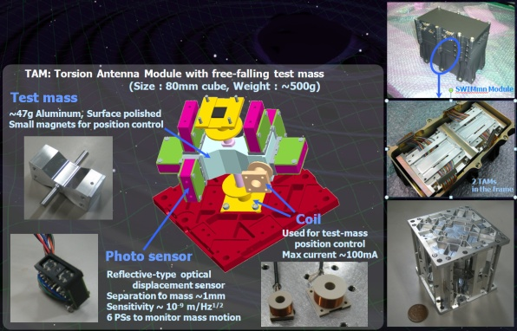

Signal processing and Control
Signal Processing and Control : SpaceWire-based system
SpC2 + SpW system
→ Signal processing and install. ctrl
Signal processor
SpC2
SWIMmn
Photo
by JAXA
Test-mass
control
Space demonstration
bySDS-1/SWIM
SDS-1
(Jan. 2009)
JAXA, U-Tokyo, Kyoto
SWIMmn demonstration
→ Test mass control in orbit
Satellite Bus
JAXA, U-Tokyo, Kyoto
Notes:
As one of R&D for DPF and also DECIGO, we have made a significant step recently.
We developed a small test-mass and signal-processing module, named SWIM.
This module was loaded on a small technology demonstration satellite, and launched
in this January. We had several in-orbit operation after that, and we are obtaining
good results. In short, it is working well. Details will be presented by W.Kokuyama
in this afternoon in the parallel session number 2. I believe that this will be an
exciting talk for most of you.

Slide 54


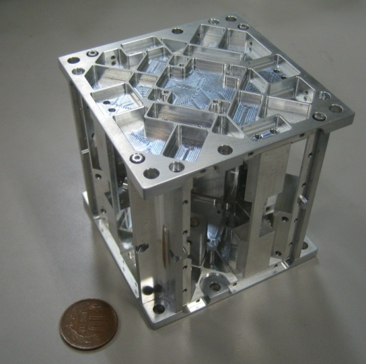


SWIM launch and operation
Tiny GW detector module
Launched in Jan. 23, 2009
Photo：
JAXA
In-orbit operation
TAM: Torsion Antenna Module with free-falling test mass
(Size : 80mm cube, Weight : ~500g)
Test mass
~47g Aluminum, Surface polished
Small magnets for position control
Coil
Photo sensor
Reflective-type optical
displacement sensor
Separation to mass ~1mm
Sensitivity ~ 10⁻⁹ m/Hz^{1/2}
6 PSs to monitor mass motion

Slide 55
Successful control
SWIM
In-orbit operation
z control on
Test mass controlled
Error signal → zero
Damped oscillation
(in pitch DoF)
yaw control on
Free oscillation
in x and y DoF
Signal injection
→ OL trans. Fn.
Operation: May 12, 2009
Downlink: ~ a week
By
W.Kokuyama

Slide 56
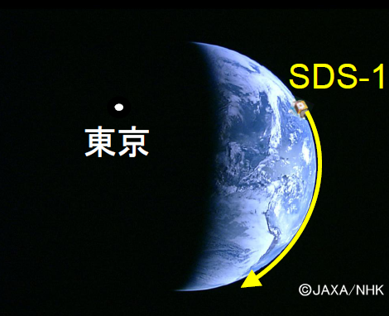
SWIM observation
Observation by SWIM
Jun 17, 2010 ~120 min. operation
July 15, 2010 ~240 min. operation
Tokyo
Kyoto
Ground-based detectors were
operated at the same period.
Data analysis
Orbital period
~100min.
Orbital Period
10mHz LPF

Slide 57
Roadmap
Figure: S.Kawamura
 | 2010 | 11 | 12 | 13 | 14 | 15 | 16 | 17 |  | 18 | 19 | 20 | 21 | 22 | 23 | 24 | 25 | 26 | 27 | 28 | 29
Mission
Objective | Space test of key tech. GW observation |  |  |  |  |  |  |  | Detect GW with min. spec FP between S/C |  |  |  |  |  |  | GW astronomy
Design | Single small satellite Short FP interferometer |  |  |  |  |  |  |  | 3 S/C 1 interferometer unit |  |  |  |  |  |  | 3 S/C x 3-4 units
R&D
Fabrication
R&D
Fabrication
R&D
Fabrication
DECIGO
Pathfinder
(DPF)
Pre-DECIGO
DECIGO
SDS-1/SWIM

Slide 58
    1. DECIGO
    Overview and Science
    Pre-conceptual Design
    2. DECIGO Pathfinder
    Overview and Science
    Design and Status
    Space Demonstration
    3. Summary

Slide 59
Summary
DECIGO : Fruitful Sciences
Very beginning of the Universe
Dark energy
Galaxy formation
DECIGO Pathfinder
Important milestone for DECIGO
Strong candidate of JAXA’s satellite series
SWIM – Operation in orbit
first precursor to space!
Notes:
Now, I will summarize my talk.
DECIGO will provide us fruitful knowledge on the beginning of the universe, dark energy,
and formation of galaxies.
DECIGO pathfinder is a first milestone mission for DECIGO, and being a
strong candidates of JAXA's small satellite series.
In addition, we have developed a SWIM module, which is under operation in orbit.
This is our first precursor to space. Though this is only a small module, we have made
a significant step

Slide 60

    End
Original
Picture : Sora
Notes:
Thanks you for your attention.

Slide 61
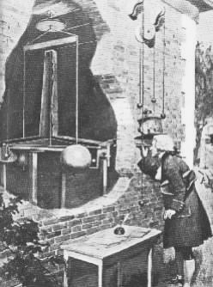
Supplementary topic

Slide 62
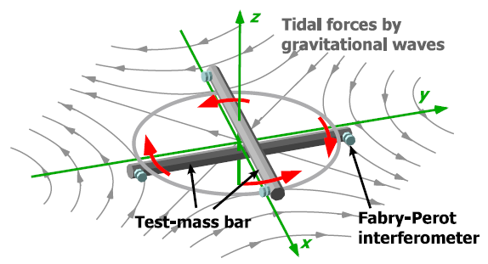
TOBA
TOBA : Torsion-Bar Antenna
Two test-mass bars
Sensitive to low-freq. GWs
even with ground-based config.
Much better in space
Monitor differential
angular fluctuation
Current Issue!
M.Ando, et. al,
Phys. Rev. Lett.
105, 161101 (2010)

Slide 63

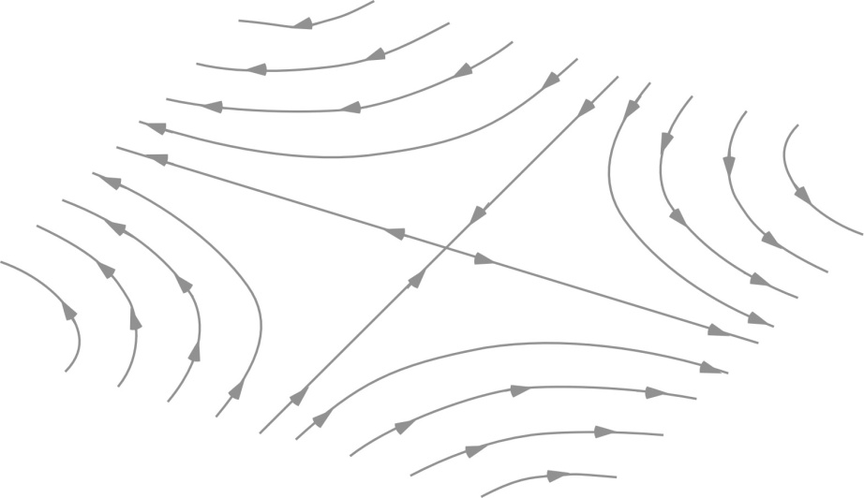
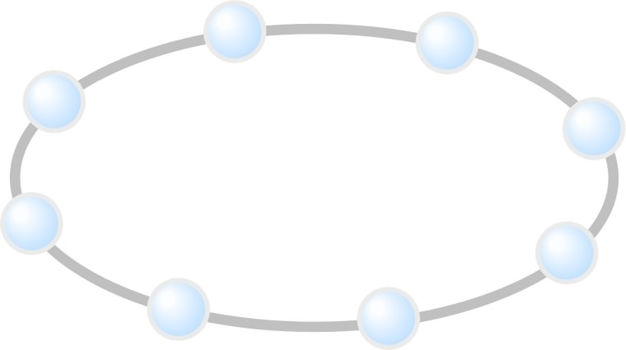

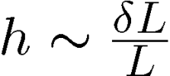
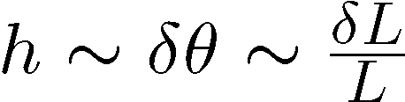
Strain and Torsion
Conventional IFO antenna
Torsion-bar antenna
Detect differential length change
Detect differential rotation
z
GWs
z
GWs
y
y
x
x
Observe change in tidal forces using free test masses

Slide 64
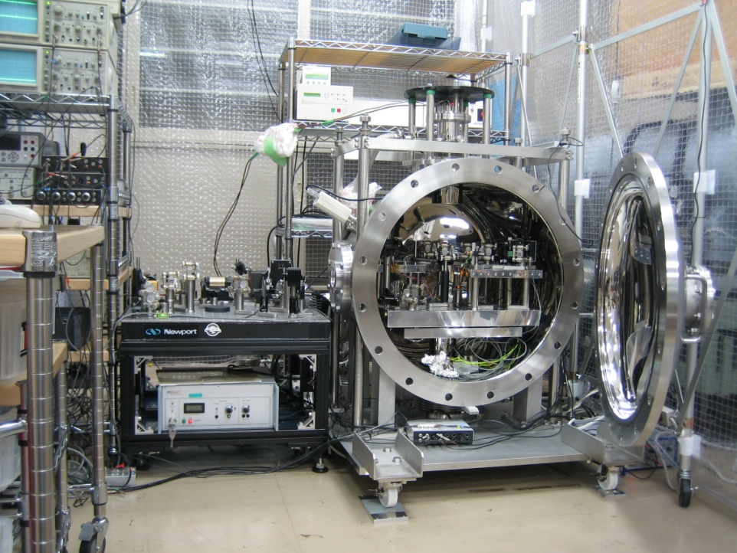
Advantages
Conventional IFO
TOBA
Obs. band 10Hz-1kHz
Obs. band 10mHz-1Hz
Suspended as pendulum
(Res. Freq. ~1Hz)
Torsion pendulum
(Res. freq ~1mHz)
Long baseline
→Accumulation of signal,
High sensitivity
Shorter length
→ Simple config.
Common-mode rejection

Slide 65
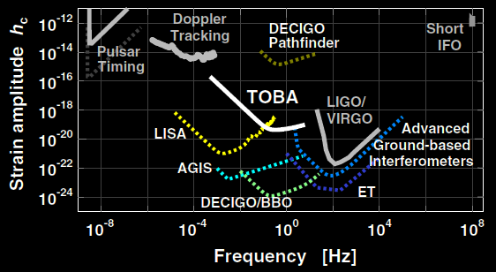
TOBA Sensitivity
Assume realistic parameters
Test mass Aluminum 7,600kg, 10m
Laser source 10W
Temperature 4K
Bar length : 10m, Mass : 7600kg
Laser source : 1064nm, 10W
Cavity length : 1cm, Finesse : 100
Bar Q-value : 10⁵ , Temp: 4K
Support Loss : 10⁻¹⁰
Rotational
operation
at 5x10⁻⁵ Hz

Slide 66

Observable range
GWs from binary BH mergers
Obs. Range ~10Gpc ( )
Calculation by K.Yagi

Slide 67
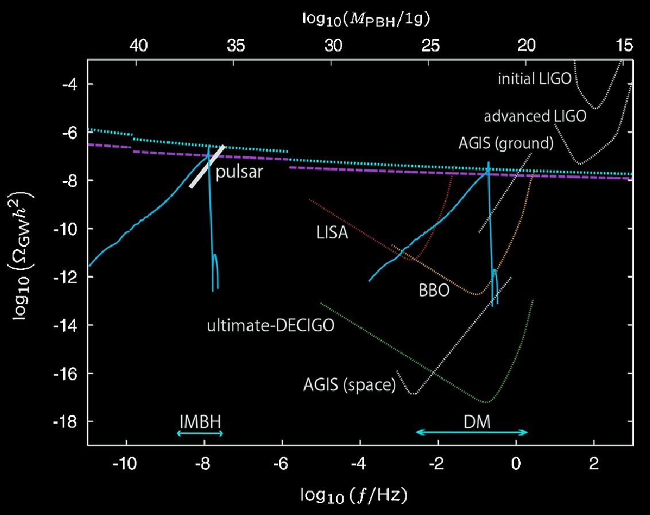
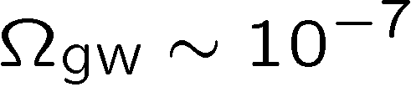
Background GWs
Observable GW
energy density ratio
(1-yr observation)
TOBA
Beat BBN upper limit
GW by primordial
tensor perturbation
R.Saito and J.Yokoyama,
PRL 102, 161101 (2009)

Slide 68
R&D for DPF (1)
By M.Musha
Stabilized Laser
BBM development
Yb:YAG (NPRO) source
Saturated absorption by I₂
→ Stability test, Packaging
IFO and housing
BBM-EM development
→ Test of concepts
+ Earth gravity sensors
By S.Sato
By A.Araya

Slide 69
R&D for DPF (1)
By M.Michimura
Main interferometer
BBM development
Locked with digital control
→ Stability test, Packaging
IFO and housing
BBM-EM development
→ Test of concepts
+ Earth gravity sensors
By S.Sato
By A.Araya

Slide 70
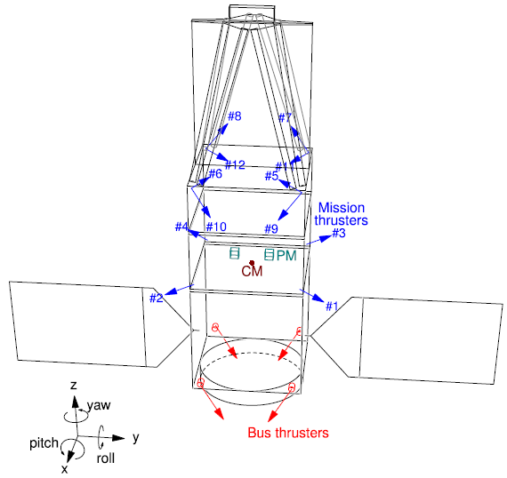
R&D for DPF (2)
By
S.Moriwaki
Attitude control and Drag-free
Satellite structure (mass distribution)
Passive attitude stabilization
by gravity gradient
Mission thruster position
Control topology
Thruster
System design
with existing tech.
Noise meas. system
(thruster stand)
Development of Slit FEEP
By I.Funaki

Slide 71
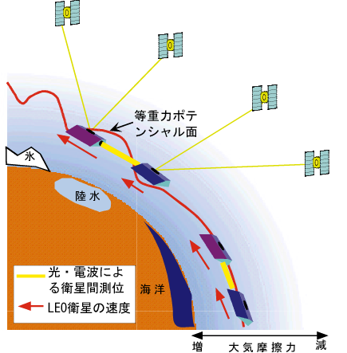
Gravity of the Earth
Measure gravity field of the Earth
from Satellite Orbits, and gravity-gradiometer
GPS satellite
Determine global gravity field
→ Density distribution
Monitor of change in time
Ground water motion
Strains in crusts by
earthquakes and volcanoes
Observation Gap
between GRACE and GRACE-FO
(2012-16)
→ DPF contribution
in international network
By Araya and Fukuda
Notes:
DPF has another scientific target, which is the gravity of the earth. Changes of the global
gravity field of the earth is being monitored by several satellite missions. However,
it is said that there will be an observation gap time between the end of the GRACE mission and
the start of GRACE follow-on. DPF would be able to contribute to bridge the gap time.

Slide 72
SWIM launch and operation
Tiny GW detector module
Launched in Jan. 23, 2009
Photo：
JAXA
In-orbit operation
TAM: Torsion Antenna Module with free-falling test mass
(Size : 80mm cube, Weight : ~500g)
Test mass
~47g Aluminum, Surface polished
Small magnets for position control
Coil
Photo sensor
Reflective-type optical
displacement sensor
Separation to mass ~1mm
Sensitivity ~ 10⁻⁹ m/Hz^{1/2}
6 PSs to monitor mass motion

Slide 73
LCGT and DECIGO
LCGT (~2014)
Terrestrial Detector
→ High frequency events
DECIGO (~2024)
Space observatory
→ Low frequency sources
Target: GW detection
Target: GW astronomy

Slide 74
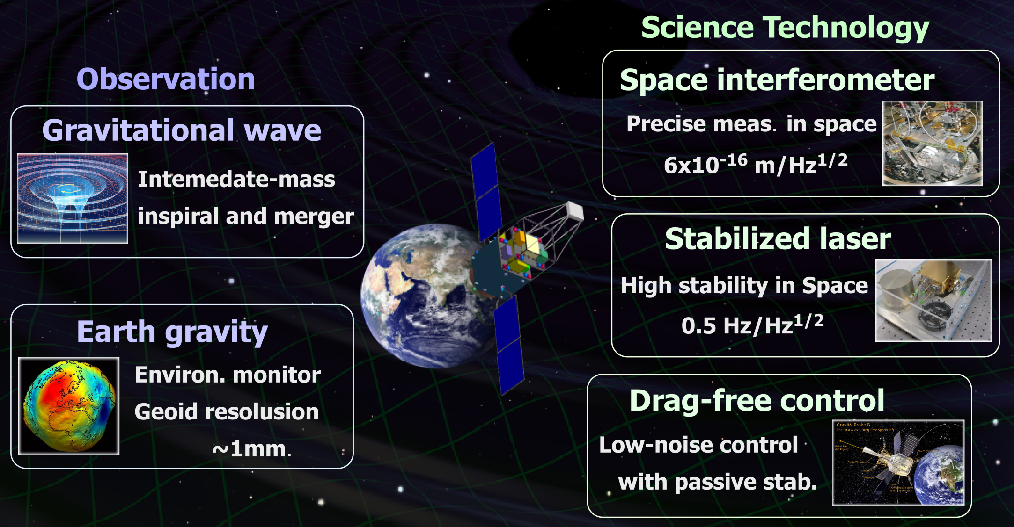
Objectives of DPF

Slide 75




DPF and DECIGO
DPF requirements
DECIGO
requirements
Disp. noise
6x10⁻¹⁶ m/Hz^{1/2}
Precise meas.
by IFO
4x10⁻¹⁸ m/Hz^{1/2}
1000km FP cavity
IFO control in space
Low external force
Large optics
Force noise
10⁻¹⁴ N/Hz^{1/2}
10⁻¹⁷ N/Hz^{1/2}
Ultra stable Laser
Stabilization of source
Stabilization by long arm
Stab. Laser
Freq. Stability
0.5 Hz/Hz^{1/2}
1 Hz/Hz^{1/2}
Formation flight
Stable orbit
Inter S/C Ranging
Drag-free control
Low-noise thruster
Drag-free
control
Satellite disp.
10⁻⁹ m/Hz^{1/2}
Thruster noise
10⁻⁷ N/Hz^{1/2}
Observation
Data procession
Data analysis
Triggered search
GW Obs.
0.1 Hz band
Observation and
Data analysis

Slide 76
IMBH inspiral and Merger
DECIGO will observe
Intermediate-mass BH (IMBH)
binary merger with
SNR>6000 for z~1 source
Information on the
formation of
Supermassive BHs
at the center of galaxies
戎崎俊一(理化学研究所) 先生のwebページより引用 http://atlas.riken.go.jp/~ebisu/smbh.html

Slide 77
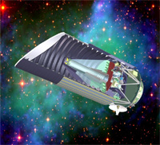
Standard Sources
Fig. from
SNAP
web page
Supernova (EM wave) Neutron-star binary (GW)
‘Standard Candle’ ‘Standard Siren’
Absolute power
or amplitude
Extrapolated from
nearby events
General Relativity
＜
Event rate
2000/yr （SNAP）
＜
10⁴⁻⁵/yr （DECIGO）
Error in distance
~10%
～
10% at z=1
～
Identification
of host galaxy
Require multiple detectors
or statistics
Easy?
＞
Others
Uncertainty by
dust absorption
Negligible interaction
with matters
＜
R.Takahashi (2006)

Slide 78


DPF targets
BHs in Globular clusters
BH masses estimated from star motion
Estimate SNR of GW signals
Equal mass, Mass ratio 1:1/3, 100Msun BH capture
Credit: NASA, STScI
(~150 Globular Clusters
in our Galaxy)
(By N.Seto)

Slide 79


Comparison with LPF
LPF (LISA Pathfinder)
DPF (DECIGO Pathfinder)
Purpose
Launch
Weight
Orbit
Test Mass
Laser source
Interferometer
Sensitivity
Demonstration for LISA
2010
Dedicated launcher (Vega)
1,900 kg
Halo orbit around L1
Drag-free attitude control
Au-Pt alloy x2
Nd:YAG (1064nm)
Mach-Zehnder
3x10⁻¹⁴ m/s²/Hz^{1/2} (1mHz)
Demonstration for DECIGO
GW observation
~2013
Dedicated launcher (M-V follow-on)
350 kg
SSO altitude 500km
Drag-free attitude control
TBD x2
Yb:YAG (1030nm)
Fabry-Perot
1x10⁻¹⁵ m/s²/Hz^{1/2} (0.1Hz)
Thruster
Control Unit
Stabilized Laser
Central
Processing Unit
Mission
Thrusters
Housing
Control Unit
Interferometer
Module
Interfererometer
Control Unit
Bus Thrusters
Solar Paddle

Slide 80
Pre-DECIGO
 | Pre-DECIGO | DECIGO
Arm length | 100 km | 1000 km
Mirror diameter | 30 cm | 1 m
Laser wavelength | 0.532 μm | 0.532 μm
Finesse | 30 | 10
Laser power | 1 W | 10 W
Mirror mass | 30 kg | 100 kg
# of interferometers in each cluster | 1 | 3
# of clusters | 1 | 4

Slide 81
Sensitivity of Pre-DECIGO
S/N~14 for NS-NS@300Mpc, 10-20 events/year

Slide 82
SWIM launch
Test of signal processing
and control system
Photo：
JAXA
SWIM (Space-wire Demonstration module)
on SDS-1 satellite
Launched in Jan. 23, 2009
SpaceCube2: Space-qualified Computer
SWIMμν : User Module
CPU: HR5000
(64bit, 33MHz)
System Memory:
2MB Flash Memory
4MB Burst SRAM
4MB Asynch. SRAM
Data Recorder:
1GB SDRAM
1GB Flash Memory
SpW: 3ch
Processor test board
GW+Acc. sensor
FPGA board
DAC 16bit x 8 ch
ADC 16bit x 4 ch
→ 32 ch by MPX
Torsion Antenna x2
~47g test mass
Data Rate : 380kbps
Size: 124 x 224 x 174
Weight: 3.5 kg
Power: ~7W
Size: 71 x 221 x 171
Weight: 1.9 kg
Power: 7W
Photo by JAXA
Photo by JAXA

Slide 83


SWIMμν
Tiny GW detector ~47g test masses inside
→ Levitated control in space
TAM: Torsion Antenna Module with free-falling test mass
(Size : 80mm cube, Weight : ~500g)
Test mass
SWIMmn Module
~47g Aluminum, Surface polished
Small magnets for position control
2 TAMs
in the frame
Coil
Used for test-mass
position control
Max current ~100mA
Photo sensor
Reflective-type optical
displacement sensor
Separation to mass ~1mm
Sensitivity ~ 10⁻⁹ m/Hz^{1/2}
6 PSs to monitor mass motion

Slide 84
Successful control
SWIM
In-orbit operation
z control on
Test mass controlled
Error signal → zero
Damped oscillation
(in pitch DoF)
yaw control on
Free oscillation
in x and y DoF
Signal injection
→ OL trans. Fn.
Operation: May 12, 2009
Downlink: ~ a week
By
W.Kokuyama

Slide 85




SWIMμν初期運用(5)
XY平面上のマスの動きと衛星スピンの効果
マスが浮上した時、XY平面上で自由振動を行っている様子が観測
X
Y
楕円が回転
Time [sec]
Time [sec]
2Hzの共振＋うなり(~0.05Hz)
スピン安定
X-Yプロット
コリオリ力により
振動軸が回転
→ 「フーコーの振り子」
Z
0.2mm
データからフィッティング：-16.8deg/s
衛星スピンレート：-16.7deg/s
よく一致
センサ固定座標系でみると

Slide 86
SWIMμν初期運用(1)
3回目 例：09/03/14 14時(JST)頃 ノルウェー上空
浮上マスの制御
OFF
Z ON
Yaw ON
そのまま地上では制御できない
(飛行機実験で20秒間の
制御を実証していた)
2月運用時に2回、
3月運用時に2回、
制御を実施
鉛直制御
４回とも宇宙空間での
制御に成功(TAM1)
フォトセンサ(変位センサ)
のオフセット最適化も実施
回転制御
TAM2は動作確認中
(注：データ処理のせいで
過渡応答は一部汚く見える)

Slide 87

SWIMμν初期運用(2)
制御時残留ノイズスペクトル
Z方向に矩形波信号注入時
XY平面内共振(後述)と倍波
8.4Hz注入信号と3倍波
Pitch
10⁻⁴
10⁻⁵
Rotational Displacement [rad/rHz]
10⁻⁶
10⁻⁷
その他のピーク：解析中
データの取得に成功・解析を実施中

Slide 88


球状星団のブラックホール
中心付近の星の速度分布の観測
中心付近の星の速度分布
と BH質量の関係
Core velocity dispersions for 25 Galactic and 10 old Magellanic globular clusters?
Pierre Dubath et al.,
Astron. Astrophys. 324, 505–522 (1997)
GEMINI AND HUBBLE SPACE TELESCOPE EVIDENCE FOR AN INTERMEDIATE-MASS
BLACK HOLE IN ω CENTAURI
Eva Noyola et al., ApJ 676 (2008) 1008Y1015

Slide 89
地球重力場観測
人工衛星の軌道から地球重力ポテンシャルを検知
軌道検知用ＧＰＳ受信機, および加速度計で構成
地球重力場観測
Globalな重力ポテンシャルの決定
→ 密度分布のモニタ
地球規模の水の監視技術
（海洋・陸水・氷床等）
地球環境モニタ
地震・火山噴火にともなう
地殻変動の検知・予測
GPS衛星
GRACEとGRACE-FOの間の期間
2012-16年を埋める可能性
→ 独自の成果, 国際貢献
東京大字地震研・新谷氏、
京都大学・福田氏の資料/情報提供

Slide 90
地球重力場観測の観測網
GRACE, GOCEが稼働中
次世代計画 GRACE-FO
GRACEと同等 (マイクロ波測距)
GRACE
L ~ 220km, ΔL ~ 5μm
→ ΔL/L ~ 2 x 10⁻¹¹
DPF
L ~ 0.3m, ΔL ~ 10⁻¹¹ m
→ ΔL/L ~ 3 x 10⁻¹¹
GRACEとGRACE-FOの間
(2012-16年) の空白を埋める可能性
→ 独自の成果, 国際貢献

Slide 91

DECIGOによる初期宇宙BH観測

Slide 92
DECIGOによるダークエネルギーの制限
‘Standard Siren’
中性子星連星までの
距離‐赤方偏移関係からモデルに制限
⇒ 宇宙の加速膨張の情報
Expansion ＋Acceleration?
DECIGO
GW
NS-NS (z～1)
Output
Template
(No Acceleration)
で決定
Strain
チャープシグナルから、直接決定
距離:
赤方偏移:
host galaxyを特定
Real Signal ?
Phase Delay
～1sec (10 years)
角度分解能 ～10arcmin （１台）
～10arcsec （３台）
at z=1
Time
Seto, Kawamura, Nakamura,
PRL 87, 221103 (2001)
標準光源としての比較
高橋 龍一氏 (2006)
超新星観測 中性子星連星観測
絶対光度
近傍の観測からの経験則
＜
相対論
イベント数
年間２０００個 （SNAP）
＜
年間 10⁴⁻⁵個 （DECIGO）
距離の決定精度
約１０％
～
約１０％ at z=1
～
＞
１台では厳しい
複数台あれば可能？
母銀河の特定 簡単？
その他
ダスト減光による不定性
＜
物質による吸収・散乱は無視

Slide 93

DECIGOの狙う重力波源とサイエンス
S.Kawamura
(2007)
巨大ブラックホール
形成のメカニズム解明
インフレーションの検証
ダークエネルギーの制限

Slide 94
What is DECIGO?
Deci-hertz Interferometer Gravitational Wave Observatory
Japanese space GW antenna to be launched after LISA
Can bridge the gap between LISA and terrestrial detectors
Low confusion noise -> Extremely high sensitivity
10⁻¹⁸
moved above
LISA band
Terrestrial detectors (e.g. LCGT)
LISA
10⁻²⁰
To be moved
into TD band
Strain [Hz^{-1/2}]
DECIGO
10⁻²²
Confusion Noise
10⁻²⁴
10⁻⁴
10⁻²
10⁰
10²
10⁴
Frequency [Hz]

Slide 95
Why FP cavity?
Transponder type
(e.g. LISA)
Shorten
arm length
Implement FP cavity
Radiation pressure noise f⁻²
Radiation pressure noise f⁻²
Shot noise f¹
Shorten
arm length
Shot noise f¹
Strain
Shot noise
Shot noise
Transponder type
(e.g. LISA)
Implement FP cavity
FP cavity type
Better best- sensitivity
Frequency

Slide 96
Drag free and FP cavity: compatible?
S/C II
S/C I
Mirror

Slide 97
FP cavity and drag free : compatible?
Relative position between mirror and S/C
Local sensor
S/C I
S/C II
Mirror
Thruster
Thruster

Slide 98
Drag free and FP cavity: compatible?
Relative position between mirror and S/C
No signal
mixture
Local sensor
S/C I
S/C II
Mirror
Thruster
Thruster
Actuator
Interferometer output (GW signal)

Slide 99
History of DECIGO
1999 the LISA study group convened by Tsubono
2000 Short-arm space antenna suggested by Kawamura
2001 Space GW antenna WG convened as one of the
possible future projects in NAOJ
2001 Named as DECIGO in the PRL paper
2002 1st DECIGO workshop
2003 2nd DECIGO workshop
(FP-type suggested by Ando)
2005 3rd DECIGO workshop
2006 4th DECIGO workshop
(FP-type adopted as a pre-conceptual design)
2007 5th DECIGO workshop
2008 6th DECIGO workshop
1st LISA-DECIGO workshop

Slide 100



LCGT and DECIGO
Establish GW astronomy Develop GW astronomy
LCGT
DECIGO
Demonstration of technology Demonstration of technology
CLIO
DPF

Slide 101
Summary
DECIGO can bridge the gap between LISA and terrestrial detectors
DECIGO can detect GWs from the inflation as well as can bring us extremely interesting science.
DECIGO uses a differential FP interferometer to enhance sensitivity
We plan to launch DPF and Pre-DECIGO before DECIGO for demonstration of required technologies

Slide 102

DECIGO-PF (7)
First step to space
Small test-mass module
SWIMμν :
Small GW detector module
To be launched in 2008
2 modules (80mm cubic, 500g each)
Sensitivity : h~10⁻⁷
Included in a SWIM module
Test mass
Photo sensor
Coil-magnet actuator
SWIM
(SpaceWire Interface demonstration Module)
200mm Cubic, 5kg
Test of space-based processor and
communication standard
→ To be used JAXA/ESA/NASA
SDS-I :
Small (~100kg) satellite
for demonstration of space technologies
To be launched in 2008 summer by H-IIA
as piggy-back satellite of GOSAT

Slide 103

宇宙重力波望遠鏡
LISA
(Laser Interferometer Space Antenna)
3台のS/Cで基線長500万kmの干渉計を構成
ターゲット: 1mHz 前後の周波数帯
ESA/NASA共同プロジェクト
打ち上げ: 2018年目標
DECIGO
(Deci-hertz Interferometer
Gravitational Wave Observatory)
3台のS/Cで基線長1000kmの干渉計を構成
ターゲット: 0.1Hz 前後の周波数帯
打ち上げ: 2025年頃
Drag-free satellite
Arm cavity
PD
Laser
Arm cavity
PD
Drag-free satellite
Drag-free satellite

Slide 104


LISA
LISA
(Laser Interferometer Space Antenna)
3機のスペースクラフトで構成された基線長500万kmの干渉計
0.1mHz - 1Hz の周波数帯をターゲット
超巨大ブラックホールの合体 → ブラックホールまでの距離の測定
星の巨大ブラックホールへの落下 → 時空のマッピング情報
銀河系内連星 (確実な波源) → 強い潮汐相互作用, 質量移動への知見
ESA/NASA共同で、2018年以降に打ち上げ予定

Slide 105

LISAの状況
LISAの状況
BEPAC (Beyond Einstein Program Assessment Committee)
Beyond Einsteinミッションの
どれを最初に打ち上げるかを検討
Constellation-X
Laser Interferometer Space Antenna
Joint Dark Energy Mission
Inflation Probe
Black Hole Finder probe
2008年9月にレポートをまとめた
→ JDEM/SNAP を最初に打ち上げる
LISAも当面サポートする
“On purely scientific grounds LISA is the mission that is the most promising and least scientifically risky … Thus, the committee gave LISA its highest scientific ranking.”
“The committee believes it is more responsible technically and financially to propose a LISA new start after the Pathfinder results are taken into account.”
得られるサイエンスは高く評価
LPF(2009年)の結果を受けて
新しいスタートをするのが良い

Slide 106

DPF概要
マスト構造
DECIGOのための前哨衛星
小型科学衛星2号機 (~2013年)
候補としてミッション提案中
ミッション
スラスタヘッド
安定化レーザー光源
小型衛星 1 機
(95cm立方x2, 350kg)
地球周回軌道 高度 500km
中央処理演算器
DECIGOのための宇宙実証
科学技術の確立
干渉計モジュール
衛星バス
宇宙・地球の観測
重力波の観測
衛星バス
3Nスラスタ
地球重力場の観測
太陽電池パドル

Slide 107

DPFが目指す科学的成果

Slide 108

推進体制
DPF-WG 84名
DECIGO 137名

Slide 109





重力波検出実験のこれまで
一般相対性理論
(アインシュタイン, 1916)
望遠鏡による観測
(ガリレオ, 1609)
重力波の予言
(アインシュタイン, 1916)
宇宙放射線の発見
(ヘス, 1912)
銀河中心からの
電波観測
(ジャンスキー, 1931)
共振型アンテナ
(ウェーバー, 1960-)
さそり座X線源の観測
(ジャコーニ, 1962)
重力波観測の報告
(ウェーバー, 1969)
連星パルサーの発見
(ハルス・テイラー, 1974)
干渉計型アンテナ
(1970頃-)
宇宙背景放射の発見
(ペンジアス・ウィルソン, 1964)
重力波存在の証明
(ハルス・テイラー, 1979)
太陽ニュートリノ観測
(デービス, 1964)
低温アンテナ
(Explorer etc, 1990-)
超新星爆発からの
ニュートリノ観測
(小柴, 1987)
極低温アンテナ
(Nautilus etc, 1996-)
大型干渉計の建設
(1995頃-)
国際共同観測
(IGEC, 1997-)
TAMAによる観測開始
(1999-)
LIGOによる観測開始
(2002-)
共同観測
(2003-)

Slide 110



連星パルサーの発見と観測
連星パルサーPSR B1913+16
(1974年 ラッセル・ハルス, ジョゼフ・テイラー)
アレシボ天文台 (プエルトリコ)
公転周期： 7.75時間
質量 : パルサー 1.44 Msolar
伴星 1.39 Msolar
公転周期の変化率：
(-2.4056±0.0051)×10⁻¹²s/s
その後の継続的な観測
重力波の放出
→ 公転エネルギーを失い, 互いに落ち込む
（3×10⁸年後に 合体する）
一般相対性理論による理論値：
(-2.40242±0.00002)×10⁻¹²s/s
理論と観測の差は0.2%程度
重力波の存在の証明
(1993年ノーベル物理学賞： テイラー, ハルス)
J.M. Weisberg, J.H. Taylor, and D.J. Nice,
APJ, 2007, in preparation

Slide 111





電磁波と重力波
電磁波
J.C. Maxwell
重力波
A. Einstein
光速で伝播する電磁場の変動
光速で伝播する時空の歪み
電磁気学から導かれる
(マクスウェル方程式の波動解)
一般相対性理論から導かれる
(アインシュタイン方程式の波動解)
1864年 : マクスウェルが予言
1888年 : ヘルツの実験で発見
1916年: アインシュタインが予言
1989年: 連星パルサーの観測
によって存在を証明
電荷の加速度運動により生成
物質による 吸収, 散乱
波源のスケール > 波長 → 画像情報
双極子放射, 2つの偏波
質量の加速度運動により生成
物質に対して 強い透過力
波源のスケール < 波長 → バルクな情報
四重極放射, 2つの偏波
p
s
From presentation
by Laura Cadonati
plus
cross

Slide 112

重力波による観測
一般相対性理論
宇宙線による
観測
強い重力場における
相対性理論
原子核理論
高密度物体の物理
ニュートリノ
高エネルギー
宇宙線
重力波による
観測
天文学
星形成
恒星進化
銀河
ガンマ線バースト
超新星爆発
高周波数
重力波
電磁波による
観測
さまざまな
天体現象
ブラックホール
巨大ブラックホール
連星合体現象
惑星
超新星爆発
低周波数
重力波
パルサー
ガンマ線
X線
可視光
赤外線
電波
宇宙背景
放射
宇宙論
バックグラウンド
重力波
インフレーション
ダークマター
ダークエネルギー
背景画: NASA/WMAP Science Team

Slide 113







重力波による天文学
重力波の特徴
宇宙を観測する新しい手段
質量の加速度運動により生成
物質に対して 強い透過力
波源のスケール < 波長 → バルクな情報
電磁波と相補的・独立な観測
他では見ることの出来ない現象
‘晴れ上がり’前の初期宇宙
激しい天体現象の内部
CMB
Radio
+
IR
x-ray
GW ?
γ-ray
GRBs

Slide 114

重力波源と期待できる知見
(例) 連星中性子星の合体現象
中性子星の自転・非軸対称性
→ ほぼ定常的(正弦波)な重力波
(連続波)
2つの中性子星がお互いの周りを公転
→ ほぼ定常的(正弦波)な重力波
(連続波)
互いに接近し、公転周期が早くなる
→ 周期が早くなると共に、振幅も増大
(チャープ波)
衝突し合体
→ 短時間の爆発的な重力波放射
(バースト波)
中性子星の物理
ブラックホールの物理
相対性理論の検証
励起されたBH振動の減衰
→ 減衰振動波形
(リングダウン波)

Slide 115
DPFが目指す科学的成果

Slide 116
DPFが目指す科学的成果

Slide 117
DECIGO (5)
DECIGO軌道
軌道選定で考慮すべき要素
  ◎ S/C間の相対加速度が小さい (干渉計制御, ドラッグフリー制御からの要請)
  ◎ 太陽電池発電が困難でない (S/C生存からの要請)
  ○ 地球からの距離が遠すぎない (通信の要請)
  ○ 軌道投入が困難でない (推力/重量からの要請)
  △ 地球からの位置関係があまり変化しない (なんとなく)
  △ 制御を失ったときにリカバリーがききやすい (Fail Safeからの要請)
  △ 軌道上に擾乱物がない (干渉計雑音からの要請)
軌道候補
  太陽周回軌道
  LISAと同様の軌道
  地球公転軌道上
  ラグランジュ点
  ハロー軌道
  ラグランジュ点付近への静止
  地球周回軌道
  なんか良い軌道がある可能性？

Slide 118

DECIGO (6)
DECIGO軌道の検討
(例1) LISAと同様の軌道 (高城氏, 森本氏)
惑星重力の効果を含める
(惑星補正なし → 30cm/yrの変動)
基線長: 1000km
地球公転と同様の軌道
(太陽から見て 20度 地球の後ろ)
無制御時の軌道
相対加速度 ~ 4x10⁻¹² m/s²
→ 必要推力 ~ 10⁻⁹ N
(例2) ラグランジュ点まわりのハロー軌道 (歌島氏)
L2点で線形展開した計算
基線長: 1000km
長半径70万kmの周回軌道
無制御時の軌道
相対加速度 ~ 4x10⁻⁷ m/s² (山川氏)

Slide 119
Pre-conceptual Design (7)
S/C thruster force
S/C orbit : TBD
(ex) Similar orbit as that of LISA
Numerical simulation of
multi-bode system
Include gravity of planets
Arm length: 1000km
Earth-like orbit,
20deg. Behind the earth
Length control is indispensable
Acceleration to be controlled:
~4x10⁻¹² m/s²
Black curve: parabolic fitting

Slide 120
Stabilized laser
Laser source
Yb:YAG laser (1030nm)
Power : 25mW
Freq. stab. by Iodine absorption line
→ 0.5 Hz/Hz^{1/2} (at 0.1Hz)
Comparable stability with that
by a reference cavity at 0.1Hz
Narrow absorption line at 515nm
Advantage of I₂ stabilization
Less affected by environment
Easier ground-base tests
Moderate vibration isolation
No vacuum system
Disadvantages
Less experience

Slide 121

Main interferometer
Test-mass module
Keeps a test inside
Local sensor/actuator
Launch-lock system
Interferometer sensors
for fine measurement
Fabry-Perot interferometer
Finesse : 100
Length : 30cm
Test mass : ~1kg
Signal extraction by PDH

Slide 122
DECIGOのための根幹技術実証
DPFで実証される技術
DECIGOで必要
とされる主要技術
6x10⁻¹⁶ m/Hz^{1/2}
の変位感度
宇宙干渉計
による
精密計測
4x10⁻¹⁸ m/Hz^{1/2}
の変位感度
基線長1000kmのFP干渉計
宇宙における干渉計制御
試験マスに対する外乱抑圧
大型光学系の製作・制御
10⁻¹⁴ N/Hz^{1/2}
の外力雑音
10⁻¹⁷ N/Hz^{1/2}
の外力雑音
安定化レーザー
の宇宙実証
安定化レーザー光源による精密計測
光源の周波数・強度安定化
長基線長を利用した安定化制御
0.5 Hz/Hz^{1/2}
の周波数安定度
フォーメーションフライト
安定な軌道の実現
宇宙機間の距離制御
ドラッグフリー制御
低雑音スラスタ
ドラッグフリー
制御の実現
衛星変動安定度
10⁻⁹ m/Hz^{1/2}
スラスタ雑音
10⁻⁷ N/Hz^{1/2}
観測運用
時系列連続データの処理
データの解析
理論予測・他の観測との比較
重力波観測
0.1 Hz帯の連続
観測とデータ解析

Slide 123
DECIGOのための根幹技術実証
DPFで実証される技術
DECIGOで必要
とされる主要技術
6x10⁻¹⁶ m/Hz^{1/2}
の変位感度
宇宙干渉計
による
精密計測
4x10⁻¹⁸ m/Hz^{1/2}
の変位感度
基線長1000kmのFP干渉計
宇宙における干渉計制御
試験マスに対する外乱抑圧
大型光学系の製作・制御
10⁻¹⁴ N/Hz^{1/2}
の外力雑音
10⁻¹⁷ N/Hz^{1/2}
の外力雑音
安定化レーザー
の宇宙実証
安定化レーザー光源による精密計測
光源の周波数・強度安定化
長基線長を利用した安定化制御
0.5 Hz/Hz^{1/2}
の周波数安定度
フォーメーションフライト
安定な軌道の実現
宇宙機間の距離制御
ドラッグフリー制御
低雑音スラスタ
ドラッグフリー
制御の実現
衛星変動安定度
10⁻⁹ m/Hz^{1/2}
スラスタ雑音
10⁻⁷ N/Hz^{1/2}
観測運用
時系列連続データの処理
データの解析
理論予測・他の観測との比較
重力波観測
0.1 Hz帯の連続
観測とデータ解析

Slide 124
DPFで実証される科学技術
意義・波及効果
DPFで実証される技術
宇宙空間での精密計測技術
→ 基礎物理学実験
無重力環境下での精密計測
6x10⁻¹⁶ m/Hz^{1/2}
の変位感度
宇宙干渉計
による
精密計測
10⁻¹⁴ N/Hz^{1/2}
の外力雑音
宇宙・衛星内環境のより深い理解
宇宙空間での高い安定度の実現
さまざまな応用
地球環境観測 (ADM-Aeolus, GIFTS),
基礎物理実験, マイクロ波標準, 通信
(ACES), 惑星探査 (TPF-C), X線観測
(MAXIM), フォーメーションフライト (LISA,
GRACE-follow-on)
安定化レーザー
の宇宙実証
0.5 Hz/Hz^{1/2}
の周波数安定度
長時間安定な無重力環境
→宇宙環境利用の新しい可能性
基礎物理学実験, 材料工学
ドラッグフリー
制御の実現
衛星変動安定度
10⁻⁹ m/Hz^{1/2}
フォーメーションフライト
のための基礎技術
(TPF-C, LISA, GRACE follow-on)
スラスタ雑音
10⁻⁷ N/Hz^{1/2}
小型低雑音スラスタの宇宙実証

